Slide 2
Challenges and opportunities for air transport restart in Europe
Giancarlo Buono

Slide 3
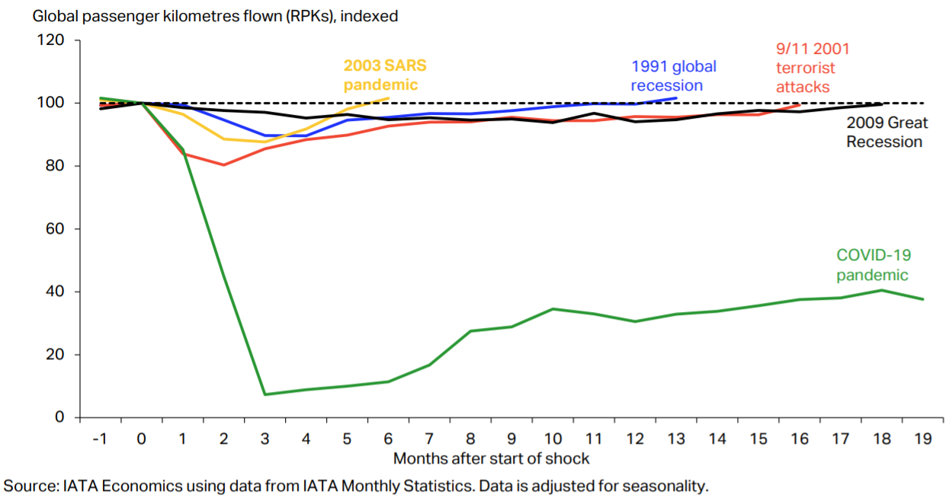
COVID-19 is the biggest and longest shock to hit aviation

Slide 10
A crisis like no other
Positive trends in terms of bookings, but traffic continues to be significantly depressed
More positive outlook in terms of travel restrictions, but don't expect to see a sudden rebound
It will take time to recover, trends are positive.
Main challenges for the re-start:
Deteriorating epidemiological situation
Environmental concerns
Availability and cost of ATM and Airport infrastructure

Slide 12
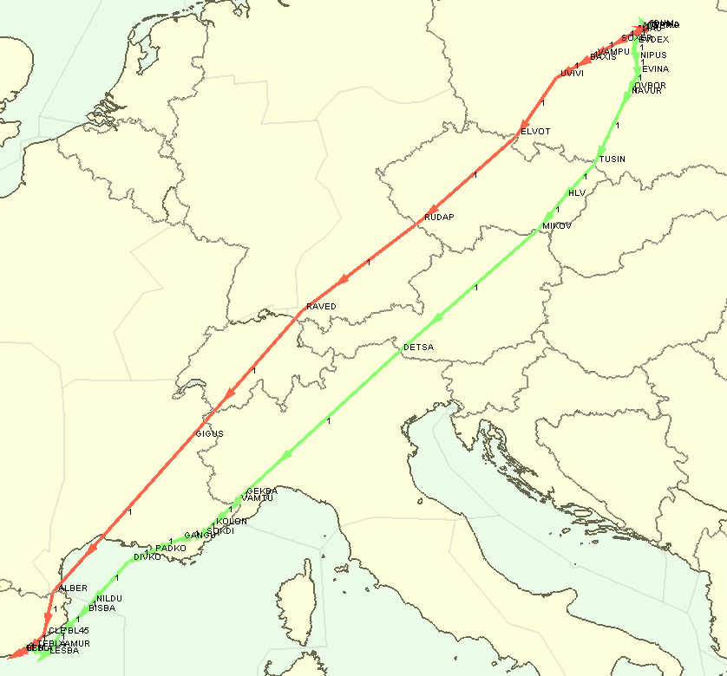
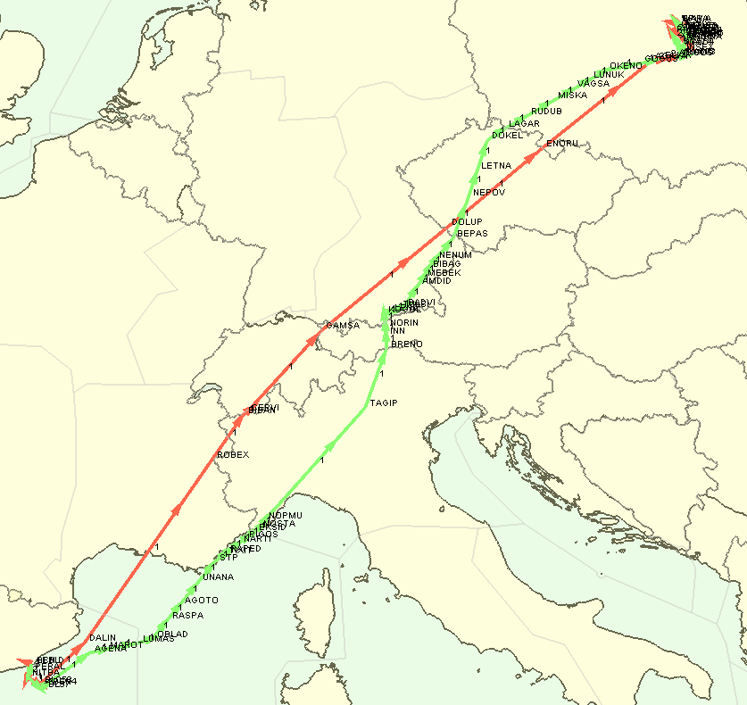
Warsaw – Barcelona 2019 vs.2030
28 June 2019
Origin | Destination | Acft Type | Callsign |  | Length (NM) | Time (min) | Fuel (kg) | CO2 (kg) | NOx (kg)
EPWA | LEBL | B738 | LOT437 |  | -14,3 | -2,3 | -49,5 | -156,6 | 0,4
LEBL | EPWA | B738 | LOT4GM |  | -60,5 | -9,9 | -561,4 | -1774,0 | -10,1
Per year with Single Sky implemented:
Reduction of distance flown: 7,40%
Time reduction: 80 hours of flying time
Fuel reduction: 240000 kg
C02 reduction: 780000 kg
Warsaw – Barcelona
(approx. 400 flights/year)
Barcelona – Warsaw
(approx. 400 flights/year)
Source: Eurocontrol

Slide 13
Combination of these 4 city-pairs 2019 vs.2030
Warsaw – Barcelona
Madrid – Stockholm
Munich – Las Palmas
Paris-Rome
Total impacted flights | Time reduction (in hours) | Fuel reduction (in tons) | C02 reduction (in tons)
12 800 | -556 | -2 500 | -7 900

Slide 14
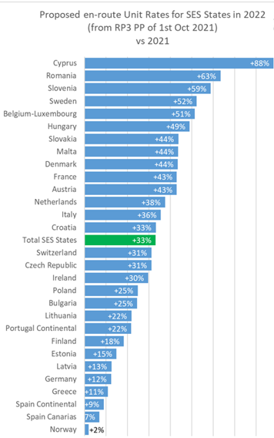
Air navigation charges – Reference Period 3
European network traffic was - 58% in 2020 Vs. 2019. Most ANSP did not react to this significant reduction in traffic.
State data for 2020 shows only a small reduction in cost; average 4% compared to 2019
Some states, were able to reduce their costs by up to 20%, six states actually increased their costs !!
Despite cost remaining constant and traffic massively reduced the ENV and CAP targets were barely met
Average Unit Rates for Enroute will increase on average +33% in 2022

Slide 15
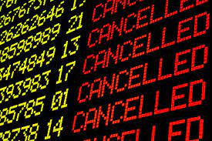
Air Navigation Charges
Airlines cannot be held accountable for this historical fall in traffic and subsequent €8.6B gap in ANS revenues.
Airlines are expected to cover their own losses but also this so called “revenue gap” from 2023.
European states could and should cover losses for their own state entities with direct funding from government. Three states have taken up this option for 2022.
Significant reform of the Performance and Charging Scheme is required, how can airlines be expected to support European economic recovery while significantly burdened by high costs and continued under delivery of the fully financed service?

Slide 16
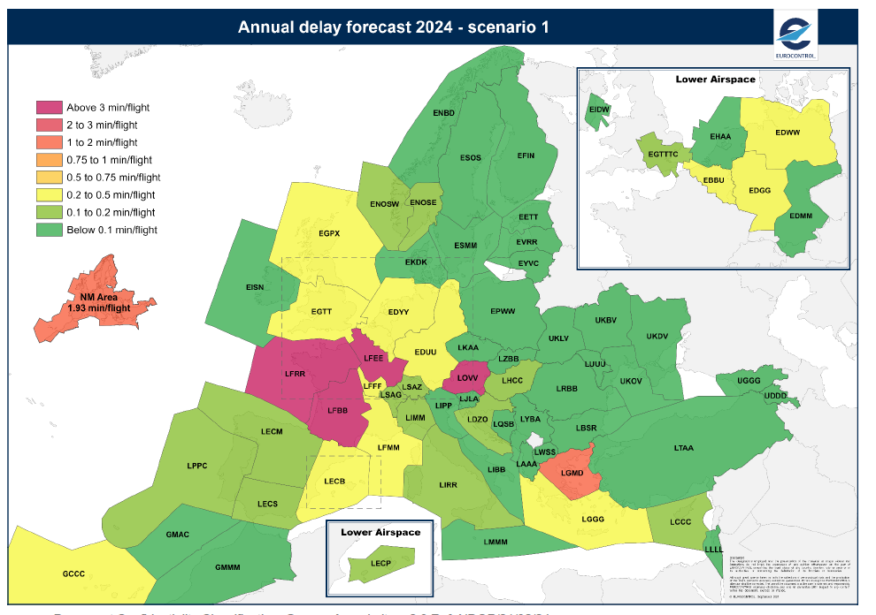
2022 - 2024: More delays
Major issues expected in 2022, which will impact upon sustained restart

Slide 17
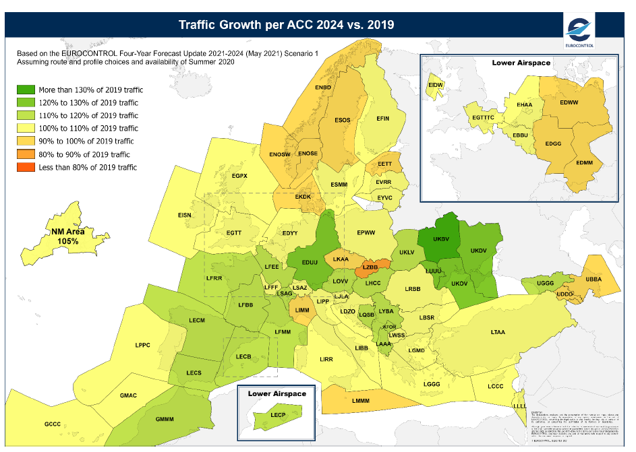
2024: Traffic to grow in the region

Slide 18
Thank you
Giancarlo Buono
buonog@iata.org
www.iata.org

