Slide 1
#I don’t have a clue

Slide 2
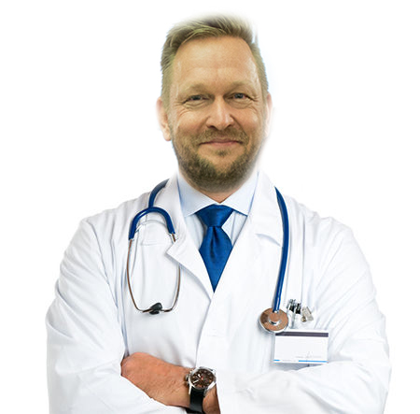

Dr. Anders Halskov-Jensen

Slide 3


Slide 4
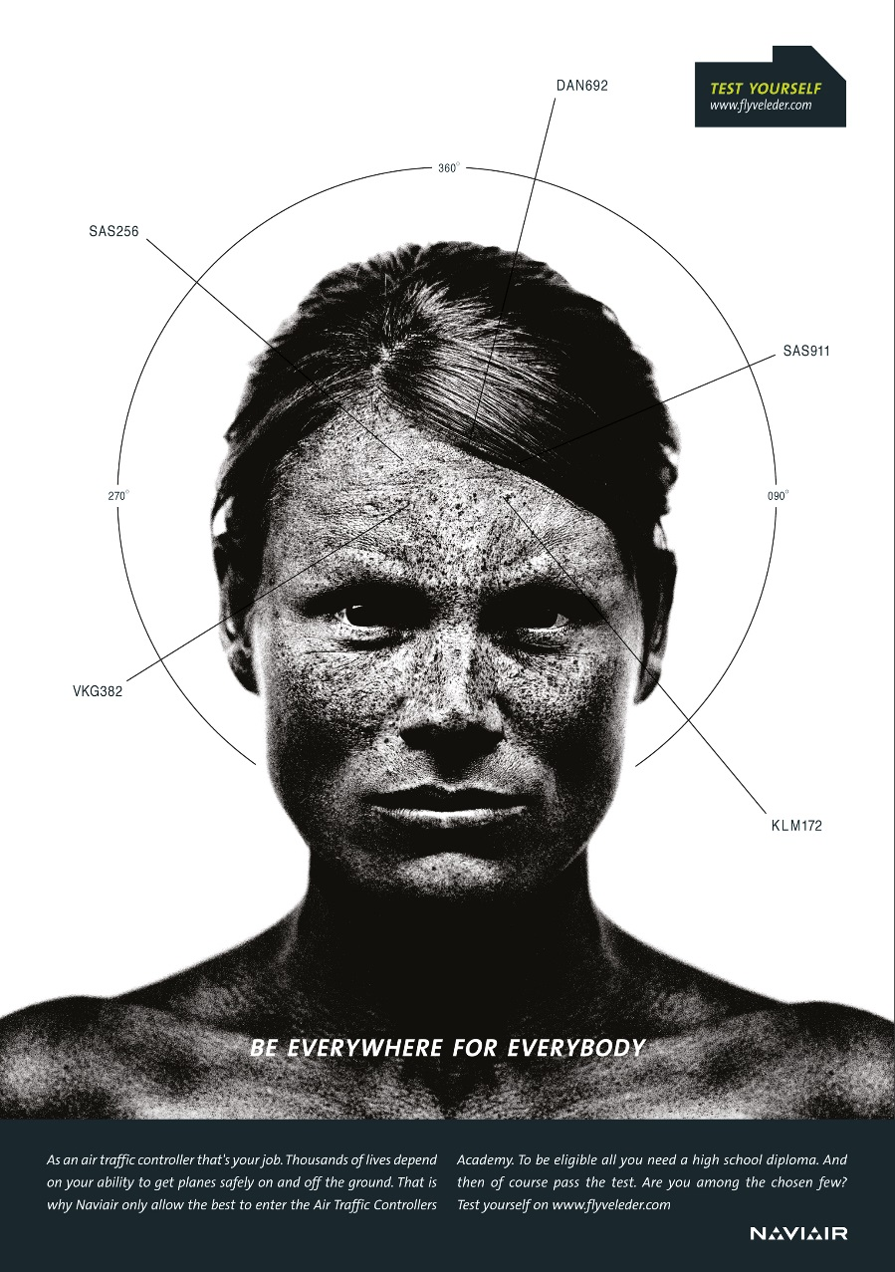
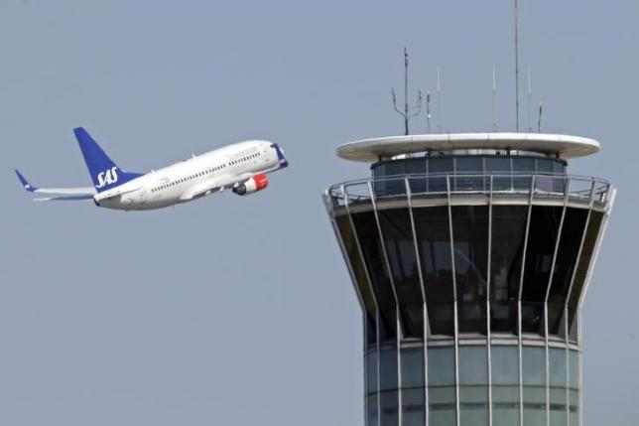
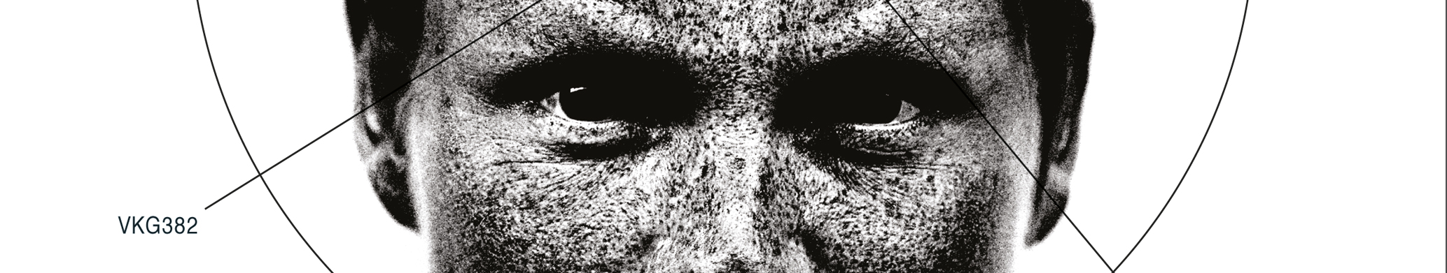
#I didn’t have a clue

Slide 5
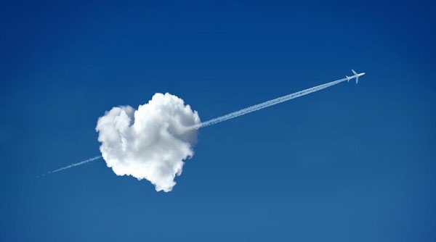

Slide 6
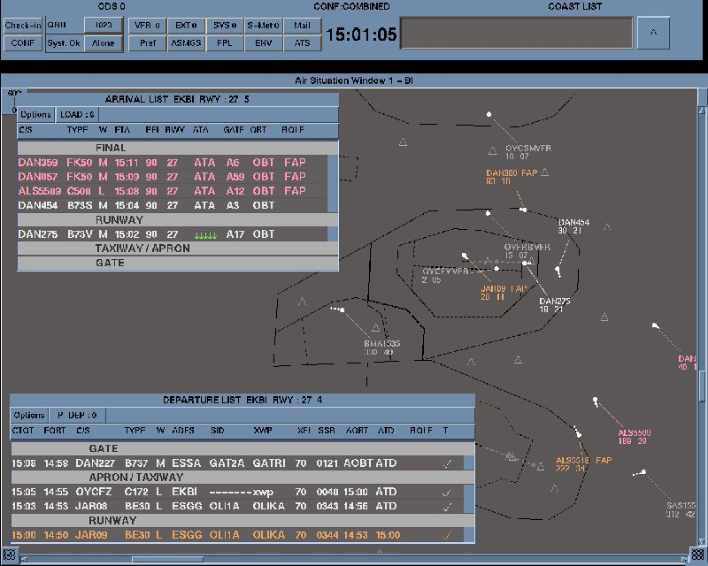
Area controller
Instructor
IFATCA Rep
Head of RVSM training
ATM System specialist
Training specialist
Client Manager
Development Specialist

Slide 7
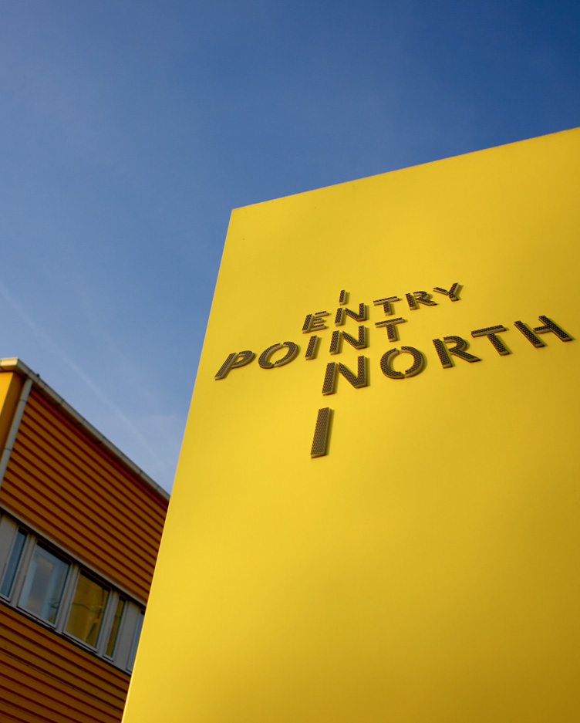
The History

Slide 8
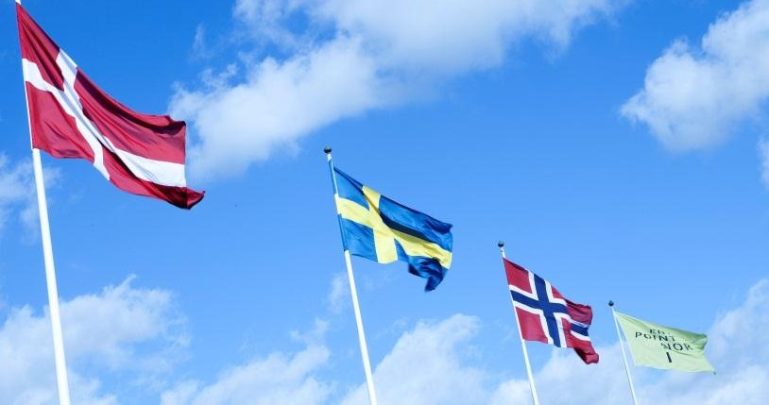




The Heritage – Our Owners
Our owners together employ more than 1800 air traffic controllers

Slide 9
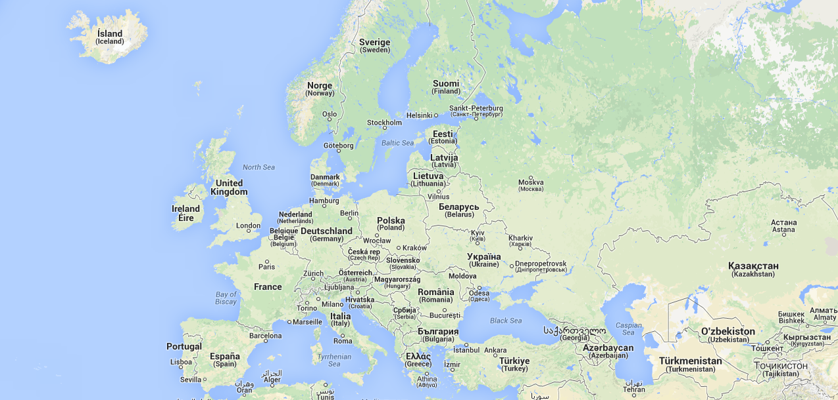
Multiple Training Sites
Entry Point North,
Malmoe
Entry Point North,
Shannon
Entry Point Central
Budapest

Slide 10
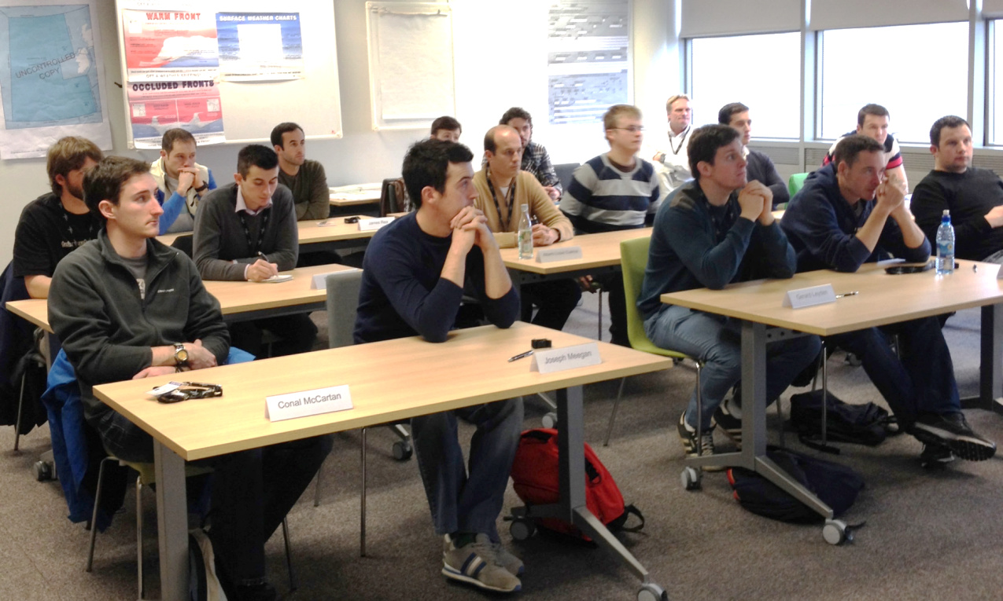
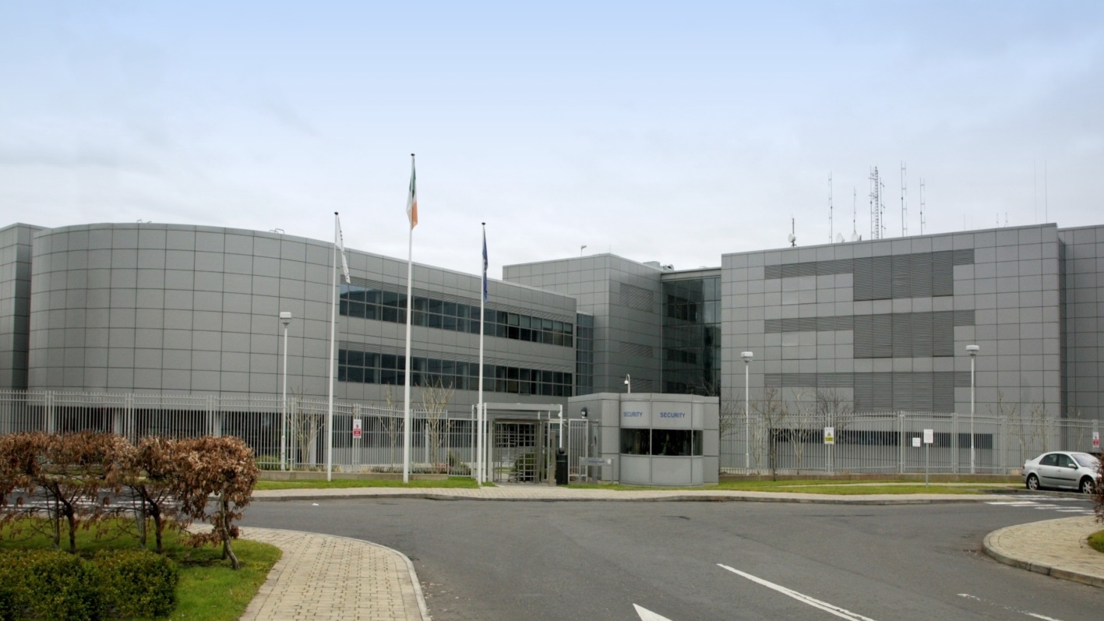
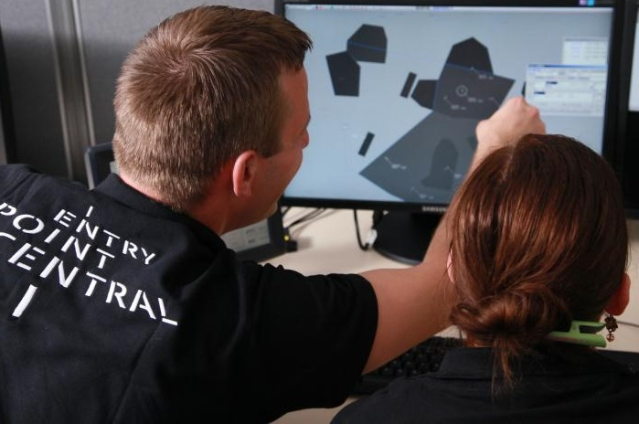
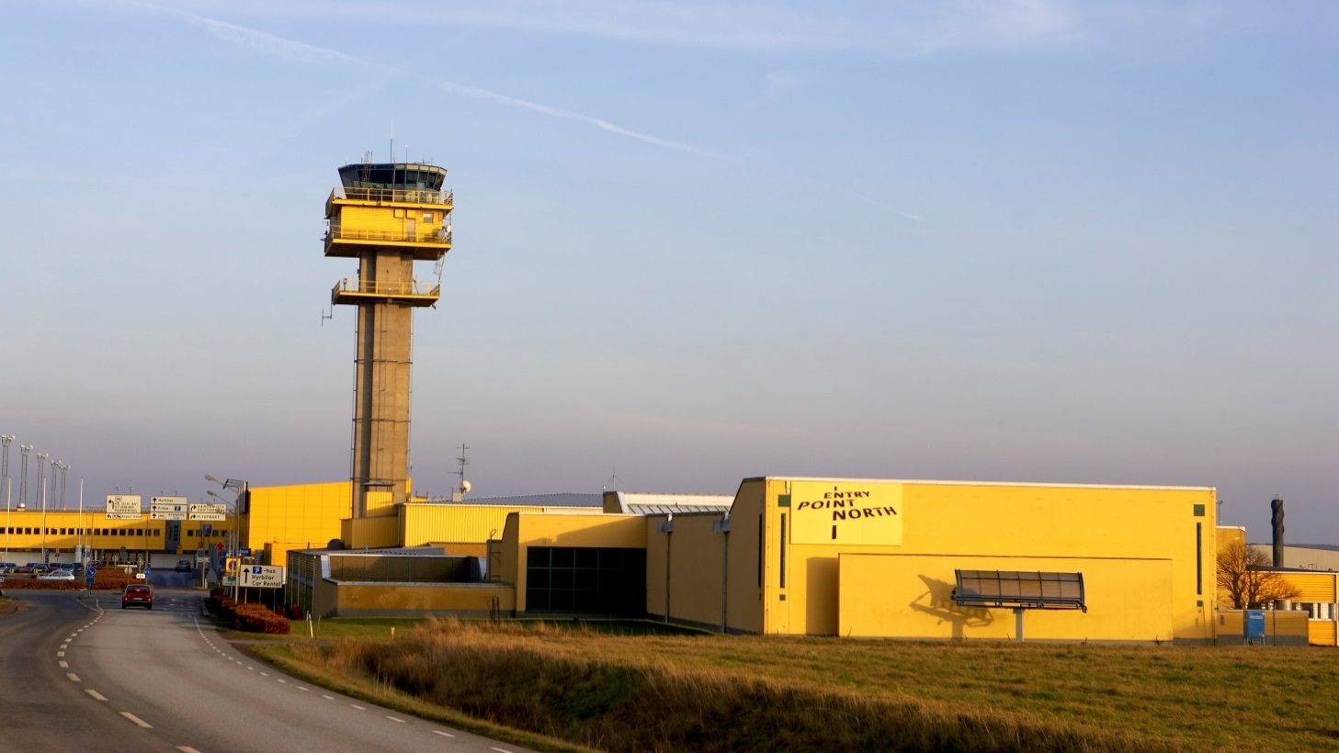
Entry Point North, Ireland

Slide 11
The Portfolio
ATC Training
ATS & FIS Training
ATSEP Training
Safety Training
Language Training and Tests
Simulator Rental
Train the Trainer
Recruitment & HR tests
ATM Related Training
Consultancy
Meteorological Training
Other Training

Slide 12
















Entry Point North Malmoe – Staff
55 employees
>30 temporarily employed teachers, consultants and SIM-pilots
16 nationalities
19 languages
T&O and Development Department:
  ATCO’s, AFISO’s, Pilots, Briefing Officers, Teachers, Administrators, Selection specialists, ATCO Assistants

Slide 13
Entry Point North clients come from:

Slide 14




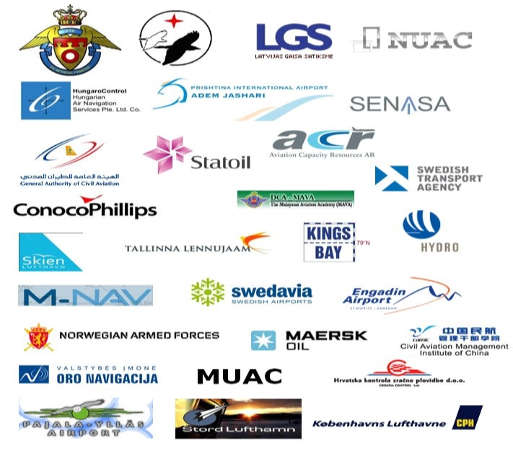




























Entry Point North clients:

Slide 15



Slide 16
IS AN ASSOCIATION OF TRAINING PROVIDERS NEEDED AND SHOULD THERE BE A EUROPEAN ONE?
I didn’t have a clue??

Slide 17


Slide 18


Questions, that I’ve asked myself

Slide 19


Questions, that I’ve asked myself
What about $$$ ?
Notes:
Organisations and individuals will only become members of something, if there are some benefits?
But let’s assume, that there are some benefits (I don’t have a clue if there is.) Then, what would be the challenges I establishing an association?
Well, there’s is the obvious issue of cost.
Aviation is no longer a wealthy industry. ANSP’s are very cost-conscious, airlines are struggling to stay alive, and it’s going to cost something to run an association. Money’s gotta come from somewhere.

Slide 20

Questions, that I’ve asked myself
Notes:
Organisations and individuals will only become members of something, if there are some benefits?
But let’s assume, that there are some benefits (I don’t have a clue if there is.) Then, what would be the challenges I establishing an association?
Well, there’s is the obvious issue of cost.
Aviation is no longer a wealthy industry. ANSP’s are very cost-conscious, airlines are struggling to stay alive, and it’s going to cost something to run an association. Money’s gotta come from somewhere.

Slide 21

Questions, that I’ve asked myself
Notes:
Organisations and individuals will only become members of something, if there are some benefits?
But let’s assume, that there are some benefits (I don’t have a clue if there is.) Then, what would be the challenges I establishing an association?
Well, there’s is the obvious issue of cost.
Aviation is no longer a wealthy industry. ANSP’s are very cost-conscious, airlines are struggling to stay alive, and it’s going to cost something to run an association. Money’s gotta come from somewhere.

Slide 22

Questions, that I’ve asked myself
Notes:
Organisations and individuals will only become members of something, if there are some benefits?
But let’s assume, that there are some benefits (I don’t have a clue if there is.) Then, what would be the challenges I establishing an association?
Well, there’s is the obvious issue of cost.
Aviation is no longer a wealthy industry. ANSP’s are very cost-conscious, airlines are struggling to stay alive, and it’s going to cost something to run an association. Money’s gotta come from somewhere.

Slide 23
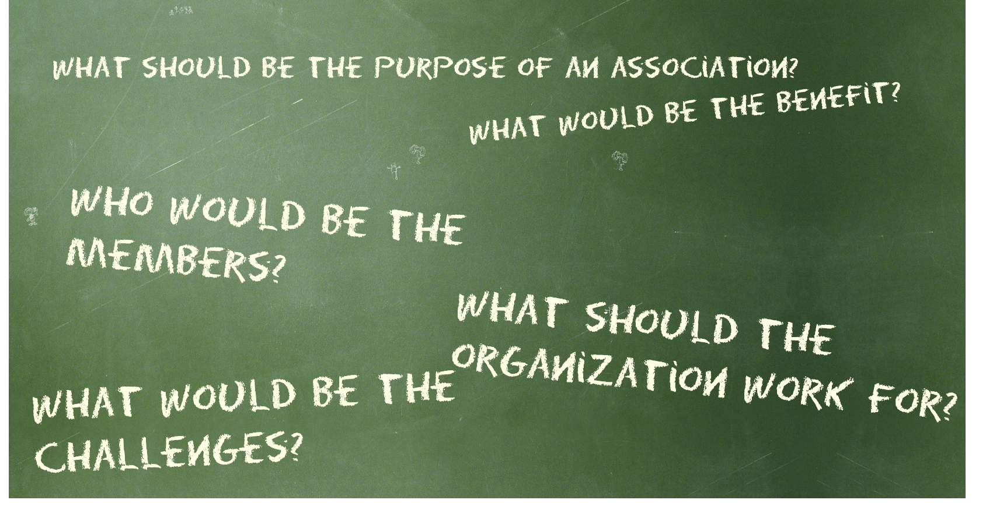
Questions, that I’ve asked myself
Notes:
Organisations and individuals will only become members of something, if there are some benefits?
But let’s assume, that there are some benefits (I don’t have a clue if there is.) Then, what would be the challenges I establishing an association?
Well, there’s is the obvious issue of cost.
Aviation is no longer a wealthy industry. ANSP’s are very cost-conscious, airlines are struggling to stay alive, and it’s going to cost something to run an association. Money’s gotta come from somewhere.

Slide 24
+
IS AN ASSOCIATION OF TRAINING PROVIDERS NEEDED AND SHOULD THERE BE A EUROPEAN ONE?
WOULD A EUROPEAN ASSOCIATION OF TRAINING PROVIDERS BE BENEFICIAL?

