Slide 1
6Th International Conference
Aviation Training, an Effective Safety Tool
Recent Developments
ICAO Global Aviation Training Office

Slide 2
Outline
FACTs about aviation
ICAO Mandate and leading role
Role of training
News to share

Slide 3
Facts about aviation
The safest mode of transport
Achievements depend on people who manage, maintain and support aviation
Largely contributes to the global economy
Aviation activities carried out by a multicultural workforce:
Standardization issues
Harmonization of level of performance
Notes:
Statistical data show that Air Transport as the safest mode of transport and the global and regional incident and accident and fatalities are very low compare to other transport modes.
Air transport also largely contributes to global economy because it support many industries such as tourism and exportation with air cargo industry
Aviation activities are also carried out by multicultural workforce which require resolving standardization issues and harmonization of level of performance of the workforces at various levels.

Slide 4
ICAO’s Mandate and Leading Role
ICAO is the driving force for:
Development of SARPs
Development of guidance material
Coordination of global aviation initiatives
Coordination and implementation of international legal instruments

Slide 5
ICAO’s Mandate and Leading Role
Assembly Resolution 38/12, Appendix D and Training Policy:
Identify the scope of ICAO activities:
Assist Member States in achieving and maintaining competency of aviation personnel through the ICAO Aviation Training Programme.

Slide 6
Role of Training
Confusion between concepts
Learning
Qualification
Training
Development
Certification

Slide 7
Role of Training
Objectives and deliverables:
Develop more people
Effectively
Efficiently
Consistently
Build new competencies
continuously

Slide 8
Role of Training
Expected programmes Performance
Individual Performance
Corporate performance

Slide 9
Role of training
Competency-based training not used
Required competencies not identified
Lack of standard qualifications and competencies for various aviation jobs
Job descriptions very generic in most cases
AND

Slide 10
Role of Training
Scope of training standards
Training Organizations
Instructional Teams
ICAO Doc. 9841
Assessment
ICAO Doc. 9868
TDC+TIC+TMC
Training Courses
ICAO Doc. 9941 - TDC

Slide 11
Role of Training
Change of training function roles
Training → Capacity building
Training and development specialists are becoming performance improvement specialists

Slide 12
Something to share

Slide 13
Recent Developments
Competency-based recruitment and training
Competency framework established for:
Flight Crew
Air Traffic Management Professionals
Maintenance Personnel
Working on other aviation jobs progressively
Competency-framework
Standardized job-tasks

Slide 14
GAT Network
Operational Entities
Civil Aviation Authorities
End Users
ASSOCIATE MEMBERS
FULL MEMBERS
RTCEs
Universities
Other PARTNERS
ASTCS
Government Safety Inspectors

Slide 15
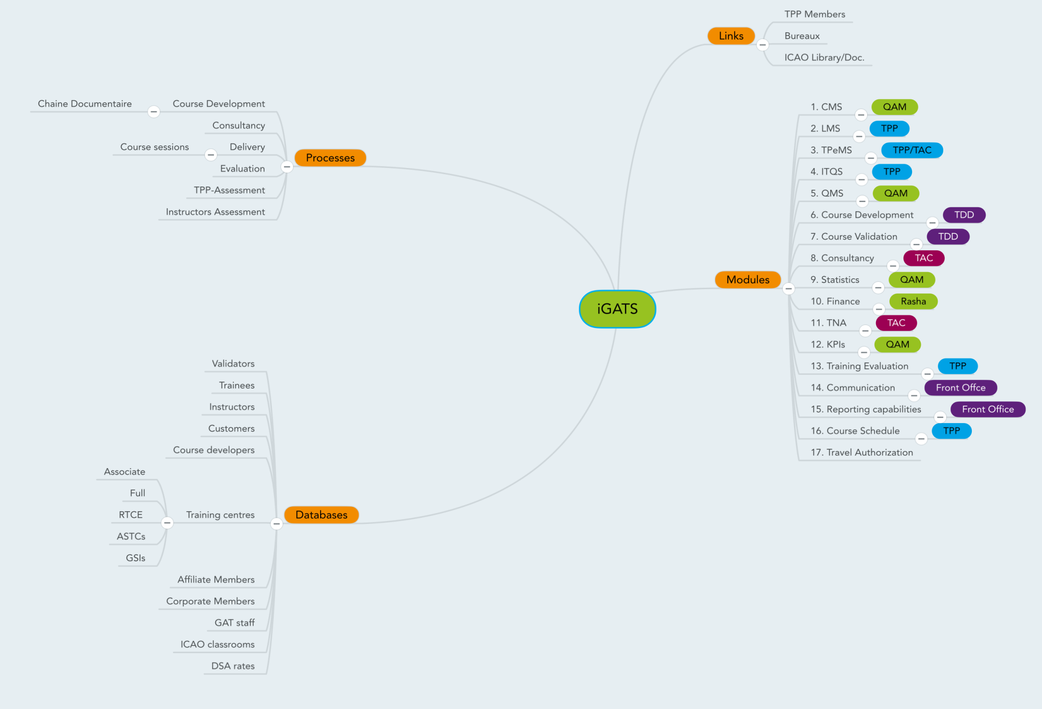

Slide 16
GAT Learning Intervention Levels
HOTS (Higher Order Thinking Skills)
LI6 | Creating | Putting elements together to form a coherent or functional whole; | 3-D Training application
LI5 | Evaluating | Making judgments based on criteria and standards through checking and critiquing. | Training activities including On the Job training with Audit and Assessment techniques
LI4 | Analyzing | Breaking material or concepts into parts, determining how the parts relate or interrelate to one. | On The Job Training Advance Practical Face to Face courses Strategic Planning Techniques
LI3 | Applying | Carrying out or using a procedure through executing, or implementing. | Practical Face to Face courses Advance Blended training Simulators E-learning (Level 3)
LI2 | Understanding | Constructing meaning from different types of | Basic Face to Face courses Basic Blended training E-Learning (Level 1 and 2)
LI1 | Remembering | Retrieving, recalling, or recognizing knowledge from memory | Seminars Conferences Symposia Workshops
LOTS (Lower Order Thinking Skills)

Slide 17
RTCE Authorized Areas Addressing ICAO Strategic Objectives
Safety
Air Navigation Capacity and Efficiency
Economic Development of Air Transport
Environment Protection
Security and Facilitation
Flight Safety and Safety Management
Aerodromes
Security and Facilitation
Air Navigation Services
Environment
Air Transport

Slide 18
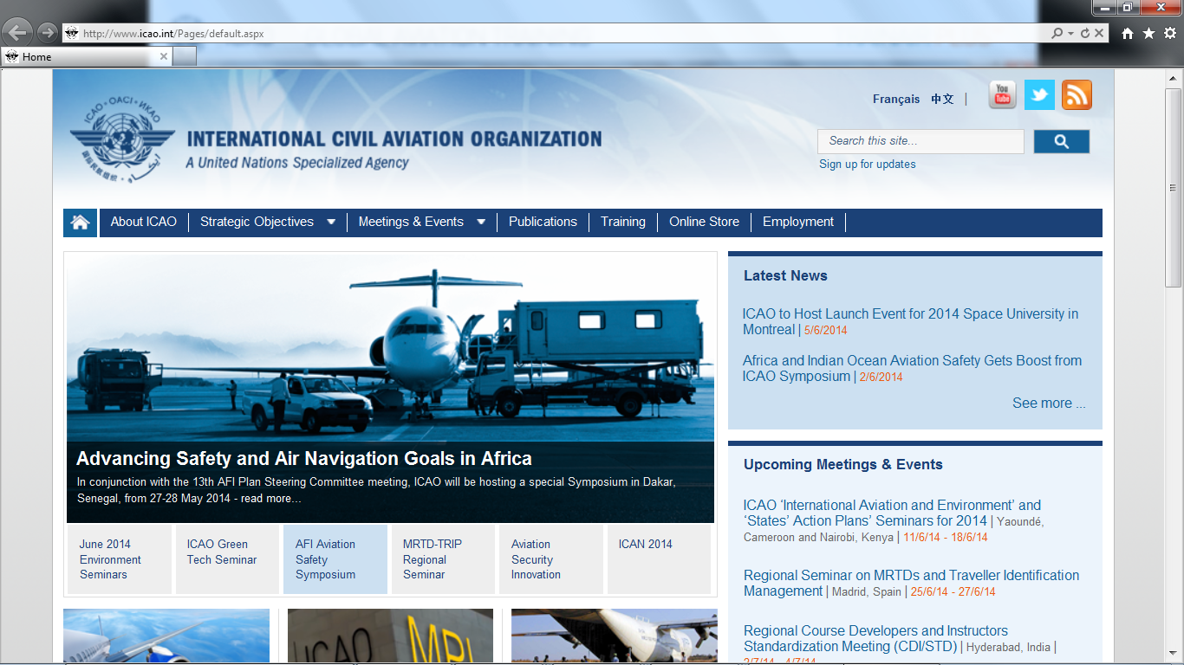

Slide 19
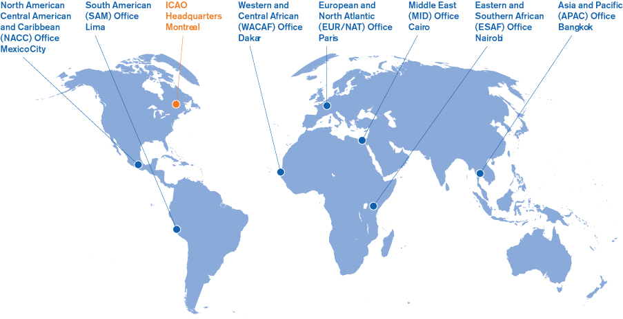
Thank you

