Slide 1
RECENT DEVELOPMENTS IN THE FIELD OF AVIATION TRAINING
RECENT DEVELOPMENTS IN THE FIELD OF AVIATION TRAINING
Stefano PROLA
IATA Safety and Flight Operations
Stefano PROLA
IATA Safety and Flight Operations
FLIGHT SAFETY FOUNDATION MEDITERRANEAN
6th International Conference - Cyprus 28/5/2015

Slide 2
OUTLINEs
Pilot Training Task Force
Upset Prevention and Recovery Training
Cyber Security

Slide 3
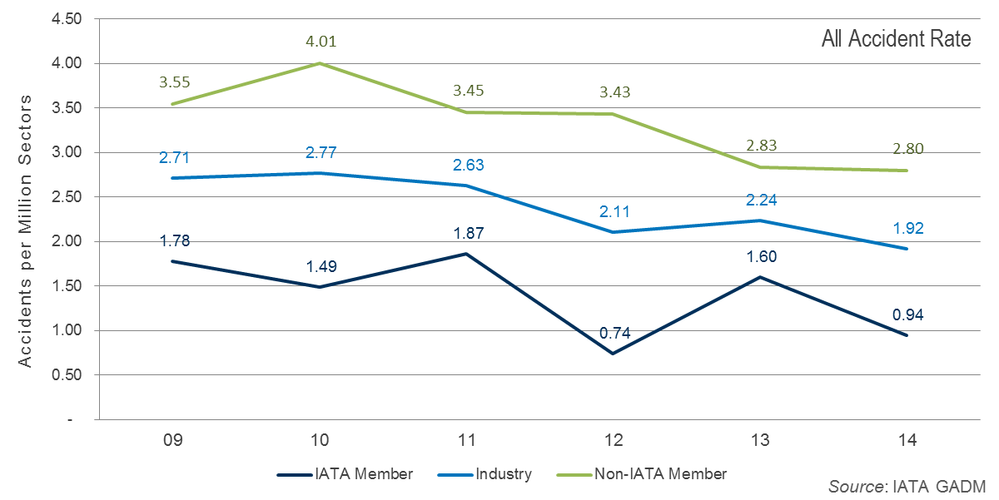
Safety Performance:
All Accidents per Million Flights
Notes:
This is the overall accident rate, which includes all eastern and western built jets and turbo-props above 5700 Kg. The statistics are relative to flights limited to normal commercial aviation activities, specifically scheduled/charter passenger or cargo service. Executive jet operations, training, maintenance/test flights are all excluded.
The rate of 1.92 per million flights is the lowest in history yet.
Any accident is one too many and safety is always aviation’s top priority. While aviation safety was in the headlines in 2014, and unfortunately also in March, the data show that flying continues to improve its safety performance.
Note the difference between IATA members and the rest of the industry. All IATA members are IOSA registered and must remain registered to maintain IATA membership.

Slide 4
All Accidents Overview
 | Year 2014 | 2009-2013 Average per year
Total Accidents | 73 | 86
Accidents with IATA Members | 17 | 26
Total Jet Hull Losses | 7 | 16
Total Turbo-Prop Hull Losses | 17 | 20
Total Fatal Accidents | 12 | 19
Fatalities | 641 | 517
Source: IATA GADM
15 May 2015
Notes:
In this table you see. the summary of last year.
There were 73 accidents over the 38 million flights flown in 2014.
Compared to the average per year over the last 5 years we see an improvement in all categories but the number of fatalities, 641.
It is a small number in proportion to the 3.3 billion passengers transported but that does not decrease the size of the single tragedies.
The year 2014 will be remembered for two extraordinary and tragic events—MH 370 and MH 17. Although the reasons for the disappearance and loss of MH 370 are unknown, it is classified as a fatal accident—one of 12 in 2014.
The destruction of MH 17 by anti-aircraft weaponry, however, is not included as an accident under globally-recognized accident classification criteria. The four aircraft involved in the events of 9.11 were treated in the same way.

Slide 5
All Accident Rate per Region of Operator As of 31 December 2014
EUR
1.35 | 2014
2.75 | 2013
2.03 | 2009-2013
CIS
2.19 | 2014
3.14 | 2013
5.92 | 2009-2013
NAM
1.00 | 2014
1.55 | 2013
1.38 | 2009-2013
NASIA
0.95 | 2014
0.53 | 2013
0.82 | 2009-2013
MENA
3.47 | 2014
3.05 | 2013
5.43 | 2009-2013
LATAM/CAR
2.73 | 2014
1.98 | 2013
3.36 | 2009-2013
AFI
11.18 | 2014
7.12 | 2013
12.45 | 2009-2013
ASPAC
2.57 | 2014
2.90 | 2013
2.76 | 2009-2013
Source: IATA GADM
Notes:
5
Looking at the all accidents by regions, the 2014 rate per million flights shows improvement over the 5 year average everywhere but in NASIA, where the turbo-prop events are driving down the all accident rate. There are relatively few turboprop operations in North Asia so the single turboprop hull loss experienced in the region in 2014 caused the turboprop hull loss rate to rise to 11.28 compared to the five-year rate of 2.41.
AFI is well above the rest of the regions. Sub-Saharan airlines had zero jet hull loss accidents in 2014 but 8 turbo-prop hull losses. Safety continues to be a challenge for Africa. The fact that the region experienced no jet hull loss accidents last year is a real progress. However, the poor performance on turboprops demonstrates that significant challenges remain. The 27 Sub-Saharan airlines on the IOSA registry are performing more than 10 times better than non-IOSA operators in terms of all accidents (1.95 per million flights versus 19.62).

Slide 6
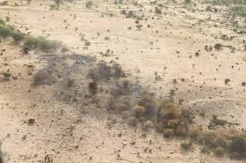
Loss Of Control In-flight 2010-2014
415 accidents total
9 % were LOC-I
49 % of fatalities:
1,242 (LOC-I) out of 2,541(total)
Notes:
Loss of Control In-flight
Loss of Control In-flight (LOC-I) refers to accidents in which the flight crew was unable to maintain control of the aircraft in flight,
resulting in an unrecoverable deviation from the intended flight path. Between 2010 and 2014, airplane accidents resulting from
a LOC-I event were the leading cause of fatalities in commercial aviation.
While few in number, LOC-I accidents are almost always catastrophic; 97% of LOC-I accidents between 2010 and 2014
involved fatalities to passengers and/or crew. Over this period, 9% of all accidents were categorized as LOC-I. LOC-I accidents
contributed to 43% of fatalities during the past five years (1,242 out of 2,541). There were six LOC-I accidents in 2014, all of which
involved fatalities. Given this severity, LOC-I accidents represent the highest risk to aviation safety.
Analysis of LOC-I accident data indicated that LOC-I can result from engine failures, icing, stalls or other circumstances that
interfere with the ability of the flight crew to control the motion of the aircraft. It is one of the most complex accident categories,
involving numerous contributing factors that act individually or, more often, in combination. These contributing factors include
latent conditions in the system, external threats to the flight crew, errors in the handling of those threats and undesired aircraft
states from deficiencies in managing these threats or errors. Many initiatives by IATA and other organizations, manufacturers
and regulatory authorities have been underway simultaneously to influence the reduction of the number of LOC-I events. ICAO
brought many of the groups involved with these efforts into the ensuing discussions under what became known as the Loss of
Control and Recovery Training (LOCART) initiative.
Still, there remains no single, simple solution for mitigating the risk of LOC-I events. IATA has embarked on a number of initiatives to
increase the attention devoted to this important area of concern:
•• IATA, in collaboration with aviation safety partners, is developing a LOC-I website to provide a single-point-of consultation
where all relevant LOC and Aircraft Upset Recovery Training Aids (AURTA) will be available. (DOC 10011) was developed with input from many expert
groups from IATA, flight simulator manufacturers, aircraft manufacturers, airlines, etc.
•• A toolkit, which will mirror the website, will also be developed
for workshop purposes.
•• To address the lack of LOC training, the implementation of training programs in recurrent training, and the proper training
of instructors, IATA’s Pilot Training Task Force has developed guidance material for LOC training.

Slide 7
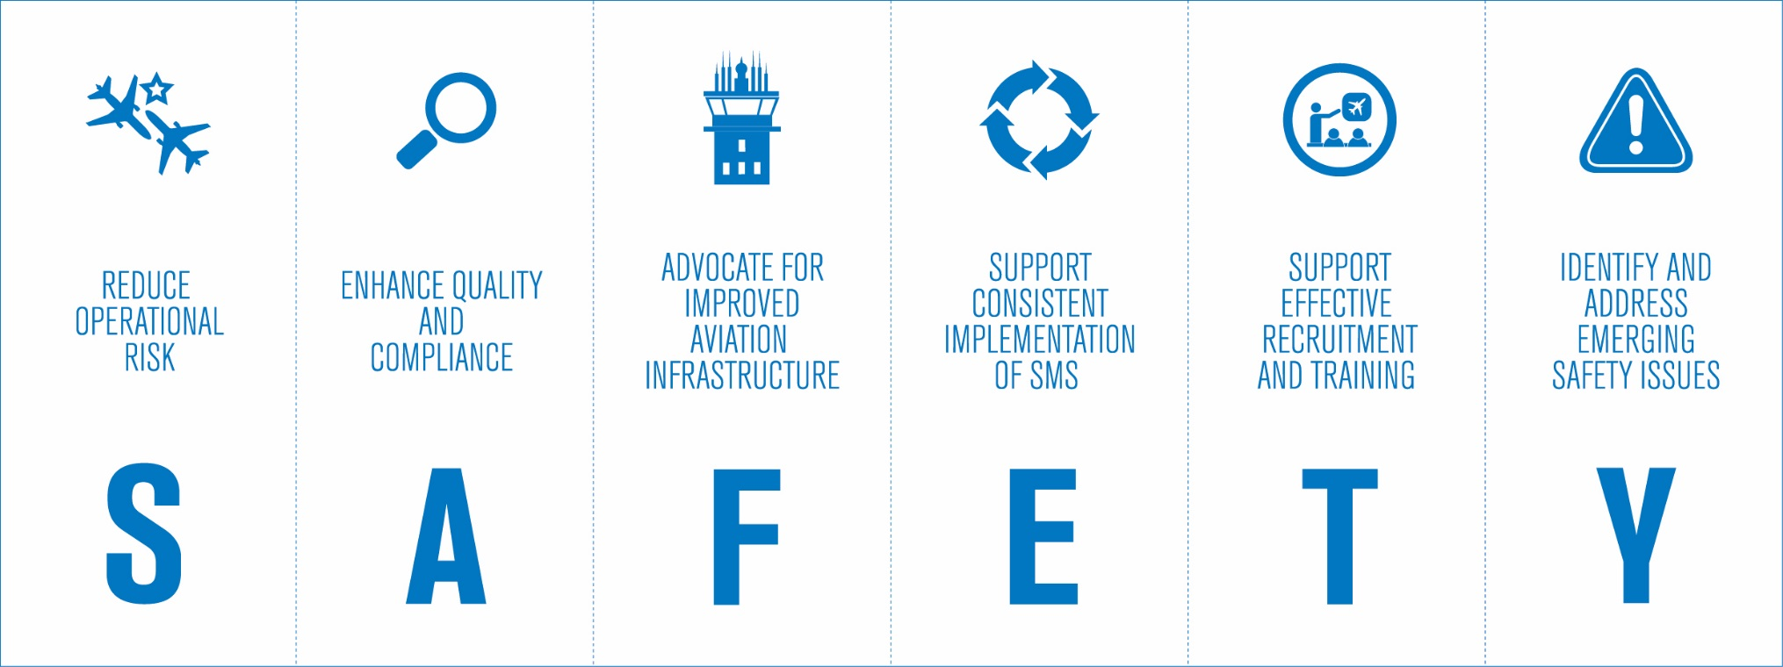
IATA Safety Strategy
Notes:
The Aviation Industry was able to decrease the accident rate while the number of aircraft and flights was growing.
If we stop this positive trend, the absolute number of accidents will inevitably increase, given the constant growth in operations.
Our goal is to further reduce the accident rate. To do this we will have to identify new and improved methodology for managing safety.
The IATA revised Six Point Safety Strategy was established in close cooperation with the member airlines and Strategic Partners through the IATA Safety Group (SG) and the Operations Committee (OPC) in 2013.
It is a comprehensive approach to identify organizational, operational and emerging safety issues.
This pillar is built to support effective recruitment and training.

Slide 8
IATA Pilot Training Task Force (PTTF)
Guidance on trends and issues/needs in
pilot training
assessment
qualification
Notes:
June 2014: creation of the IATA PTTF
Guidance on the latest trends
and most pressing and relevant issues/needs

Slide 9
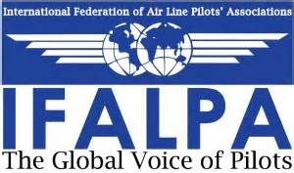
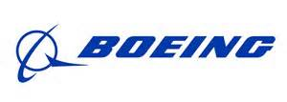
IATA PTTF – 15 members
Notes:
Representatives from 15 airlines and stakeholders currently serve on the PTTF.

Slide 10
PTTF 2015 Priority Areas
IATA Guidance Material and Best Practices for the Implementation of Upset Prevention and Recovery Training (UPRT)
Pilot monitoring and situational awareness
Unrestricted Multi-crew Pilot License (MPL)

Slide 11
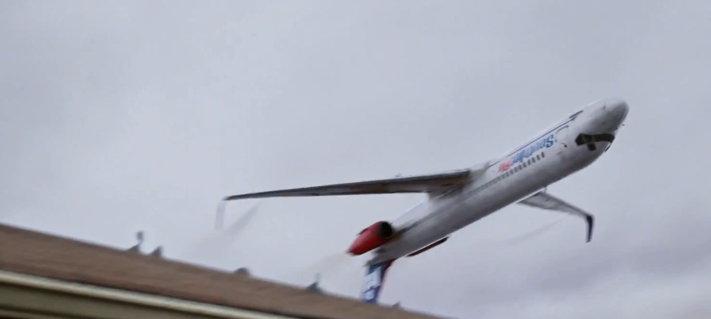
Upset Prevention and Recovery Training

Slide 12
Guidance Material and Best Practices for the Implementation of Upset Prevention and Recovery Training
2015
1st Edition

Slide 13
IATA UPRT Manual - Content
Regulatory compliance
Academic training
Practical training
Notes:
Objective – UPRT Manual development: to fill the gaps not to repeat what is already covered in detail in the documents published by ICAO Doc 10011, Manual on Aeroplane Upset Prevention and Recovery (MAUPR) and the OEMs’ Airplane Upset Recovery Training Aid (AURTA), i.e., whatever is recommended in ICAO Doc 10011 is what we should do, but how we do it is what we have in the IATA manual.
It is a practical, hands-on manual for the trainers.
1st edition of the manual focuses on recurrent training, but it may also be considered when including UPRT into other programs, such as conversion, upgrading and type rating training.
It should also refer to competency-based training; i.e., what do instructors need to do under Evidence-Based Training; and address UPRT in a multi-crew environment.
The document also focuses on practical guidance for UPRT-specific instructor training.
Regulatory compliance: FAA All pilots operating under part 121 must complete ground training on stall prevention and recovery and upset prevention and recovery during initial, transition, upgrade, and recurrent training”. Compliance is required no later than March 12, 2019. / EASA has published, May 4th, ED Decision 2015/012/R on UPRT, which will enter into force on May 4th 2016.
Academic training
Thorough understanding of aerodynamics, flight dynamics, aircraft performance and aircraft design principles is an indispensable prerequisite for successful upset-prevention. Academic training therefore is of critical importance for the success of a UPRT program.
Operators are encouraged to first identify possible theoretical knowledge gaps of their pilots, then use AURTA and the variety of existing publications or Apps to develop the academic part of their UPRT program.
Theoretical training should precede and be integrated into practical training. It should include classroom instruction and self-study in preparation for FSTD lessons.
Practical training
Threat and Error Management and the core competencies
Flight crew discipline
Flight path monitoring
Flight path management - manual flying skills
Training envelopes (Validated Training Envelope / Normal Flight Envelope)

Slide 14
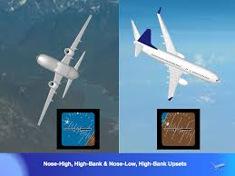
IATA UPRT Manual – Content (cont.)
UPRT Instructors
Assessing pilots performance
Operator / ATO UPRT implementation
Notes:
UPRT Instructors/ Regulatory aspects:
ICAO has mandated UPRT for MPL, type- and recurrent training and recommended it for CPL courses. Instructor qualification requirements are presently being developed by the national authorities.
ICAO DOC10011 states in Chapter 5 that “Regardless of an individual’s background, all instructors assigned to provide training in a UPRT programme should successfully complete a UPRT instructor qualification training course approved by the Licensing Authority.”
There is consensus that special emphasis on instructor training is needed as “In UPRT the safety implications and the consequences of applying poor instructional technique or providing misleading information are arguably more significant than in most other areas of pilot training.” (quoted from ICAO DOC10011 Chapter 5)
Avoiding Negative Training:
Course developers should ensure compliance and consistency of their training programs with the regulations, procedures and recommendations provided by Authorities, OEMs and AURTA.
A high risk of negative training is associated with the well-intended design of self-made exercises and is inherent to scenario-design, especially when deriving scenarios from case studies where the affected aircraft type may be different from the type used for training. In such cases operators should cooperate with their OEMs to avoid negative training.
Negative transfer of training can occur for example when using FSTDs outside the VTE and from inappropriate on-aeroplane UPRT.
Assessing pilots performance: There is consensus in the training community that UPRT should be non-jeopardy, it is seen as training and not as checking. In terms of the instructional system design process UPRT programs however would not be effective without guidance for instructors on how to measure acceptable performance of crews in UPRT.
ATOs serving operators: Operators engaged in ab-initio schemes should ensure that UPRT delivered by their contracted ATOs is consistent with their own training principles. Operators may also consider to use contracted ATOs to offer on-aeroplane training to airline instructors and line pilots.
On-aeroplane instructors: Special attention should be given to instructors teaching on-aircraft all-attitude/all-envelope training. Required instructor performance in the all-attitude/all-envelope environment is beyond that experienced in normal operations. By no means should an ATO assign this task to “normal” flight instructors.
On-aeroplane UPRT is a true resilience-builder: Compared to and in addition to teaching flying skills in FSTDs on-aeroplane UPRT is first and foremost a human factor training. It should address mainly human-factor training objectives and less flying skills training, which might not always be transferrable to another aircraft type. It can be the most valuable tool to build long-lasting confidence of a pilot.
Course evaluation and safety management:
Training- and safety management of the operator should cooperate to validate the program, perform its evaluation and ensure that the training program will not introduce additional risks, i.e. the risk of unintended consequences.
Data from the Safety Management System are needed to support this process.
Airline specific data indicating upsets may be limited, but a correlation between the rates of particular upsets, and the rates of developing upsets may assist the airline in understanding which type of divergences pilots find most difficult to manage. If all divergences are managed before the aircraft is in upset conditions, then the current crew strategies are likely to be successful.

Slide 15
Cyber Security Threats
System/Data Availability
Data integrity
Confidentiality
Notes:
There are three overarching common impacts of malicious Cyber-attacks;
System/Data Availability – the attack is able to present barriers to accessing the data by the appropriate users
Data Integrity – the attacker is able to insert, remove, or modify data in airline systems to the detriment of the airline.
Confidentiality – the attack is able to capture data which is considered private and confidential by the airline, including financial, personal, or operational records.

Slide 16
Impact of cyber threats
Safety and security
Operational disruption
Business disruption
Notes:
Safety and Security –
On board/inflight - interference affecting onboard systems, communications with aircraft, EFB, navigation, avionics.
Airport - common use kiosks and terminals, airport network (often connected to public wireless).
Airline - departure control systems, kiosk applications, reservation systems, mobile apps, passenger data communication networks and software, middleware, crewing, flight planning and scheduling, financial systems, web site, frequent flyer systems.
Operational disruption – inability to operate flights due to flight planning, tracking systems, DCS, passenger data transmission and crewing system interference.
Business disruption – inability to take bookings, check-in, manage crewing, planning and scheduling. Email and network disruption affecting normal business processes
Political and PR concerns – loss of data privacy, release of private information
THERE IS A THREAT BUT WHAT IS THE RISK?

Slide 17
Industry stakeholders challenges
Perception of threat / risk management
Defining roles and responsibilities
Sharing of information
Raising awareness and training
Notes:
The industry (airlines in particular) is looking for gaining operational efficiency through the introduction of computer systems, and their integration to optimize the management of their networks. The number of software systems, connectivity and entry points is raising constantly. Systems and processes are becoming more convenient, efficient and integrated, but consequently increasingly vulnerable to cyber threat
Although the issue itself has been defined some time ago (at the ICAO level, work commenced on the topic of the cyber threat in 2009 with the 20th AVSEC Panel recognizing cyber as an emerging threat) still it is perceived as “new” for stakeholders due to difficulties in identification of threats and assessing potential impact. This threat is more difficult to visualize than known physical threats (for instance Improvised Explosive Device). The threat is subject to constant evolution as a result of increasing use of IT and new solutions being introduced.
The industry recognizes this subject is crossing over the entire organization going out of the operational areas involving not only security and safety but also maintenance, procurement, IT
To improve identification of threats and ultimately to help in risk assessment development sharing of information is necessary however it might conflict with existing barriers within the industry as well as between industry and governmental stakeholders

Slide 18
Cyber Security Training
Aimed to:
Locate, prioritize and assess cyber risks in aviation businesses
Recommend risk mitigation processes
Implement Cyber Security Management System (CSMS) guiding principles in your business
Notes:
The industry (airlines in particular) is looking for gaining operational efficiency through the introduction of computer systems, and their integration to optimize the management of their networks. The number of software systems, connectivity and entry points is raising constantly. Systems and processes are becoming more convenient, efficient and integrated, but consequently increasingly vulnerable to cyber threat
Although the issue itself has been defined some time ago (at the ICAO level, work commenced on the topic of the cyber threat in 2009 with the 20th AVSEC Panel recognizing cyber as an emerging threat) still it is perceived as “new” for stakeholders due to difficulties in identification of threats and assessing potential impact. This threat is more difficult to visualize than known physical threats (for instance Improvised Explosive Device). The threat is subject to constant evolution as a result of increasing use of IT and new solutions being introduced.
The industry recognizes this subject is crossing over the entire organization going out of the operational areas involving not only security and safety but also maintenance, procurement, IT
To improve identification of threats and ultimately to help in risk assessment development sharing of information is necessary however it might conflict with existing barriers within the industry as well as between industry and governmental stakeholders

Slide 19
Thank you
Stefano Prola
prolas@iata.org
Larnaca
May 28th, 2015
LATAM/CAR RCG 30
19
May 31 - June 1, 2011 Miami, FL
Notes:
This concludes my presentation on IATA safety activities.
My wish is that we can make the theme of your conference come true and make each day matter.
Thanks for listening to me.

