Slide 1
ICAO and Remotely Piloted
Aircraft Systems (RPAS)
Sarantis Poulimenakos
ICAO EUR NAT RO
FSF MED RPAS Conference 2016
21 October 2016, Larnaca, Cyprus

Slide 2
Unmanned Aviation
  A historical perspective
  Unmanned aviation has been around for quite some time now
  Sudden and dramatic growth
  Challenged regulators and airspace users alike
  Not all are equal
  Diversity in size, capability and use
  Categorize UAS and establish pertinent framework for each
Kettering Bug (1918)5
Notes:
Unmanned Aviation
A historical perspective
Unmanned aviation has been around for quite some time now
Sudden and dramatic growth
Challenged regulators and airspace users alike
Not all are equal
Diversity in size, capability and use
Categorize UAS and establish pertinent framework for each

Slide 3
Legal basis
Pilotless aircraft have been a part of the legal framework for international civil aviation, since the Regulation of Aerial Navigation (1919, Paris Convention), as amended by the Protocol of 15 June 1929.
The 1929 Protocol modified Article 15 of the Paris Convention , in pertinent part, as follows: “No aircraft of a contracting State capable of being flown without a pilot shall, except by special authorization, fly without a pilot over the territory of another contracting State.”

Slide 4
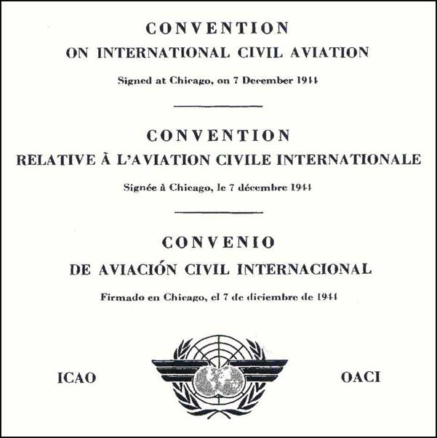
7 Dec. 1944

Slide 5
Legal basis –ICAO Convention, Art. 8
Article 8 of the Chicago Convention entitled “Pilotless aircraft” provides:
“No aircraft capable of being flown without a pilot shall be flown without a pilot over the territory of a contracting State without special authorization by that State and in accordance with the terms of such authorization. Each contracting State undertakes to insure that the flight of such aircraft without a pilot in regions open to civil aircraft
shall be so controlled as to obviate danger to civil aircraft.”

Slide 6
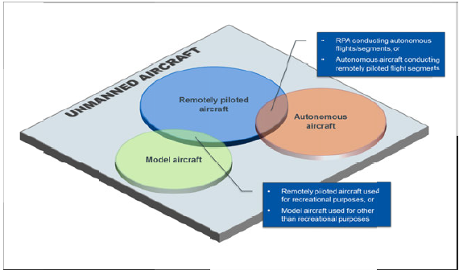
Notes:
Unmanned Aviation
A historical perspective
Unmanned aviation has been around for quite some time now
Sudden and dramatic growth
Challenged regulators and airspace users alike
Not all are equal
Diversity in size, capability and use
Categorize UAS and establish pertinent framework for each

Slide 7
ICAO UAS Study Group (UASSG)
  April 2007 ICAO Secretariat established the UASSG (aka The Study Group)
  -to assist the Secretariat in coordinating the development of ICAO Standards and Recommended Practices (SARPs),
  -to support a safe, secure and efficient integration of UAS into non-segregated airspace and aerodromes
  -to develop a UAS regulatory concept and associated guidance material to support and guide the regulatory process.
  Much discussion took place within the UASSG on what ICAO’s focus should be :
  After studying the Convention and Annexes, and coordinating with LEB and OPS, the UASSG narrowed its focus to IFR operations in controlled airspace and aerodromes where UAS would operate alongside manned aircraft. This would require SARPs and close alignment with manned aviation. UAS would need to ‘fit into the aviation system, not expect manned aviation to adjust or equip to accommodate UAS’.
Notes:
RPAS Panel
Developing the regulatory framework for RPAS to conduct IFR operations in controlled non-segregated airspace/aerodromes
Alongside manned aircraft, as a predictable, cooperative airspace user:
With fundamentals of airworthiness, operations and licensing as pre-requisites to airspace integration
Meets all the standard equipment and capability requirements for the airspace/procedures
Must ‘fit in’ without requiring other airspace users or providers to equip
OTHER ANB Panels supporting on technical matters:
FSMP (Spectrum)
FLTOPSP FLIREC-WG (OPS and Flight Recorders)
AIGP (Accident Investigation)
ATMOPSP (ATM Operations)
AIRP (Airworthiness)
CP (Communications)
SP (Surveillance)
SASP (Separation)
SMP (Safety management)
OTHER ICAO
Legal Committee
New implications of RPAS as its highest priority work programme item
Legal issues related to remote pilots and oversight
Handovers of piloting and remote PIC responsibilities during flight
Including multiple State oversight responsibilities
Committee on Aviation Environmental Protection (CAEP)
Aviation Security Panel (AVSEC)
Established its own RPAS Task force
Address physical security issues
Identify threats and risks presented by UAS

Slide 8
From UASSG to RPAS Panel
  The UASSG identified a subset of UAS that would meet the mandate of Article 8 for “control” and decided to designate it RPAS. Autonomous aircraft and model aircraft were outside of scope.
  January 2011, UASSG drafted Circular 328 :a ‘snapshot’ of the collective knowledge obtained through ICAOs Secretariat work-The Cir explained the issues that had been identified without yet providing solutions.
  March 2012, Council adopted the first package of Standards on RPA in Annexes 2 and 7.
  During 2014, as part of the Modernization of Panels, the UASSG was transitioned into the RPAS Panel.
  March of 2015, ICAO published the RPAS Manual, Doc 10019. Developed primarily by UASSG.Extensive coordination was done within the Secretariat to validate the material and its consistency with existing ICAO provisions. Learning experience.
Notes:
RPAS Panel
Developing the regulatory framework for RPAS to conduct IFR operations in controlled non-segregated airspace/aerodromes
Alongside manned aircraft, as a predictable, cooperative airspace user:
With fundamentals of airworthiness, operations and licensing as pre-requisites to airspace integration
Meets all the standard equipment and capability requirements for the airspace/procedures
Must ‘fit in’ without requiring other airspace users or providers to equip
OTHER ANB Panels supporting on technical matters:
FSMP (Spectrum)
FLTOPSP FLIREC-WG (OPS and Flight Recorders)
AIGP (Accident Investigation)
ATMOPSP (ATM Operations)
AIRP (Airworthiness)
CP (Communications)
SP (Surveillance)
SASP (Separation)
SMP (Safety management)
OTHER ICAO
Legal Committee
New implications of RPAS as its highest priority work programme item
Legal issues related to remote pilots and oversight
Handovers of piloting and remote PIC responsibilities during flight
Including multiple State oversight responsibilities
Committee on Aviation Environmental Protection (CAEP)
Aviation Security Panel (AVSEC)
Established its own RPAS Task force
Address physical security issues
Identify threats and risks presented by UAS

Slide 9
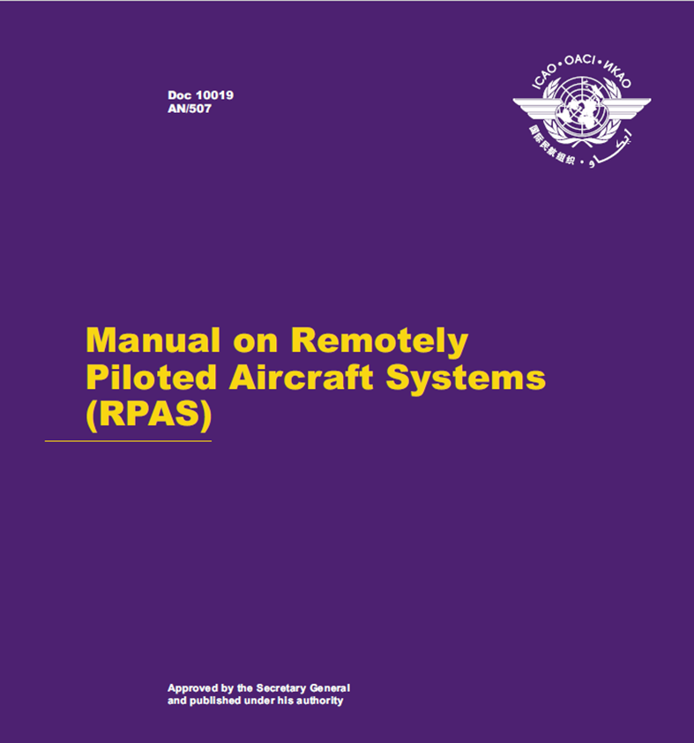

Slide 10
RPAS: Safety and Efficiency
  RPAS Panel
  Developing the regulatory framework for RPAS to conduct IFR operations in controlled non-segregated airspace/aerodromes
  Alongside manned aircraft, as a predictable, cooperative airspace user:
    With fundamentals of airworthiness, operations and licensing as pre-requisites to airspace integration
    Meets all the standard equipment and capability requirements for the airspace/procedures
    Must ‘fit in’ without requiring other airspace users or providers to equip
  Other ANB Panels supporting on technical matters
FSMP (Spectrum)
FLTOPSP FLIREC-WG
(OPS and Flight Recorders)
AIGP
(Accident Investigation)
ATMOPSP (ATM Operations)
AIRP
(Airworthiness)
CP
(Communications)
SP
(Surveillance)
SASP
(Separation)
SMP
(Safety Management)
Notes:
RPAS Panel
Developing the regulatory framework for RPAS to conduct IFR operations in controlled non-segregated airspace/aerodromes
Alongside manned aircraft, as a predictable, cooperative airspace user:
With fundamentals of airworthiness, operations and licensing as pre-requisites to airspace integration
Meets all the standard equipment and capability requirements for the airspace/procedures
Must ‘fit in’ without requiring other airspace users or providers to equip
OTHER ANB Panels supporting on technical matters:
FSMP (Spectrum)
FLTOPSP FLIREC-WG (OPS and Flight Recorders)
AIGP (Accident Investigation)
ATMOPSP (ATM Operations)
AIRP (Airworthiness)
CP (Communications)
SP (Surveillance)
SASP (Separation)
SMP (Safety management)
OTHER ICAO
Legal Committee
New implications of RPAS as its highest priority work programme item
Legal issues related to remote pilots and oversight
Handovers of piloting and remote PIC responsibilities during flight
Including multiple State oversight responsibilities
Committee on Aviation Environmental Protection (CAEP)
Aviation Security Panel (AVSEC)
Established its own RPAS Task force
Address physical security issues
Identify threats and risks presented by UAS

Slide 11
CURRENT ICAO ACTIVITIES
  The top priorities for the RPASP are three areas: the licence, certificate of airworthiness and operator certificate. International operations cannot occur without these documents
  Legal, Safety management and human factors, OPS ,ATM issues are folowing
  Taken all together, 18 of the 19 Annexes will need to be revised to include RPAS and their operations. Only Annex 5 on units of measurement is unaffected.
  At the request of the Legal Committee, the Secretariat developed a questionnaire that was sent to States in late August asking for feedback on the level and type of regulations States currently have in place and any international legal issues they have identified that should be brought to the attention of ICAO. Responses to the survey are due by 31 October 2016.
Notes:
RPAS Panel
Developing the regulatory framework for RPAS to conduct IFR operations in controlled non-segregated airspace/aerodromes
Alongside manned aircraft, as a predictable, cooperative airspace user:
With fundamentals of airworthiness, operations and licensing as pre-requisites to airspace integration
Meets all the standard equipment and capability requirements for the airspace/procedures
Must ‘fit in’ without requiring other airspace users or providers to equip
OTHER ANB Panels supporting on technical matters:
FSMP (Spectrum)
FLTOPSP FLIREC-WG (OPS and Flight Recorders)
AIGP (Accident Investigation)
ATMOPSP (ATM Operations)
AIRP (Airworthiness)
CP (Communications)
SP (Surveillance)
SASP (Separation)
SMP (Safety management)
OTHER ICAO
Legal Committee
New implications of RPAS as its highest priority work programme item
Legal issues related to remote pilots and oversight
Handovers of piloting and remote PIC responsibilities during flight
Including multiple State oversight responsibilities
Committee on Aviation Environmental Protection (CAEP)
Aviation Security Panel (AVSEC)
Established its own RPAS Task force
Address physical security issues
Identify threats and risks presented by UAS

Slide 12
Two Approaches – Two Streams of Work
RPAS
Full regulatory
approach
Other UAS
‘Tool Kit’ to enable domestic operations
PENDING
Network/
Delivery Drones
Notes:
Two Approaches – Two Streams of Work
RPAS as a full aviation system user, using full regulatory approach
Affect all aspects of civil aviation and all ICAO Annexes
Includes comparable certifications and licenses as in manned aviation
Other UAS which are accommodated in the airspace
Don’t have the same capability, or need, to operate like manned aircraft
May be seen as hazard to manned aviation and people or property on the ground
Used as tools for public and private benefit, or for recreational purposes
Pending: network/delivery drones

Slide 13
Notes:
Unmanned Aviation
A historical perspective
Unmanned aviation has been around for quite some time now
Sudden and dramatic growth
Challenged regulators and airspace users alike
Not all are equal
Diversity in size, capability and use
Categorize UAS and establish pertinent framework for each

Slide 14




UAS Other than RPAS
Tool kit being developed by the UAS Advisory Group
  General guidance for national regulations
  Best practices and lessons learned from many States
  Practical examples
Awareness campaign through partnerships
Notes:
UAS Other than RPAS
Tool kit being developed by the UAS Advisory Group
General guidance for national regulations
Best practices and lessons learned from many States
Practical examples
Awareness campaign through partnerships
Amazon
Facebook
Google

Slide 15
SECURITY
  Within the AVSEC Panel, they have established an RPAS Task Force whose role is to:
  • examine security considerations of RPAS operations;
  • consider RPAS threat and risk scenarios identified by the WG on Threat and Risk, and coordinate these with the AVSEC and RPAS Panels; and
  • coordinate with the RPAS Panel to provide security input into the work of both Panels.
  Security is not just about who has access to the aircraft or station, but who or what can interfere with the command and control links. Cyber-resiliency is fundamental to the security of RPAS operations.
Notes:
RPAS Panel
Developing the regulatory framework for RPAS to conduct IFR operations in controlled non-segregated airspace/aerodromes
Alongside manned aircraft, as a predictable, cooperative airspace user:
With fundamentals of airworthiness, operations and licensing as pre-requisites to airspace integration
Meets all the standard equipment and capability requirements for the airspace/procedures
Must ‘fit in’ without requiring other airspace users or providers to equip
OTHER ANB Panels supporting on technical matters:
FSMP (Spectrum)
FLTOPSP FLIREC-WG (OPS and Flight Recorders)
AIGP (Accident Investigation)
ATMOPSP (ATM Operations)
AIRP (Airworthiness)
CP (Communications)
SP (Surveillance)
SASP (Separation)
SMP (Safety management)
OTHER ICAO
Legal Committee
New implications of RPAS as its highest priority work programme item
Legal issues related to remote pilots and oversight
Handovers of piloting and remote PIC responsibilities during flight
Including multiple State oversight responsibilities
Committee on Aviation Environmental Protection (CAEP)
Aviation Security Panel (AVSEC)
Established its own RPAS Task force
Address physical security issues
Identify threats and risks presented by UAS

Slide 16

Education is Essential
Information on RPAS and other UAS
  Regulators - what and how to regulate
  Industry, including manufacturers
  Service providers
  Operators and other airspace users
  General public
General information is needed for each group
  Targeted information on how to operate safely
  Where/why other areas are dangerous
Notes:
Education is essential
Information on RPAS and other UAS
Regulators - what and how to regulate
Industry, including manufacturers
Service providers
Operators and other airspace users
General public
General information is needed for each group
Targeted information on how to operate safely
Where/why other areas are dangerous

Slide 17

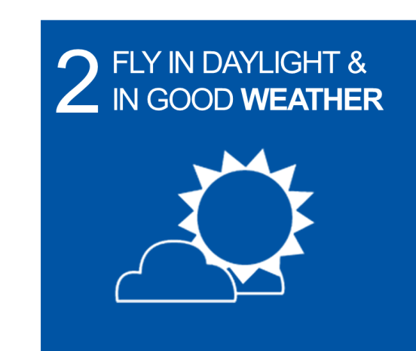


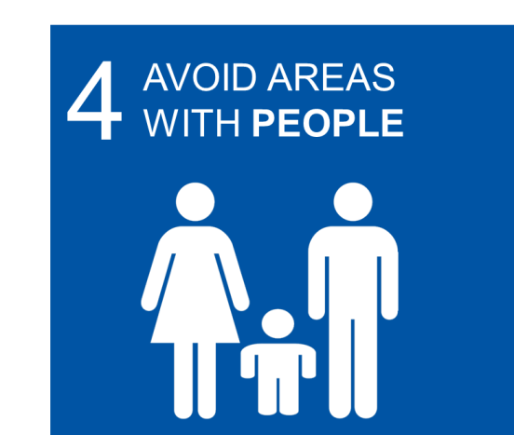
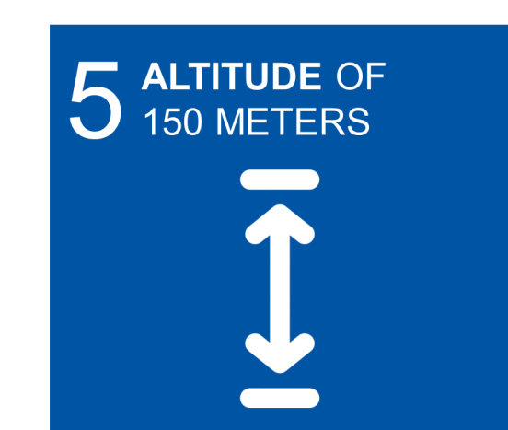
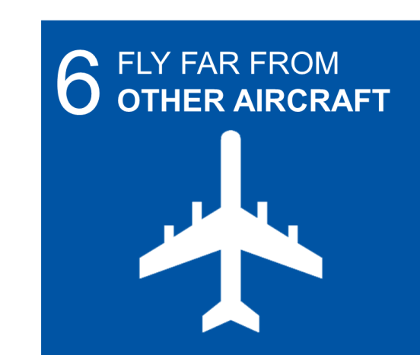
6 Basic Tips For
UNMANNED
AIRCRAFT
SYSTEMS
(UAS)
www.icao.int/RPAS

