Slide 1
Impact of RPAS on ATM
Eduardo Garcia
7th International conference. LARNACA, Cyprus - 21 OCTOBER 2016

Slide 2
About CANSO
Vision: to be the recognised leader in transforming global air traffic management (ATM) performance
Mission: as the global voice of ATM, represents the views of ANSPs and creates value for its Members and stakeholders
Delivers policy and standards of best practice through committees’ work programmes: Safety, Operations, and Policy
CANSO Members support over 85% of world air traffic – 88 Full Members; 79 Associate Members

Slide 3
CANSO Global Presence
HQ - Amsterdam
Montreal
Brussels
Singapore
Mexico City
Amman
Johannesburg

Slide 4
General Comments
CANSO is committed to the development of seamless, safe, and efficient airspace and is dedicated to ensuring ANSPs are equipped with the tools to safely and seamlessly integrate RPAS into global ATM
From the perspective of an ANSP, integrating RPAS into non-segregated airspace is of special interest.
CANSO is leading the way towards a safe integration of RPAS in the global airspace by focusing on training materials and standardising contingency/emergency procedures.

Slide 5
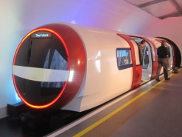
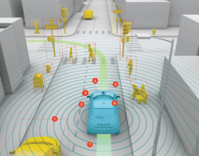
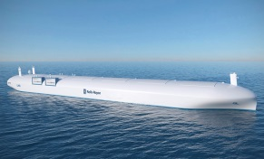
The rise of RPAS/Drones
RPAS/Drones are becoming an increasingly common sight in our skies
RPAS/Drones have the potential to open up all sorts of new opportunities and applications, from:
Emergency and life-saving applications;
Aerial surveillance and mapping;
And retail deliveries like Amazon
In addition, RPAS are an emerging market that is creating jobs and growth
… Autonomous capabilities are growing in other industries rapidly !
Railways
Automotive
Ships
AI / robotics
Internet of things
Notes:
Remotely Piloted Aircraft Systems (RPAS) have challenged the traditions and culture of aviation, including the pilot and controller communities
Taking advantage of accelerated technological improvements, both programs have the potential to dramatically improve aviation efficiency and safety
But as technology accelerates, how fast can the culture really keep up? How do we effectively manage safety?

Slide 6
Our Objective
Integration of RPAS into current and evolving ATM systems
Addressing insertion of emerging technologies
Key factors -
Ensuring safety
Maintaining efficiency
RPAS (regardless of size) operating within controlled airspace should comply with existing equipage requirements, procedures, and regulations unless operating with a waiver or exemption
Work closely with RPAS stakeholders on integration issues
Notes:
Remotely piloted aircraft systems (RPAS)/Drones are an important element in the transition to the aviation system of the future

Slide 7
Challenges
RPAS are unique and varied aircraft.
ANSPs confirm that small RPAS operations are already impacting the safety and efficiency of ATM operations
One of the most unique challenges that ANSPs face today is bridging the gap between ATM and non-traditional users.
Inability to comply with many standard and routine ATM procedures (including contingency operations and emergency management)
Aerodrome surface movement
Lack of standardised procedures and means to mitigate hazards associated with lost link and flyaway situations
Insufficient application of existing safety management and safety risk management policy
Lack of standard phraseology and terminology
Inconsistent implementation, globally, on RPAS integration particularly small, low-level
Notes:
There is a need for standardised contingency operations and emergency management. CANSO is leading efforts to be progressive in emergency management of RPAS by creating innovative ways to bridge the communications gap between RPAS operators, ANSPs, and pilots of manned aircraft.
Phases have been described as: Accommodation, Integration, and Evolution
We are still in Accommodation…..we need to be about Integration
But what does Integration mean for air traffic management (ATM)?
Can/should ANSPs apply the same separation standards as we do for manned aircraft?
Can/should ANSPs apply the same wake vortex criteria?
How will RPAS taxi on the surface of an aerodrome?
….

Slide 8
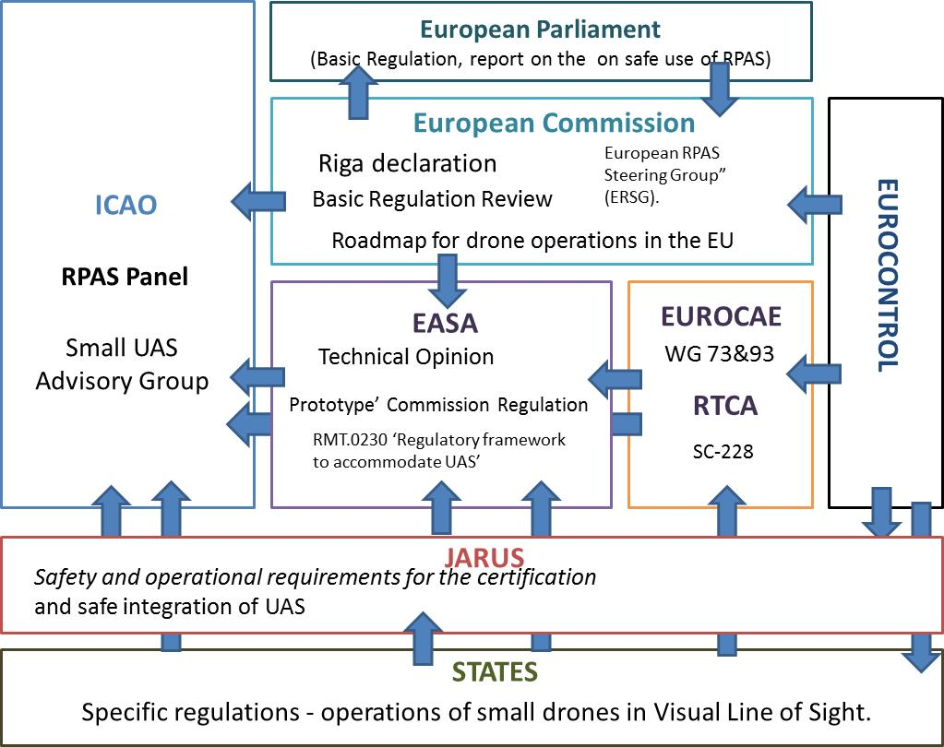
Regulatory Landscape is complex…

Slide 9
Actions - What is CANSO doing?
Representing CANSO
ICAO RPAS Panel – SARPS development
JARUS Industry Stakeholder Consultation Board – Still kicking the tires (Next meeting in Madrid/April)
SESAR 2020 RPAS Definition Phase
ICAO sUAS Advisory Group
CANSO is leading efforts to be progressive in emergency management of RPAS
Finalising RPAS position paper regarding ANSP concerns about the proliferation of small UAS
Developing training materials for ANSP's on general RPAS operations
Updating CANSO ANSP Considerations for RPAS Operations Publication
Providing inputs to EASA (e.g. Prototype Rule,…etc)
Notes:
Firstly, CANSO, together with its ANSP Members and industry stakeholders, is developing the necessary international RPAS standards, procedures and best practices that will ensure the safe and efficient integration into non-segregated airspace
Develop ANSP generic training material for RPAS that serves as an introduction to many in the work force that have yet to actually talk to or work an RPAS
Continued changes to the “Considerations” document by adding an artifacts list of known changes to existing automation and/or policies that need to be considered by ANSPs for ATM inclusion at some point in the future
Propose or publish a statement on the ANSP concerns relative to the proliferation of small RPAS operating at VLL, especially those operating too close to the aerodrome environment

Slide 10
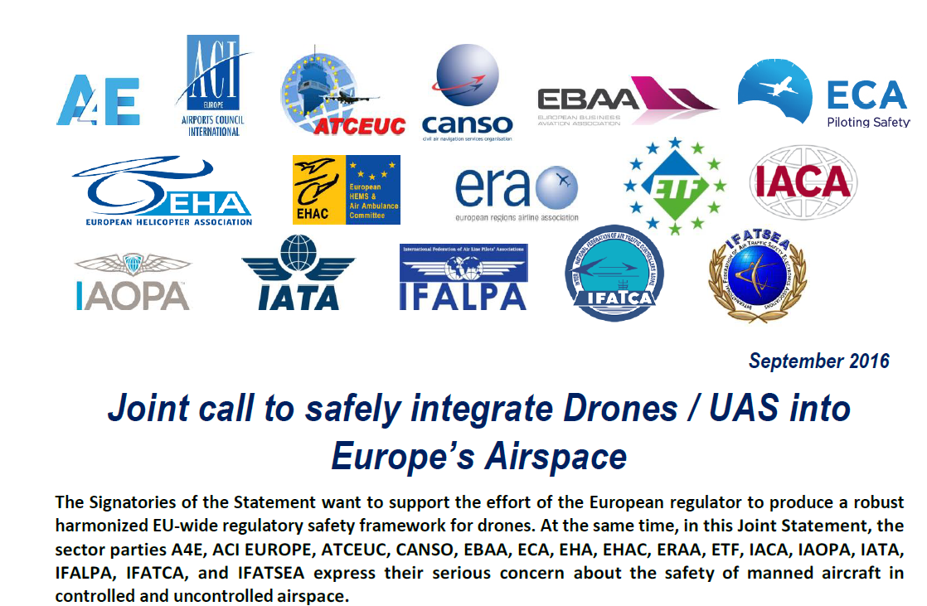
CANSO supports active collaboration with stakeholders

Slide 11
Role of ANSPs in the future UAS Traffic Management
OPS Concept for the integration of very low level (VLL) operations for UAS has to be developed and validated
ANSPs have to be involved actively in the process of the Unmanned Aircraft System (UAS) Traffic Management (UTM) development to ensure:
Safe and fair integration for all airspace users.
Appropriate safety at "boundaries“, especially in the integration of VLL flying UAS in the vicinity of aerodromes.
Interoperability between the UTM and ATM systems
ANSPs should be involved in the implementation and development for new SMS requirements due to the UTM

Slide 12
Conclusions
RPAS are a game changer and an exciting opportunity to change the way people, businesses and State organisations do things
CANSO is putting a lot of resources and effort into the RPAS area
Safety, Safety, Safety…

Slide 13
Questions & Answers
www.canso.org

Slide 14
Thank you !!!

