Slide 1
Drones, RPAS, UAV’s, UAS
Unmanned aircraft

Slide 2
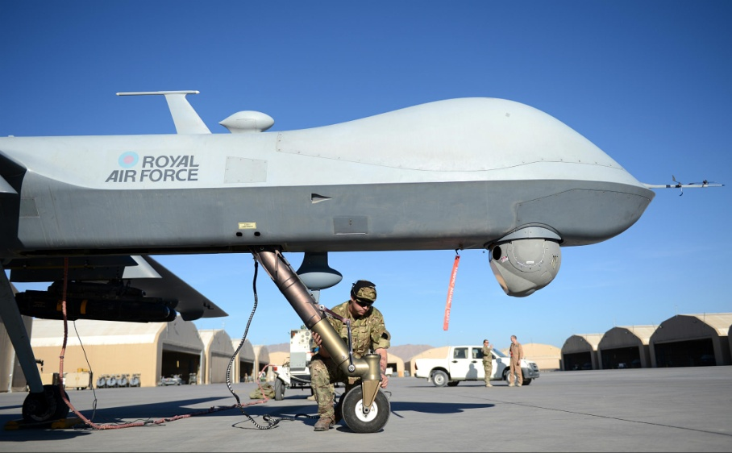
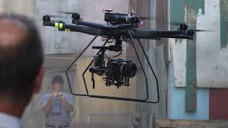
What is the use of these systems?
Recreational
Surveillance
Military
Weather observations

Slide 3
USING CIVILIAN AIRSPACE
Regulations govern manned aviation (110 years of history)
Aircraft certification
Pilot licensing
Organisation certificate

Slide 4
Regulations for Unmanned aircraft?
Some countries have made efforts to regulate unmanned flights
ICAO RPAS Panel
Regulation proportional to risk

Slide 5
Position on UAS
UAS technology is not capable of replacing human capabilities – complex in time and safety critical.
UAS cannot be used to supplant the role of pilots in any type of air transport operations.

Slide 6
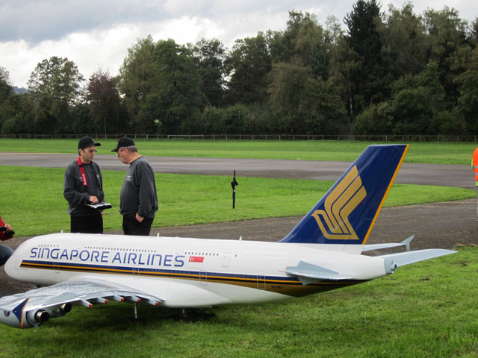
Model aircraft safety vs UAS used for surveillance, recording or photography in VLOS
Aim and location differs significantly. Safety comparisons invalid.
Formal qualifications for certain sectors of UAS not foreseen therefore unlikely to have a trained, qualified and responsible pilot.

Slide 7
IFALPA’s Position
For operations in the airspace where an encounter with a manned aircraft is possible, mandatory training and certificate /license should obligatory.
Mitigation of risk of collision and airspace infringement due to lack of formal qualifications of pilots.
Introduction of Mandatory Technical Performance limitations e.g. Geofencing and altitude.

Slide 8
Exceptions for qualifications for certain types of UAS – risk mitigation
Public awareness campaign by the states regarding safety risks, liabilities, insurance, requirements, responsibilities and third party privacy issues associated with UAS operations.
ALL UAS to be registered in a compulsory state system – enforcement of rules, motivation for training.

Slide 9
Safety oversight
Delegation by the aviation authorities to other authorities.
Responsible authorities have to be staffed, trained and equipped sufficiently to be effective in enforcement

Slide 10
Collision risks
Urgent in depth research into the impact of collisions between a small UAS and a manned aircraft to establish severity of impact.
The UA has to be conspicuous with a manned aircraft in order to allow see and avoid.
States must establish specific rules for the integration of recreational UA into national Model Aircraft Regulations.

Slide 11
Collision risks
IFALPA does not believe that autonomous unmanned aircraft are ICAO compatible and can be integrated into common airspace yet.
Closing airspace to facilitate UA flights only.
IFALPA rejects the denial of airspace to manned aviation in order to accommodate ICAO-non compatible UAS

Slide 12
Remotely Piloted Aircraft Systems (RPAS)
It is not acceptable that rules and regulations have to be changed for manned aviation in order to accommodate RPAS integration.
All RPAS engaged in non segregated public airspace should be certified and compliant with the provisions to follow.
Non compliant UAS will require segregated airspace or mitigation by special authorisations.

Slide 13
Design and operation
Operation in non segregated civilian airspace
Civil and military UAS certified with same standards as manned aircraft
Safety assessment with target levels of safety
Human factors

Slide 14
Design and operation
Data link and ground station components must be part of the certification.
Human factors consideration for the design of control stations, devices, controls, displays, software, interface and operation.
Pilot in command - ability to control the flight path and exercise responsibility of the flight free from distractions (sterile cockpit).

Slide 15
Air Traffic Control
Designated pilot in command of a UAS complies with the Rules of the Air and ATC instructions without delay.
UAS equipment to enable collision avoidance at all times with other aircraft (C/S transponders or other systems).
State operated UAS should not be exempt from the above requirements.

Slide 16
Security
Personnel dealing with pre-flight preparation, servicing, programming and operation should have their security background checked.
Persons entering UAS control/programming stations screened as per ICAO Annex 17 to prevent unlawful interference.
Data link communications and programming to counter cyber attacks

Slide 17
Licensing and duty time
Selection, licensing, instruction and training criteria of pilots/operators of UAS to be established by the Certification Authority.
Limits on duty time to be regulated based on existing limits for pilots and scientific evidence.

Slide 18
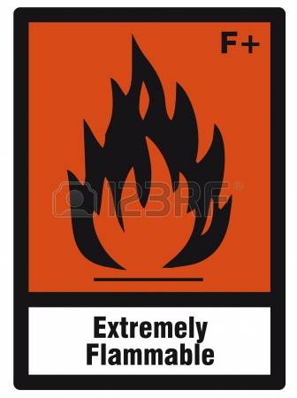
Dangerous Goods
Must not be carried by UAS unless there is equivalent safety to manned aircraft:
Fitted with fire detection and suppression systems.
Follow ICAO rules for safe packaging, transportation and notification of PIC.
Notification of authorities in case of incident or accident.

Slide 19
Ground Operations – Airport Layout
Consider impact of UAS operations at civilian aerodromes.
No special procedures requirement which would cause disruption to normal operations particularly in inclement weather.

Slide 20
Safety Management Systems
UAS operators should implement safety management systems in accordance with ICAO provisions and approved by the state of the operator.

Slide 21
CONCLUSION
UAS operation poses risks of collisions with manned aircraft in non segregated airspace.
Security threats to manned aviation, airports, power stations, etc.
Regulation required by ICAO and the Member States. Registration of UAS mandatory.
States must make efforts to confine non compliant drone operations to segregated airspace.
Impose penalties to unlawful operations in the vicinity of airports, power stations, non segregated airspace.

Slide 22
QUESTIONS?
THANK YOU!

