Slide 1

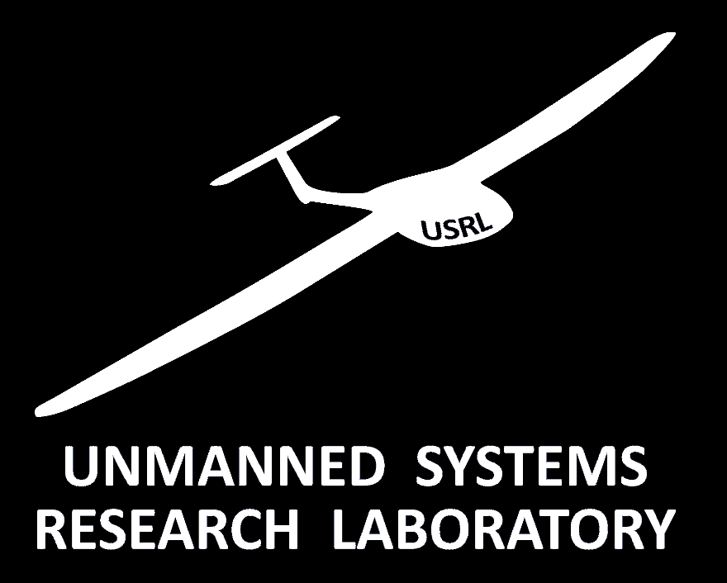
The Unmanned Systems Research Laboratory (USRL) of the Cyprus Institute:
Operation Experience with UAVs
C. Keleshis*, M. Argyrides, A. Apostolou,
P. Antoniou, P. Vouterakos, J. Sciare
SEVENTH INTERNATIONAL CONFERENCE
"The use of RPAS/drones and the impact on aviation safety and security / Challenges and Opportunities"
LARNACA, Cyprus - 21 OCTOBER 2016

Slide 2
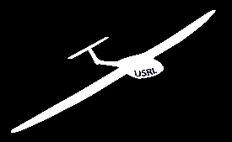
Outline
The facility USRL
  History
  Scope & Applications
  Personnel
  Infrastructure
    Laboratory & Permanent Runway / Airspace
    Fleet of UAVs
    Mobile GCS
Research Activities
  Air Pollution in Athens Campaign
  Aerosol-Cloud Interaction Campaign
  Routine Flights
USRL Operation
  Development of the UAVs
  Compliance with regulations
  Training
  Scheduled Operation
Feedback and Suggestions as UAV operators
Notes:
I will start my talk with a brief History of the facility, I will continue with its Scope & Applications, I will then introduce the Personnel of the USRL and I will go over the new developments on the Infrastructure which are…
I will continue with the recent Research Activities which were the….
I will finish up with the planned future work which involves Routine UAV flights for atmospheric measurements and the development of a UAV test & training facility in Cyprus.

Slide 3
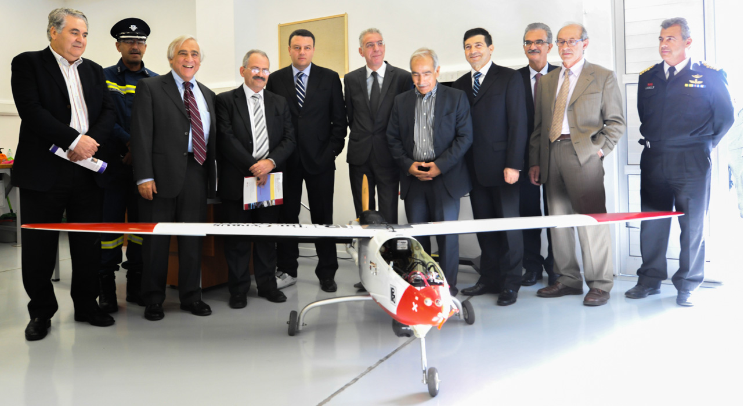
History
2009-2013
  Autonomous Flying Platforms for Atmospheric and Earth Surface Observations (APAESO)
  Co-financed by the European Development Fund and the Republic of Cyprus through the Cyprus Research Promotion Foundation: ΝΕΑ ΥΠΟΔΟΜΗ/ΝΕΚΥΠ/0308/09
November, 2013
  Inauguration of USRL (former Minister of Communications and Works of Cyprus, Mr. Tasos Mitsopoulos)

Slide 4
Scope
To become a sustainable facility under the Cyprus Institute (CyI) in order
  to provide high quality services to public and private organizations as well as to relevant research projects.
  to improve, develop & enhance current Unmanned Aerial Systems (UAS) capacities paying special attention to safety issues.

Slide 5
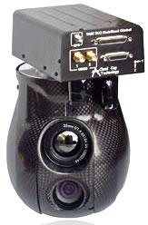
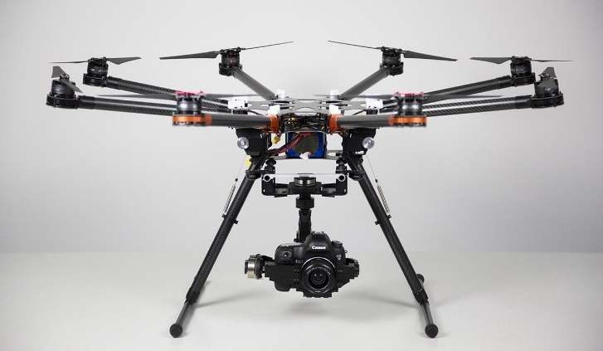
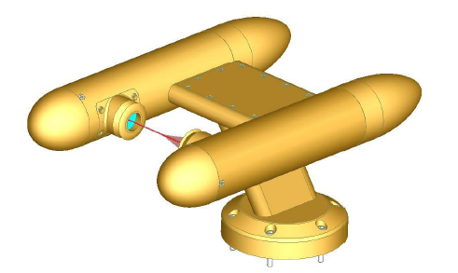
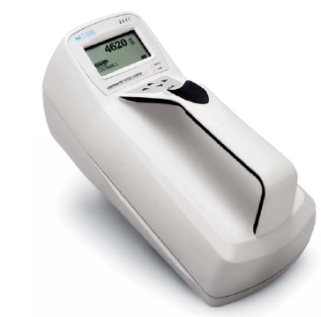
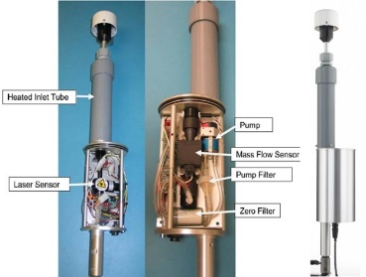
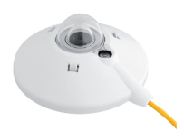
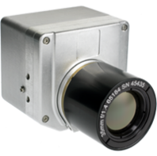

Applications - Capabilities
Atmosphere
Physical, chemical, and optical properties of aerosols
Atmospheric Dynamics
Earth Surface
3d reconstruction of Archaeological Sites
Dual-Use Surveilance
Surface Morphology
Vegetation and Land use patterns
Ocean Surface properties (biology, waves, currents, contaminant detection)

Slide 6
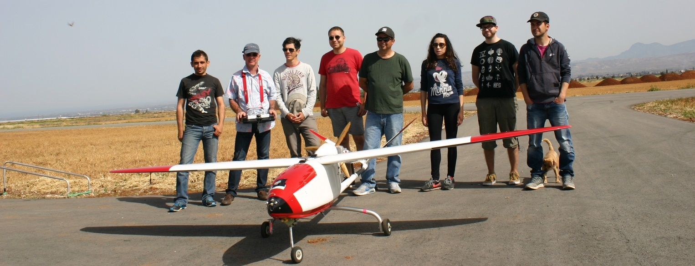
USRL Team
  Jean Sciare (Manager / EEWRC Director)
  Christos Keleshis (Associate Research Scientist, Electrical Engineer)
  Marios Argyrides (Chief Pilot)
  Apostolos Apostolou (Mechanical Engineer)
  Panayiotis Vouterakos (RC Developer, Pilot)
  Panagiota Antoniou (Electrical Engineer)
  Constantinos Savvides (Pilot)
  Michael Pikridas (Post Doctoral Fellow, Atmospheric Scientist)
  Kimmo Neitola (Post Doctoral Fellow, Atmospheric Scientist)
Notes:
They were some recent additions to the USRL team.
Since Fall of 2015 the new director of Energy, Environment and Water Research Center of the CyI Mr. Jean Sciare is the new USRL Manager. Christos Keleshis and the chief Pilot remain from the old members and we recently recruited….

Slide 7
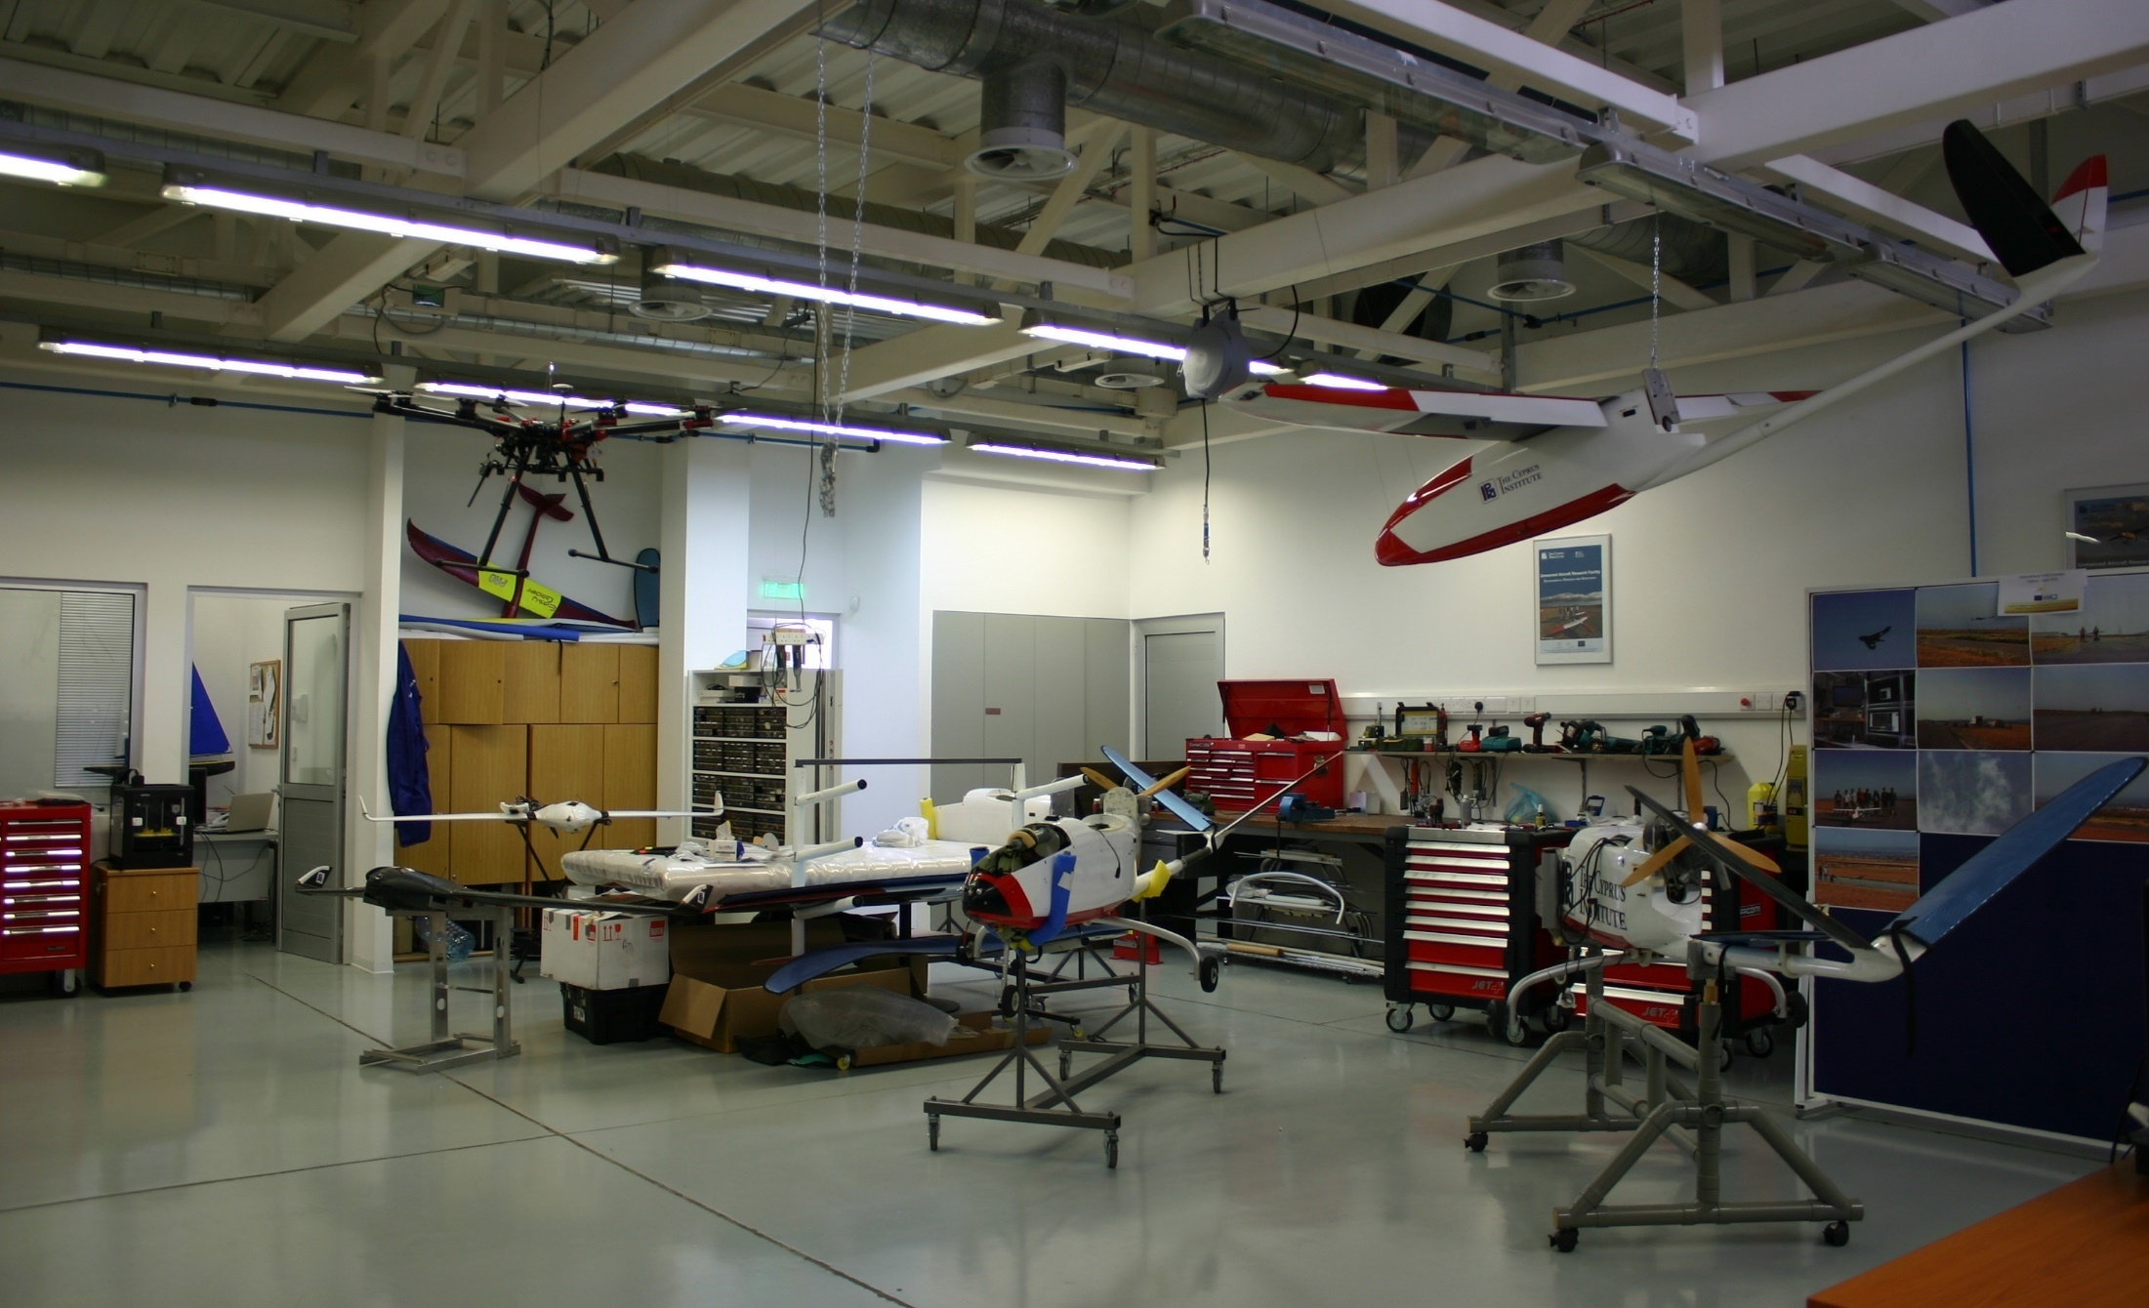
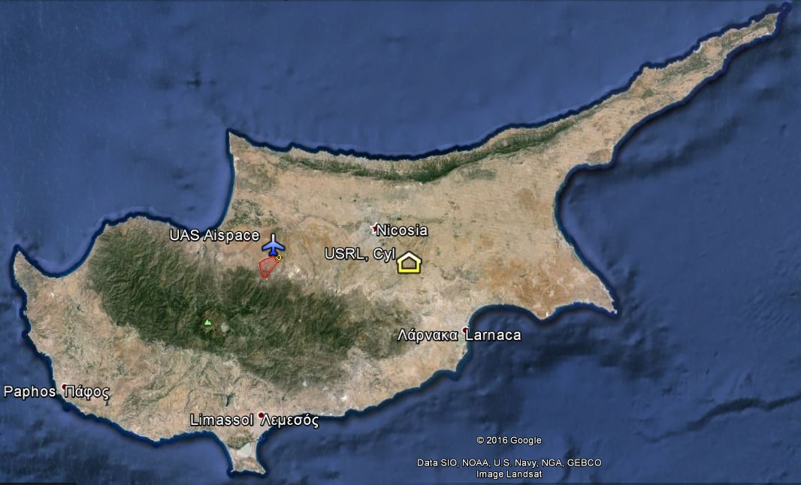
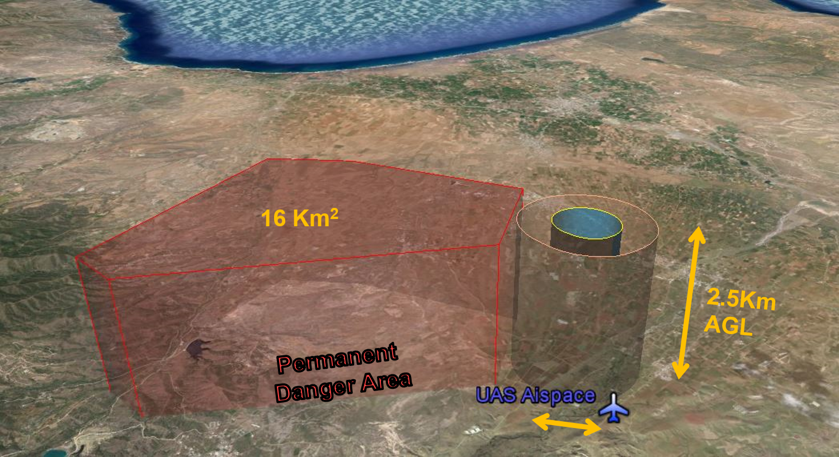
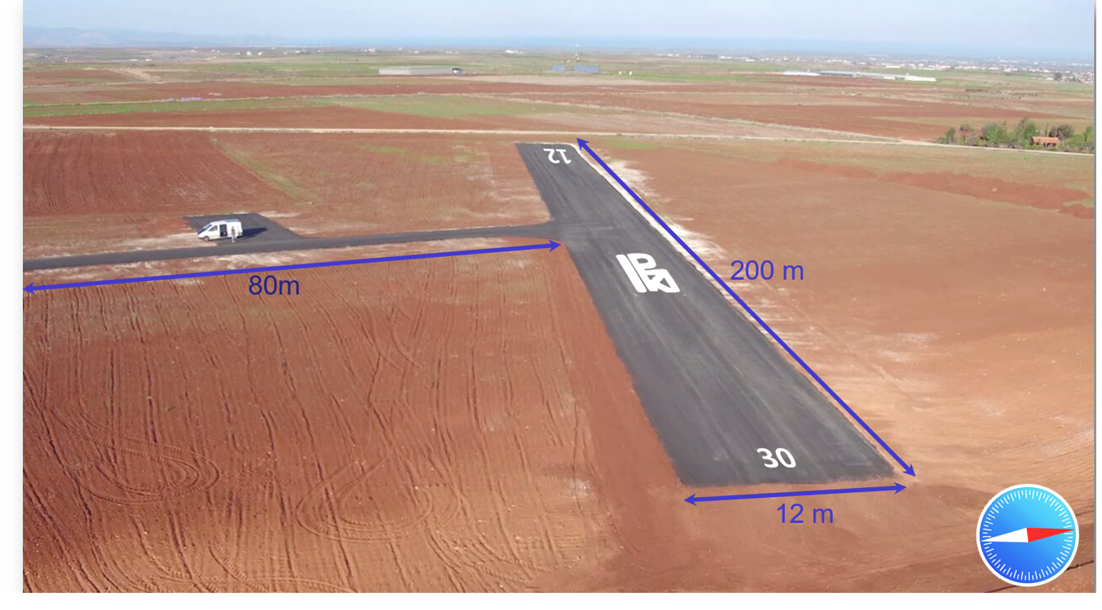
Infrastructure
  Private Runway (CyI)
  Flat Terrain Remote Area
  25 Km West of Nicosia
  Exclusive Overhead Airspace committed for CyI UAVs
  Located 4 Km from CyI ground-based Atmospheric
  Observatory (Agia Marina)
  100 m² Laboratory
  Equipped for unmanned systems research and development
Notes:
Most Recent infrastructure development is the runway in the UAS Airspace at Orounda
500m diameter

Slide 8
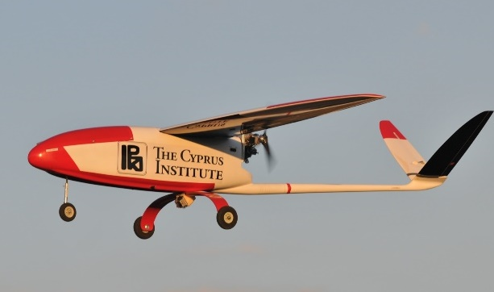
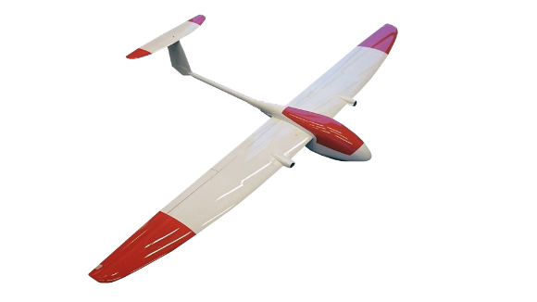
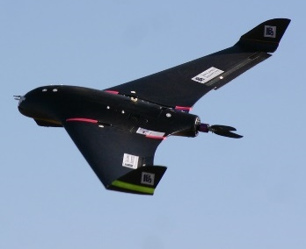
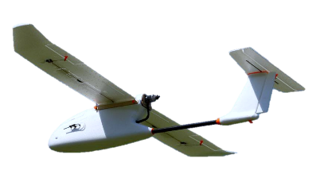
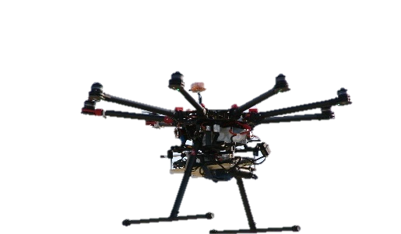
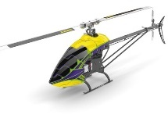
Fleet of Unmanned Aerial Vehicles (UAVs)
  Fixed wing
  4 UAVs
  1 UAV
  4 UAVs
  3 UAVs
Cruiser
Medium Size: 35 Kg
Payload: 12 Kg
Endurance: 4 hours
Ceiling: 4 Km
Mini Cruiser
Small Size: 11 Kg
Payload: 4.5 Kg
Endurance: 3 hours
Ceiling: 4 Km
Skywalker X8
Small Size: 5 Kg
Payload: 2 Kg
Endurance: 2 hours
Ceiling: 3 Km
Skywalker 1680
Small Size: 4 Kg
Payload: 1.5 Kg
Endurance: 1.5 hours
Ceiling: 3 Km
  Rotary Wing
Logo 800
Small Size: 12 Kg
Payload: 5 Kg
Endurance:~30 minutes
Ceiling: 3 Km
Dji S1000+
Small Size: 11Kg
Payload: 4 Kg
Endurance: ~20 minutes
Ceiling: 1 Km
  1 UAV
  1 UAV
Notes:
Το 2009 ξεκινήσαμε με 4 UAV που αποκτήθηκαν με κεφάλαια του προγράμματος υποδομής.
Από τότε, Ο στόλος των αεροσκαφών μας συνεχώς επεκτείνετε, και αυτή τη στιγμή έχουμε πάνω από 10 Μη Ε αεροσκάφη, 1 ΜηΕ ελικόπτερο και ένα Multicopter.
Το κάθε ΜηΕΣ έχει τα δικά του πλεονεκτήματα και μειονεκτήματα.
Πχ το ελικόπτερο μπορεί να φτάσει πολύ γρήγορα σε μια τοποθεσία ενδιαφέροντος, να παρατηρήσει από ένα σταθερό σημείο για λίγα λεπτά και ανεξάρτητα από τη κακοκαιρία. Σε αντίθεση, το αεροπλάνο πρέπει να κινείται συνέχεια και περιορίζετε από τη κακοκαιρία, αλλά ο χρόνος πτήσης του είναι κατά πολύ μεγαλύτερος από αυτόν του ελικοπτέρου.
Ανάλογα δηλαδή με τις απαιτήσεις της εκάστοτε έρευνας, χρησιμοποιούμε και το ανάλογο σύστημα.

Slide 9
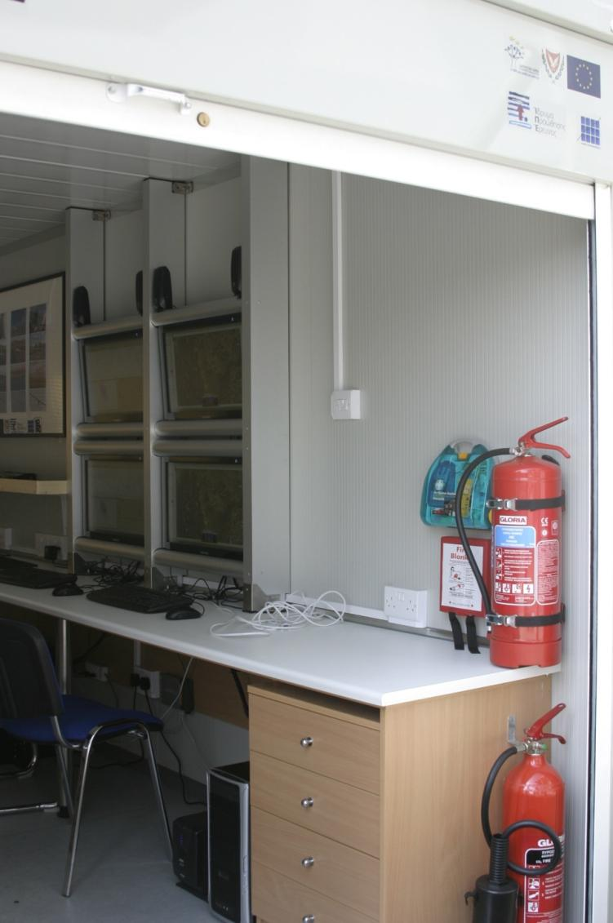
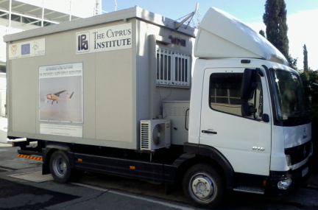
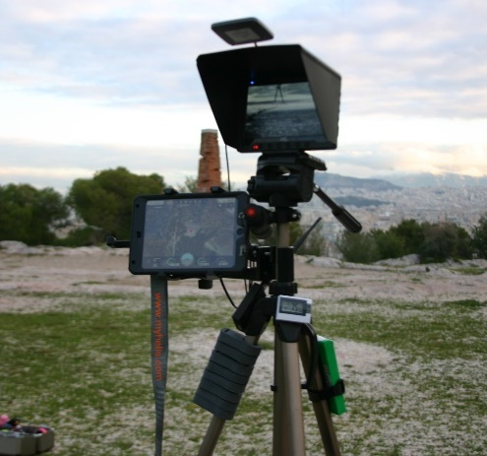
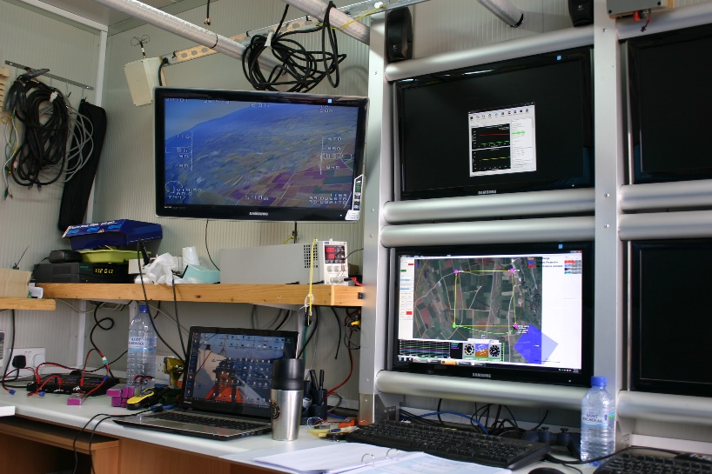
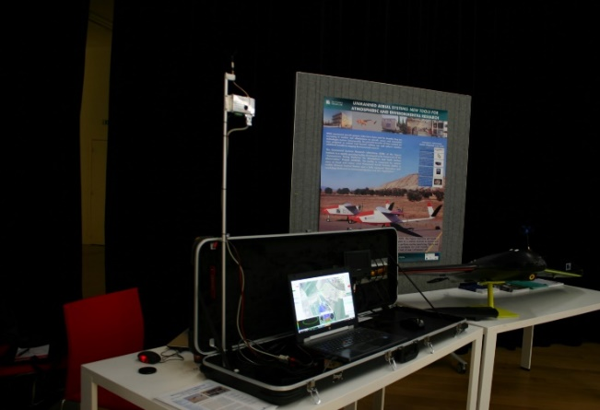
Mobile Ground Control Station (GCS)
Truck with GCS
GCS / Mobile Laboratory
Portable GCS
Monitoring & Control of
UAV, Payload, Camera

Slide 10
Outline
The facility USRL
  History
  Scope & Applications
  Personnel
  Infrastructure
    Laboratory & Permanent Runway / Airspace
    Fleet of UAVs
    Mobile GCS
Research Activities
  Air Pollution in Athens Campaign
  Aerosol-Cloud Interaction Campaign
  Routine Flights
USRL Operation
  Development of the UAVs
  Compliance with regulations
  Training
  Scheduled Operation
Feedback and Suggestions as UAV operators

Slide 11

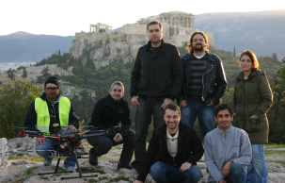

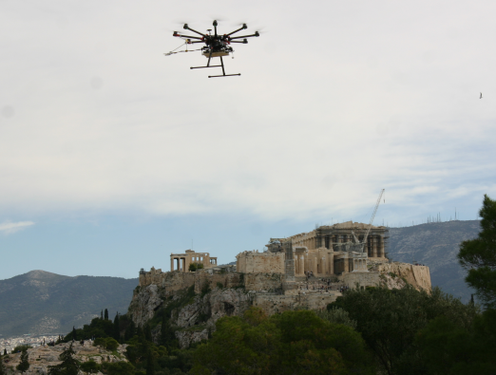
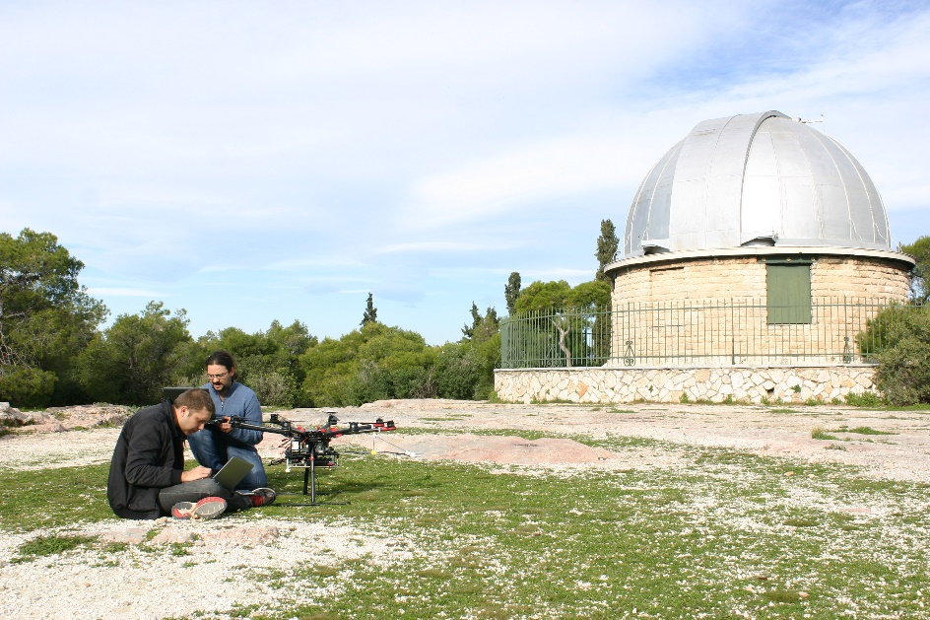
Air Pollution in Athens Campaign
EU-H2020-ACTRIS2
Athens, Greece, January 2016
Scope:
  Inter-comparison of commercial and prototype miniaturized Black Carbon (BC) sensors against standardized absorption instruments
  Evaluate their performance when airborne
Platform: Octocopter (MTOW 11Kg)
Total of 26 vertical profiles
10-15 minutes for each vertical profile!
Intensive Day Measurements
  1 vertical profile every 1 hour from dawn to dusk
Daily Vertical BC profiles above the city of Athens

Slide 12


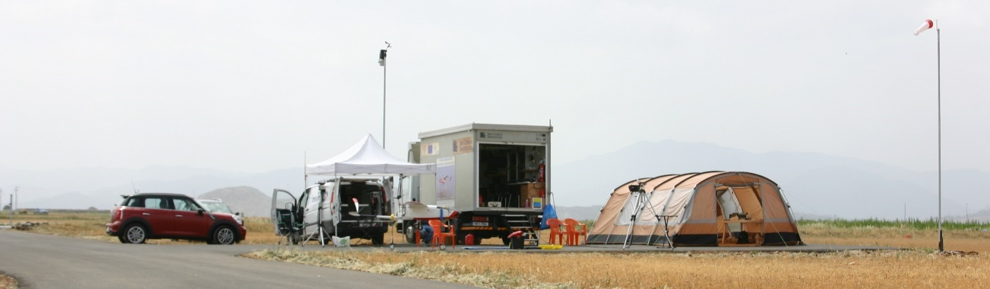
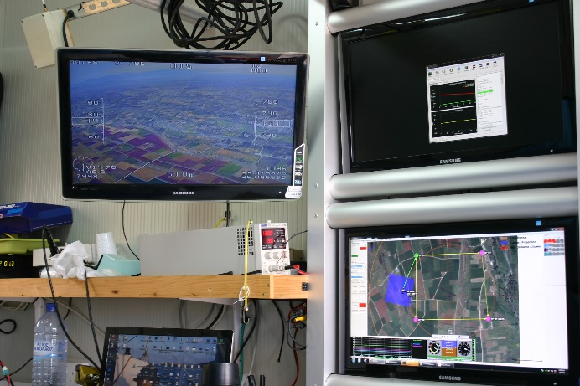
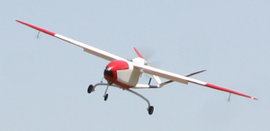
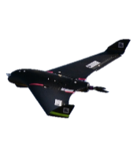
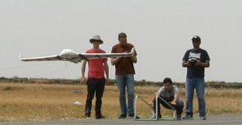
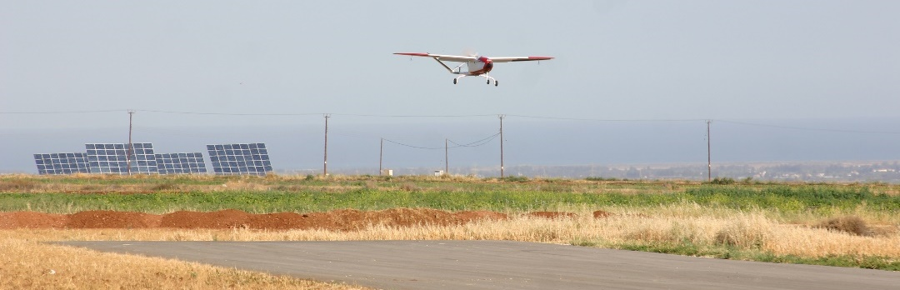
Aerosol-Cloud Interactions Campaign
Cyprus, April 2016
  EU-FP7-BACCHUS
  EU-H2020-ACTRIS2
Scope:
  Ice-Nuclei Properties
  Aerosol Optical Properties
Measurements:
  Ground Based
  Remote Sensing (Ground + Satellite)
  Aerial (UAV)
Aerial Platforms:
  Cruiser UAVs (35 Kg)
  Skywalker X8 UAVs (5 Kg)
The CyI private runway at Orounda

Slide 13
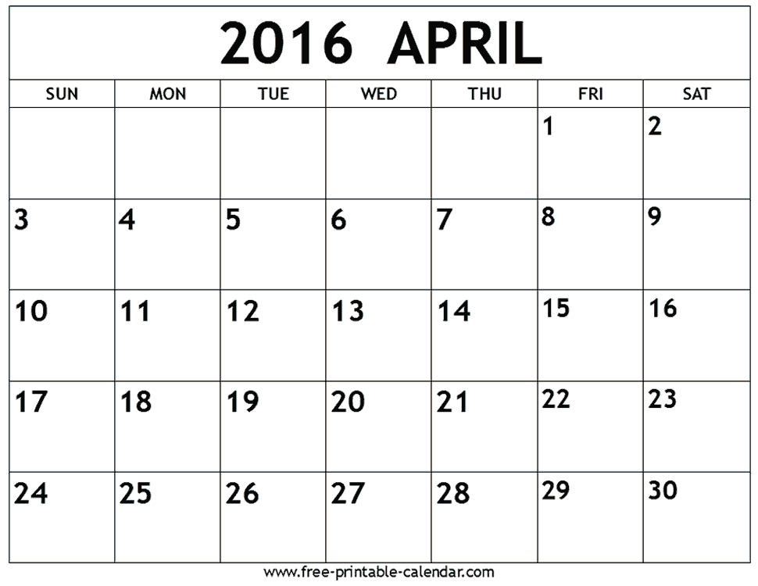

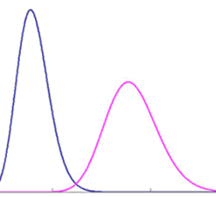





Cruiser Flights / TOTAL = 8
2
3
1
Skywalker Flights / TOTAL = 49
3
3
4
1
2
6
2
3
3
2
4
3
3
2
Black Carbon profile / TOTAL = 24
Aerosol size profile / TOTAL = 8
dust
X
# of IN samples / TOTAL = 47

Slide 14
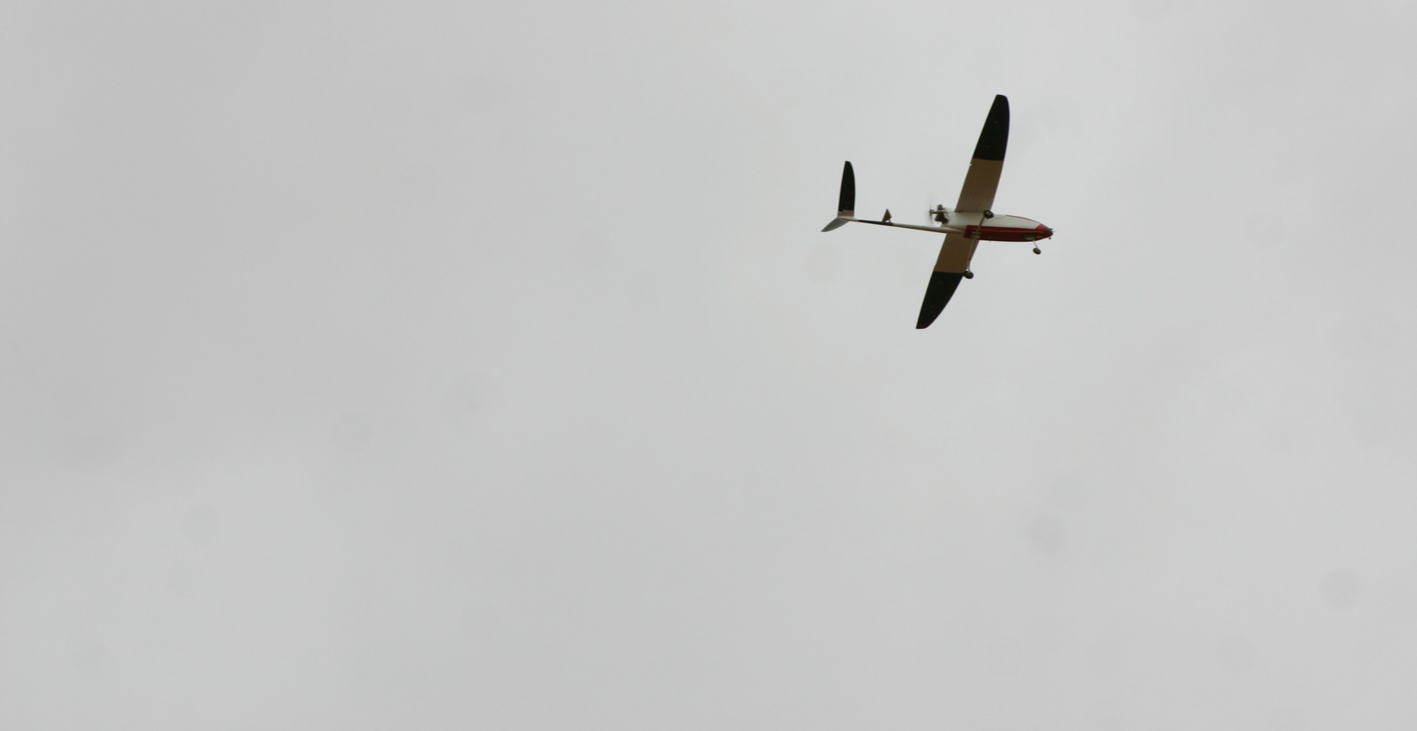


UAV routine monitoring activities
1-year routine (September 2016 – September 2017) observation of the vertical composition of the atmosphere with weekly UAV flights (Absorption, Size distribution, AOD, Ice Nuclei, etc) completing similar 1-year co-located (Cyprus) remote sensing observations (TROPOS)
Scientific motivations:
Build a unique atmospheric database in the Mediterranean with boundary layer and free tropospheric in-situ observations (seasonality,
Investigating the influence of boundary layer vs free troposphere on atmospheric processes
In-situ constrain of remote sensing (sunphotometer, lidar) retrieval algorithms of aerosol optical properties and IN parametrization
Demonstration of the added-value of UAV platforms in long-term routine observations of the atmosphere (ACTRIS ESFRI)
Notes:
Aerosol Optical Depth
1 day / week

Slide 15


Runway and Airspace transformation into a UAV test facility
Objective:
To further evolve the CyI runway and exclusive overhead airspace in order to serve as an international facility for UAV testing and training purposes.
Potential Uses:
Legally fly USRL UAVs for testing & scientific purposes
Attract various UAV groups (academic/industry) to test their UAVs. Currently, there are no other similar sites in the region of eastern Mediterranean.
Have a UAV training academy operating in the field
  Offer Courses (e.g. Safety Management System (SMS), CRM, aerial photogrammetry)

Slide 16
Outline
The facility USRL
  History
  Scope & Applications
  Personnel
  Infrastructure
    Laboratory & Permanent Runway / Airspace
    Fleet of UAVs
    Mobile GCS
Research Activities
  Air Pollution in Athens Campaign
  Aerosol-Cloud Interaction Campaign
  Routine Flights
USRL Operation
  Development of the UAVs
  Compliance with regulations
  Training
  Scheduled Operation
Feedback and Suggestions as UAV operators

Slide 17
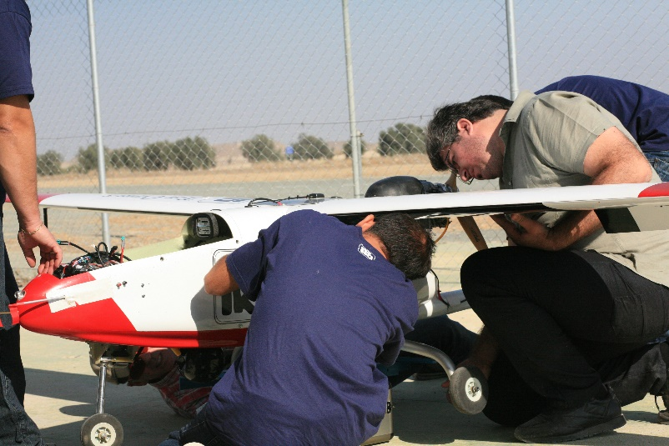
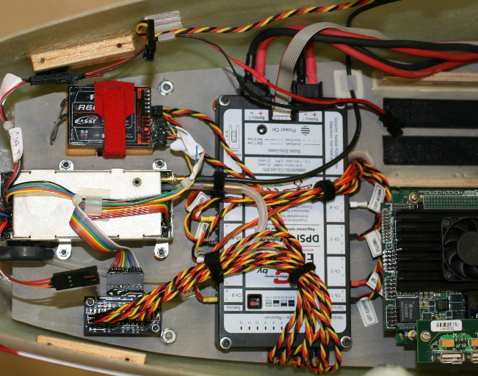
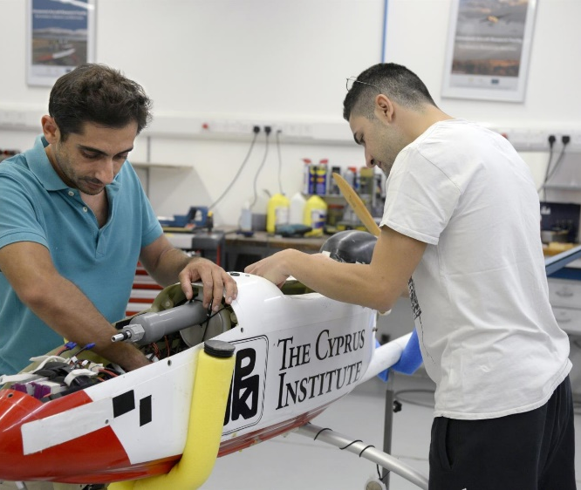
UAV Development
Always build according to manufacturer’s specifications
Trying to reach the highest possible level of redundancy and reliability.
Perform necessary tests and actions to eliminate interference
  Separate the avionics system from the instrumentation side.
  Perform required shielding
  Always retest when something is moved or changed
Extensive ground testing in order to confirm the serviceability of all systems.
Extensive flight testing to confirm the airworthiness of the platform.

Slide 18
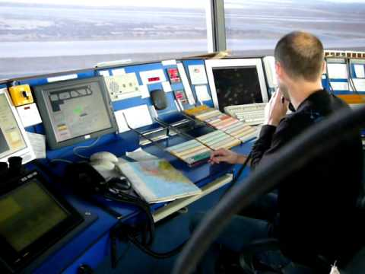
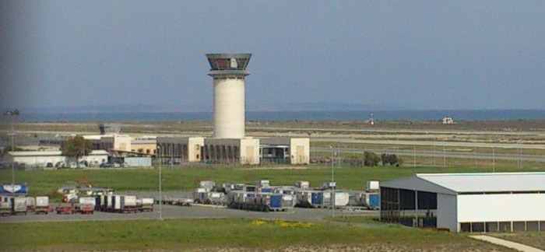
Compliance with Regulations
Started flying UAVs before the national regulations
  Consulted CAA and monitored UAV operations in other countries
Prepare all documentation to DCA for the issuing of CoA and registration.
Use Certified pilots preferably acting CPL/ATPL license holders to benefit from their safety culture (CAP722)
Perform all tests of preregistered aircrafts in an authorized segregated area
Inform the relevant authorities (CAA, ATC) for our activities
(or incidents if any)

Slide 19
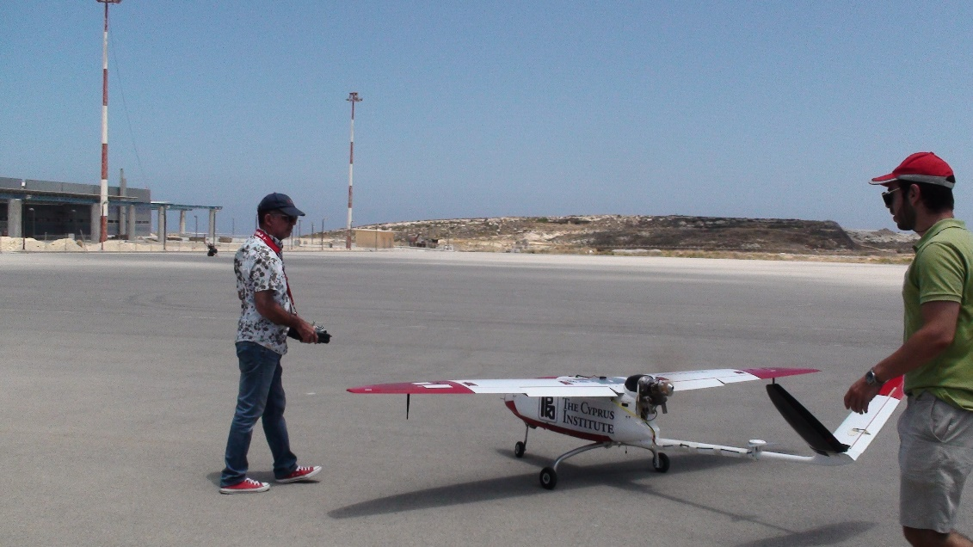
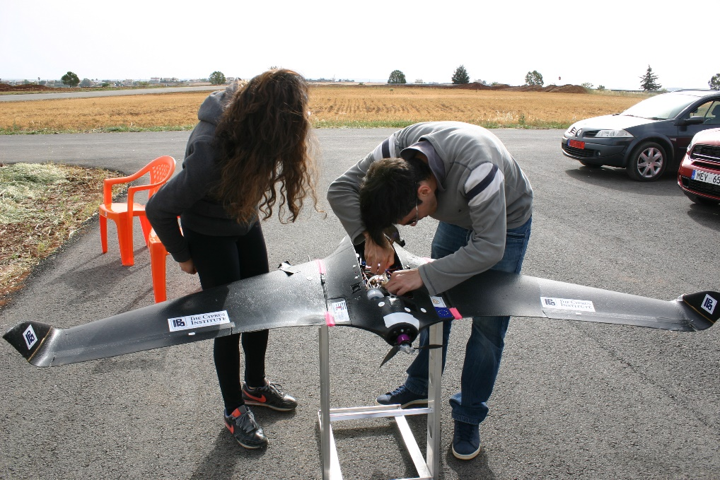
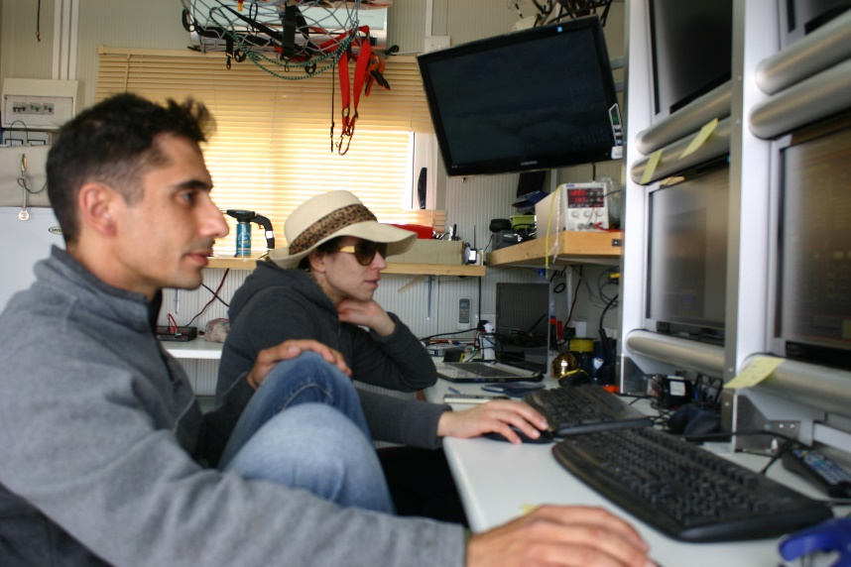
Training
Continuous development of the UAV team via training on:
Various UAV types/systems (maintenance and operation)
Communication (among the team / with the authorities)
Gathering and analysing information
Reporting system

Slide 20
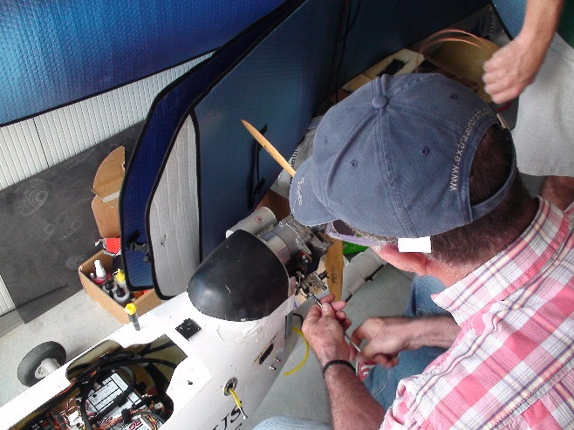
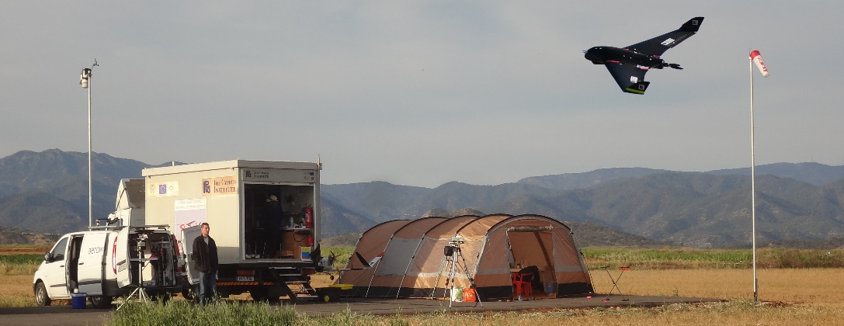
Scheduled Operation
Follow strictly the maintenance schedule and keep flight logs
Team briefing before every flight
Perform pre-flight checks according to the check-list
Confirm: Flight plans, Fuel and Electrical requirements
Re-evaluate Weather
Inform Relevant Authorities (LCA Control Tower) to get permission for take-off
After take-off and still on manual control the integrity of the UAV sensors/automation is confirmed by the GCS
  Otherwise discontinue the mission and land immediately (A full redundant control system allows pilot to overwrite all automatics and gain manual at any time)
The missions is monitored closely by the GCS operator and the pilot
Have always alternative escape routes and solutions on every flight phase. (i.e.: Take off, Climb, Cruise, Descent approach and landing).
SAFETY above all
  Return home if in any doubt the mission is not performed as planned. (Pilot’s decision)
Team-De-briefing upon completion of the flight
  Evaluation of the mission
  Identify room for improvement

Slide 21
Outline
The facility USRL
  History
  Scope & Applications
  Personnel
  Infrastructure
    Laboratory & Permanent Runway / Airspace
    Fleet of UAVs
    Mobile GCS
Research Activities
  Air Pollution in Athens Campaign
  Aerosol-Cloud Interaction Campaign
  Routine Flights
USRL Operation
  Development of the UAVs
  Compliance with regulations
  Training
  Scheduled Operation
Feedback and Suggestions as UAV operators

Slide 22
Feedback & Suggestions as UAV operators
Ensure that sufficient skilled and trained resources are available to implement safety strategy and policy. Use the highest level of piloting skills
Develop and embed a safety culture to the whole team including end users
Clearly define to all UAV team members their responsibilities for the development and delivery of safety strategy and performance
Comply with, and whenever possible exceed legislative and regulatory requirements and standards
Ensure all staff are provided with essential safety information and training
Continually improve the safety performance
Conduct safety and management reviews and ensure that relevant actions are taken
Do not forget the golden rule in autopilot assisted flights: when in doubt disconnect automatics and revert to manual flight!
  In all cases manual-control must have the highest priority (must by autopilot manufacturers)
  Despite the huge technological advances in automation of flights we are not ready yet to eliminate the human decision
Fly safe, be legal!
Notes:
Finally I would like to finish up with giving you our feedback as UAV operators

Slide 23
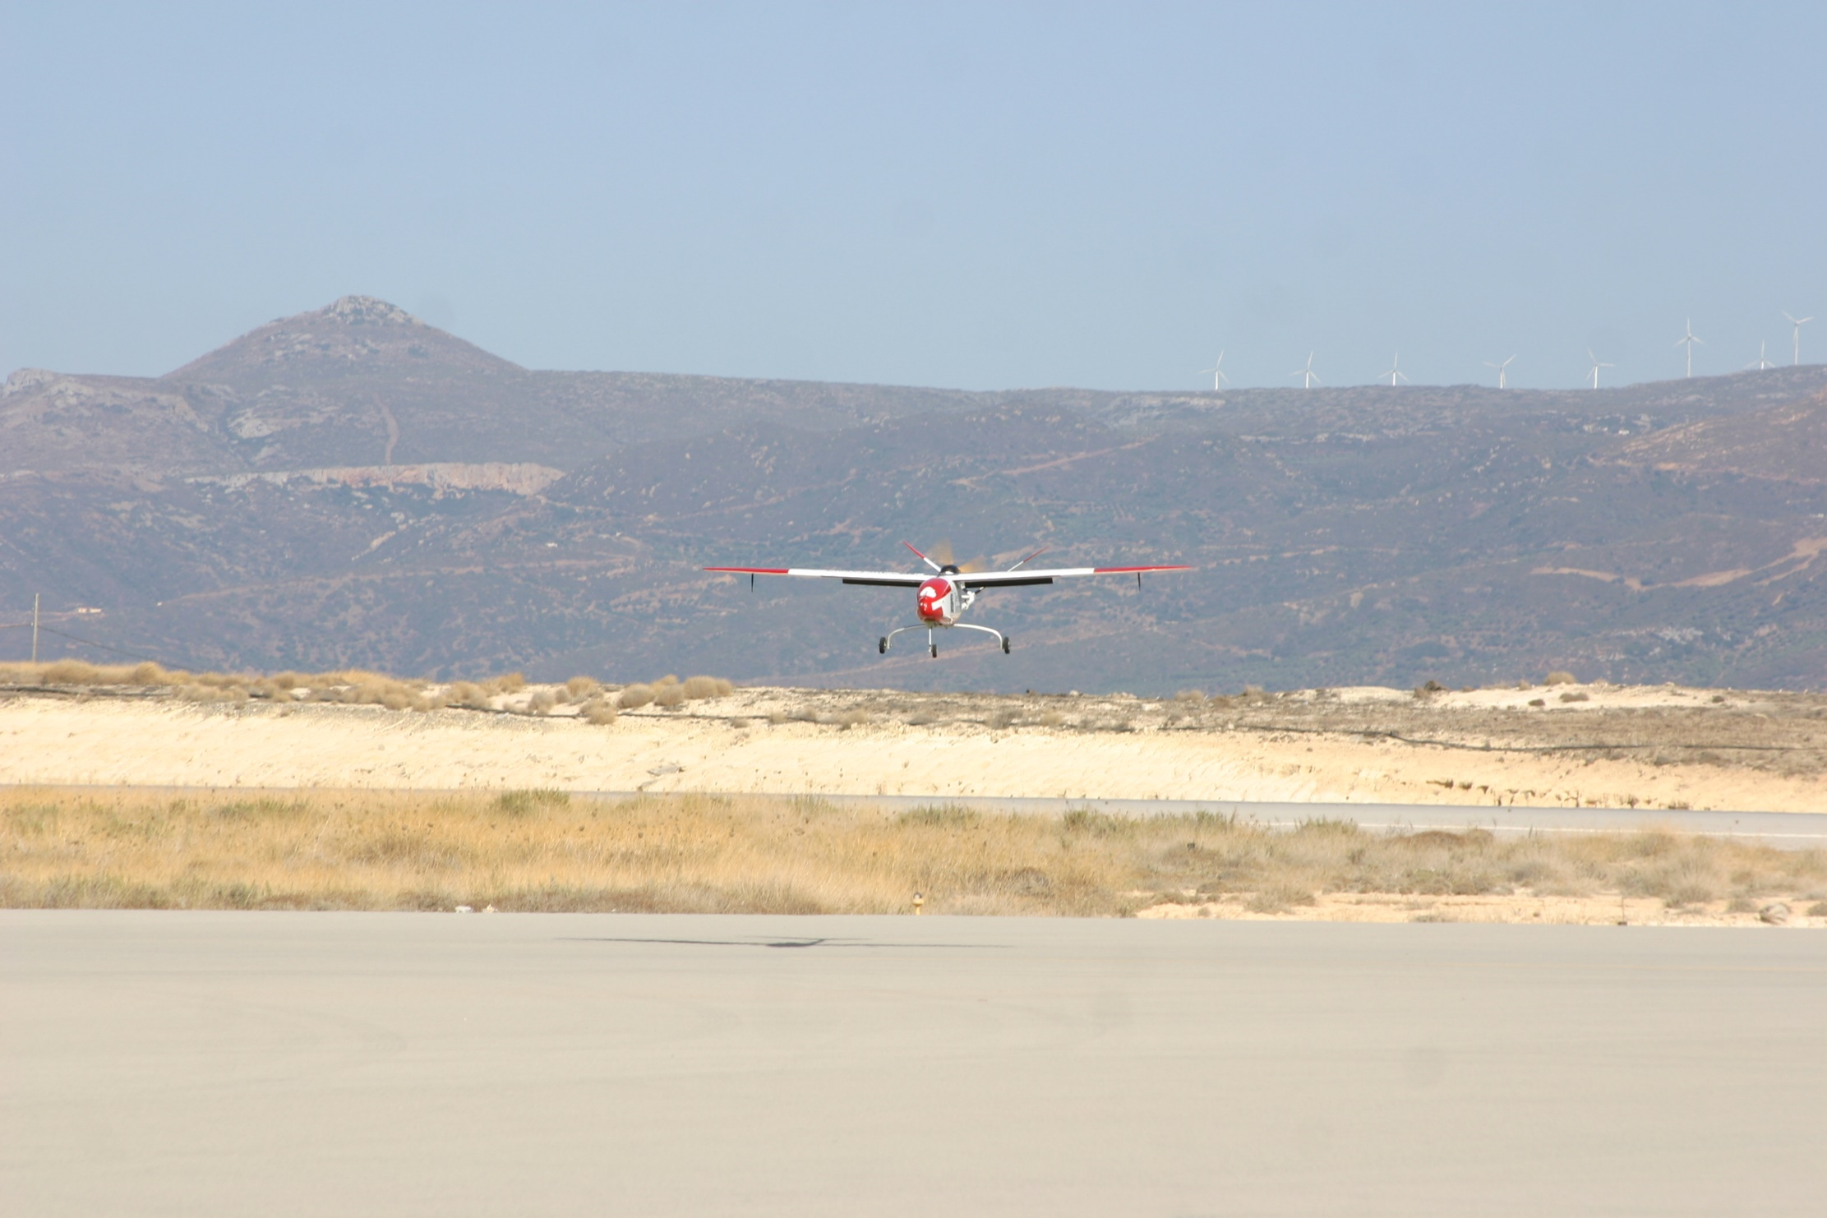
Thank you !
Contacts:
Christos KELESHIS
The Cyprus Institute
keleshis@cyi.ac.cy
+357 22 208 659
www.cyi.ac.cy
Marios ARGYRIDES
The Cyprus Institute
m.argyrides@cyi.ac.cy
+357 22 208 710
www.cyi.ac.cy
Jean SCIARE
The Cyprus Institute
j.sciare@cyi.ac.cy
+357 22 208 675
www.cyi.ac.cy

