Slide 1
How Completely and Similarly Do Safety Authorities Address Hazards Posed by drone Operations?
Anastasios Plioutsias (Technical University of Athens, GR)
Dr. Nektarios Karanikas (Amsterdam University of Applied Sciences, NL)
Dr. Maria Mikela Chatzimichailidou (University of Cambridge, UK)
FSF-MED 7th International Conference, 21 October, Larnaca, Cyprus.

Slide 2
Some figures (proximally)
Commercial Aviation
21.000 aircraft
34 million departures annually
3.5 billion miles flown annually
92 accidents / 474 fatalities (2015)
General Aviation (2014)
About 365.000 aircraft
? departures
42 million flight hours annually
x 50 more accidents than commercial aviation (EASA, FAA)
Drone market
700.000 - 1.200.000 drones sold worldwide only in 2015
? departures, miles, hours
37 accidents, 584 occurrences only in EU in 2015.

Slide 3
How much is aviation regulated
Commercial aviation:
Fully standardized for airworthiness, air operations, staff qualifications, air navigation, aerodromes, airspace control, control & management across all levels (e.g., from pilots to authorities) etc.
General aviation:
Mostly standardized for airworthiness and aircrew qualifications
Less strictly regulated for air navigation, aerodromes, control & management
Drone flights regulations:
Focus mainly on the end-user, who is frequently the only responsible for a safe flight.
Lack of reference to the role and responsibilities of the manufacturers and authorities.
No universally accepted risk assessment framework.
2.8 / million dep
140 / million dep
??? / million dep

Slide 4
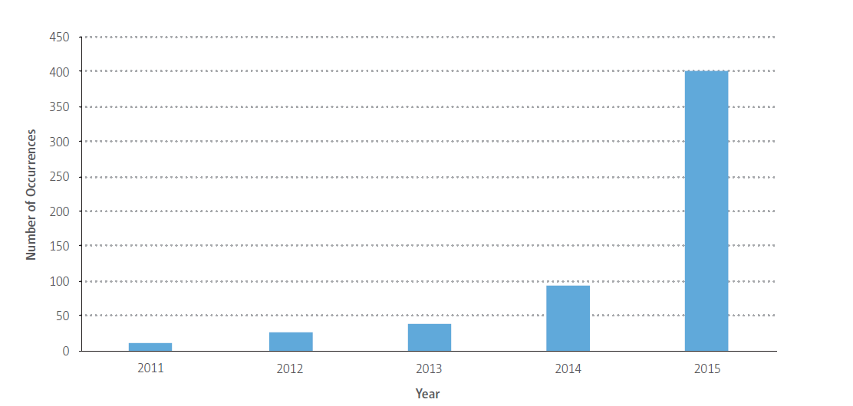
Drone EU occurrences 2011-2015
Are we ready to tackle this rapid increase?

Slide 5
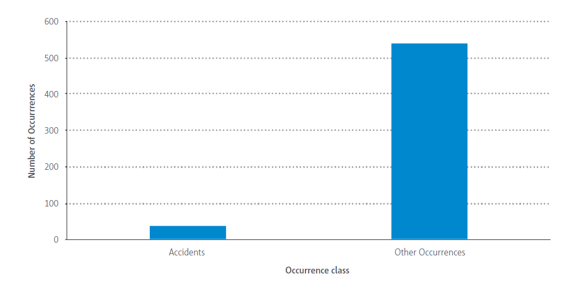
Drones and Occurrence classes 2011-2015
Does this mean than the end-user controlled the situation and saved it?

Slide 6
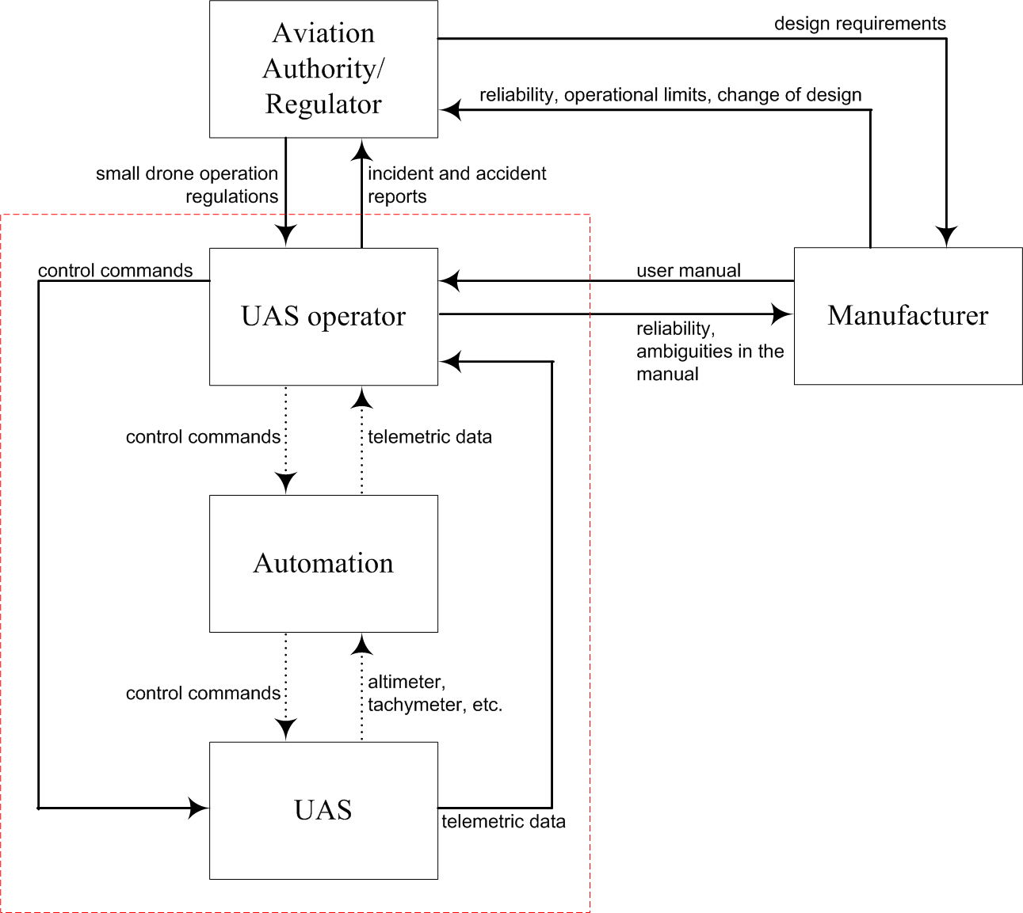
A systemic view

Slide 7
Research method
Application of the System Theoretic Process Analysis (STPA) method (Leveson, 2011) on a small drone system.
Generation of:
28 hazardous states
24 causal factors
67 safety requirements across: authority, manufacturer, end-user and automation.
Assignment of type of responsibility for each requirement/actor: Regulate, Document, Define, Act, Informed, Support
Gap analysis and statistical comparison amongst regulatory frameworks from 56 countries.

Slide 8
Results: Regulations’ analysis
Minimum value: 5.3%, Maximum value 66.7%

Slide 9
Results: regulations’ comparison
0.436 (24)
0.534 (2)
0.442 (14)
0.391 (2)
0.442 (12)
0.506 (2)
OVERALL AGREEMENT: 0.432

Slide 10
Results: regulations’ comparison
Things are even “worse” in terms of diversity and complexity:
Req: Operator shall maintain continuous visual contact with drone during flight.
All 56 authorities dictate so.
33 States have no value for the distance between end-user and drone. Some require extra attention to weather conditions, obstacles, drone capabilities etc.
11 States allow a maximum distance between 100m to 5.5Km. One of those States express the distance in Ft and another in Miles.
Highly different requirements about:
Skills and competencies of the operator
Flight area boundaries
Separation from other flying objects

Slide 11
Conclusions
A common regulatory framework based on a systemic and systematic risk analysis is missing.
Current regulations assign the end-user almost as the only responsible for observing rules and limits.
Existing regulations meet the requirements of the authority level at extremely low to moderate levels.
Regulations across States are highly different amongst them, even when they address the same requirement.
The high differentiation of rules across countries might confuse users and affect the market.

Slide 12
Recommendations
A common regulatory framework based on systemic and systematic risk analysis is needed to avoid impeding drone market growth.
Such a framework must clearly state the roles, responsibilities and interdependencies of the main system controllers, namely authorities, manufacturers and end-users.
States might adopt a customizable and flexible regulatory framework which will:
Classify drones depending on how risk control is distributed between the operator and the automated functions of drones.
Based on the classification above, define the set and boundary values of certification, training, maintenance etc. requirements

Slide 13
How Completely and Similarly Do Safety Authorities Address Hazards Posed by drone Operations?
Anastasios Plioutsias (National Technical University of Athens, GR)
Dr. Nektarios Karanikas (Amsterdam University of Applied Sciences, NL)
Dr. Maria Mikela Chatzimichailidou (University of Cambridge, UK)
Questions?
FSF-MED 7th International Conference, 21 October, Larnaca, Cyprus.

