Slide 1
IDS Unmanned Traffic Management (UTM) Platform
Marcello Davide Mannino
Corporate Sales & Marketing Director
Aeronautical AIM/AIS Systems and EM Analysis Solutions for Civil and Military Agencies
IDS Ingegneria Dei Sistemi S.p.A
Roma Branch Office: Via Flaminia, 1068 - 00189
ROMA - Italy -
Phone: +39 06 33217452
Mobile : +39 3351359236–
e-mail: m.mannino@idscorporation.com
Valerio Paciucci
Air Navigation Division/Engineering Department
System Engineer
IDS Ingegneria Dei Sistemi S.p.A.
Rome Branch Office: Via Flaminia, 1068, 00189
Roma - Italy
Tel: +39 06 33217410
Mobile: +39 3456 817311
Fax: +39 06 33217402
e-mail: v.paciucci@idscorporation.com

Slide 2
VLL - Very Low Level Operations
UTM Vision
IDS UTM platform capabilities
Introduction
Regulatory Environment VLOS →BVLOS
Implementation Roadmap

Slide 3

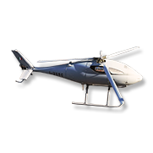
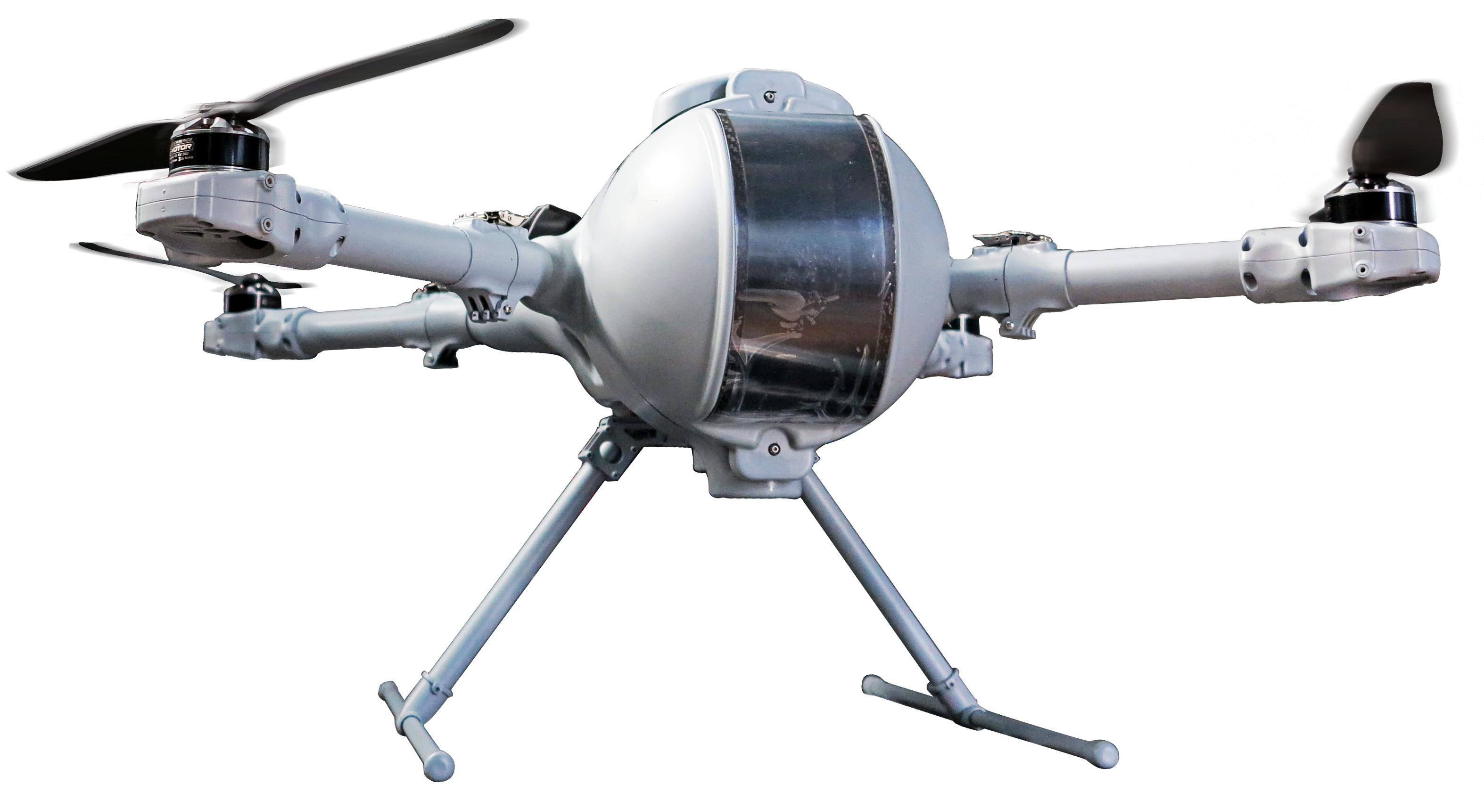
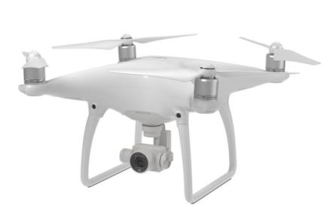

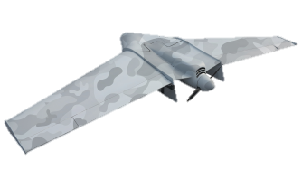
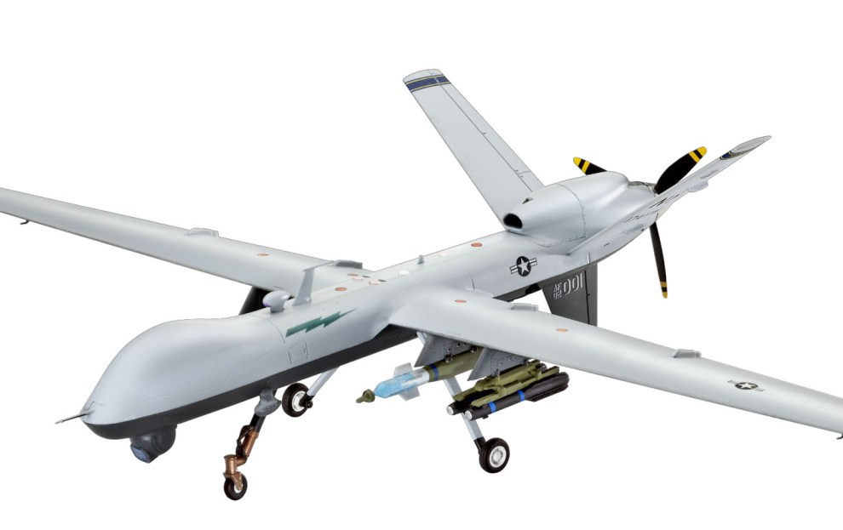
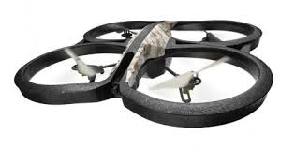
IDS UTM platform - the mission:
to allow the safe and efficient integration of UAS into low altitude airspace
to act as a enabler for the implementation of enhanced, more profitable operations (e.g. : BVLOS operations)
Civil VLL - Very Low Level Operations
(up to 500ft AGL, with some exemptions)
sUAS – small Unmanned Aerial Systems (<25Kg)

Slide 4
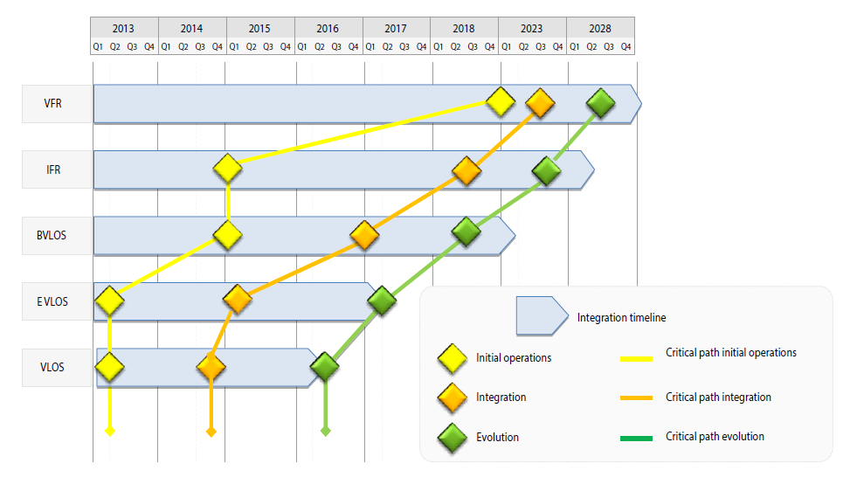
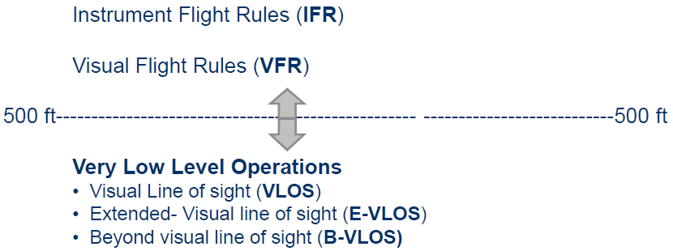
Civil UAS Classification: Type of operation criteria
The European RPAS Steering Group, on behalf of the European Commission, splits operations involving civil drones into two main categories:
Very low level (VLL): VLL operations with civil drones take place below the normal minimum altitude for manned aviation of 150 m.
VFR or IFR: Operations in airspaces above the normal minimum altitude for manned aviation.
RLOS
BRLOS

Slide 5
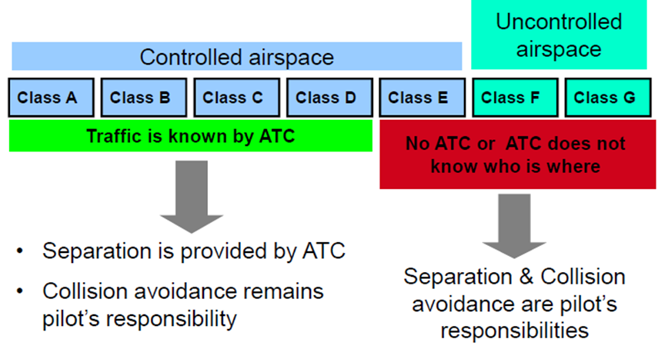
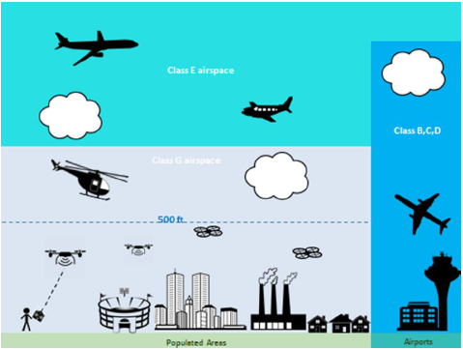
UAS VLL Operations (below 150 meters)
The airspace below 500ft/150m is used by many air vehicles
Uncontrolled (e.g. Class G) and controlled airspace (e.g. CTR)
Small UAS VLL operations raise safety/security/privacy concerns
New challenges: persistent CNS coverage, detect and Track, separation management and collision avoidance between UAS, UAS and manned vehicles, natural obstacles and buildings.
For several applications UAS Operators need to fly at higher altitudes (e.g. 2000ft AGL)
Integration of UAS operations in VLL airspace and traffic management requires a completely new approach to ensure safe operations

Slide 6
VLL UAS Regulatory Environment
The majority of authorized civil UAS operations are being performed under visual line of sight (VLOS).
Most of existing and new emerging civil UAS applications can be served by UAS with MTOW < 25 Kg (sUAS - small UAS)
sUAS are the main focus in many countries.
Very few countries all around the world have some level of regulation in place for Beyond Visual Line of Sight (BVLOS) operations.
The increasing demand for BVLOS operations (mostly commercial) makes the definition of enablers (technical and regulatory) necessary

Slide 7
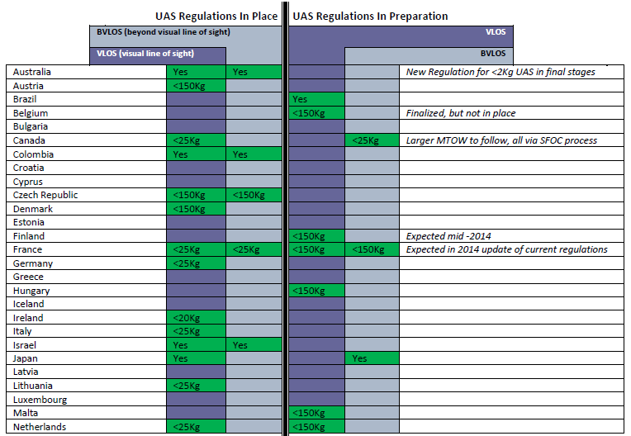
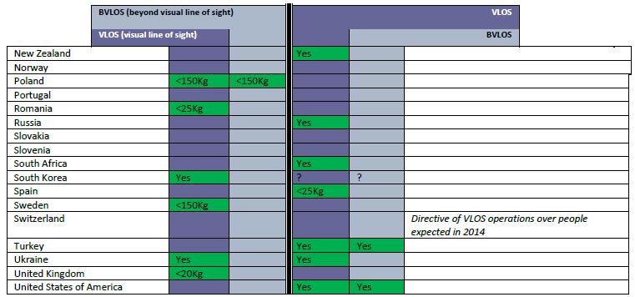
SUMMARY OF UAS REGULATIONS BY COUNTRY
(CANADIAN CIVIL UAS 2015, “Canadian Market Opportunities for UAS: Non-Military Applications” )

Slide 8
BVLOS and improved airspace access
While the 25kg VLOS regulation has served the market well to date, the establishment of BVLOS regulations or best practices is now required to allow the sector to continue its growth.
Several civil UAS applications require the ability to operate at longer distances over specific areas or targets of interest in order to be cost-effective and practical.
Many additional commercial UAS applications await BVLOS capability to become practical businesses.
Some enabling technological solutions exists (geofencing and return-to-base programming) but there is little to no access available for civil commercial beyond visual line of sight (BVLOS) UAS operations
The main enabler for a full integration of UAS in the airspace, D&A systems, lack of standards & requirements

Slide 9

EASA A-NPA 2015-10: “Introduction of a regulatory framework for the operation of drones”
The current Scope of EU Basic Regulation is limited to drones with an MTOM above 150 kg. This means:
the vast majority of UAS development today is regulated by national aviation legislation
legislation is not harmonized and there is no obligation on mutual recognition
  the current legislation in EU is based on the assumption that small drones are operating locally
EASA A-NPA 2015-10: “Introduction of a regulatory framework for the operation of drones”
This regulatory framework proposes that all drones be regulated at EU level !

Slide 10
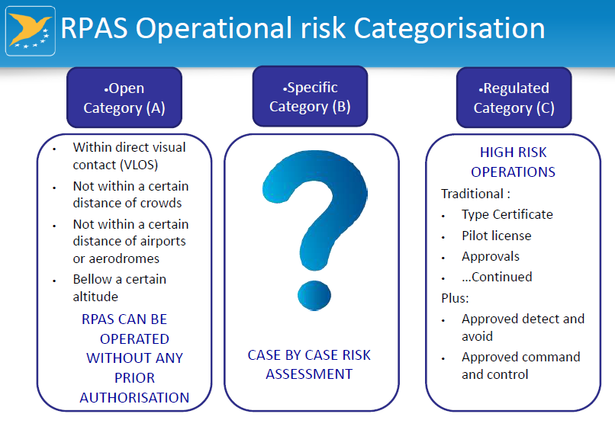

Slide 11
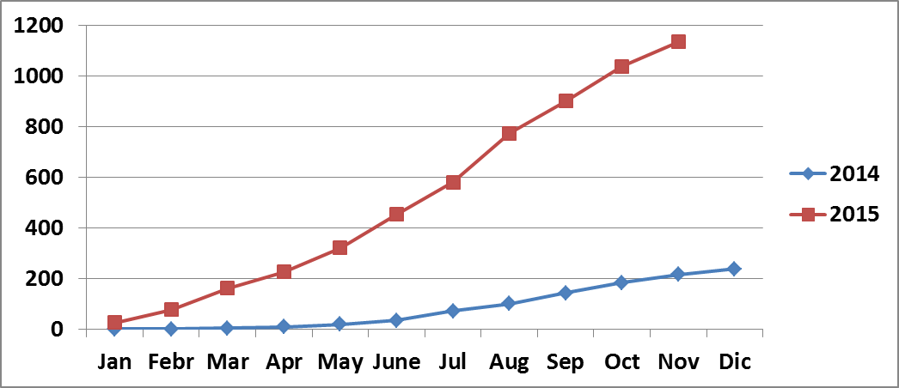

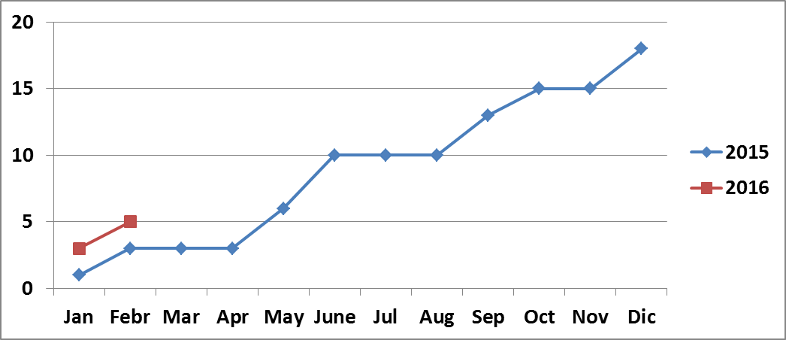
UAS sighting reports
USA (FAA)
Italy
2015
18 reports: UAS interfering with manned traffic close to airports/approach path
12 airports
2016 (January- February)
5 incident reports:
4 Airports

Slide 12

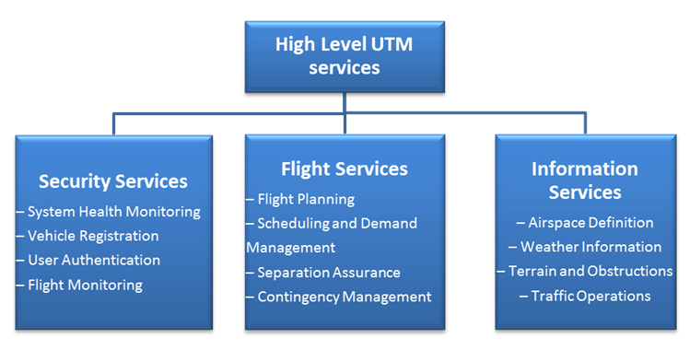
UTM NASA Vision
The development of a new UTM infrastructure is becoming an urgent task, primarily because of the need to manage critical safety aspects arising from compatibility between manned and unmanned aircraft.
UAS Traffic Management: a system concept for the management and tracking of small UAS traffic in low altitude airspace.
The shape, content, role and components of the UTM are under definition

Slide 13
UTM Challenges
low altitude CNS, tracking and surveillance
Number of aerial vehicles
UTM operator: role, responsibilities, procedures
different performance characteristics of UAS vehicles, mission needs, and suitability to wind and weather conditions; acceptable and hazardous wind and weather conditions
terrain & obstacle data sources, real time and predictions meteorological data
separation standards, separation management alternatives, determination of separation minima in the vertical and horizontal directions
Maturity of technological enablers for BVLOS and autonomous operations

Slide 14
NASA Implementation and demonstration of UTM capabilities
BUILD 1 (2015)
• Reservation of airspace volume
• Over unpopulated land or water
• Minimal general aviation traffic in area
• Contingencies handled by UAS pilot
• Enable agriculture, firefighting,
infrastructure monitoring
BUILD 3 (2018)
• Beyond visual line-of-sight
• Over moderately populated land
• Some interaction with manned aircraft
• Tracking, V2V, V2UTM and internet
connected
• Public safety, limited package delivery
BUILD 2 (2016)
• Beyond visual line-of-sight
• Tracking and low density operations
• Sparsely populated areas
• Procedures and “rules-of-the road”
• Longer range applications
BUILD 4 (2019)
• Beyond visual line-of-sight
• Urban environments, higher density
• Autonomous V2V, internet connected
• Large-scale contingencies mitigation
• News gathering, deliveries, personal use

Slide 15
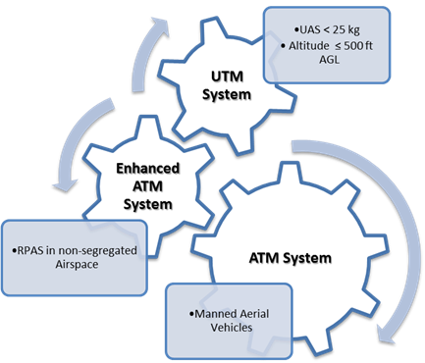
UTM IDS vision
ATM community is highly conservative and safety-focused
UAS community is highly innovative and business driver
Need of a balance between safety and innovation
Technical solution able to conciliate safety constraints coming from ATM domain and requirements and challenges of drone industry, reaching the right balance between safety and innovation.
Implementation of basic operational capabilities and services
R&D developments for innovative services and applications

Slide 16

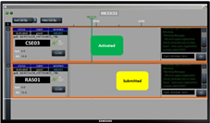
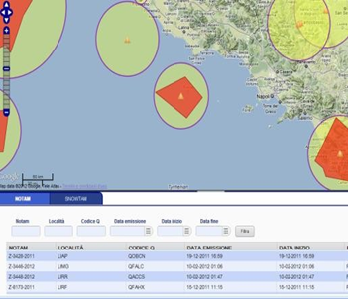
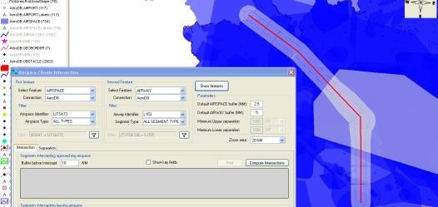
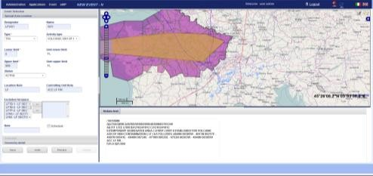
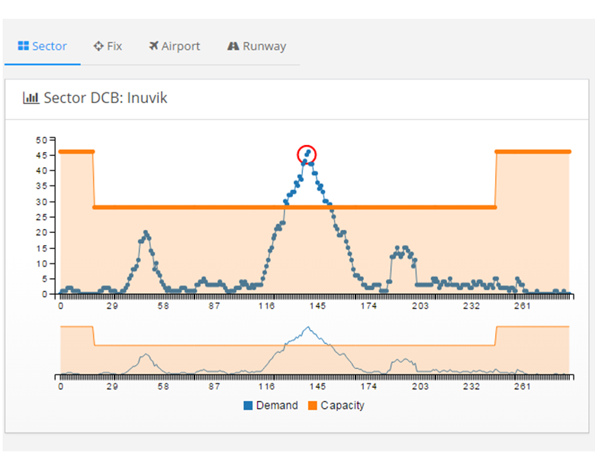


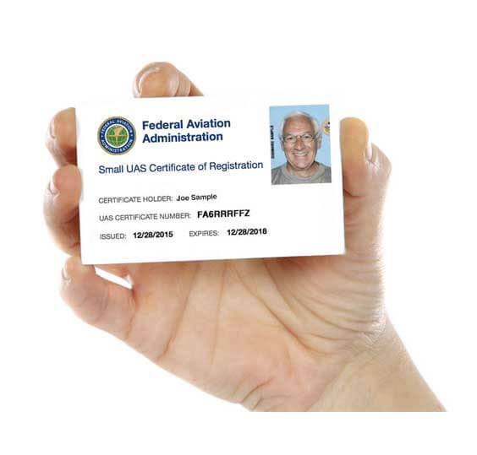
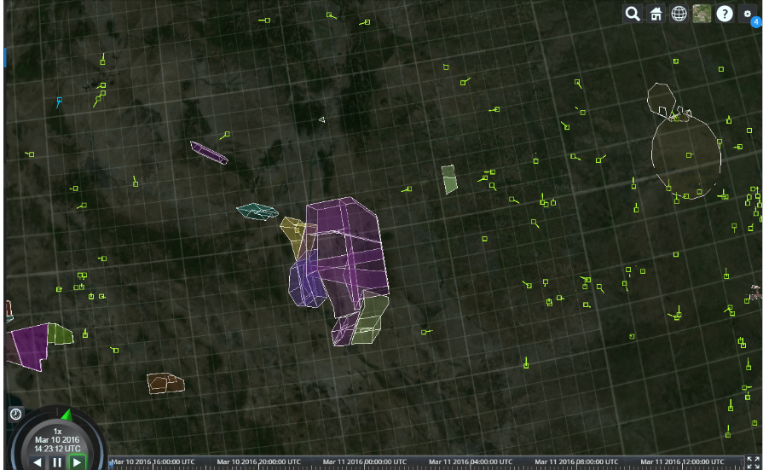
Flight plan definition, and validation
Flight Scheduling
Situation awareness, UAS tracking & alert generation
Airspace reservation, and No fly zone creation
Airspace occupancy prediction & DCB
Step 0
Vehicle Registration & identification, UAS Operators
Web-Services
Recording, playback and investigation
Data
Management
Accurate & reliable static & dynamic data
Data Acquisition Services
Communication via cellular network and/or ADS-B
Up to date HR terrain & obstacle data
CNS infrastructure
Population density areas
MET Data
NOTAM
AMHS/AFTN
Airspace & No fly zones

Slide 17
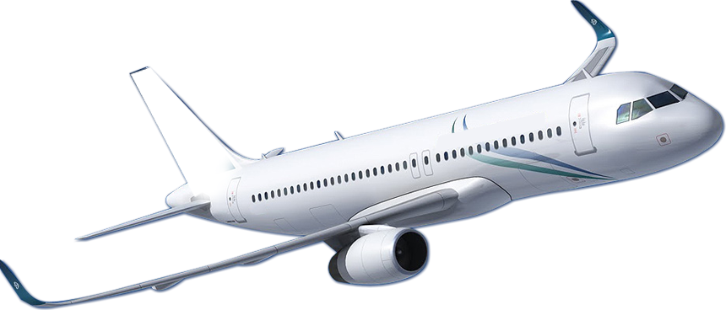
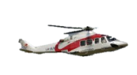


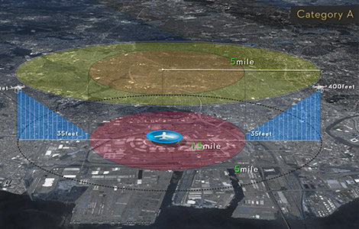
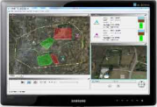
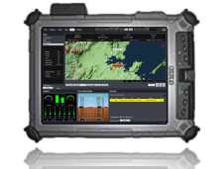
CAA
Law Enforcement
IDS UTM Platform
HEMS – S&R
ATC & Airport Authority
Local Authority
Other special users
UAS Segment: UAS Operators/Pilots/Owners

Slide 18
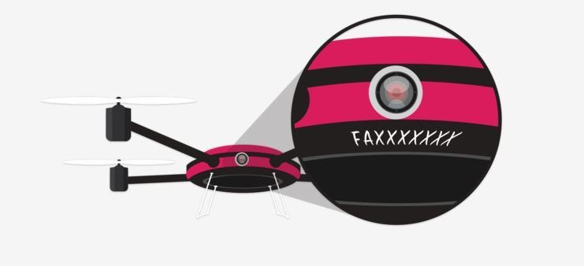
UAS users (Hobbyist and coommercial) are aviators....that title comes a great deal of responsability !!!
Different web-based UAS Registration process:
  Hobbyists
  Commercial Operators
automatic generation of
  UAS unique ID
  Q/R code
  Registration certificate
A means for quick UAS identification in case of incident/accident
Direct opportunity to educate small UAS owners on safety requirements before the begin operating

Slide 19
Implementation ROADMAP
Flight plan definition, and management
Recording, playback and investigation
Corridor & airspace design & reservation, No fly zone creation
Airspace occupancy prediction & DCB
Summer 2016
End 2016
End 2017
Vehicle Registration & identification, UAS Operators
Situation awareness, UAS tracking & alert generation
Flight Validation & Scheduling

Slide 20


