Slide 1
JAA-TO Presentations
International Conference:
RPAS (drones)
Larnaca (Cyprus), 21 October 2016
Filippo Tomasello

Slide 2
Who is the speaker?
Italian Passport
European Citizen
Neapolitan national
Member of international civil aviation family
15 years flight test engineer in the IAF
15 years in Italian civil Air Navigation Service Provider (ENAV)
15 years in European entities (EUROCONTROL, Commission, EASA)
Since Sept 2014 in EuroUSC-ItaliaTM (today CEO)
JAA TO Faculty Manager for the Drones/RPAS subject, responsible for the development of all JAA TO courses in this category
… unfortunately (for him) born in the past century (1950) ☹

Slide 3
Content
1st challenge: Dimensions of the problem
2nd challenge: awareness
3rd challenge: training of remote pilots
4th challenge: education of professionals

Slide 4
Drone Invasion
No. OF CIVIL UAS | REPORTED BY | SOURCE
2 500 operators (400 in the UK, 300 in Germany, 1 500 in France, 250 in Sweden, etc.) | EP | Point 1 of EP Resolution of 29 Oct 2015
6743 legally authorised civil RPAS operators in Europe in January 2016 | UVS International | Page 70 of Yearbook 2016-17
400,000 UAS (>250 gr) registered in USA (Part 48) in 2016 Q1, against 300,000 manned aircraft registered by FAA in entire history | Mr. S. Creamer, Director ANB | Statement at ICAO Symposium, 09 May 2016
More than 5550 exemptions granted according to Section 333, until end of August 2016 | Web consultaion on 02 Aug 2016 | FAA web site

Slide 5
EASA < 150 kg
Resolution of European Parliament (EP)
29 October 2015
22. Supports the Commission’s intention to remove the 150kg threshold and to replace it with a coherent and comprehensive EU regulatory framework that would allow national competent authorities, qualified bodies or associations to assume validation and oversight activities; considers that the proportionality of the rules should be complemented by the necessary flexibility in processes and procedures
Also Qualified Entities blessed

Slide 6
Qualified Entities
Less workload on authorities for segments of aviation of less societal relevance
Authority
Accreditation
Reporting
Application
Applicant
Accredited QE
Certificate
Privileges
Privileges

Slide 7
Drones at intersection of four realities
aviation
Robotics (NERDs)
We need to pursue:
Awareness of public
Training (and continuing competence) of remote pilots
Education of managers, professionals, inspectors, instructors, etc.
Aero-modelists
surveys
DRONES

Slide 8
Awareness
Voluntary: DRONE-RULES project aims to create THE reference resource in Europe for RPAS rules, facilitating access to the European market for operators. also showcase opportunities for economic and job growth that RPAS represent for entrepreneurs and SMEs https://ec.europa.eu/easme/en/drone-ruleseu-rpas-rules-regulation-portal
Compulsory: Appendix I.12 EASA prototype rules https://www.easa.europa.eu/system/files/dfu/UAS%20Prototype%20Regulation%20final.pdf Awareness leaflet to raise attention of operator about the applicable legislation on aviation safety, security, privacy and data protection, liability and insurance

Slide 9
Standardised training for remote pilots
Independent Qualified Entity (QE)
EuroUSC established in 2003
Operates globally
Standard BNUC-S for remote pilots already recognised by several authorities
Inspectors and Examiners everywhere in the world
http://eurousc.com/pilot-qualifications

Slide 10
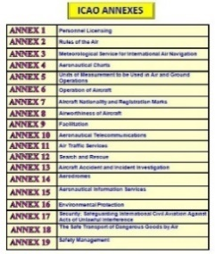
Education beyond awareness and trianing: JAA TO
ECAC
Foundation, Non-Profit
Regulatory Training
ICAO (RTCE; TPP Full; TPSC Member)
EASA (EVA Member; Approved RITO; E-exam Provider)

Slide 11
JAA TO’s Courses & Activities
Maintenance
Auditing Techniques
Nominated Postholder
Dangerous Goods
Quality Management
Airside Safety
Operations
Licensing
Intro to Aviation Regulations
> 150 Training Courses and Trainers
> 13 Regional Training Locations Worldwide
Assisted building >5 National Training Academies
> 500 courses scheduled annually
Safety Management Systems
PRM
Accident and Incident Investigation
Environmental
SAFA
International Aviation Law & Policy
Flight Dispatch
Certification
Fatigue Risk Management
Human Factors & CRM
Logistics Management
Crisis Management
Aviation English
Military
Train the Trainer Programs
Airworthiness
Facilitation
Accountable Manager Seminar
Aerodrome & Ground Operations

Slide 12
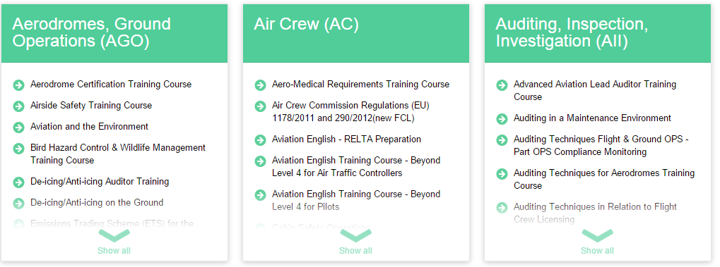
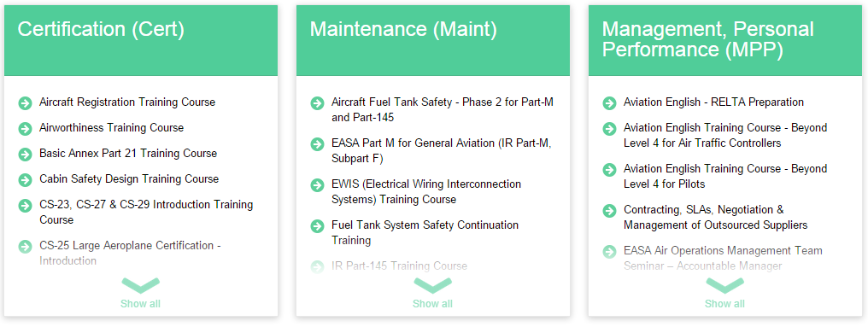
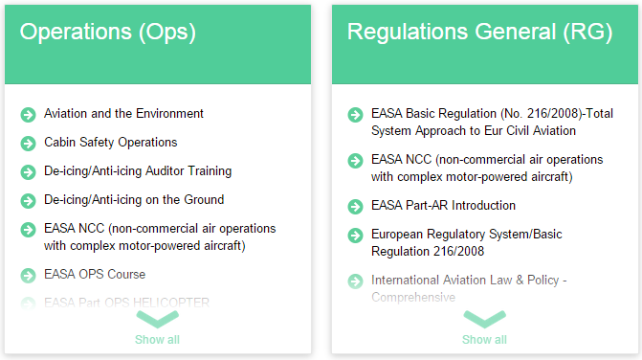
Training Portfolio
8 Main Categories

Slide 13
JAA TO RPAS Faculty
RPAS – INI – Initial course on the scenario and international regulatory framework of non-military RPAS https://www.jaato.com/courses/499
RPAS – OPS on professional operations of RPAS “operation centric” (i.e. the operator is the responsible entity for safety of operations, even in the absence of a formal type certificate for the aircraft) https://www.jaato.com/courses/552/
Sister courses on integration of RPAS in ATM at EUROCONTROL IANS https://trainingzone.eurocontrol.int/ilp/pages/coursedescription.jsf?courseId=4996611

Slide 14
Courses at Clients’ Locations
Advantages:
Larger groups, own location
Cost-effective
Translation & Interpretation
Tailoring
Combination of courses

Slide 15
What can JAA TO Offer?
Partnerships in various levels:
Course Delivery by JAA TO
Joint Course Delivery/Development
Classroom or virtually
Train the Trainers
Licensed use of JAA TO’s ITMS (Integrated Training Management System)
Assistance in Setting up Training Academies
A blend of the above

