Slide 1
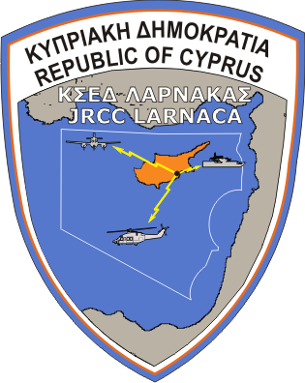
JOINT RESCUE COORDINATION CENTER larnaca
search & rescue system
Of the republic of cyprus
RESEARCH & DEVELOPMENT
Cpt (AF) Iacovos Stylianides – Ops Dpt
21 October 2016
Notes:
Mr chairman, Ladies and Gentlemen, good afternoon. I am Captain AF Iacovos Stylianides of the Operations and Training Department of JRCC Larnaca
First and foremost, I would like to thank you for the opportunity to present the current status of SAR readiness of the Republic of Cyprus and also the constant effort of JRCC to upgrade its capabilities in the provision of SAR services, according to the ICAO guidelines and suggestions. click

Slide 2
JRCC LARNACA
PRESENTATION TOPICS
JRCC LARNACA
JRCC’S UAVs
USE, LEGAL FRAME AND FLIGHT SAFETY
Notes:
3.
My presentation will focus on the following topics:
Firstly, I will say a few words about JRCC Larnaca, who we are, what we do and how we do it.
Then I will present to you the UAVs that we acquired earlier this year, in order to be more specific regarding the intentions of use
And I will close with a reference on how we intend to proceed with the Legal framework and the procedures on flight security during familiarization flights, exercises and operations

Slide 3
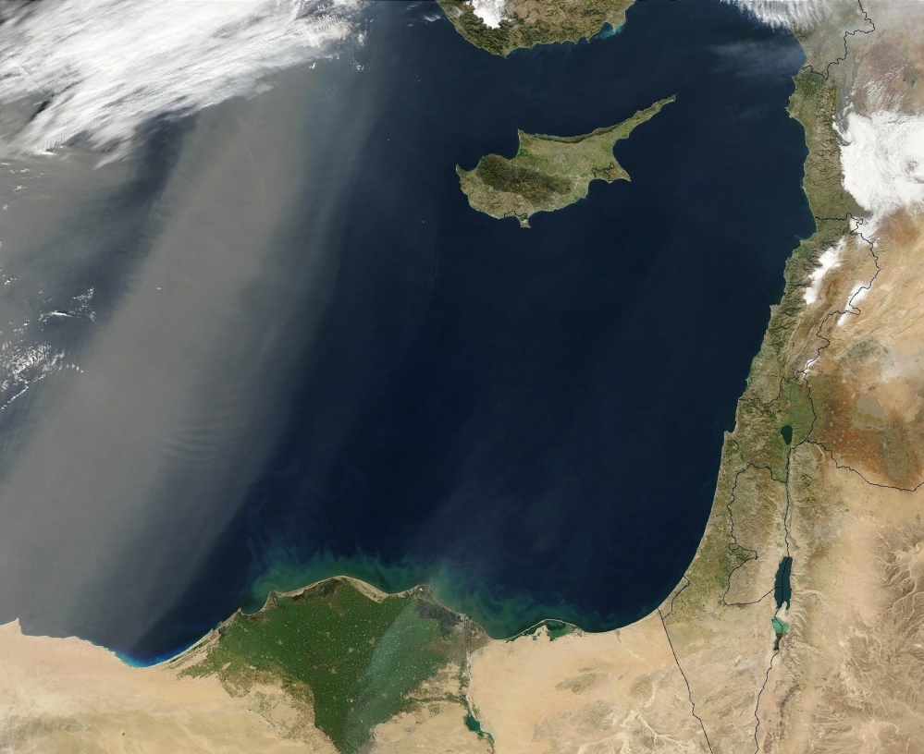
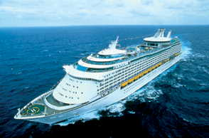
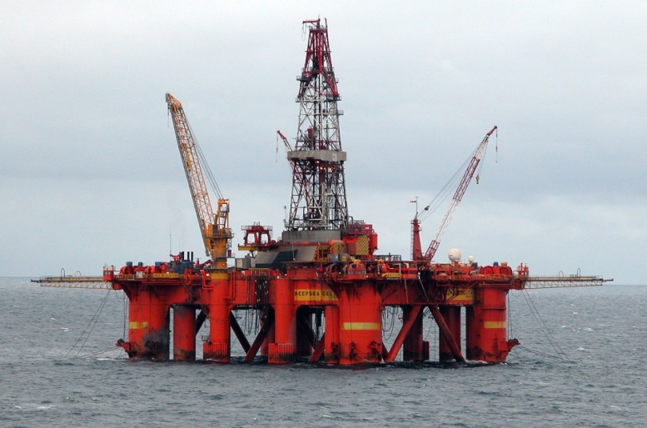
JRCC LARNACA
REPUBLIC OF CYPRUS
«THE CROSS ROAD OF 3 CONTINENTS»
Notes:
3.
For the Republic of Cyprus, the prompt and effective response in providing SAR services when in need, constitutes a crucial national goal.
Our priority is to continuously upgrade and develop our Search and Rescue System.
Cyprus has been a crossroad of civilizations for thousands of years. Our territorial waters, the Exclusive Economic Zone and the Nicosia FIR, form a vital maritime and aeronautical route crossroad, underlining the importance and need for presence of a competent national SAR-services provider.
This is a fact proved by the
-150,000 (one hundred fifty thousand) commercial, passenger, cargo and other types of ships that sail through the SRR of Cyprus and the
-300,000 (three hundred thousand) aircrafts that fly through the SRR on an annual basis.

Slide 4
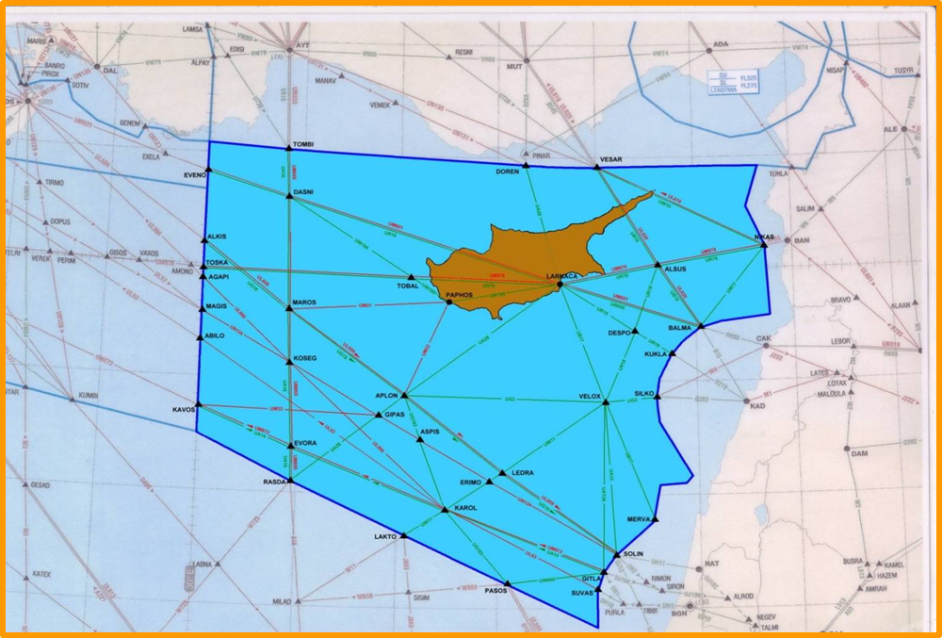
JRCC LARNACA
MISSION
The primary mission of the JRCC is to organise the Cyprus Republic SAR system, command & control and coordinate SAR operations,
in order
to find and rescue people in distress as a result of naval or aircraft incidents; operating within its own area of responsibility.
NICOSIA FIR
Notes:
2.
As a joint Rescue Coordination Centre, our mission is.. To:
Organize the Cyprus Republic SAR system and, of course,
to command, control and coordinate SAR operations in order to locate and rescue people in distress as a result of naval or aircraft incidents within our area of responsibility.
The Aeronautical SRR coincides with the Maritime SRR, being the Nicosia FIR. Click

Slide 5
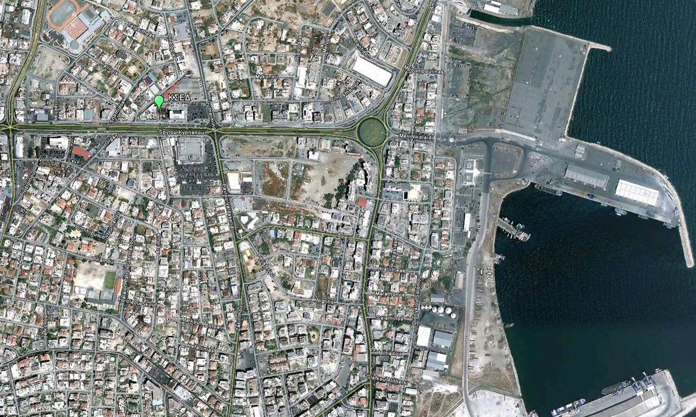
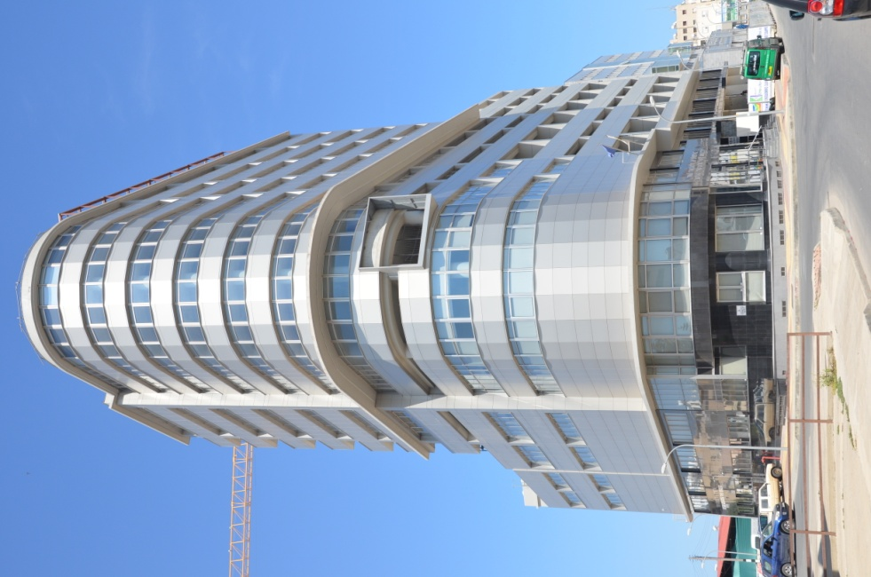
JRCC LARNACA
ORGANISATION OF THE JRCC LARNACA
JRCC
JRCC ADDRESS
50, SPYROU KYPRIANOU Avenue
IRIDA No 3 Building, 11th Floor, 6057 Larnaca
Notes:
3. JRCC Larnaca is located in the city of Larnaca, in proximity to the Larnaca International Airport and Larnaca harbor.
The competent authority of SAR issues according to the national Law, is the Ministry of Transport, Communications and Works which is also responsible for the operating expenses, technical support and logistics of the JRCC and the SAR system. The Minister of Defense is responsible for the establishment and operation of the JRCC Larnaca. click

Slide 6
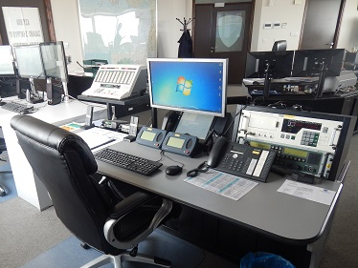
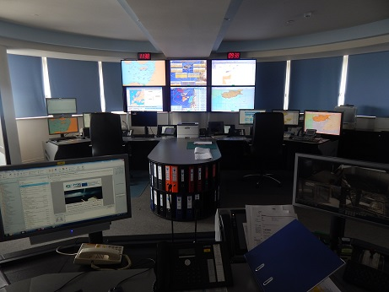
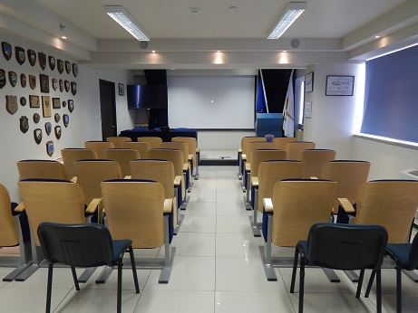
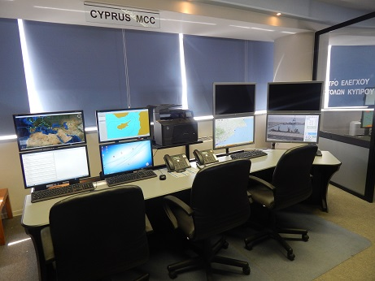
JRCC LARNACA
ORGANISATION OF THE JRCC LARNACA
Notes:
4. In its modern installations, JRCC can fulfill its demanding role, successfully. The Operations Center has been designed to meet the highest standards and it is equipped with the required technology and documentation, as defined in the ANNEX 12 & IAMSAR manual.

Slide 7
SEARCH AND RESCUE SYSTEM
OF THE REPUBLIC OF CYPRUS
INTERNATIONAL
CONVENTIONS
ICAO ANNEX 12
IAMSAR MANUAL
NATIONAL
SAR LAW
NATIONAL
SAR PLAN
“NEARCHOS”
&
BILATERAL
AGREEMENTS
REGIONAL
COOPERATION
& SAR PLAN
Notes:
5.
The role of the Center is defined as seen On the slide where a simplified description of the Republic of Cyprus Search and Rescue System components, at present, is presented. Our philosophy is based on three main pillars which are: The International conventions which the Republic has ratified, The ANNEX 12 and The IAMSAR Manual,,, and of course Our National Law. Taking these elements into consideration, we have compiled our National SAR Plan, code-named “NEARCHOS”, which is being implemented, in addition to the bilateral agreements with neighboring countries. click

Slide 8
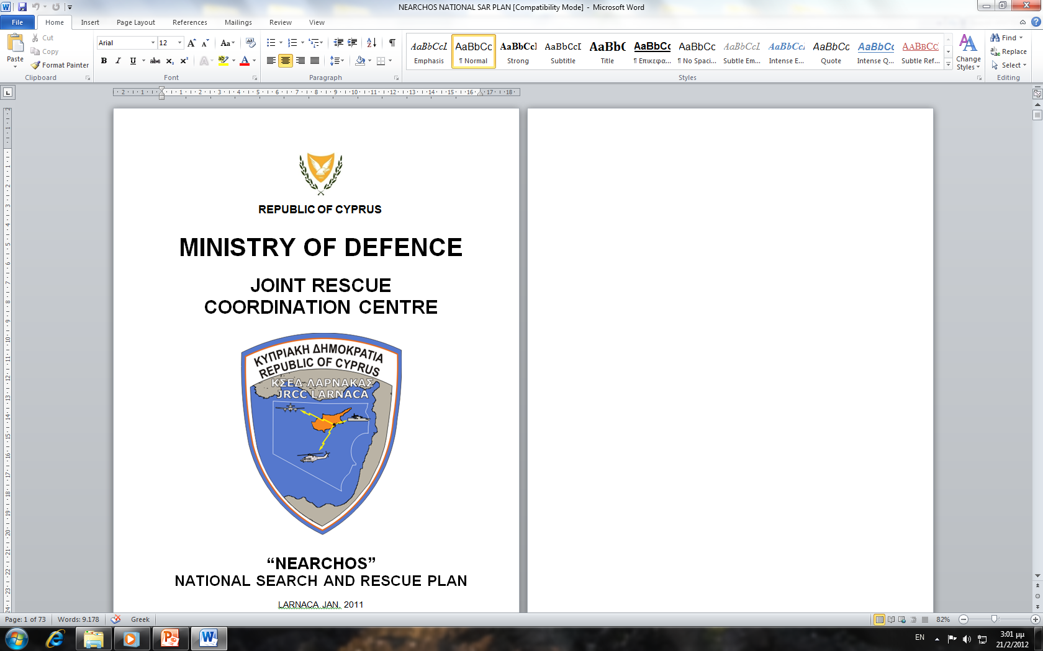
JRCC LARNACA
NATIONAL SAR PLAN «NEARCHOS»
Basic coordinating instructions are provided in the National SAR Plan, in respect of the main SAR incidents that may be handled in the operational environment of the Republic of Cyprus. These instructions set out the role of every service depending on the incident.
Notes:
8. The National SAR Plan “NEARCHOS” provides the coordinating instructions to all of the involved agencies in case of a SAR mission in the operational environment of Cyprus.
It is clear that, “time” is a very important factor in SAR operations and for this reason both our National Law and SAR Plan define the primary and the secondary SAR units. All participating primary SAR units should be deployed, under the operational control of JRCC Larnaca, within maximum 30’ minutes. click

Slide 9
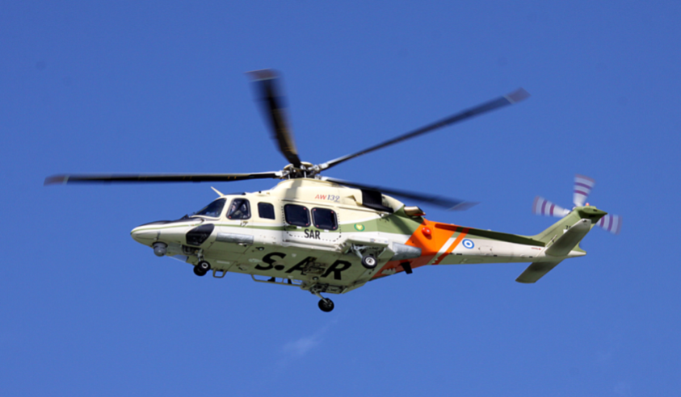
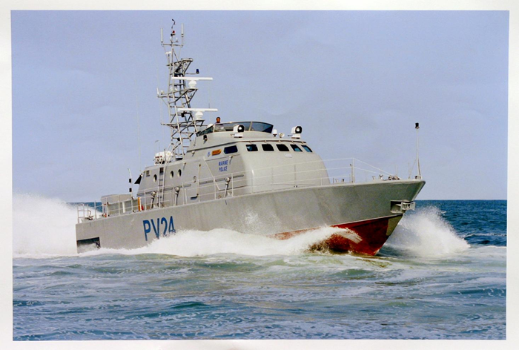
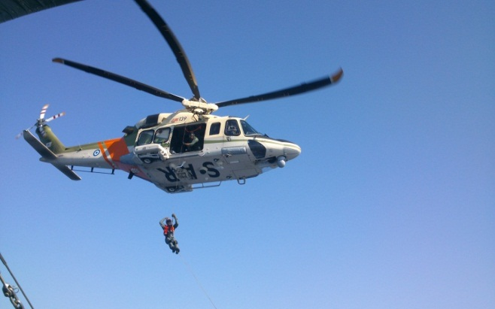
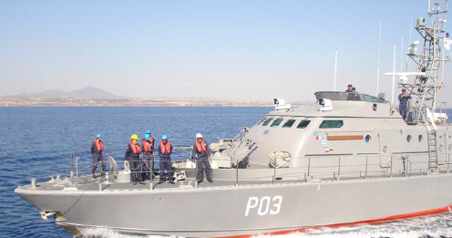
JRCC LARNACA
PRIMARY SAR UNITS
Notes:
9
The Republic’s Primary SAR units are divided in the 2 main categories of airborne and naval. The Airborne category contains AW-139 and Augusta Bell helicopters of the Air Force and the Police Aviation Unit, while in the Naval units category is consisted of various types of Cyprus Navy Command and the Port & Marine Police Fast Patrol Boats.
In addition, JRCC Larnaca maintains a sound collaboration with the 84 SQN based at Akrotiri, which participates in SAR Operations with 2 Griffin BELL helicopters

Slide 10
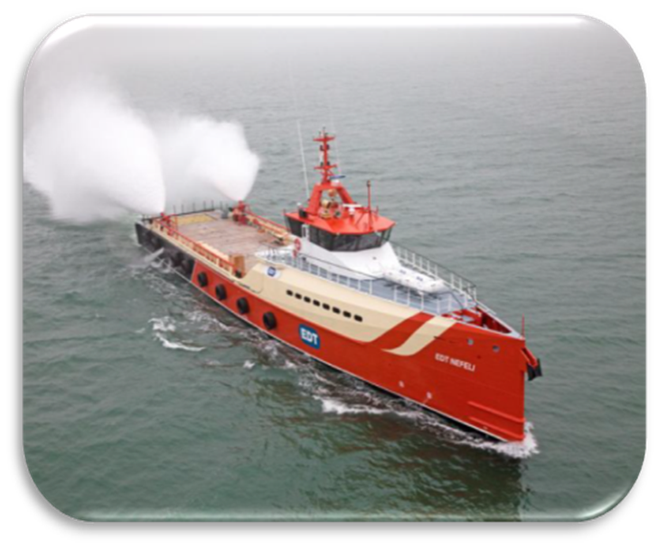
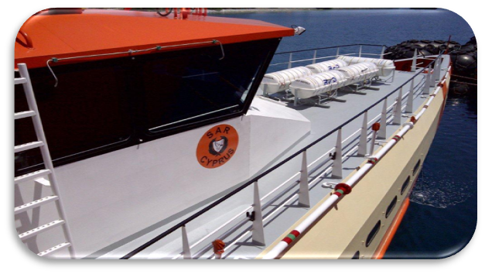
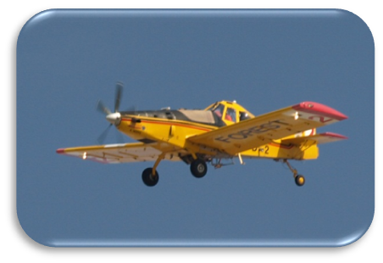
JRCC LARNACA
SAR UNITS / AUXILIARY RESOURCES
JRCC can also utilize the following services:
Aircrafts from the Forestry Department.
Cyprus Police Emergency Response Unit.
Lifeguards & Tug Boats.
Merchant ships or Warships, cruising in the vicinity of the incident.
Groups of Personnel and Assets of National Guard, Police Force, Civil Defense, District Administration and Cyprus Red Cross.
Rescue Vessels (RV) of Fisheries and Marine Research Department.
EDT Offshore Company support Vessels to the Oil and Gas industry.
Notes:
12. Apart from the primary units… JRCC upon request… can make use of the following services… assets… and personnel, as secondary units:
From the Aircrafts ( KLICK) of the Flight Unit of the Forestry Department, …… to the fleet ……( KLICK) of the EDT Offshore Company, with the sign of Cyprus SAR on every ship's bridge.
EDT Offshore Company is a Cyprus based company and operates as a supplier and manager of (KLICK) high specification support vessels to the Oil and Gas industry. click

Slide 11
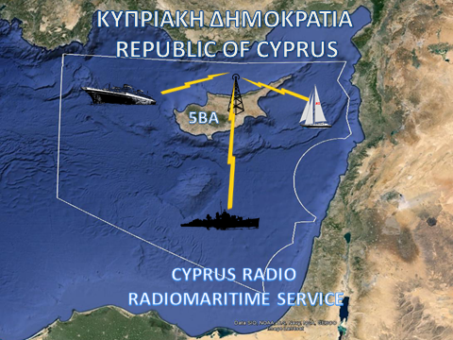
JRCC LARNACA
COASTAL SERVICES-CYPRUS RADIO
Notes:
The most recent addendum, is the Cyprus Coastal Radio, which provides coastal services to mάriners, such as Navigational Warnings and Meteorogical Forecasts. The co – location results in reducing the running costs while a better coordination between the two services is achieved. Coastal radio is operated on a 24/7 basis by personnel of the National Guard and specifically, the Navy and Air Force, supporting the demanding mission of the JRCC.

Slide 12
JRCC LARNACA
SAR OPERATIONS PER YEAR
Notes:
6. According to SAR Statistics …. Since the first day of its establishment (Aug 1995) …………….. until today…………… JRCC has investigated approximately a total number of 4800 distress incidents worldwide; more than 740 of these, demanded the coordination of SAR operations. click

Slide 13
JRCC LARNACA
PERSONS RESCUED PER YEAR
Notes:
7. As a result of the SAR Operations, 3121 persons in distress, were rescued. click
On the slide you can see that the number of persons rescued in year 1997 is significantly higher and this is a result of the sinking of the passenger ship ROMANTICA, on the 4th of October 1997, 60NM South of Limassol. The SAR system responded successfully by saving all of the 673 passengers onboard.

Slide 14
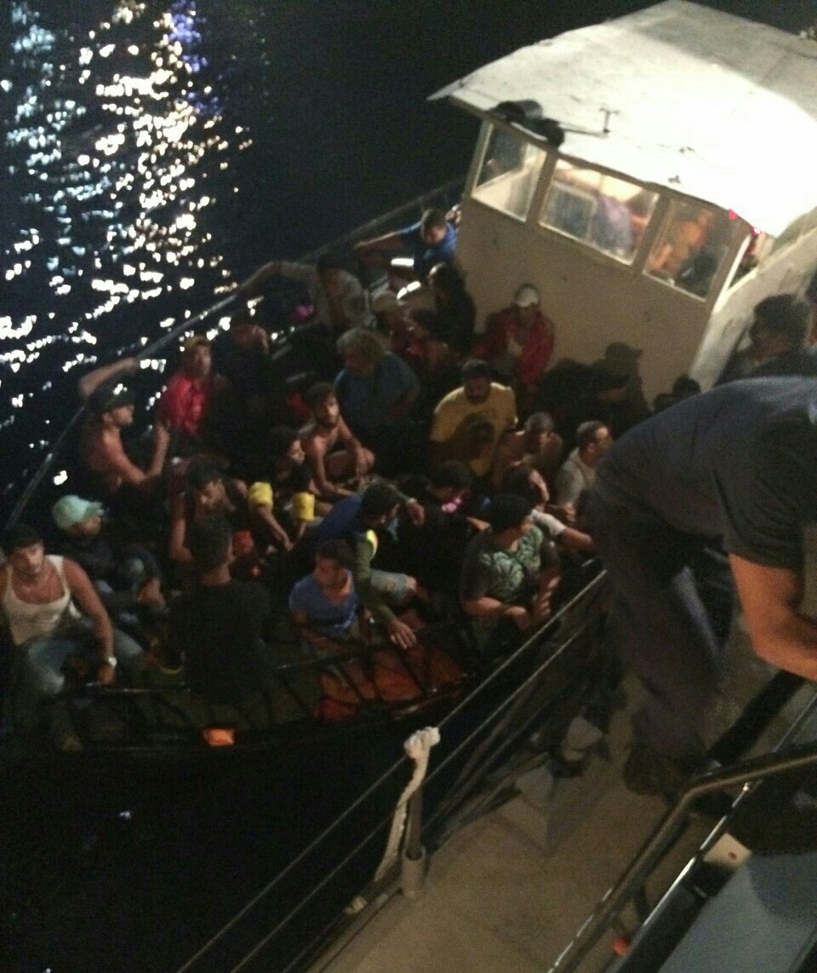
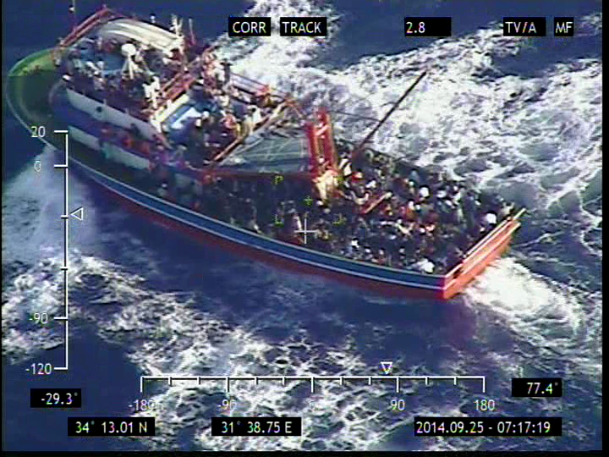
JRCC LARNACA
REAL LIFE SAR INCIDENTS
MASS RESCUE OPERATION OF MIGRANTS - REFUGEES
Notes:
An example of JRCC’ s effectiveness is the fact that the past 3 years several search and rescue mass operations were coordinated, due to the enormous increase of the migration flow towards Europe, without any loss of human lives.

Slide 15
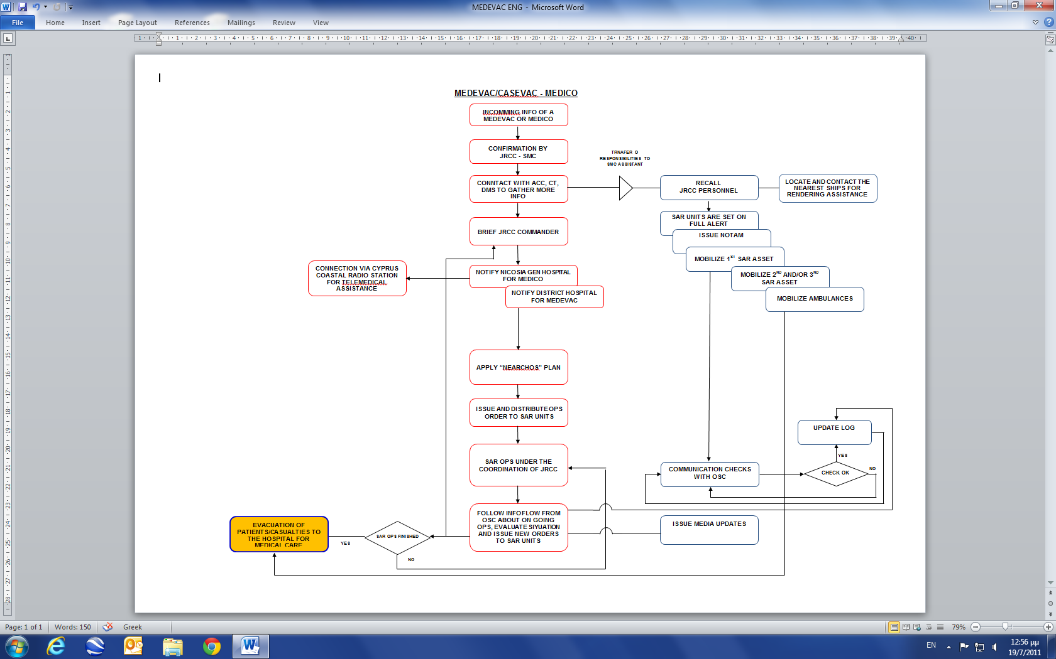

JRCC LARNACA
MEDEVAC OPERATION FLOWCHART
Notes:
22.
For each incident, Standard Operating Procedures are provided to the operators. According to the National SAR plan, in case of a mass rescue operation, the Ministerial Crisis Management Team and the Crisis Handling Coordination Team consisting of representatives from all services which are expected to be involved in the incident, will be gathered at JRCC Larnaca.
On the screen you can see the flowchart of the SOPs in case of a Mass Rescue Operation. Klik
I would also like to point-out that the JRCC Larnaca’s SOPs are harmonized with the requirements of the international quality standard ISO 9001 of 2008. As a result, the effective command-control and coordination of the SAR units, is achieved.

Slide 16
JRCC LARNACA
NATIONAL SAR PLAN «NEARCHOS»
POSSIBLE MAIN SAR INCIDENTS
OPEN SEA
NEAR THE SHORE
AIRPORT AREA –
SALT LAKES
WATER DAMS
INACCESSIBLE AREAS
MARITIME
MARITIME
AERONAUTICAL
AERONAUTICAL
AERONAUTICAL
AERONAUTICAL
AERONAUTICAL
ARTIFICIAL ISLANDS – OIL PLATFORMS
FISHING VESSELS –
YACHTS
SWIMMERS –
DIVERS
Notes:
14.
There are five possible main SAR incidents in the operational environment of Cyprus which our JRCC may be called to handle. For every possible incident there are relevant EMERGENCY RESPONSE “ search and rescue” prescribed actions as following:
1. At Open Sea (this refers to aeronautical or maritime incidents that may occur at a distance in excess of six (6) nautical miles from the Cyprus coast).
2. Near the Shore (this refers to incidents that may occur at a distance up to six (6) nautical miles from the Cyprus coast).
3. Airport areas/Salt lakes (this refers to air accidents that may occur within a range of 5 NM from the centre of the runway).
4. water dams …. and
5. inaccessible areas . click
(It has to be noted that due to the small size of our country and respective limitations in its capabilities, we have explored and investigated all the possible options to be utilised and used as auxiliary and or even primary SAR units.)

Slide 17
JRCC LARNACA
FLIGHT SAFETY
NOTAM
SOPs
ACO
COMMUNICATION WITH ACC/TERMINALS
Notes:
22.
Our main concern during the exercises and operations, is the safety of the crews and the people involved. In order to be failproof, we follow all the procedures provided. We request the publication of a NOTAM that includes the area of interest, we follow the SOPs regarding the progress of operations of the aerial units, we assign an ACO, either positioned at the Operations Room of the Center or the commanding officer of a SAR unit on-scene capable of acting as one, and we keep a direct line of communication with the ACC and the Airport terminals.
With this information, I will now proceed to the presentation of our UAVs.

Slide 18
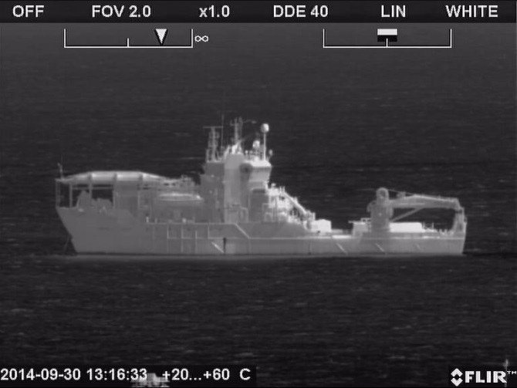
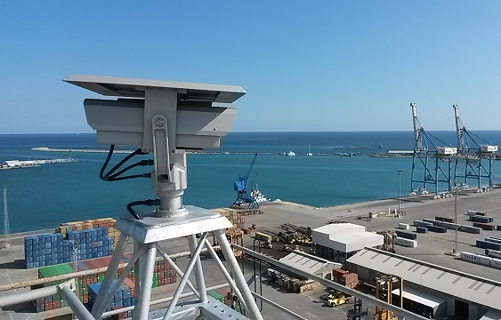
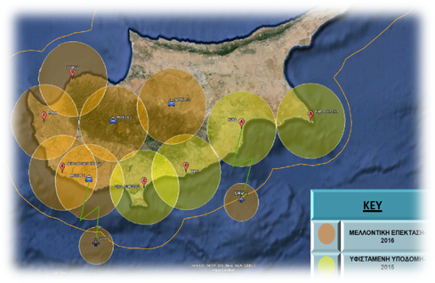
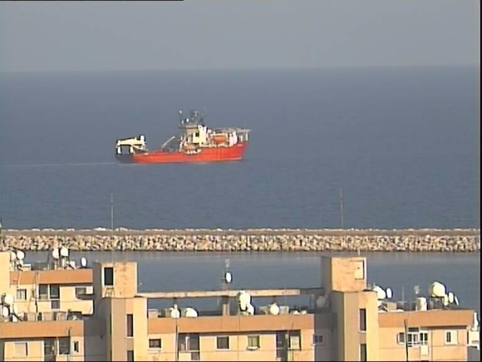
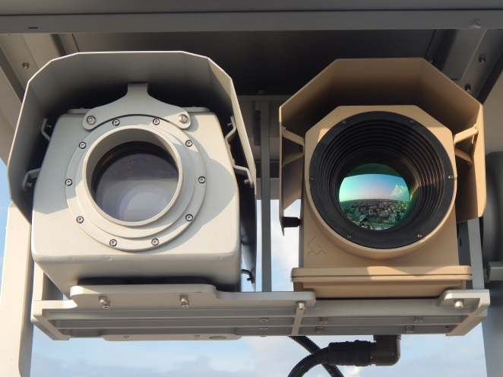
JRCC LARNACA
RESEARCH AND DEVELOPMENT 2016 - 2020
Coastal surveillance System
Notes:
42.
The Department of European Programs and Development of the Center, in collaboration with the Operations Department and the Commander of JRCC, is thriving not only to maintain but also to upgrade the level of services provided by the Center, and under this scope, we are trying to always keep up with new technologies that will enhance our efforts.
One of the most important goal is the completion of the deployment of a coastal surveillance system.. The project consists of a number of Long Range Observation Platforms placed on fixed towers, mobile units and UAVs, fully controllable by the Command & Control Centre which is located at the JRCC operations room.

Slide 19
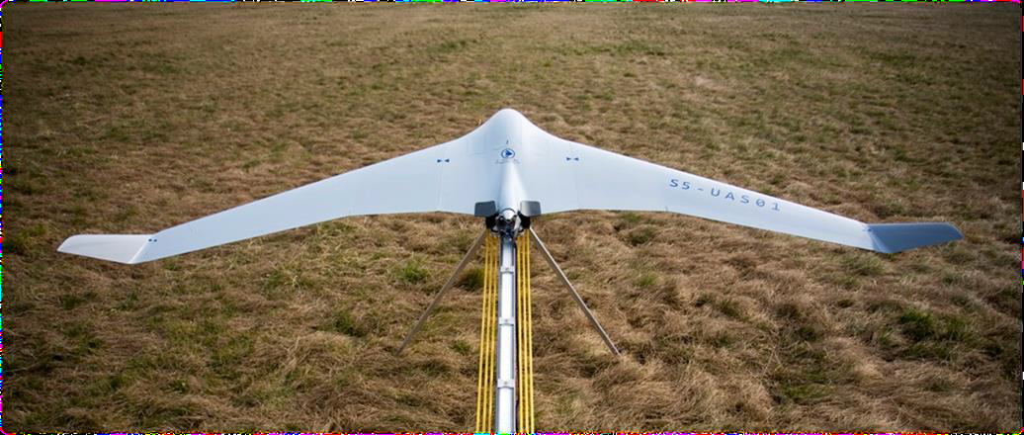
JRCC LARNACA
UAVs EXPLOITATION
Coastal surveillance System
Notes:
The coastal surveillance system is currently under development, with only the cameras on fixed towers being operational. The next step, though, is the operational exploitation of the 2 UAVs acquired this year.
UAVs can be used in numerous of situations having the advantage of being the Eye in the Sky.

Slide 20
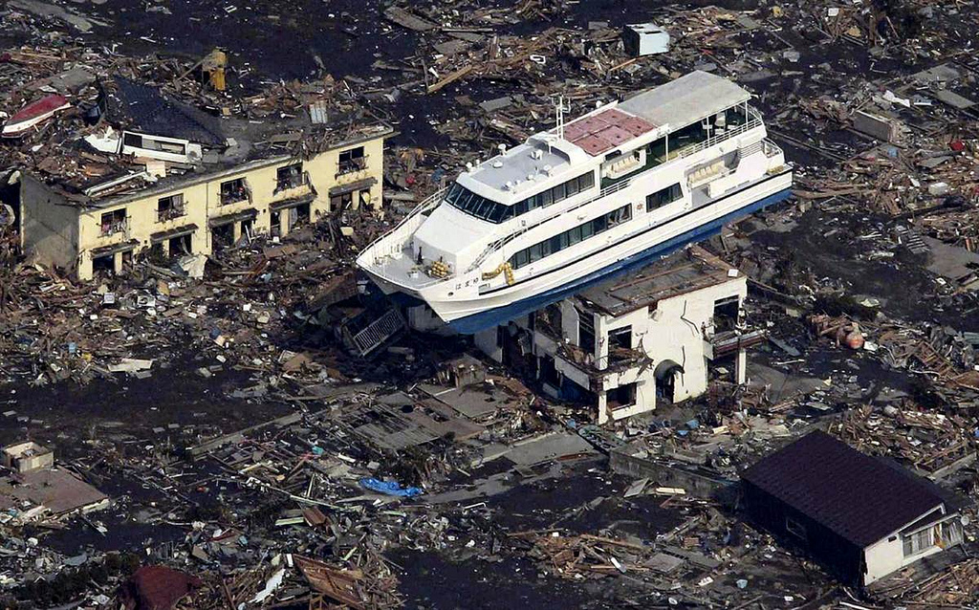
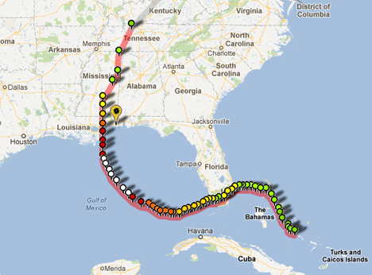
JRCC LARNACA
UAVs EXPLOITATION
Coastal surveillance System
Notes:
In every situation where a person is in distress, time is the most important factor. The probability of survival decreases while time passes, therefore to act quickly and efficiently is the Number one challenge.
Unmanned aerial vehicles are entering the SAR family, providing us a tool that can be used in various situations. After the devastating pass of hurricane Katrina, drones were used in order to help the SAR units to locate survivors and missing persons. Also, CLICK rotary wing vehicles equipped with radiation sensors, infrared thermometers and cameras helped out at Japan’s post-tsunami facility.
Being successful during these missions, the UAVs have started to gain trust.

Slide 21
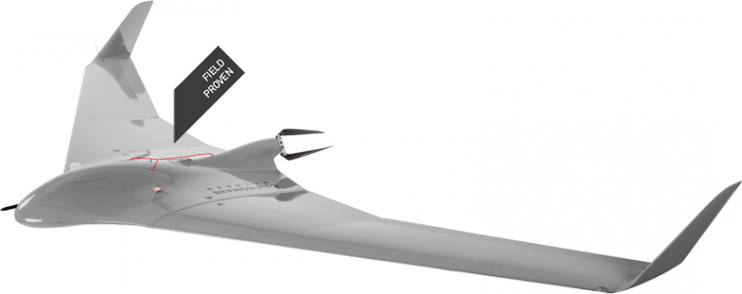
JRCC LARNACA
UAVs EXPLOITATION
Notes:
Having in mind that unmanned systems are much smaller than manned aircrafts, easier to maintain and transport and therefore much more cost-effective, providing excellent productivity and fast return on investment, Republic of Cyprus, through the European Union’s funding programmes, acquired 2 Unammned Aerial Vehicles.

Slide 22
JRCC LARNACA
UAVs EXPLOITATION
UAVs - CONCEPT OF OPERATIONS
SAR MISSIONS ENHANCEMENT
Notes:
The concept of operations of the UAVs, in order to enhance the SAR missions of the Center, is that the UAVs will provide live feed from the area of operations or interest.
To be able to see the progression of operations right in the Ops Room, is something that changes almost everything. Besides, One picture is a thousand words so thousands of high-resolution frames, are a whole story.

Slide 23
JRCC LARNACA
UAVs EXPLOITATION
UAVs - CONCEPT OF OPERATIONS
Flight Duration: 180 min
Cruise Speed: 30Kn
Loiter Duration: 60 min
Climb rate: 960fpm
Notes:
In nominal conditions and after a climb at 200m height, the overall flight duration is CLICK 180 minutes. Also, if we take into account the optimal cruise speed for maximum flight duration being CLICK 30 Knots, while the max is 42, then it is easy to calculate of a loiter time of 1 hour.
The overall flight duration maybe decreased when the UAV climbs at higher levels, but also our statistics show that the larger amount of incidents that we have to deal with, are close to the shore and up to 6NM, so the loiter time increases. Additional information is the climb rate which is CLICK 960feet per minute.

Slide 24
JRCC LARNACA
UAVs EXPLOITATION
UAVs - CONCEPT OF OPERATIONS
Weather Conditions
Max. Wind Speed: 6 Beaufort
Temperatures: -10 - +45 ˚C
Humidity: 5 – 95%
Notes:
The most important factor that is taken into account before a SAR unit is deployed is the weather conditions, and the same factor plays a crucial role to our decision to whether deploy a UAV or not.
The weather restrictions that we have is a Max. Wind Speed of CLICK 6 units on the Beaufort scale and temperatures not lower than CLICK -10 and not higher than 45 celcius.
Also, operations cannot be carried out in presence of fog, rain, snow, mud and water, but the resistance to Humidity is very high as you can see on the slide.

Slide 25
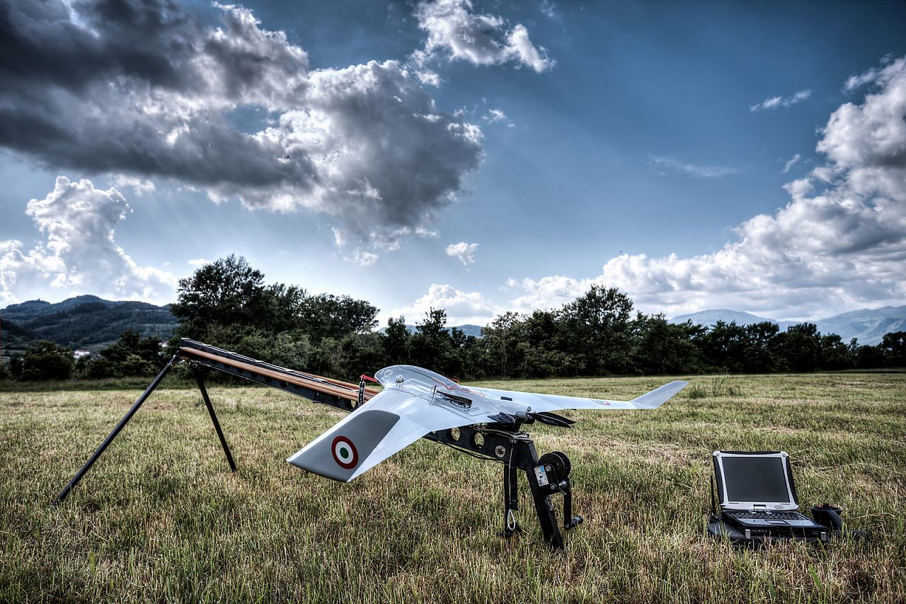
JRCC LARNACA
UAVs EXPLOITATION
UAVs - CONCEPT OF OPERATIONS
Notes:
Another benefit is that it can be launched by almost anywhere. Also, they can easily transported to the launch area, and that is the main concept which we based on for developing the procedures that will be added in the SOPs of the center, in order to use the aircrafts in an efficient manner. One of the procedures that is under study, is for the UAVs to be launched from a platform on board a Rescue Vessel. This way we can have more duration in loiter mode while the landing area can be at home base. CLICK

Slide 26
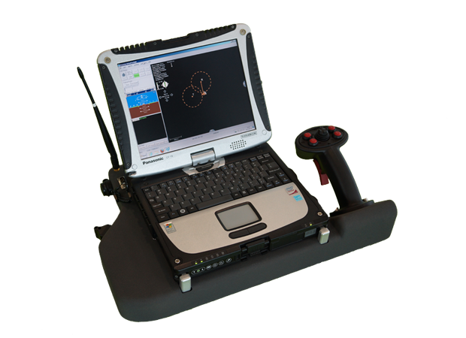
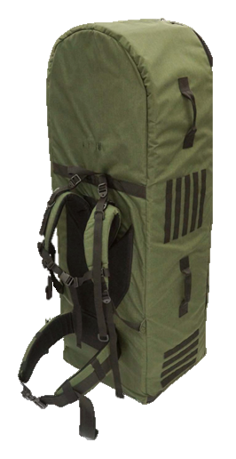
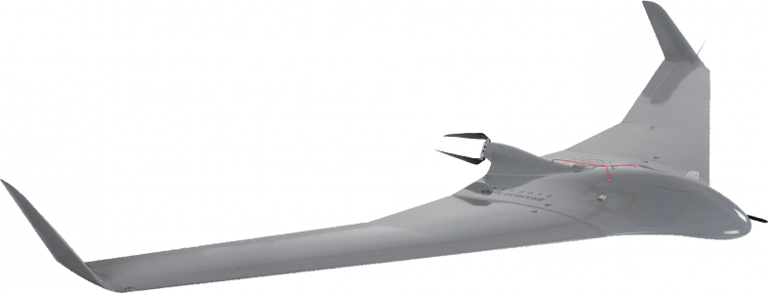
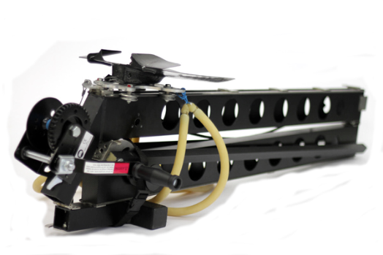
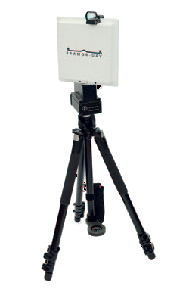
JRCC LARNACA
UAVs EXPLOITATION
WORKSTATION
CATAPULT
BACKPACK OR TRANSPORT CASE
LONG RANGE
ANTENNA
Notes:
The UAV, along with its catapult, is stored inside the transport vehicle, and the optimal deployment time is 5-10 minutes, depending on the crew experience.
The 4,5 Kg total weight along with the relatively small size (we have a wingspan of 230cm) makes everything much easier. The small weight is crucial and in order for it to be achieved, the frame is made of a blend of Kevlar, Carbon fiber and Vectran.

Slide 27
JRCC LARNACA
UAVs EXPLOITATION
UAVs – MAIN FEATURES
SEARCH PATTERNS
LOITER (RALLY MODE)
THERMAL
Notes:
Being unmanned means that various tasks have to be carried out automatically with the most important being the navigation. GPS is used for positioning purposes and for navigation, various maps can be used, according to the operator and mission needs. And this brings us to the modes of operations according to which, the basic tasks of the UAVs are carried out.
So according to the modes of operation the aircraft can
Execute search operations for locating persons in distress
Loiter around a certain target, providing us live feed from a scene of operations where otherwise we wouldn’t have eyes.
Use the thermal camera in order to locate person in distress.
There are also other modes which are semi automatic, giving the opportunity to the operator to control the UAV remotely.

Slide 28
JRCC LARNACA
UAVs EXPLOITATION
FAMILIARIZATION STAGE
MoU with Department of Civil Aviation
Fail proof procedures
Notes:
We are now at the familiarization stage, where our operators fly every week in order to get to know the system and its true capabilities. In this stage, we use a flight area, defined by the Department of Civil Aviation, activating the LCD whenever needed.
The next step is the operational exploitation of the UAVs and for this, discussions have started with the Department in order to find a solution that will not have impact on the time of deployment of the UAVs but will also keep everyone safe while the UAV is acting in the area. An unmanned aerial verhicle that is remotely monitored and made of Kevlar and Carbon fibre, cannot be seen on a Radar screen and the only one that can control it is the operator. We have to be prepared for everything, so we have to be prepared for the possibility that the UAV loses communication with everyone and its ability to navigate. This is one of our main concerns and our goal is to build the procedures that will involve the whole SAR system and all the aerial and Naval units, in order to exploit the UAVs in the best possible way. For example, the UAV will not under any circumanstances, fly above a manned air unit or even share the same area of operations with another unit. This means that the UAV will be an additional search unit in case of SAR operations.

Slide 29

JRCC LARNACA
UAVs EXPLOITATION

Slide 30
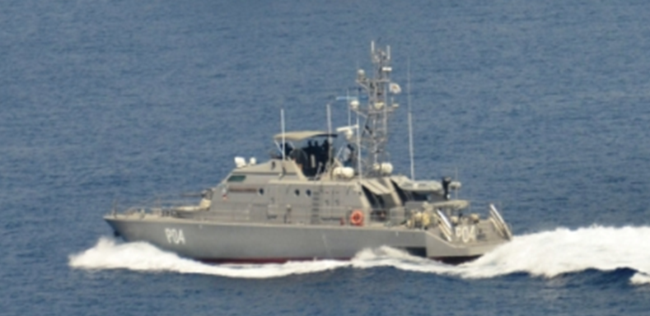
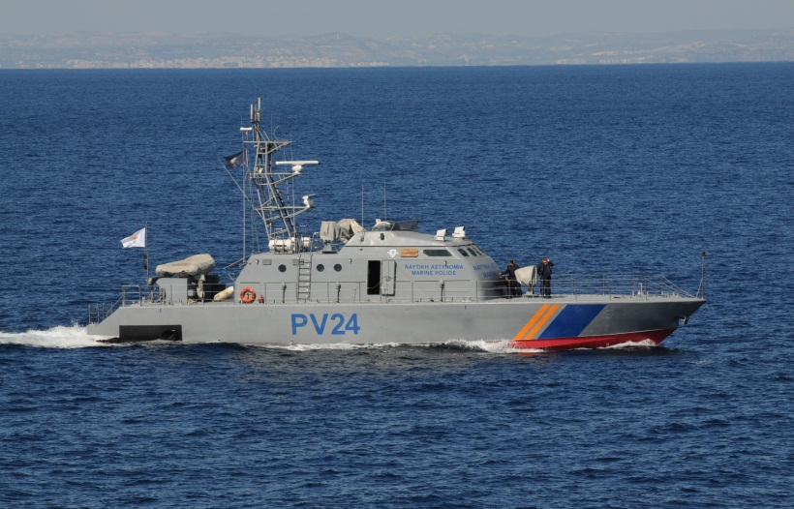
JRCC LARNACA
PRIMARY SAR UNITS
Rescue Vessels (RV) and Rescue Boats (RB)
of the Cyprus Navy and the Port & Marine Police.
Notes:
10. Maritime units of the Navy Command, and the Port & Marine Police are also used as primary SAR units. The vessels used for SAR operations, basically consist of Coastal fast patrol boats of various types and capabilities. CLICK

Slide 31

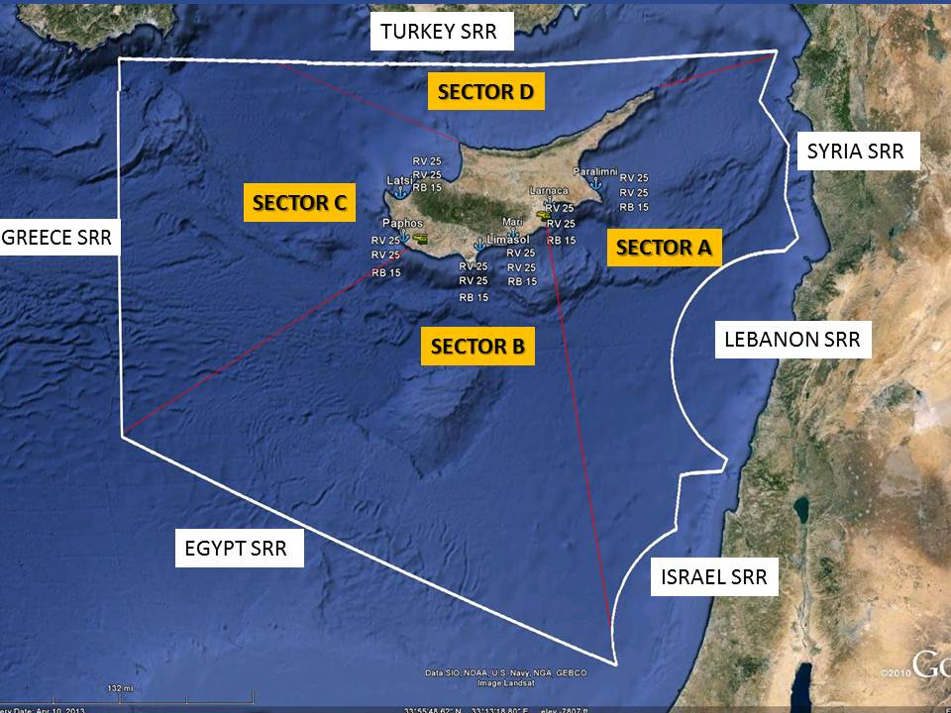
OPERATIONAL SECTORS - READINESS OF VESSELS
Notes:
11. In order to achieve full coordination…, assets are allocated in an ergonomic way. The available vessels in each sector and their distribution around the island, is also presented on the slide. click
(The occupied area of the Republic of Cyprus, in Sector DELTA is covered by Rescue Vessels and Boats, which are based at the Port & Marine Police stations to the East and to the west.
For sector DELTA, we have established specific procedures with the United Nation Forces in Cyprus, in order to ensure the safety of the assets and personnel, while they are acting for SAR operations. In 2015 we dealt with 4 naval incidents, executing the operations using the ships in the vicinity.)

Slide 32
JRCC LARNACA
SAR UNITS / AUXILIARY RESOURCES
JRCC can also utilize the following services:
Aircrafts from the Forestry Department.
Cyprus Police Emergency Response Unit.
Lifeguards & Tug Boats.
Merchant ships or Warships, cruising in the vicinity of the incident.
Groups of Personnel and Assets of National Guard, Police Force, Civil Defense, District Administration and Cyprus Red Cross.
Rescue Vessels (RV) of Fisheries and Marine Research Department.
EDT Offshore Company support Vessels to the Oil and Gas industry.
Notes:
12. Apart from the primary units… JRCC upon request… can make use of the following services… assets… and personnel, as secondary units:
From the Aircrafts ( KLICK) of the Flight Unit of the Forestry Department, …… to the fleet ……( KLICK) of the EDT Offshore Company, with the sign of Cyprus SAR on every ship's bridge.
EDT Offshore Company is a Cyprus based company and operates as a supplier and manager of (KLICK) high specification support vessels to the Oil and Gas industry. click

Slide 33
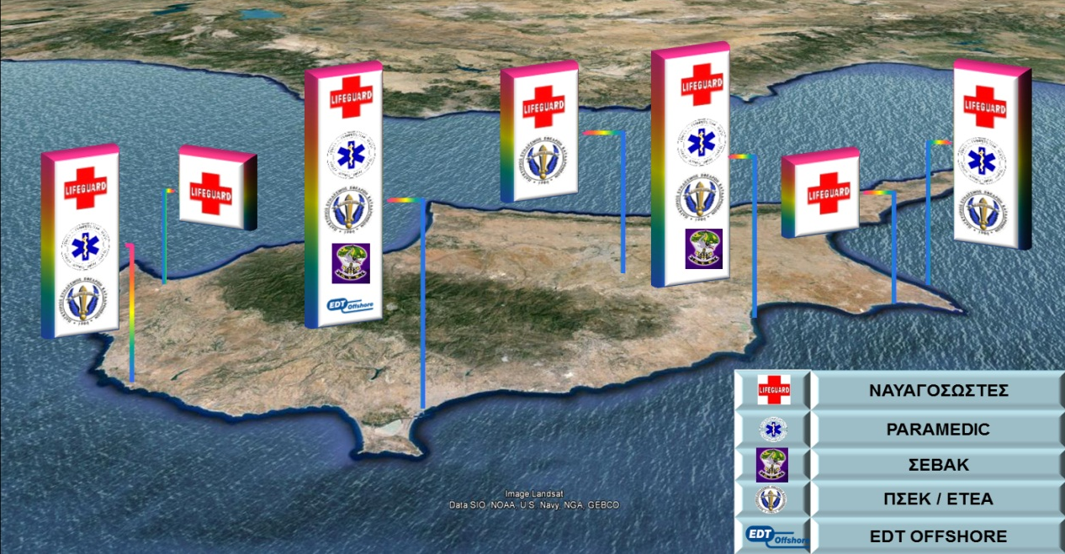
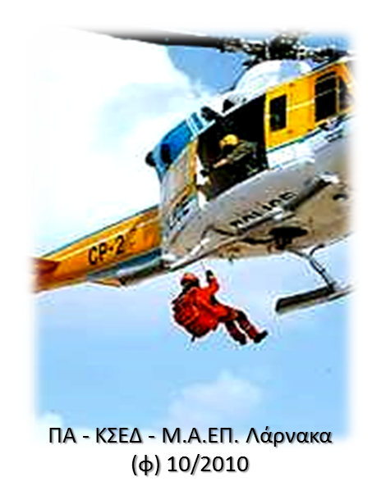
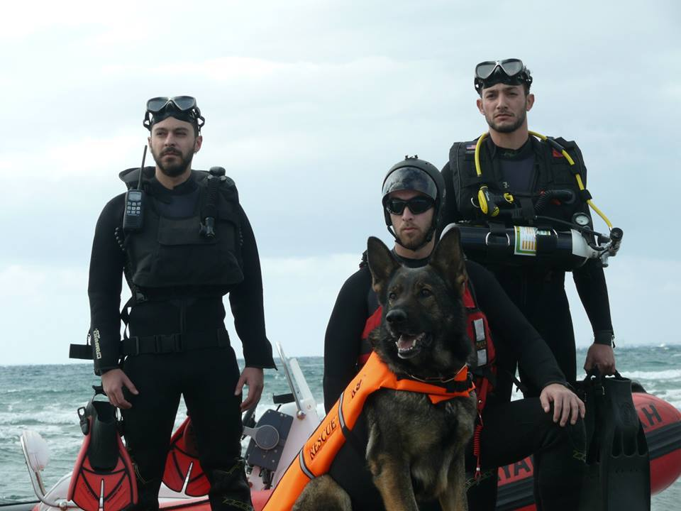
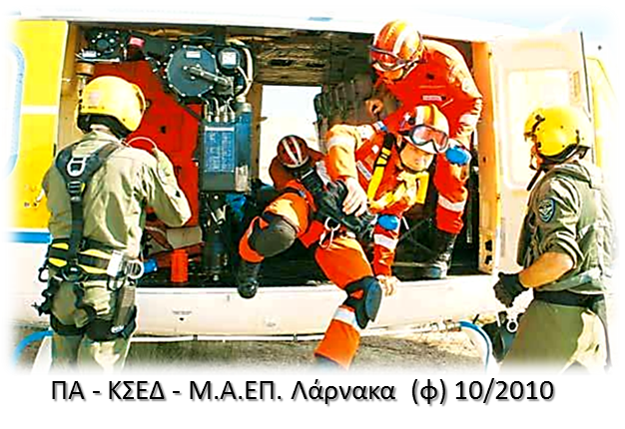
JRCC LARNACA
VOLUNTEER ORGANISATIONS
Notes:
13.
In addition … volunteer organizations assist SAR activities and we are proud that volunteers in Cyprus play an important role in our SAR System. For example.. The doctors and paramedics who board on and fly with our SAR helicopters are volunteers who respond immediately whenever they are called. click

Slide 34
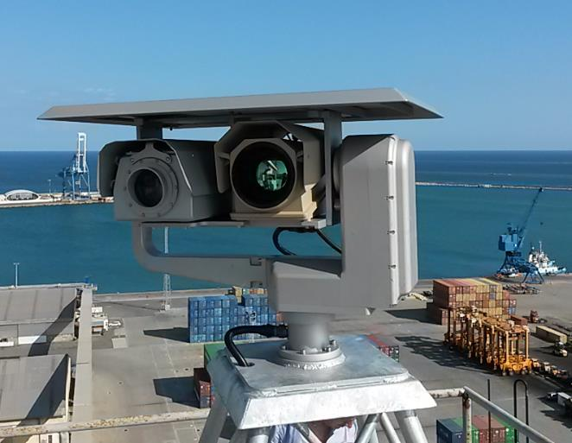


JRCC LARNACA
RESEARCH AND DEVELOPMENT 2016 - 2020
Coastal surveillance System
Thermal Camera
Model: FLIR HRC E
Range: 20Km
Detection:
Human target at 11 km
Detection of a small boat at 17,7 km
Day/Night
Model: Dat-con DAY LR 60
Range: 30Km
Human Recognition 6.6km
Car Recognition 20km
Ship Recognition 30km

Slide 35
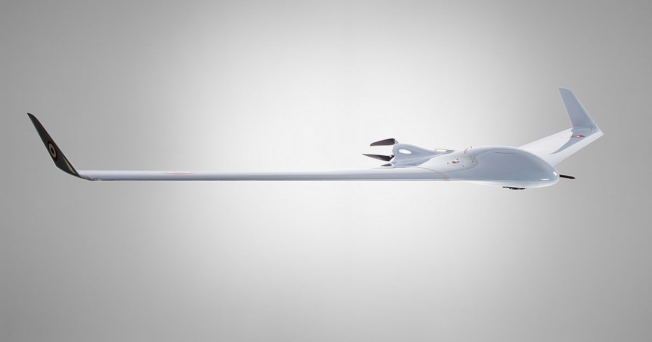
JRCC LARNACA
UAVs EXPLOITATION
Notes:
The use of UAVs is something new to us, not only as Republic of Cyprus, but also as SAR community.
We only have answers for a fraction of the questions that arise and I believe that whatever we might come up with, experience will be the best teacher. UAVs have to be used in the field in order for us to learn more about their true capabilities and restrictions. The idea of having live video feed from an incident that is 20NM away from shore, without satellite link or telecommunication network, is something really remarkable. Also, considering the development of computers, satellite systems and telecommunications, more data will be available to us, with less effort and cost.

Slide 36
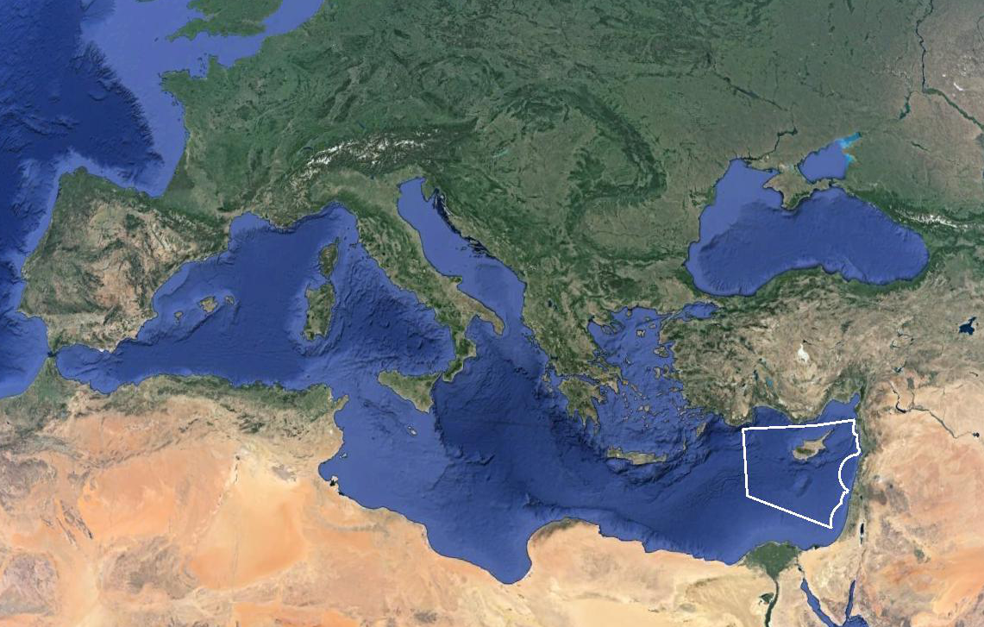
JRCC LARNACA
POLITICAL COMPONENT
INTERNATIONAL CONVENTIONS
EU DIRECTIVES
NATIONAL SAR PLAN “NEARCHOS” &
BILATERAL AGREEMENTS
OPERATIONAL COMPONENT
MULTINATIONAL SAREX
EXCHANGE KNOWLEDGE
EXTEND CAPABILITIES
ZERO LOSS OF LIVE
Notes:
17.
Obviously, Cyprus has a crucial role in the Eastern Mediterranean in case of a SAR incident. The Republic of Cyprus has the obligation to prepare and coordinate these operations within Nicosia FIR, in accordance with the international conventions and the EU Directives. Thus, JRCC Larnaca has set numerous goals, aiming to upgrade its capabilities and achieve optimal operational results.
The ultimate goal, not only for us, but for everyone involved in SAR, is to never lose a single life.

Slide 37
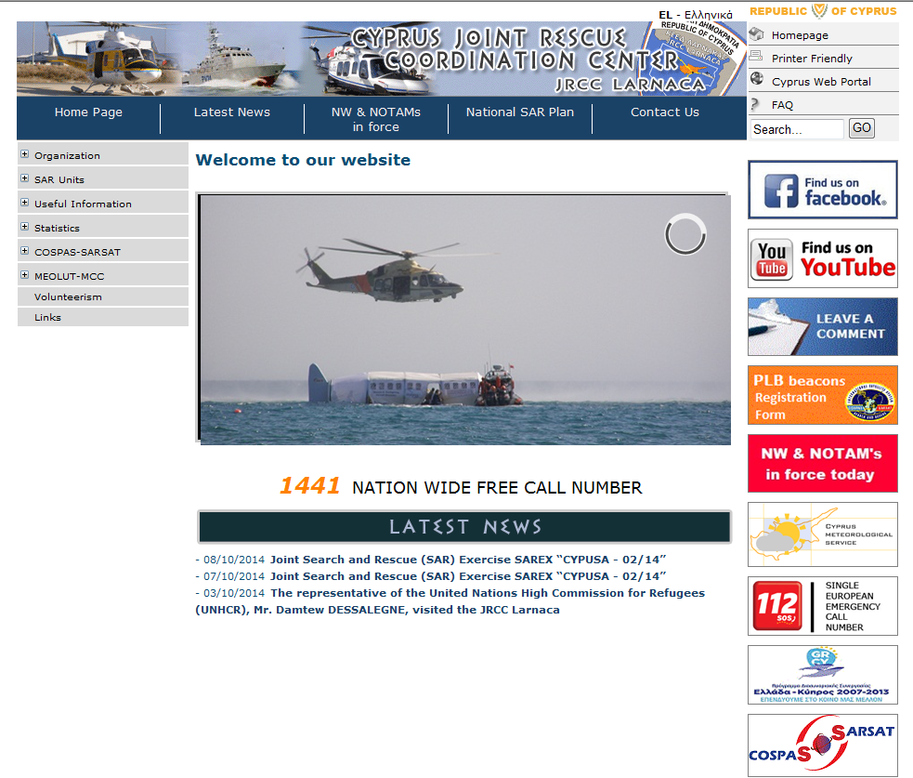

JRCC LARNACA
Notes:
31. This concludes my presentation. I would like to thank you for your time and attention. On the slide you can also find our website, where you can find information about JRCC’s recent operational and training activities, NATIONAL SAR PLAN NEARCHOS and any other relevant information. click

