Slide 1

The Importance Of Air Transportation in the Tourism Industry

Slide 2

- Does tourism demand lead to increased air connectivity?
OR
- Does increased air connectivity attract more tourists to a destination?
A Classic Question

Slide 3
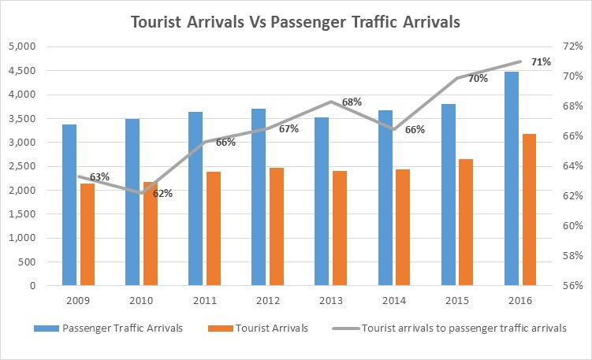
Cyprus Case – Strong correlation

Slide 4
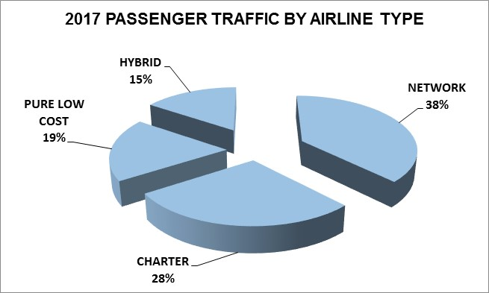
Cyprus connectivity
Balanced portfolio of airline models
77 airlines operating over 140 routes
To 115 destinations in 40 countries

Slide 5
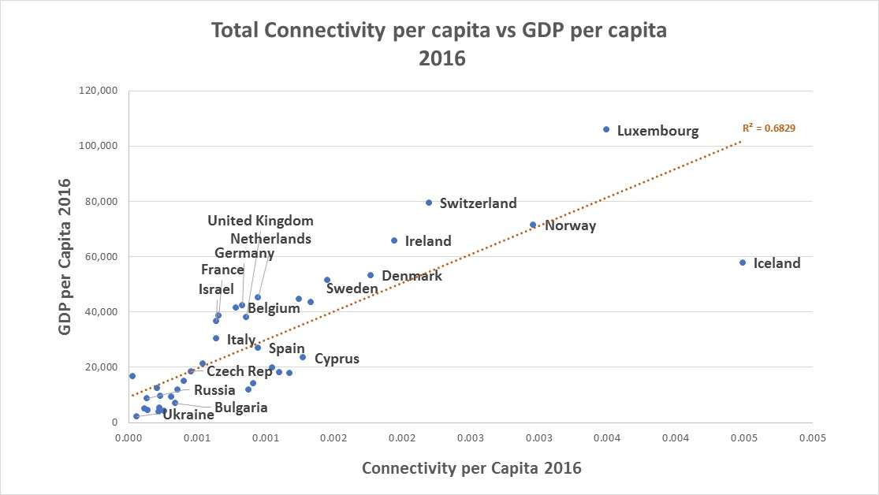
Cyprus connectivity is satisfactory
In fact it shows that the available connectivity could support a higher GDP
  Source: ACI_2016_Connectivity Report & IMF 2016

Slide 6
Challenges
Opportunities
Take advantage of unexplored customer segments in all markets
Invest in airlines that have capacity to expand and close gaps
Closer collaboration with stakeholders
National Tourism Strategy implementation
  Relatively longer sector length
  Small local market
  High seasonality
  Weak, or outdated Cyprus branding
  Low penetration of Cyprus in the individual market segment

Slide 7


Fundamental Questions – Airline’s perspective
Does Cyprus fit:
Does Cyprus:
Profitability, Risk, Investment, Opportunity Cost
Our network?
Our business model?
Our customers?
Our plan?
Work as a place to do business?
Offer the right product?(market demand)
Have the right partners?(airports, tourism stakeholders, Government)
Have a good future?/can we make money?
Notes:
Does Cyprus fit
Our network
Our business model
Our customers
Our plan
Does Cyprus
Work as a place to do business
Offer the right product and partners
Have a good future
by partner we mean everybody in this room, so all of you have an accountability
one reason why having an integrated approach to marketing the destination is essential
Important for the airline to have confidence that the destination will deliver – customers, revenue
- Confident that the stakeholders are working together effectively

Slide 8
Introduction of New Route – Airline’s perspective
Destination Branding/ Demand creation
Stakeholders’ support/incentives
Promotion of the route
Reinforcement from local travellers (outbound traffic)
1. Airline introduces two summer weekly frequencies
2. Airline’s yield and load factors satisfactory
Support at all stages is necessary
Support at all stages is necessary
4. Expansion of operation with additional frequencies
3. Extension of the season and winter operation
Hotels capacity available & affordable
Winter product offering /brand
Hotels to stay open

Slide 9

Collective power is key
  Work with airlines and stakeholders to improve seasonality
  Work closer with airlines & Tour operators in promoting Cyprus
  Support the implementation of National Tourism Strategy
  Work together with neighboring countries for attracting traffic from long haul destinations

Slide 10

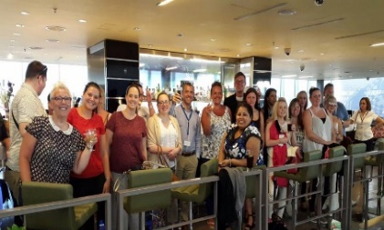
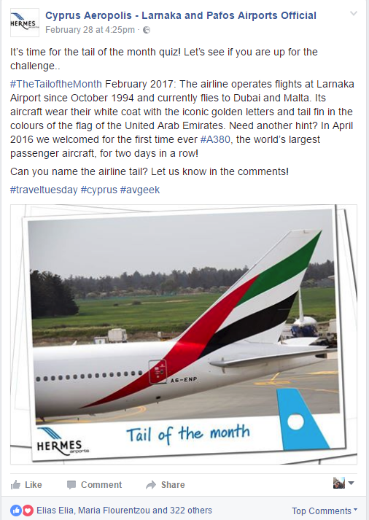
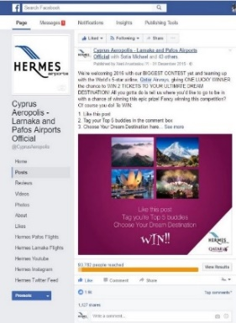
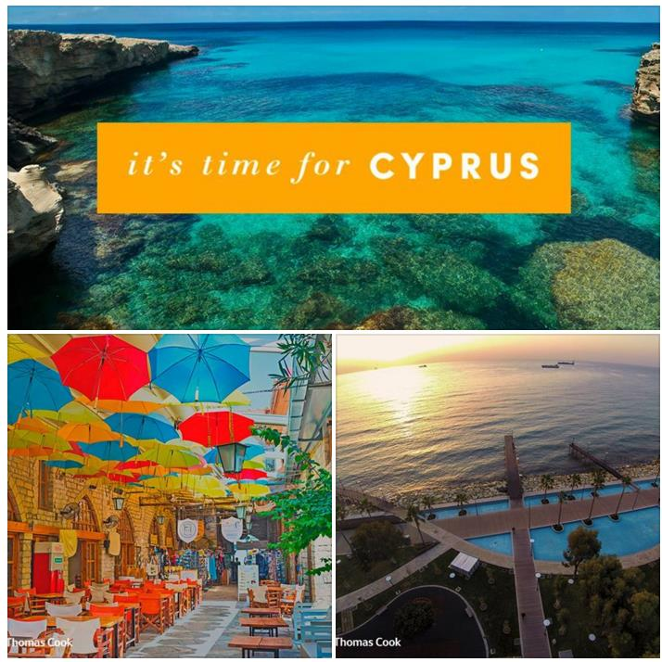
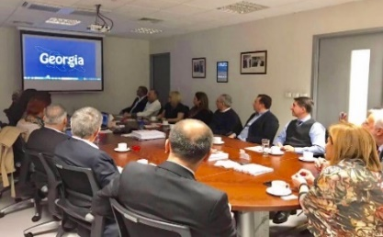
Tourism Related Marketing Activities
-
  Hermes active in promoting Cyprus as a tourism destination
  -Stakeholders’ relations-National Tourism Strategy
  -Participation in industry forums– Routes, WTM, ITB etc.
  -Marketing Campaigns – Thomas Cook, Aegean
  -Events organization – Thomas Cook, Jet 2, etc.
  -Exploring market opportunities – Israel, Georgia, Egypt

Slide 11


Thank You

