Slide 1
Προκλήσεις και προοπτικές αεροπορικών εταιρειών
Λευκωσία, 4 Μαιου, 2017

Slide 2
Aegean 2016
Full Service Carrier
Focus on quality customer service & efficiency
Fleet of 61 Aircraft: 47 A320 family + 14 Turboprops
12.5mio passenger in 2016
Star alliance member since 2010
Expanding International Network Reach
145 destinations in 45 countries in 2016 out of which 111 International
Award winning airline
7x Skytrax best regional award
Traffic in RPKs (m)
5x

Slide 3
18 years of challenges
2014-2016 Strong international expansion
2013
Olympic Air Acquired
2011
Intl traffic exceeds domestic for the fist time
2009
OA privatisation
2010
Star Alliance
2007
Listing in Stock Exchange, A320 Deliveries
Olympic
2003
First Year with Profits before Taxes
Low-cost enter Greek market
2005
Lufthansa Agreement, Airbus A320 Order
1999-2002
Air Greece acquisition
Cronus merger, First Int flights
May 1999
Domestic Deregulation. Launch of Scheduled Flights
International
Domestic

Slide 4
Aegean’s current challenges and objectives
Profitable, sustainable growth:
healthy balance sheet
Development in international markets
Focus on:
quality service to our customers: differentiation
cost efficiency/productivity: competitiveness

Slide 5
Aegean’s key levers
Continuous investment in our people, the asset that makes the difference:
skill development
training
Continuous investment in technology / process improvement for:
the customer
simplification of internal processes and the day-to-day job of our people

Slide 6
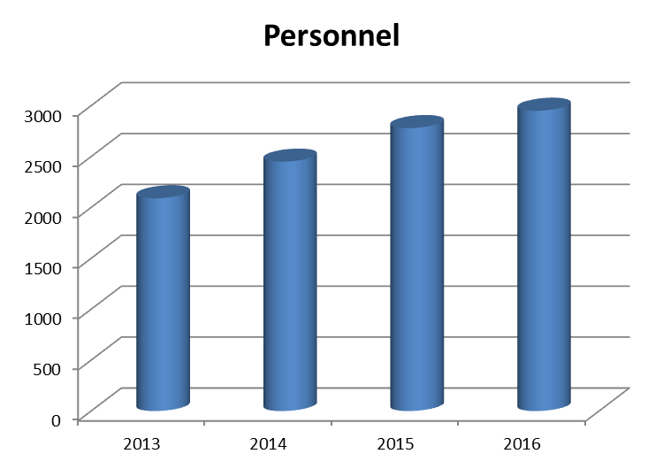
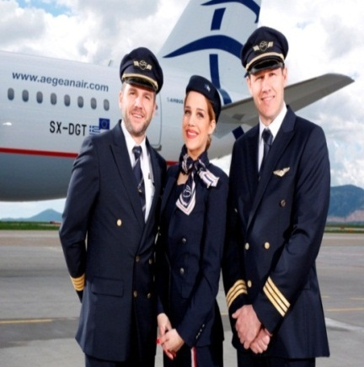
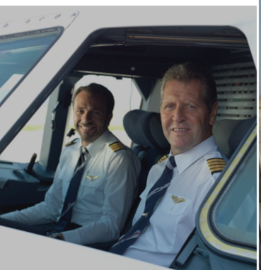
Continuous investment in our people and training facilities
3.000 employees in Summer 2016 (+900 post OA acquisition)
600 cockpit crew
1200 cabin crews
350 engineers and mechanics
ATO: Approved Training Organisation for A320, Q400 & Dash-8 (cockpit & cabin crews)
MTO: Maintenance Training Organisation for A320, Q400 & Dash-8 (mechanics & engineers)
+900 employees

Slide 7
Investment in Technology: customer service + efficiency
Continuous roll out of new services:
New responsive Booking site: My Booking, Award Booking & Rebooking Services
Flight Related Notification Services / Miles+Bonus Push Notifications
Passport & ID Scanning in Apps for Faster Check-in
Google now Boarding Pass Integration… and more to come
++10ppt

Slide 8
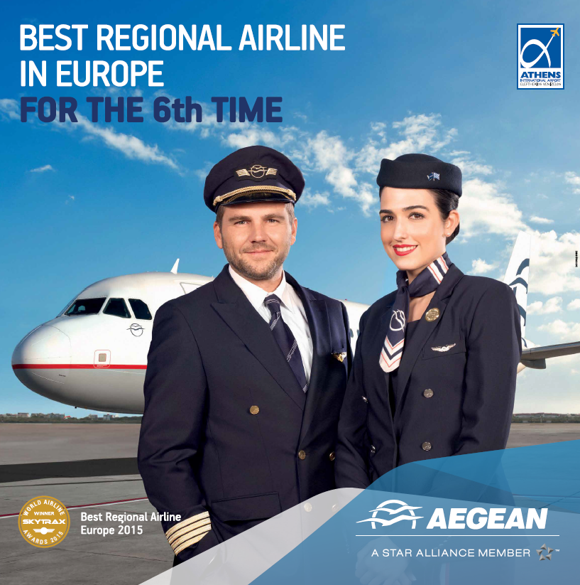
Customer service recognized internationally by passengers
Best Regional Airline
in Europe 2016
For the 7th Time
According to SKYTRAX
Best Regional Airline 2014
Best Regional Airline 2013
Best Regional Airline 2012
Best Regional Airline 2015 + 2016
Best Regional Airline 2011
Best Regional Airline 2009

Slide 9
2011-2016 Growth during the crisis: 3x more international destinations
Passengers & Available Seats from/to Athens
101
destinations
89
destinations
76
destinations
64
destinations
71
international
40
destinations
59
international
35
destinations
47
international
34
international
28
international
22
international

Slide 10
Athens main hub + 6 other A/C bases in Greece and Cyprus
2016 :145 destinations
111 international
34 domestic
% international activity by source market
Western Europe: 55%
Cyprus: 10%
Central Europe: 25%
Middle East: 10%
THESSALONIKI
ATHENS
KALAMATA
% international activity by base
Athens: 70%
Thessaloniki & Larnaca: 15%
Regional / Leisure: 15%
RHODES
CHANIA
HERAKLION
LARNACA
HERAKLION

Slide 11
Aegean’s Evolution 2013-2016
Country: Cyprus
1 Aircraft
4 Destinations
460,071 Passengers
50 Employees
14,385 Miles+Bonus Members
1 Aircraft
3 Destinations
485,634 Passengers
55 Employees
18,811 Miles+Bonus Members
3 Aircraft
11 Destinations
1,023,703 Passengers
≈100 Employees
42,547 Miles+Bonus Members
2016
2014
2013

Slide 12
2010-2016: sustainable financial performance during crisis
.. Despite 30% Loss in GDP

Slide 13
Growth & Healthy Profitability / Cash flow
 | FY:08 | FY:09 | FY:10 | FY:11 | FY:12 | FY:13 | FY:14 | FY:15 | FY:16
Total Revenue | 558.8 | 552.9 | 515.8 | 580.0 | 562.9 | 850.0 | 911.8 | 983.0 | 1,020.3
EBITDAR | 102.2 | 95.9 | 75.8 | 61.8 | 73.4 | 181.8 | 209.5 | 217.3 | 206.9
EBITDAR margin | 18.3% | 17.3% | 14.7% | 10.7% | 13.0% | 21.4% | 23.0% | 22.1% | 20%
Earnings Before Tax (EBT) | 39.9 | 32.5 | (18.7) | (31.2) | (12.6) | 70.9 | 94.9 | 100.3 | 51.6
EUR m | FY:08 | FY:09 | FY:10 | FY:11 | FY:12 | FY:13 | FY:14 | FY:15 | FY:16
Period end cash & other financial assets | 183 | 213 | 196 | 172 | 156 | 244 | 218 | 238 | 253
Payout to shareholders / Dividend - Capital returns | 18 | 9 |  |  |  | 71 | 50 | 50 | 28.6

Slide 14
Efficiency & competitiveness
High Quality but CASK equal to LCC easyJet with 30% shorter segment length
2013-2016= 11% reduction
unit costs ex fuel
 | Aegean | easyJet
Stage Length KM | 860 | 1,120
Model | Full Service | Low Cost
Fleet | Mix Airbus & Turboprops | Airbus only
Costs per ASK - € cents | 5.90 | 5.60
Source: A3, Companies annual reports

Slide 15
Looking forward / back to basics: service quality + efficiency
Our basis
& Industry dynamics
Our
Strategy / Vision
Solid Balance Sheet
Further exploit network synergies and connectivity
Distribution cost initiatives
Efficient cost structure
Cost discipline on controllable costs
Strong positioning on key markets
IT / ecommerce investments / Value cycle loyalty enhancements
Flexibility
Weak economy remains
Increased reliance on incoming leisure
Focused on customer service
Training & Skill development of our people

Slide 16
THANK YOU

