Slide 1
COBALT AIR
Challenges and Opportunities in Cyprus
Andrew Madar CEO

Slide 2
INTRODUCTION
Cobalt Air is a scheduled airline based in Cyprus serving destinations in Europe and Middle East.
Cobalt Air is a hybrid airline. It uses elements from both the Low Cost Carriers and Full Service Carriers cost and revenue wise. The main scope of the airline is to serve the worldwide market, initially short haul and later long haul, by offering a distinct branded product.

Slide 3
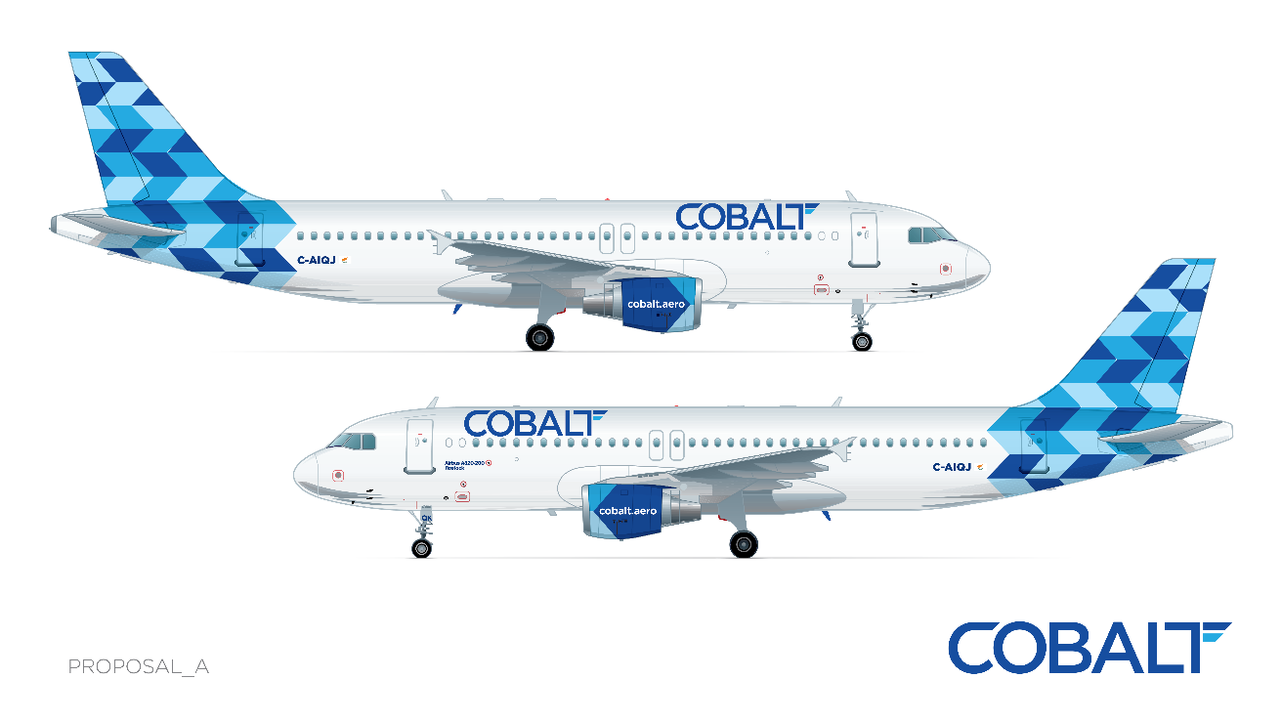
Cobalt Air Main Objectives
Operational Safety
Customer Satisfaction
Increased Revenue through product quality and ancillary services
Lower Direct Operating and Fixed Costs through cost cutting measures

Slide 4
CobaltAir Fleet and served destinations
Currently Cobalt Air utilizes an all Airbus fleet and is comprised of 2 A319,s and 4 A320’s serving 14 destinations.
ATH (Athens Greece)
SKG (Salonica Greece)
HER (Heraklion Greece)
CHQ (Chania Greece)
STN (Stansted London UK)
MAN (Manchester UK)
BHX (Birmingham UK)
MAD (Madrid Spain)
ZRH (Zurich Swiss)
CDG (Paris France)
IKA (Teheran Iran)
TLV (Tel-Aviv Israel)
BEY (Beirut Lebanon)
DUB (Dublin Ireland)

Slide 5
opportunities and advantages
Cyprus Political System - Stable, democratic, business friendly
Population - Skilled and dynamic population. Heavy travellers!
Region - Air travel opportunities in the region resulted from nearby political and economic instabilities (Turkey, Egypt, Syria, etc.). Redirecting investments and tourism waves to Cyprus.
Geography / Location - Cyprus is ideally located in eastern Europe and just 30 minutes flight from the closest port of Middle East (Lebanon). The location gives airlines operating from Cyprus an advantage in terms of serving passengers from one continent to another, using low cost short haul aircrafts.
Neighbouring countries - Cypriot identity of Cobalt gives the airline an advantage of being able to make use of the bilateral agreements in place, between Cyprus and third countries other than the already established agreements with the EU.

Slide 6
COMMERCIAL CHALLENGES
Seasonality of Cyprus destination
Summer peaks and winter dips in traffic flow, and winter closures.
Capacity and Quality of hotels, facilities and accommodations.
Aerospace Restrictions
Turkey’s overflight ban; time and fuel penalties; Cypriot vs. non Cyprus registered aircraft.
Routes to the east overfly conflict zones and countries with troubled relations between them.
Competition
Increased competition from European Based Airlines.
Strong hubs in the Area

Slide 7
COMMERCIAL CHALLENGES
Non-Schengen status
Visa’s to Cyprus
Local Airports
High Costs → Operating Costs
Capacity - Single runway; Passenger areas, Jetways
Facilities - No airport hotel, minimal shopping / restaurants
Transportation from/to airport – Limited means available
Small local population
Larnaca!

Slide 8
OPERATIONAL CHALLENGES
ATC - Navigation aid infrastructure not up to European standards.
CAT I ILS
No approach radar
DCA Manpower - Reduced civil aviation manpower results in delaying approvals of operational nature.
Location
Location of Cyprus does not allow for satisfactory crew and aircraft utilisation (mainly for European destinations).
Close proximity to the sea creates corrosion problems on the aircraft structure and humidity affects the electronic systems.
Increased bird strike incidents.

Slide 9
THANK YOU

