Slide 1
Hermes Airports
Larnaka and Pafos

Slide 2
Safety Systems – Results YTD
SMS
OH&S
Wildlife
Environmental
40
50
60
40
50
60
40
50
60
40
50
30
70
30
70
30
70
30
60
20
80
70
20
80
20
80
20
80
10
90
10
90
10
90
10
90
0
100
0
100
0
100
0
100
  No serious safety
  Incidents,
  SPIs met
No serious airport
employee and/or
public injury
SPIs Exceeded
PFO specific action plan
  No significant
  environmental issues
All Safety Management Systems Are Functioning Proactively

Slide 3





Accreditations
  Energy
ISO 5001:2001 for Energy Management System – NOV 2016
  Carbon Accreditation
Airport Carbon Accreditation at Level 1, LCA & PFO - DEC 2016
Proceeding for Level 2
  OH&S
  Final Stages OSHAS 18001
  Environmental
  Final Stages EMAS & ISO14001:2015

Slide 4
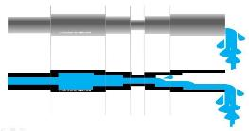

Passenger Control Process Flow

Slide 5
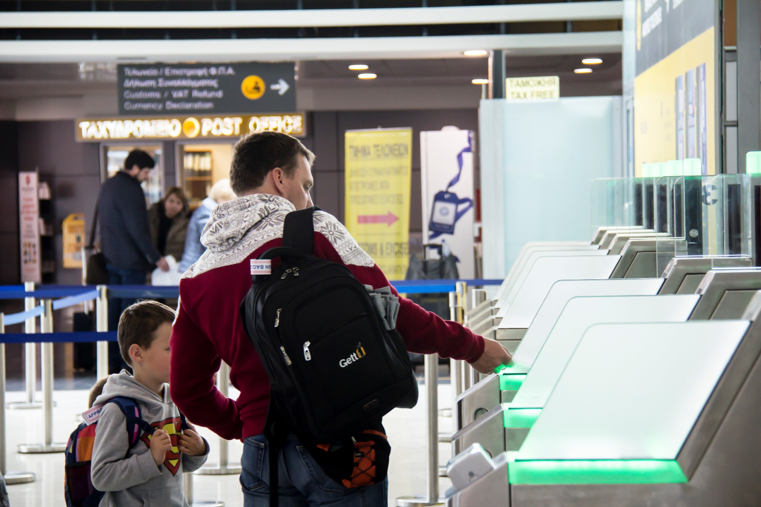
Efficient use of Facilities & Systems
  Use of Technology to improve efficiency vs deploying traditional infrastructure methods
  Alternative Check In methods
    CUSS with Baggage labels
    Remote Check in abilities
    Bag Drop
    Web Check In
  Boarding Card Gates
    7 E-Gates installed in LCA
    4 E-gates to be installed in PFO

Slide 6
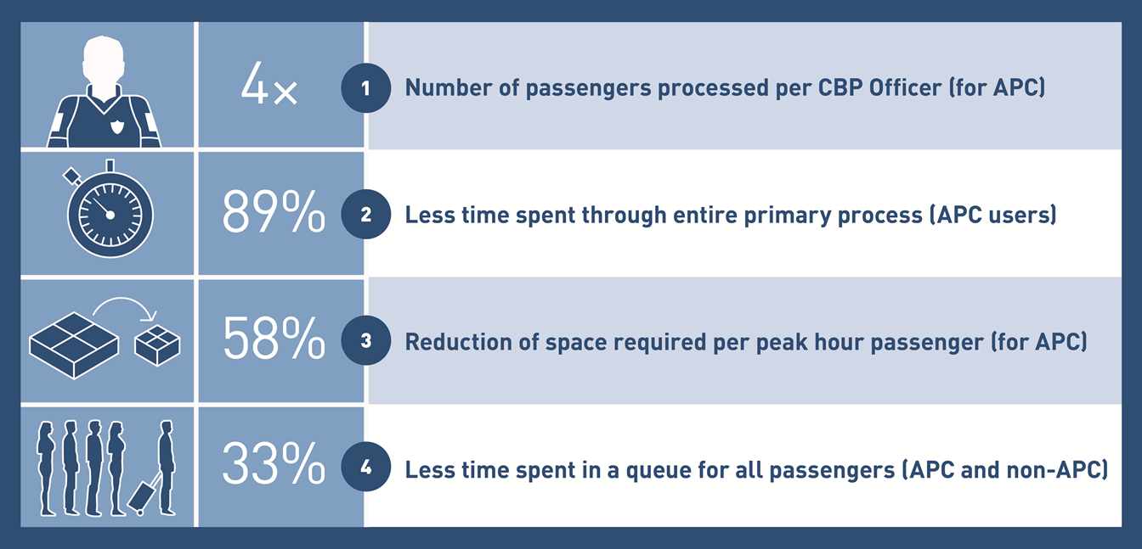
Efficient use of Facilities & Systems
  6 BorderXpress kiosks to be deployed in Pafos in June
  Greater throughput
  Faster process time
  Less queuing time

Slide 7
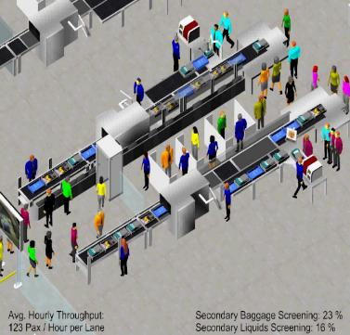
Aviation Security provision
Transition to finish end of June
Quality / Compliance Control & Customer Care terms to be fully observed
Expected to increase throughput by matching resources to traffic profile

Slide 8
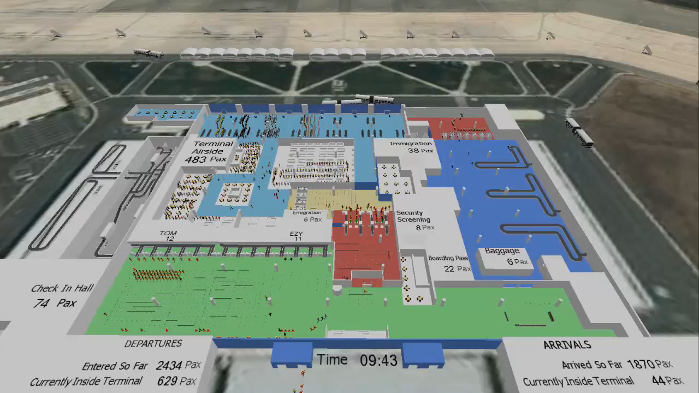
Efficient use of Facilities & Systems
  Capacity study for both airports
  Simulation based
  Assess proposed technology on merit
  (cost, benefit, efficiency)
  Examine impact on capacity & future
  Internal team to assess new technologies
  See technologies deployed
  Discussions with TOs regarding remote check in possibilities
  Modifications to existing stands and gates to be able to receive more traffic

Slide 9

Seamless Customer Experience
(SCOTT BELSKY)

Slide 10
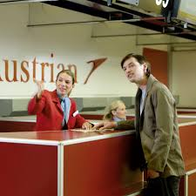

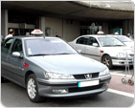

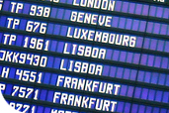

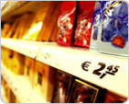
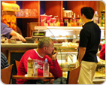
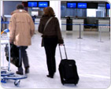


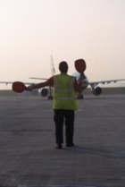

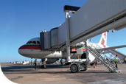
Airports – The most complex “service chain”
Airports are undoubtedly the most complicated “service chain”, whereby stakeholders each have their own customer care “philosophy” which directly influences the way a customer “feels”
6

Slide 11

Passengers’ Expectations…
  Clean premises
  Good ambience
  Welcoming attitude by staff
  Efficient and smooth processes with minimum inconvenience
Notes:
Premises does not refer only to Hermes. It also refers to the airline signage, to the Retail and F&B outlets.

Slide 12
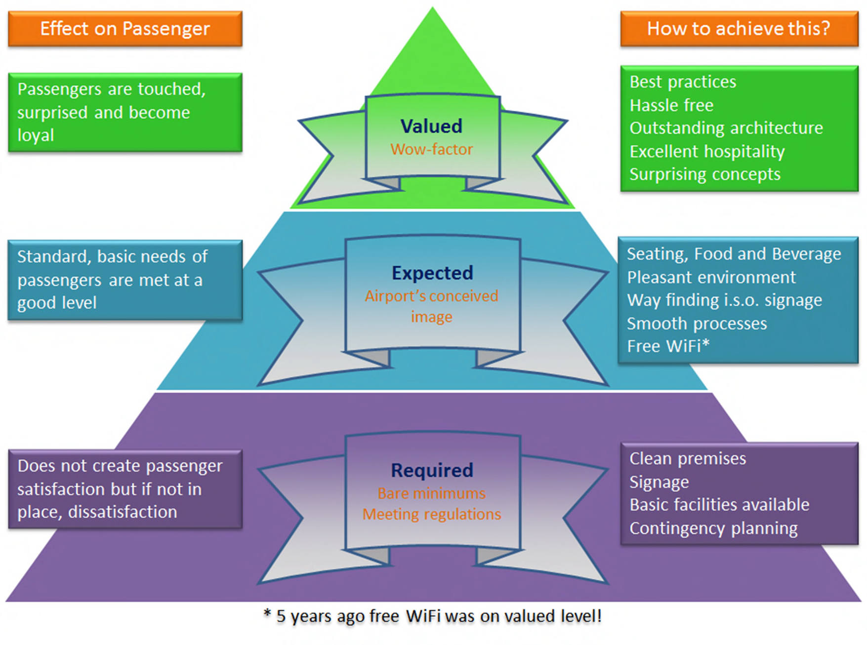
The Passenger Experience Pyramid
Notes:
How can we provide Great passenger experience – By recognising what is important to them.

Slide 13

What influences the passenger experience?
Processes
People
Premises
Customer Experience

Slide 14
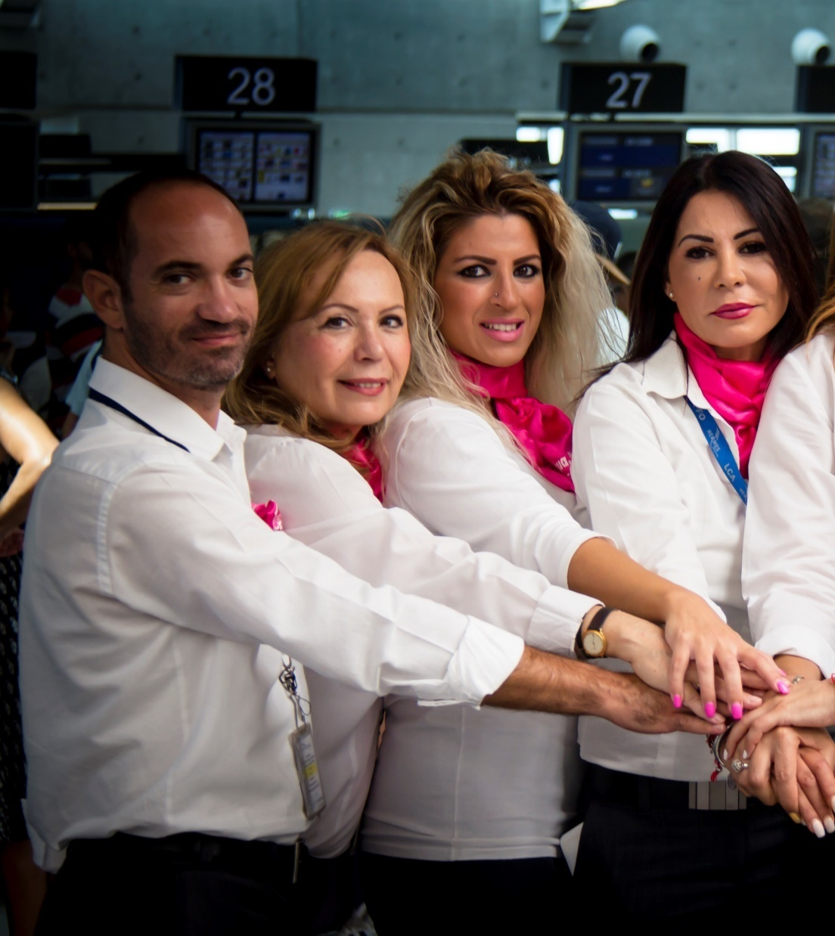
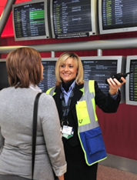
Example - PEOPLE - Acting as “Good Hosts”
“Guests” not passengers
“Connecting” with guests – not simply talking to passengers
Genuine feeling of care by staff
Bidding “Welcome” & “Goodbye”
Anticipating and acting pro-actively

Slide 15

Customer Care Strategy
“MIMIC”
MOVE
INFORM
MEASURE
INVOLVE
CARE
Reflecting Best International practices

Slide 16
Customer Care Strategy 2014 - 2018
customer service is not a department – It’s Everyone’s Job!
Strategy Key Word | MOVE | INFORM | MEASURE | INVOLVE | CARE
Strategy | Enable customers to quickly, easily, and pleasantly move throughout the airport facilities. | Provide customers with the information they require when, where and how it is needed. | Continually measure and improve customer satisfaction and service quality of all services and processes. | Involve stakeholders to deliver leading experience as judged by the customer. [Stakeholders are both internal (Hermes teams, employees and sub-contractors) and external (e.g. partner companies such as airlines, Retail, F&B, etc.).] | Care for employees, volunteers and partners who serve the community, and in so doing, care for our customers (passengers, visitors, airlines).
Objectives | Anticipate passenger traffic and engage entities to be prepared . React effectively to real-time bottlenecks | Provide essential passenger information that assists with optimizing the passenger experience. | Develop and implement a Customer Survey System for internal and external customers. | Develop standards and programs that sustain and celebrate the entire airport community's involvement in, and contribution to, world-class customer care. | Listen to employees and partners, thus enabling them to better serve our customers.
 | DAILY OPS COORDINATION MEETINGS WITH MAIN STAKEHOLDERS - Host preparation / coordination briefings between the Hermes and other frontline entities such as handlers (passenger and ramp), Police Security, Immigration, Retail and Food & Beverage in anticipation of passenger traffic for awareness and preparation. Brief all stakeholders on anticipated traffic and peculiarities. | HERMES AIRPORTS HOSPITALITY PROGRAM - Introduce the "Hermes Hospitality Program" whereby during the summer months we can employ students or Volunteers who will act as hosts to passengers and visitors alike in key areas, as and when required. Before taking up their duties, this team will need to be fully trained in Customer Service and have a good operational know-how. | ENRICH THE CUSTOMER SATISFACTION SURVEY PROGRAM - Enrich the existing customer satisfaction program to provide better coverage for arriving passengers, while at the same time allowing additional questions aiming to focus on specific problematic areas that were identified in previous waves. This will allow effective interpretation of the problematic areas that are deem to be scoring low in repeated survey waves. The results will be shared results with relevant stakeholders to enhance the customer experience. | FORMAL PROFESSIONAL QUALIFICATION FOR TOURISM - Engage and lobby the Ministry of Transport to create a professional qualification for people that are involve in the tourism industry that will also include a significant training element in customer service | RECOGNITION PROGRAM - Setup a Hermes Recognition Program designed by the "Recognition Working Group", geared to recognise exceptional customer care. Use this program as a basis to create a greater program for the airport community to recognise and reward staff and organisations that have been singled out for providing consistently exceptional customer care on an annual basis.
 | WEEKLY COORDINATION MEETINGS WITH POLICE AND IMMIGRATIONS - Proactively provide weekly forecasts of anticipated traffic flows and collaborate with Immigration & Police to help them optimize their roster ensuring that their staffing levels will meet the traffic peaks. | COMPLAINT MANAGEMENT SYSTEM - Launch a complete complaint management handling system that will enable the company to respond promptly to all complaints while creating the feeling to each complainant that he/she is treated respectfully with a personal touch. Identify complaint trends and create action plans with relevant stakeholders to improve customer experience. | INTERNAL CUSTOMER SATISFACTION SURVEYS - Introduce additional internal surveys to measure customer satisfaction attributes that relate to staff of airlines and handlers and other tenants and stakeholders aiming to establish levels of satisfaction among these groups. | CUSTOMER CARE TRAINING QUALIFICATION - Develop and roll-out Customer Care "Train the Trainer" Training for both the Hermes Team and the greater stakeholder environment at LCA & PFO. The aim will be for this program to become the core element of the formal professional qualification for the tourism industry. | UNIFORMS FOR FRONTLINE STAFF AND VOLUNTEERS - Introduce a new uniform for Hermes Front-Line and Volunteer Staff. Create a climate of "wear it with pride" and "we make a difference".
 | USE TRACKING TOOLS FOR REAL-TIME ALERTING OF PASSENGER MOVEMENT THROUGH THE TERMINALS - Use passenger tracking tools to develop real time alerts of forming bottlenecks. Produce reports that depict patterns and habits of passengers and use these in upcoming facilities allocation. | SOCIAL MEDIA INFORMATION - Support monitoring of social media that relate to Hermes . Respond to real time inquiries and alert the company when crisis tend to be created. Facilitate the response during crisis periods based on the instructions of the management. | INSTALL FOCUSED CUSTOMER SATISFACTION MEASURING TOOLS - Use focussed purpose build tools such as the "HAPPY OR NOT?" system to survey targeted areas such as cleanliness of toilets or baggage delivery service, thus obtaining direct satisfaction level indicator for certain areas that are under constant perception that are not performing well. | DISABILITY TRAINING EXPERIENTIAL WORKSHOP - Provide annually Disability & Equality Awareness Training to PRM Service Provider at LCA & PFO, as required by EU Reg. 1107/2006, with a focus on an experiential workshop. | FEEDBACK MECHANISMS FOR STAFF - Setup feedback mechanisms from Hermes teams and partners to identify gaps and create opportunities to equip them with, e.g., training, skills, facility enhancements, and tools to best serve customers.
 | QUEUE MANAGEMENT - React to Check-In queues in real time, assist with Queue Management Set-Up, replace or second Boarding Card Check-Point so as to release Boarding Card Officer to facilitate the opening of an additional Screening Point. | AIRPORT MOBILE APP - Explore the opportunity to create an Airport Smart Phone Application, via which customers can access relevant information at any time, including flight status updates, retail promotions, etc. | PEAK TIME USAGE MONITORING OF TOILET BLOCKS - Implement a system whereby the time interval between the time that toilet blocks are cleaned is recorded, monitor and if needed adjusted to meet the traffic demand. | FACILITATION MEETINGS - Lead various facilitation meetings that relate to the use of the airport facilities in a manner that all the stakeholders are both involved and motivated to improve the passenger processes. | RAISE THE EXPECTATION THROUGH PRIDE - Continually enhance the customer service skills of all Hermes front line staff creating the feeling that Hermes is the industry leader in Customer Service and Care provision.
 | MEETINGS WITH AGENCY HEADS aiming to change patterns and behaviours in an effort to move people efficiently. | PASSENGER RIGHTS - Embark on passenger rights information campaigns in conjunction with the Department of Civil Aviation (DCA). Display passenger rights in clear and easy to comprehend manner. | USE TRACKING TOOLS FOR DETERMINING PATTERNS IN PASSENGER MOVEMENT THROUGH THE TERMINALS - Use passenger tracking tools to develop meaningful reports on how the passengers move through the terminals. Use this reports to depict patterns and habits of passengers and use these in upcoming facilities allocation. | CUSTOMER SERVICE & DISABILITY AWARENESS TRAINING FOCUSSED FOR TRANSPORT PROVIDERS - Set a Customer Service Training & Disability Equality Training for Taxi Drivers as a prerequisite for them to work at the airport. Eventually this may also form part of the formal professional qualification for the tourism industry | ENGAGEMENT PROGRAM - Engage employees and, where possible and appropriate, airport partners in identifying issues and opportunities, and empower them to find, or facilitate provision of, solutions.
 | Enhance the overall passenger experience in relation to security screening formalities while expediting the overall process | TOURIST INFORMATION KIOSKS - Lobby the Ministry of Tourism, the Cyprus Tourist Organization as well as local municipalities to set up Interactive kiosks for promoting Cyprus. | MYSTERY PASSENGER PROGRAM Explore the possibility of introducing a "Moments of Truth" Mystery Shopper Program with Quarterly reports and "live" video footage - to be presented to relevant stakeholders for improvement purposes.

Slide 17

INVOLVE – Part of the MIMIC Strategy
  STRATEGY
  Involve stakeholders to deliver leading experience as judged by the customer
  OUTCOME
  The airport community is engaged in cooperatively serving the customer, celebrating service quality excellence
  ALL STAKEHOLDERS WORKING TOGETHER
  “AS ONE”

Slide 18

Collaboration “As One”
One goes faster, but all together we go further!

Slide 19

Use a variety of tool to reach and motivate
Cross Functional Working Groups to draw on the collective experience and perspectives
Develop accountability for each part of the passenger journey
Establish a Customer Care Forum to share best practices
One goes faster, but all together we go further!

Slide 20

Implementing the concept to the whole industry
“End to End” exceptional Customer Care
Improved “Tourism Product” for Cyprus
Accreditation for all stakeholders in the tourist industry

Slide 21
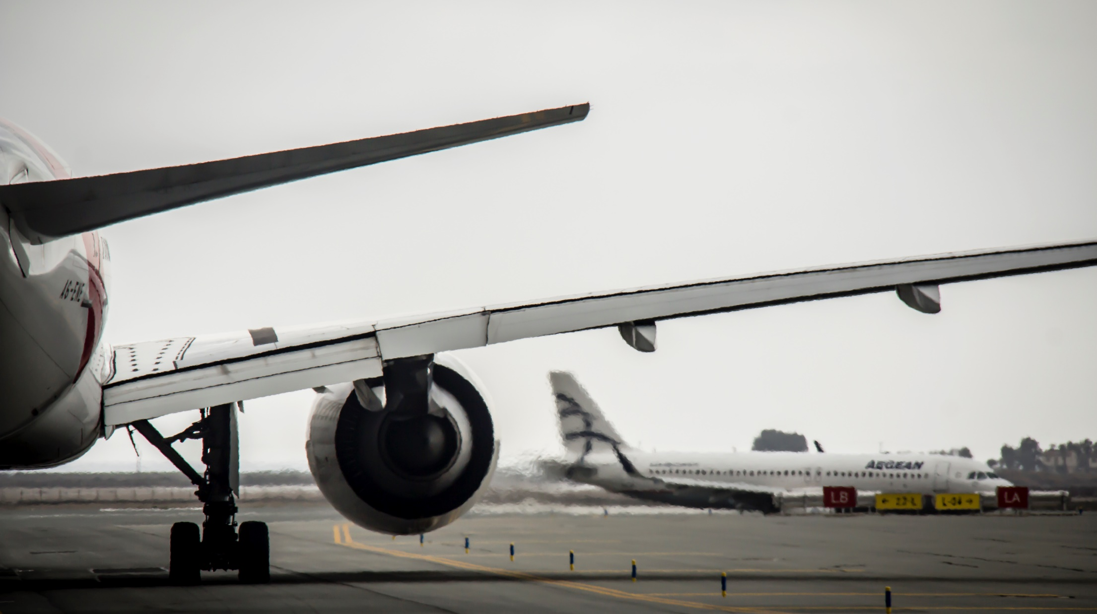

Thank you for your attention

