Slide 1
AVIATION TRAINING & EDUCATION
Prospects in Cyprus
Vangelis Demosthenous
ETHICS. STANDARDS. VALUES.

Slide 2
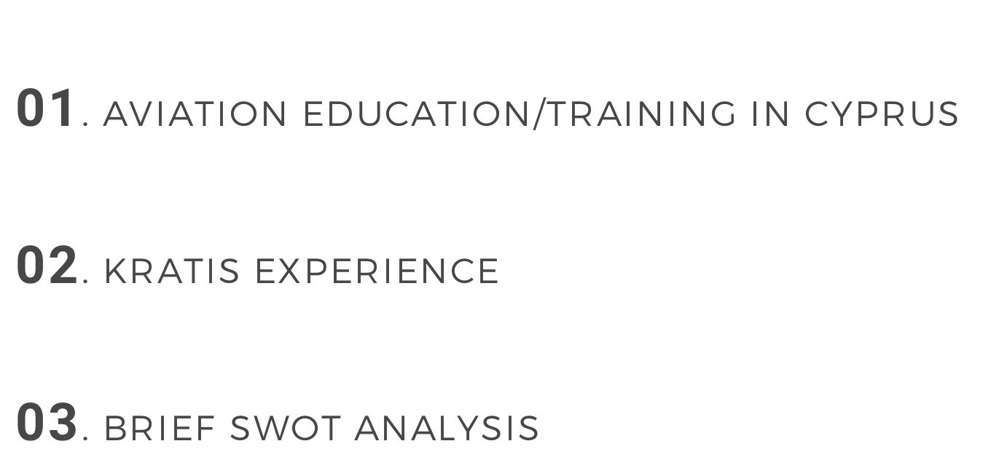
OUTLINE
01. AVIATION EDUCATION/TRAINING IN CYPRUS
02. KRATIS EXPERIENCE
03. BRIEF SWOT ANALYSIS

Slide 3
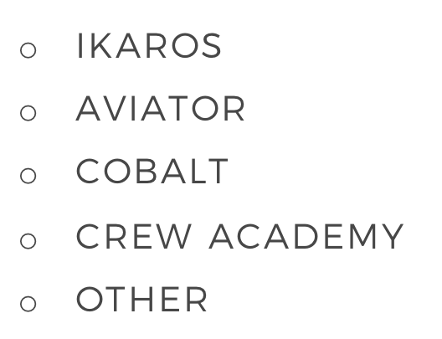
TYPES OF TRAINING/EDUCATION
PROFESSIONAL
ACADEMIC
SPECIALISED
IKAROS
AVIATOR
COBALT
CREW ACADEMY
OTHER
SEVERAL
(ONLY COLLEGE-LEVEL)
KRATIS
OTHER

Slide 4
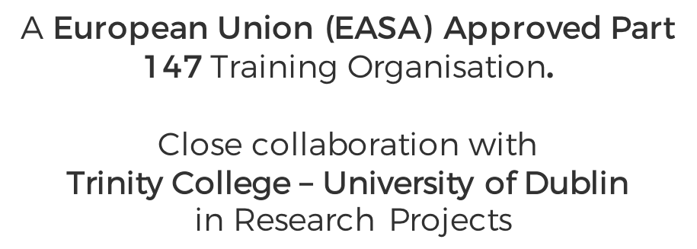
ABOUT KRATIS
The company was
established in 2005
A European Union (EASA) Approved Part 147 Training Organisation.
Close collaboration with
Trinity College – University of Dublin
in Research Projects

Slide 5
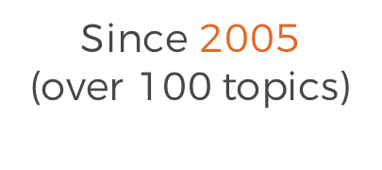
SPECIALISED
Since 2005 (over 100 topics)
PROFESSIONAL QUALIFICATION
Engineers Licence (EU) Airbus A320 2017
ACADEMIC
University of Cyprus 2017
Trinity College Dublin 2016

Slide 6
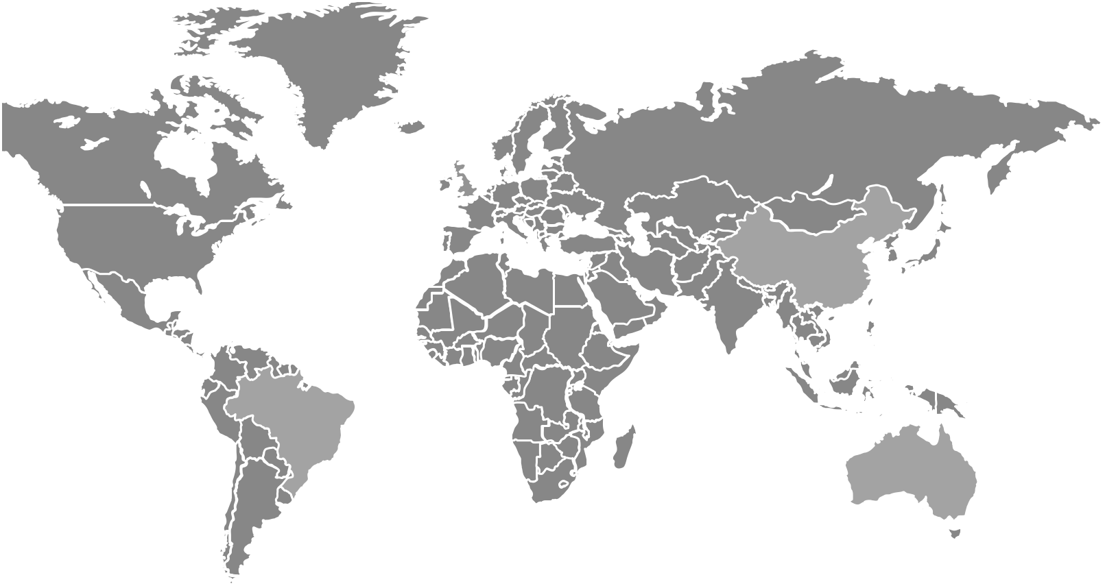
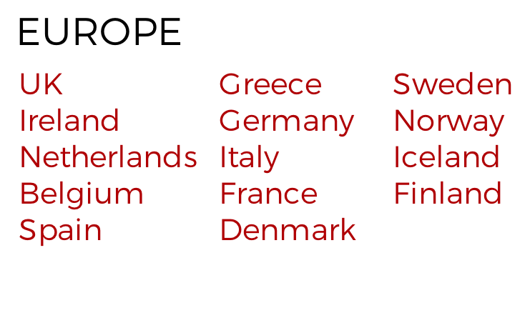
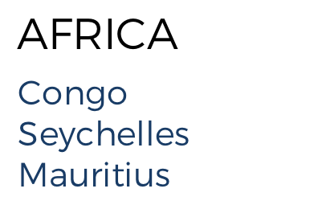
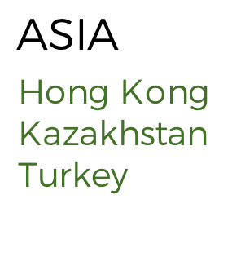
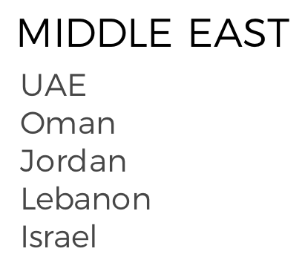
GLOBAL
PRESENCE
Our Clients around the globe
EUROPE
AMERICA
AFRICA
ASIA
MIDDLE EAST
UK
Ireland
Netherlands
Belgium
Spain
Greece
Germany
Italy
France
Denmark
Sweden
Norway
Iceland
Finland
USA
Canada
Brazil
Congo
Seychelles
Mauritius
Hong Kong
Kazakhstan
Turkey
UAE
Oman
Jordan
Lebanon
Israel

Slide 7
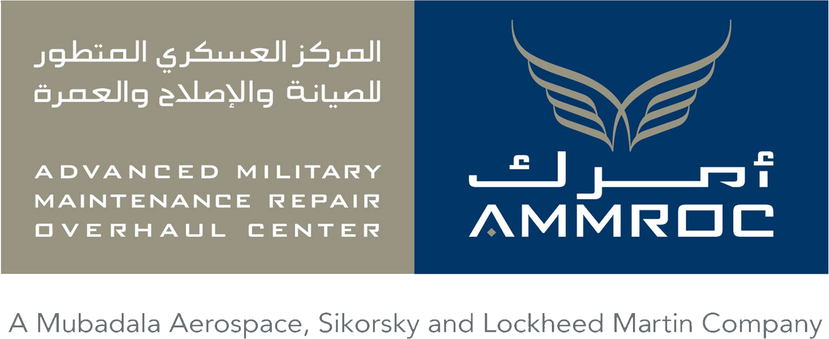
CLIENT PORTFOLIO
We are honored to work with numerous reputable brands worldwide

Slide 8
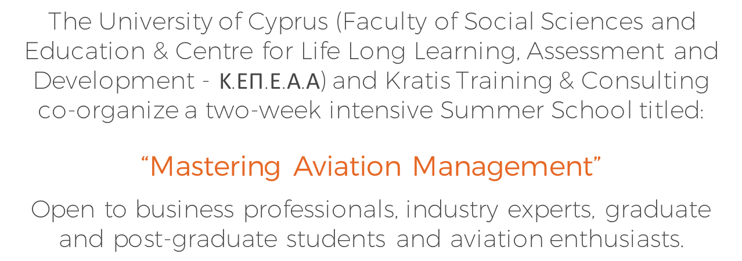
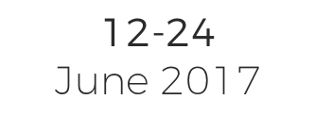
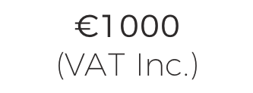
Aviation Summer School
An Innovative Program
The University of Cyprus (Faculty of Social Sciences and Education & Centre for Life Long Learning, Assessment and Development - Κ.ΕΠ.Ε.Α.Α) and Kratis Training & Consulting co-organize a two-week intensive Summer School titled:
“Mastering Aviation Management”
Open to business professionals, industry experts, graduate and post-graduate students and aviation enthusiasts.
12-24
June 2017
University
Of Cyprus
€1000
(VAT Inc.)

Slide 9
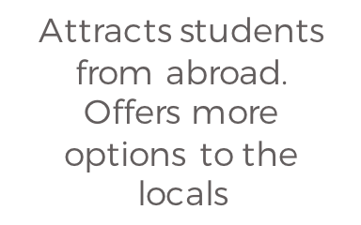
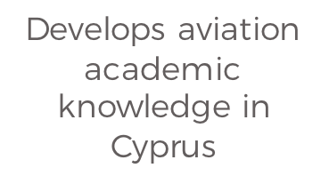
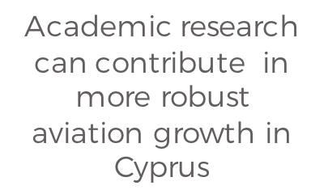
MASTERING AVIATION MANAGEMENT
BENEFITS
1
2
3
Attracts students from abroad. Offers more options to the locals
Develops aviation academic knowledge in Cyprus
Academic research can contribute in more robust aviation growth in Cyprus

Slide 10
IMPORTANT PRINCIPLE &
SUCCESS FACTOR
Dedication to High Standards

Slide 11
BRIEF S.W.O.T.
AVIATION EDUCATION/TRAINING IN CYPRUS
STRENGTHS
WEAKNESSES
Location
S
W
Sometimes not fully dedicated to standards
Weather
Security
Support from the State
Open to cultures
Professionals
EU Standards
O
T
OPPORTUNITIES
THREATS
International demand for pilots and engineers
Competition (training)
Stability of aviation industry in Cyprus
Demand for academic courses

Slide 12
CONCLUSIONS
Aviation training in Cyprus: significant activity
Aviation academic education (accredited) is very limited
There are huge potentials for both
Further development can bring multiple benefits
Dedication to high standards – it is not optional

