Slide 1


Education in Aviation

Roxani Athousaki
Lecturer in Aviation
School of Mechanical, Aerospace and Automotive Engineering
Faculty of Engineering, Environment and Computing






« Αερομεταφορές στην Κύπρο / Προκλήσεις και Ευκαιρίες / Σημασία για τουρισμό»

Slide 2
Agenda
A Global Industry
Education in Aviation
Roxani Athousaki

Slide 3
What industry are we in?
Roxani Athousaki

Slide 4
Aviation is a Global Industry
Economic and Social Benefit of Air Transport
Air transport drives economic and social progress
It connects people, countries and cultures
It provides access to global markets
It generates trade and tourism
It forges links between developed and developing nations
Sourcehttp://www.atag.org/ assessed Sep 2016
Study conducted by Oxford Economics on behalf of the Air Transport Action Group (ATAG)
Roxani Athousaki

Slide 5
A Flight to Remember
1st Scheduled Airline: Air Boat Line
Route: St Petersburg – Tampa FL 01/01/1914
Benoist Type XIV
1 pax
Source: http://www.space.com/16657-worlds-first-commercial-airline-the-greatest-moments-in-flight.html
Roxani Athousaki

Slide 6
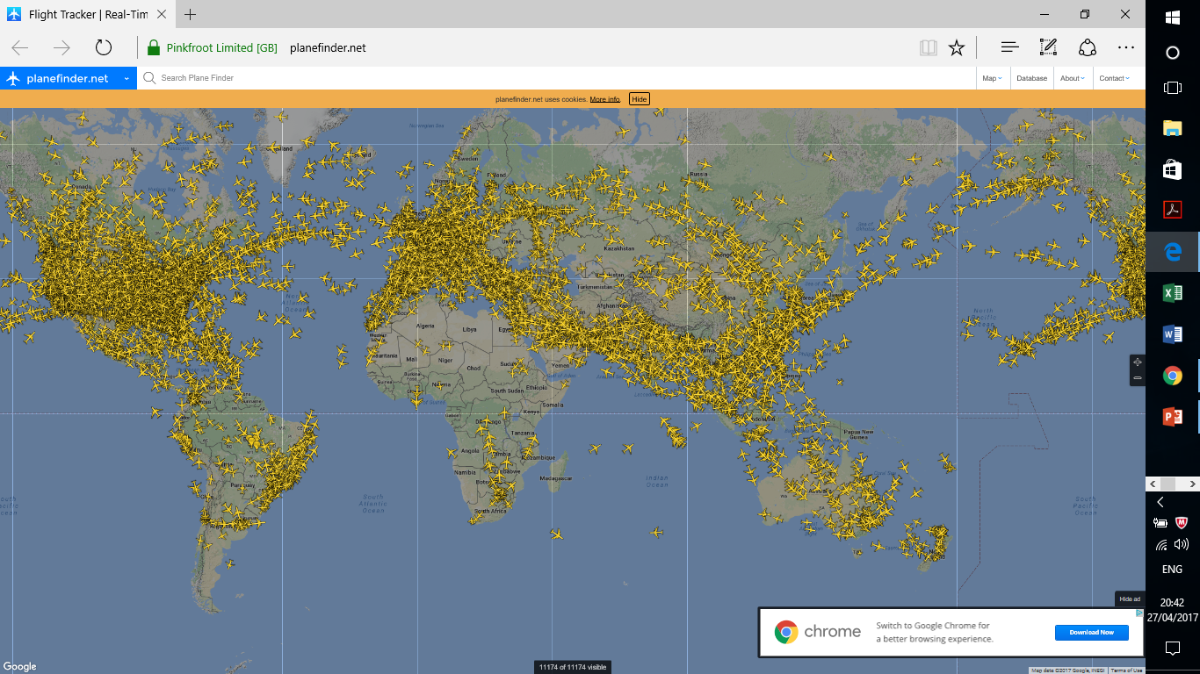
Aviation is a Global Industry
How the Sky looks like on a Thursday afternoon……
Source: https://planefinder.net/ assessed 27 Apr 2017
Roxani Athousaki

Slide 7
Aviation is a Complex and Regulated Industry
Aviation
System
key stakeholders
International Organisations
Manufacturers
ANSPs
Airlines
MROs
Airports
GDS
Lessors
Ground Handlers
Travel Agents
Catering
Freight Forwarders
Regulatory Bodies
Global Level
Regional Level
National
Non Governmental Organisations
*Value Chain*
Main challenge is to be able to implement global standards!
Source: Ilias Panagopoulos _Roxani Athousaki Available at _http://moodle.coventry.ac.uk/ec/course/view.php?id=4279
*Source: Profitability and the air transport value chain, IATA IATA ECONOMICS BRIEFING N0 10, pg 12
Roxani Athousaki

Slide 8
Aviation is a Dynamic Industry
If aviation were a country, it would rank 21st in size by GDP
3.5% Global GDP is supported by Aviation
Aviation's total global impact is $2.7 trillion including direct, indirect and the catalytic effects of tourism
1,402 Commercial Airlines
3,883 Commercial Airports
26,065 Commercial Aircraft in service
173 Air Navigation Providers
3.3 bn Paxs
in 2015 carried by airlines
51,554 routes Served Globally in 2014
34.8 Million flights
Sourcehttp://www.atag.org/ assessed Sep 2016
Study conducted by Oxford Economics on behalf of the Air Transport Action Group (ATAG)
Roxani Athousaki

Slide 9
Education in Aviation
Roxani Athousaki

Slide 10
By 2034
In the next 20 years
PAX from 3.3 to 6.9bn
Impact from $2.7 trillion to 5.9$ trillion
a/c from 26,065 to 43.560
Jobs 62.7 million to 99.1 million
Sourcehttp://www.atag.org/ assessed Sep 2016
Study conducted by Oxford Economics on behalf of the Air Transport Action Group (ATAG)
Roxani Athousaki

Slide 11
Aviation is a Global Industry
Projected annual growth rate for international traffic by region 2014-2034….
Sourcehttp://www.atag.org/ assessed Sep 2016
Study conducted by Oxford Economics on behalf of the Air Transport Action Group (ATAG)
Roxani Athousaki

Slide 12
292EKM
A Dynamic Approach to Education
Education in Aviation
Practical Skills
Industry Experience
Diversity
Knowledge
Roxani Athousaki

Slide 13
Education in Aviation _The Coventry Approach
Global Industry – Global Alumni
Great Britain, Ireland, France, Spain, Poland, Italy Bulgaria, Romania, Latvia, Russia, Switzerland, Holland, Greece, Cyprus, Germany, Belgium, Hungary, Czech Republic, Slovakia, Lithuania, USA UAE, Oman, Qatar, Turkey, Pakistan, India, Indonesia, Thailand Taiwan, China, Hong Kong, Vietnam, Malaysia, Nigeria, Bermuda, Sudan, Kenya, Mozambique, Rwanda, Ghana, Libya, Mauritius, South Africa.
Roxani Athousaki

Slide 14
Education in Aviation _The Coventry Approach
Knowledge in Aviation
Fundamentals of air transport, airport operations, Airline Marketing and Management, Aviation Safety, Security and Emergency Planning, Airport Passenger and Cargo Operations, Aircraft Service and Maintenance Management, and Simulation for Aviation and Transport Logistics, Human Factors, Airline Operations, Aviation Strategy and Planning, Project management, Dissertation.
Academic staff who have many years of relevant aviation industry experience both in the UK and overseas in airport, airline and tour operator management, commercial and military flying, and bring this into their teaching
Roxani Athousaki

Slide 15
Management Knowledge for Key Stakeholders
Aviation
key stakeholders
International Organisations
Manufacturers
ANSPs
Airlines
MROs
Airports
GDS
Lessors
Ground Handlers
Travel Agents
Catering
Freight Forwarders
Regulatory Bodies
Global Level
Regional Level
National
Non Governmental Organisations
*Value Chain*
Source: Ilias Panagopoulos _Roxani Athousaki Available at _http://moodle.coventry.ac.uk/ec/course/view.php?id=4279
*Source: Profitability and the air transport value chain, IATA IATA ECONOMICS BRIEFING N0 10, pg 12
Roxani Athousaki

Slide 16
Education in Aviation _The Coventry Approach
Unique Activities and Tools
Airline Simulation
Aviation Experience Module (Montreal, Dubai, Hong Kong, Paris ..)
Industry Guest Lectures and Workshops
IATA Seminar
Intelligence tools (Flightglobal, CAPA, RDC)
Roxani Athousaki

Slide 17
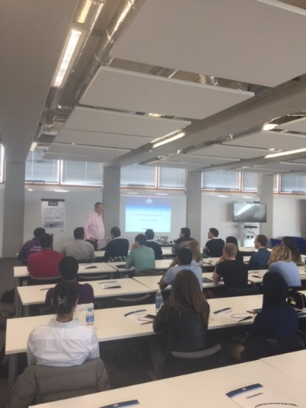

Education in Aviation _The Coventry Approach
Unique Activities and Tools
Roxani Athousaki

Slide 18
Education in Aviation _The Coventry Approach
Optional Placement Year – Study Abroad
Placement opportunities and graduate schemes within industry, which have in the past included British Airways, Lufthansa, Cathay Paciﬁc Airways, Eastern Airways, Easy Jet, CityJet, Airbus, London Heathrow Airport, Birmingham Airport Ltd, Coventry Airport/Patriot Aviation, Servisair, Skyguide, Star Alliance, Eurocopter, TAROM, TUI Travel, and UBM Aviation Routes;)
Source : Coventry University Site
Roxani Athousaki

Slide 19
292EKM
A Dynamic Approach to Education
“The secret of change is to focus all your energy, not fighting the old, but on building the new.”
Socrates
Roxani Athousaki

Slide 20

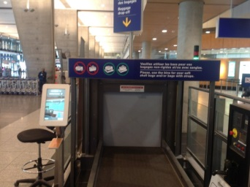
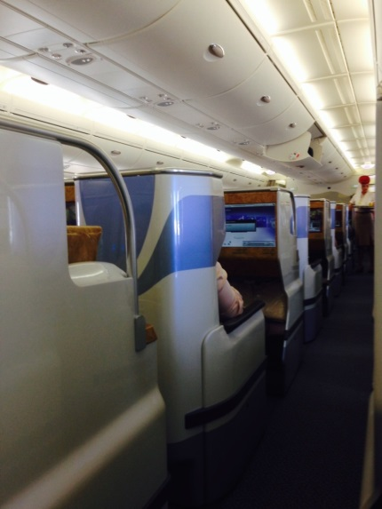
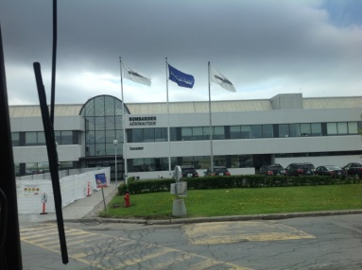
Education in Aviation
Thank you for Listening!!!!
Roxani Athousaki

