Slide 1
THE VIEWS OF ICAO ON ATM
Sarantis Poulimenakos
EUR/NAT NCLB TAP Programme Manager
ICAO EUR NAT – ANS /Implementation RO
FSF MED – NICOSIA

Slide 2
INCREASED DEMAND : HOW MUCH-HOW FAST
Global Aviation Safety & Air Navigation Updates

Slide 3
Growth of Air Transport
+3.8%
vs. 2015
205 billion FTK
+7.4%
growth rate vs. 2015
7.1 trillion RPK
Scheduled commercial traffic
Source: ICAO Annual Report of the Council
Total (international and domestic) services
Notes:
Because we know that the challenges will not lessen, but grow in time considering that the forecast does not indicate reduction in the aviation activities, exactly the opposite, and with new entrants to share the airspace complexity of operations is also a factor to be considered. (click)
Revenue passenger miles (RPMs) and revenue passenger kilometers (RPKs) are measures of traffic for an airline flight, bus, or train calculated by multiplying the number of revenue-paying passengers aboard the vehicle by the distance traveled.

Slide 4
Encouraging Outlook

Slide 5
Preliminary Global Traffic Forecasts
Notes:
Committee on Aviation Environmental Protection (CAEP) is a technical committee of the ICAO Council established in 1983. CAEP assists the Council in formulating new policies and adopting new Standards and Recommended Practices (SARPs) related to aircraft noise and emissions, and more generally to aviation environmental impact.
GATO 2030 Global Air Transport Outlook to 2030

Slide 6
ICAO Global PLANS/GANP-GASP VISIONS OF THE FUTURE
Global Aviation Safety & Air Navigation Updates

Slide 7
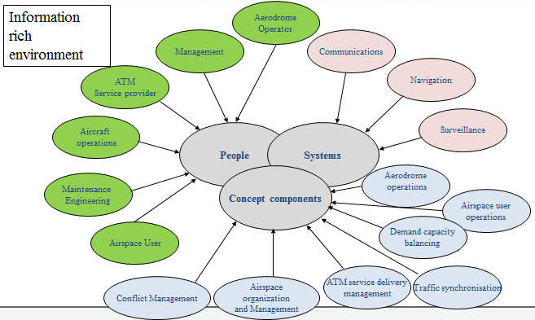
What is global ATM? - Integration and a common vision

Slide 8
What is global ATM? Vision -Expectations
Meeting the expectations of the aviation community
meeting safety objectives
address interoperability and seamlessness
operate along preferred 4D trajectories (business trajectories)
improved scheduling
gate availability
environmental objectives
Other emerging issues
Notes:
The 4D trajectory concept is based on the integration of time into the 3D aircraft trajectory. It aims to ensure flight on a practically unrestricted, optimum trajectory for as long as po
ssible in exchange for the aircraft being obliged to meet very accurately an arrival time over a designated point.
three spatial dimensions plus time as a fourth dimension

Slide 9
How did we start ? Air Navigation Conference 11
Endorsement of the global ATM operational concept already at 11th Air Navigation Conference in 2003
ICAO is requested to:
develop ATM system requirements
address interoperability and seamlessness
define requirements for global AIM
publish the operational concept
amend the Global Plan
develop a performance framework

Slide 10
Air Navigation Conference 11 Follow up in the ICAO Assembly
Assembly Resolution A35-15 (2004)
Calls upon States, regional planning groups and the aviation industry to use the ICAO Global ATM Operational Concept as the common framework to guide planning and implementation of CNS/ATM systems and to focus all such development work on the operational concept

Slide 11
Air Navigation Conference 12 How do we continue
The Conference unanimously endorsed the Aviation System Block Upgrades (ASBUs) framework introduced by ICAO to set goals in terms of operational improvements on a consensus-driven basis.
The Conference also endorsed the draft 4th edition of the Global Air Navigation Plan (Doc 9750), as unified planning mechanism,
ICAO is tasked to include the key policy principles in the GANP, develop financial policies, SARPS development plan, define a stable and efficient process to update the GANP
ICAO (through Regional Offices) will provide guidance and assistance on ASBUs implementation to States, establish a group and mechanism for inter-regional cooperation

Slide 12
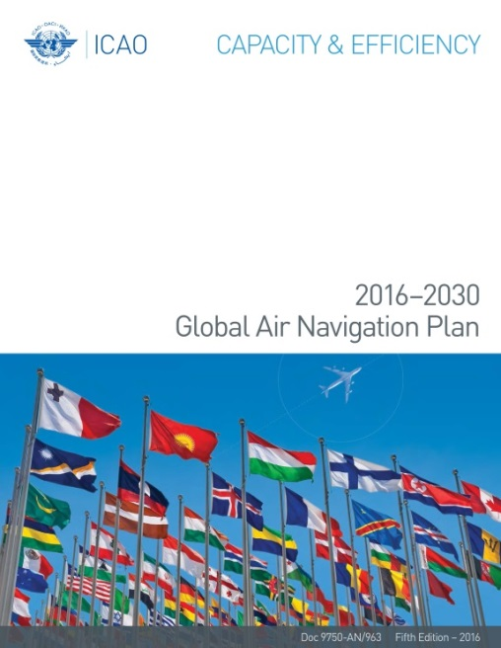
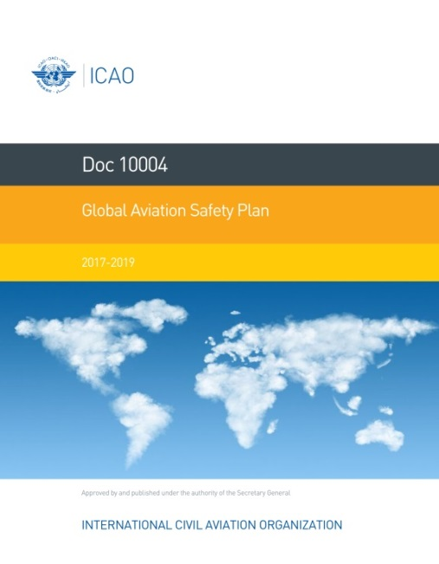
Notes:
From last year’s assembly, we have a unified vision of the future through the recent endorsed GASP and GANP.

Slide 13
2017-2019 Global Aviation Safety Plan (GASP)
2017-2019 Edition
Maintains the framework, objectives and safety performance enablers of the 2014-2016 edition
New global aviation safety roadmap ensures that safety initiatives deliver the intended benefits associated with the GASP objectives through enhanced coordination
Reducing inconsistencies and duplication of efforts
Cooperative, collaborative, and coordinated approach
Together with all stakeholders and under the leadership of ICAO, the GASP offers a long-term vision in developing a harmonized safety strategy.
Notes:
The Global Aviation Safety Programme (GASp) is the ICAO programme which enables the Organization to achieve its strategic objective on Safety and provides a structured approach for the implementation and monitoring of the GASP, its associated roadmap and supporting safety initiatives.
The dedicated Programme (GASp) now addresses implementation, including workshops and tools. There is a series of regional workshops currently underway on GASP implementation, across all RASGs.
On the Safety side, the 2017-2019 edition of the GASP sets forth the global strategic direction for safety and provides the framework in which regional, sub-regional and national implementation plans are developed and implemented.
This recently endorsed 2017-2019 edition of the GASP maintains the framework, objectives and safety performance enablers of the 2014-2016 edition.
A significant change in the revised GASP is the development of the new global aviation safety roadmap. The roadmap includes specific safety initiatives aimed at States, Regions and Industry, and is complementary to the GANP, as some ASBUs address Safety, and that the implementation of ASBUs will require safety assessments prior to implementation.
Consistent with Assembly Resolution A38-2, the second edition of the GASP recognizes that further progress in improving the global safety, capacity and efficiency of civil aviation is best achieved through a cooperative, collaborative and coordinated approach in partnership with all stakeholders under the leadership of ICAO. The GASP offers a long-term vision that will assist ICAO, States, regional safety oversight organizations, regional aviation safety Group (RASGs), international organizations and industry in developing a harmonized safety strategy.

Slide 14
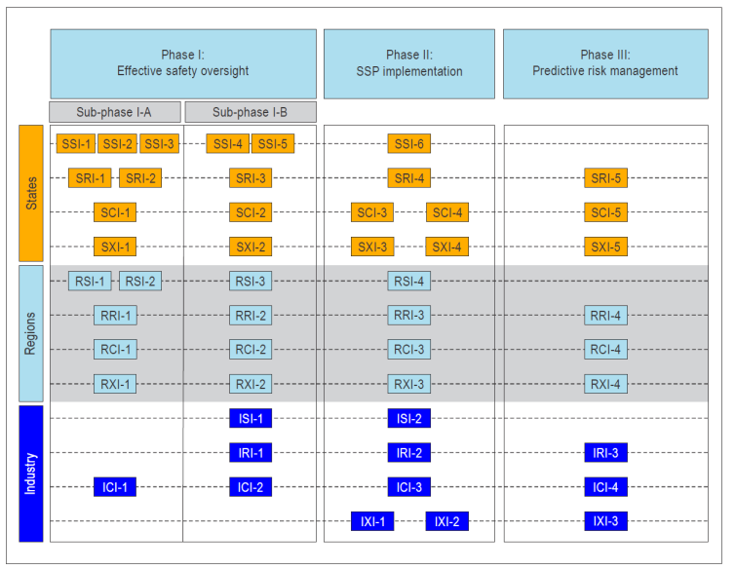
New GASP Roadmap
Goals:
Ensure that safety initiatives deliver the intended benefits associated with the GASP objectives
Reduce inconsistencies and duplication of efforts
Specific safety initiatives aimed at States, Regions and Industry
Complements the GANP
Some ASBUs address safety
Implementation of ASBUs will require safety assessments prior to implementation
Notes:
As mentioned earlier, the GASP roadmap’s goal is to ensure that safety initiatives deliver the intended benefits associated with the GASP objectives through enhanced coordination, thus reducing inconsistencies and duplication of efforts.
A significant change in the revised GASP is the development of the new global aviation safety roadmap. The roadmap includes specific safety initiatives aimed at States, Regions and Industry, and is complementary to the GANP, as some ASBUs address Safety, and that the implementation of ASBUs will require safety assessments prior to implementation.
Consistent with Assembly Resolution A38-2, the second edition of the GASP recognizes that further progress in improving the global safety, capacity and efficiency of civil aviation is best achieved through a cooperative, collaborative and coordinated approach in partnership with all stakeholders under the leadership of ICAO. The GASP offers a long-term vision that will assist ICAO, States, regional safety oversight organizations, regional aviation safety Group (RASGs), international organizations and industry in developing a harmonized safety strategy.

Slide 15
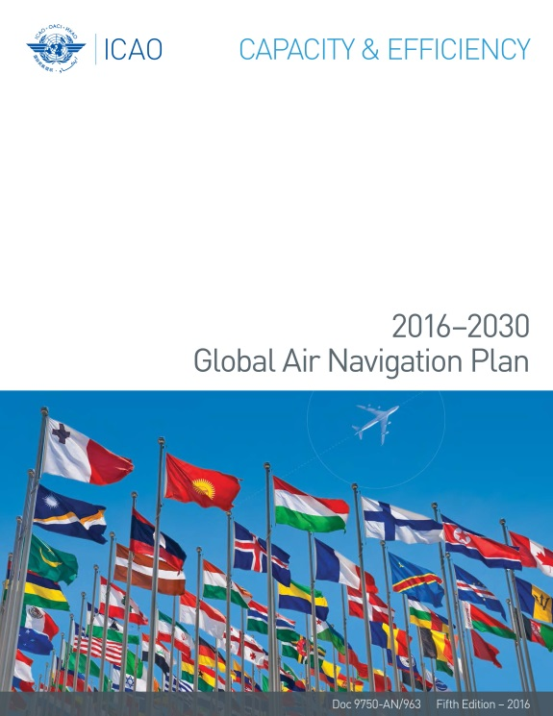
2016-2030 Global Air Navigation Plan (GANP)
5th Edition of the GANP (2016-2030)
Includes the 2016 edition of the Aviation System Block Upgrades (ASBU) document
Stability
Included improvements:
Six-year cycle for the Blocks to align with Assembly cycles
Update of the ASBU framework and all technical roadmaps
Concept of performance-based approach as foundation for implementation strategies
Notion of minimum path
ATM logical architecture
Creation of GANP webpage
Notes:
The fifth edition of the Global Air Navigation Plan includes the 2016 edition of the Aviation System Block Upgrades document.
Although stability was the main requisite for updating this edition of the GANP, some improvements were included in it, such as:
a six-year instead of five-year cycle for the Blocks to adjust to Assembly
an update of the Aviation System Block Upgrade framework and all technical roadmaps
the performance-based approach concept as foundation for implementation strategies.
The notion of a minimum path
An ATM logical architecture
And the creation of a dedicated GANP resources page
These improvements to the fifth edition are the starting point to continue making of the GANP a more serviceable planning tool for all stakeholders.

Slide 16
Action items requiring additional resources
RPAS/UAS
Monitoring and Analysis
GASP
GANP
Medical provisions
Safety information
Regional Cooperation
Regional Cooperation and technical assistance to resolve safety deficiencies
Establishing priorities and setting measurable targets
Flight crew mental fitness
Wind shear
Aerodrome certification database
Accident investigation

Slide 17
Evolving our approach
Global Aviation Safety & Air Navigation Updates
Notes:
At ICAO, we continue to find new ways to evolve our approach in order to improve implementation, as well as become more efficient/effective.

Slide 18
Evolving Standardization
Innovation starts on the flight deck, at the control position and on the tarmac
People using the tools are the first to know how they can be improved
???
Awesome
Separation
Phraseologies
Data Link
PBCS
ATFM
CDM
Notes:
In terms of Standardization, our evolving approach is to ensure that all stakeholders of the aviation community are able to critical provide feedback into the Global plans.
There is a wealth of ideas for improvement in each of our stakeholder’s environments. Users in the field are the ones to see the problems with existing tools and procedures, and also capable of providing practical and real-world solutions.

Slide 19
Evolving Standardization
SARPs-ready proposals from Standards-making organizations and other aviation stakeholders
Currently looking at candidates for further proof-of-concept work
Notes:
As I previously mentioned, I think most of the innovations can be found locally in the various environments, or in one of the regional groupings of stakeholders. So, we’d like to foster a design philosophy that encourages change advocates to start there, following a collaborative model.
We are also looking at candidates for a Proof-of-concept, which will help assess future methodologies and process.

Slide 20
Standards Roundtable
Interface between standards-making organizations and ICAO
Standardization roadmap
Increase referencing of industry standards
Support performance-based standards
Notes:
As a first step and example for our evolving standardization methodology is the Standards Roundtable, which offers Standards-making organizations and ICAO with a venue to strengthen their ties, ensure communication flows and deal with common issues.
This venue allows for the continued development of the Standardization roadmap, which will help ensure that work programmes at ICAO and other standards-making organizations are aligned and ready according to the GANP and the ASBU elements.
This initiative also enables the referencing of industry standards in ICAO documentation, and ultimately support the creation of performance-based standards

Slide 21
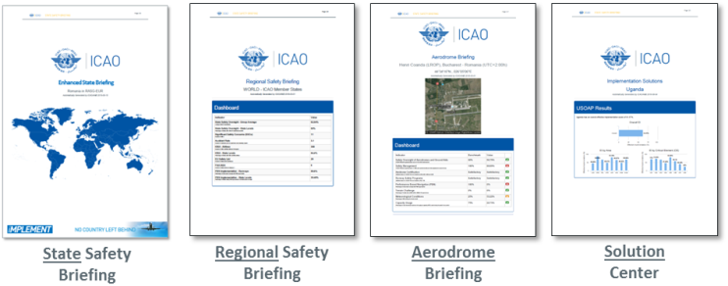
Evolving Safety Performance
iMPLEMENT is a data-driven decision making process that:
Assesses the current status of aviation (Safety Briefings)
Identifies the best solutions in order to maintain or improve the aviation capability of the State (Solution Center)
Evaluates the needs of the aviation system (money, people, infrastructure) (CAA HR Tools, PAINT/iAID, etc.)
Identifies resources through existing national, regional, or global mechanisms (ASIAP, SAFE Fund, etc.)
Showcases the real added value of air transport and the socio-economic return on investment of aviation
A ‘No Country Left Behind’ Initiative:
Facilitating Data-Driven Decisions for Aviation
* Site: www.icao.int/iMPLEMENT
Notes:
Much of the safety analysis and tools we have represent how we try to evolve safety performance. These are driven by our ‘No Country Left Behind’ initiative. Specifically, we have iMPLEMENT, which is a data-driven decision making process that:iMPLEMENT is an ICAO product designed to help the Directors General of Civil Aviation
and the Transport Ministers:
Assesses the current status of aviation (Safety Briefings)
Identifies the best solutions in order to maintain or improve the aviation capability of the State (Solution Center)
Evaluates the needs of the aviation system (money, people, infrastructure) (CAA HR Tools, PAINT/iAID, etc.)
Identifies resources through existing national, regional, or global mechanisms (ASIAP, SAFE Fund, etc.)
Showcases the real added value of air transport and the socio-economic return on investment of aviation

Slide 22
ICAO Safety Audit Results
Focus on
meeting the GASP EI target
Focus on
SSP Implementation
Source: iSTARS 3.0 – Regional Safety Briefing (https://portal.icao.int/space)
Notes:
Here are the results of the Safety audits for ECAC, where the regional average is 78%.
93% of the States in the region (41 of 44 Audited States) have achieved the GASP target of 60% EI.
[Click 1] In terms of SSCs, there are none identified within the region. However, in line with ‘No Country Left Behind’, we need to remain vigilant in order to help the remaining States achieve the GASP EI target (60% EI).
And then for those States who have already achieved this, we would encourage to work towards SSP implementation.

Slide 23
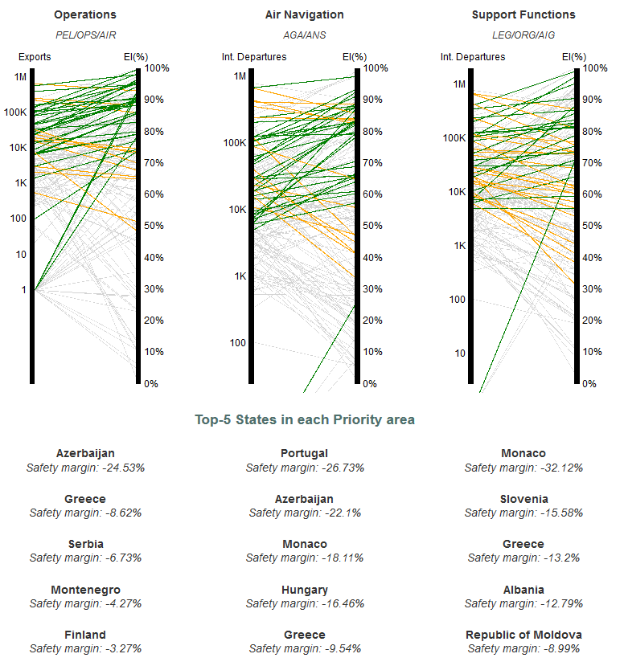
Regional Priorities
The States are prioritized by considering the level of EI as well as the related activity at risk in operations, air navigation and support functions
The profile of each State is benchmarked against all other ICAO member States
Priority is given to the least performing areas in ascending order
Source: iSTARS 3.0 – Regional Safety Briefing (https://portal.icao.int/space)
Notes:
An indicator that we have used recently to help identify regional priorities is the Safety margin concept.
Through this concept, States are prioritized according to the level of EI, as well as the related technical activity at risk such as operations, air navigation, and support functions
Each State’s profile is then benchmarked against all other ICAO member States, with a priority order provided to the least performing areas in ascending order.
What you see here on the bottom right are the priority order for your region, grouped by technical activity.

Slide 24
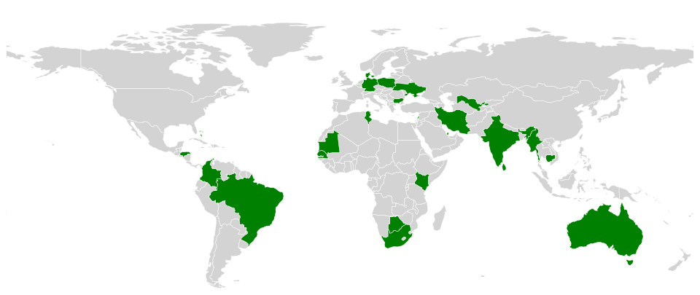
USOAP Activity Plan (EB 2017/35)
2017-2018 Audits
Notes:
In terms of the USOAP CMA Programme, an electronic bulletin was just issued in June (EB 2017/35) which shows the latest activity plan for 2017 and 2018.
Here you will see the planned audits for 2017 and 2018

Slide 25
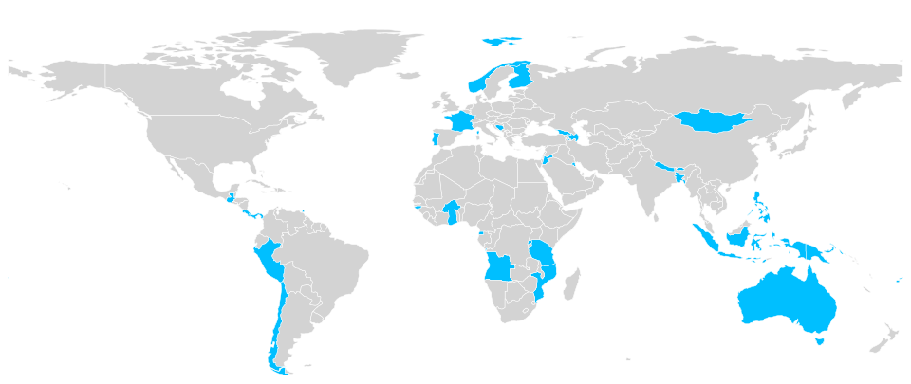
USOAP Activity Plan (EB 2017/18)
2017-2018 Audits
2017-2018 ICVMs
Notes:
And here you will see the planned validation missions for 2017 and 2018

Slide 26
GANIS/SANIS – Global Planning for the 40th assembly
Global Harmonization: An ICAO Perspective

Slide 27
Sustainability and enhancement of safety and air navigation system performance
GANIS / SANIS 2017
Two back-to-back symposiums from 11 – 15 December 2017 in Montréal, Canada
2nd Global Air Navigation Industry Symposium (GANIS) to discuss issues and chart next steps to achieve a seamless global aviation system
1st Safety and Air Navigation Implementation Symposium (SANIS) to offer a performance-based implementation methodology including the first Global RASG/PIRG Forum
Includes an Industry exhibition of current and emerging technologies
Showcase solutions which will provide a snapshot of the global air navigation industry
Provide insight on how all stakeholders can work together to address technical, operational, regulatory and economic challenges
A crucial networking and knowledge-sharing opportunity
Presentations from ICAO, international and regional organizations, standards-making organizations and leading industry stakeholders
Will lay the foundation for the 13th AN-Conference in 2018

Slide 28
2019 Update of the GANP
Multilayer Structure

Slide 29
TIMEFRAME
Assembly September 2019
Global Managerial Level
Final Editing Publication: Jul 2019
Council Approval: May 2019
ANC Final Rev: March 2019
SL: Dec 2018
ANC Prelim Review: Sept 2018
Final Draft Coordination: April 2018 (GANP Document)

Slide 30
40th Assembly
(2019)
13th Air Navigation Conference
(2018)
Council Working Paper
(2018)
NEEDS / REQUIREMENTS
GANIS/SANIS
(Dec 2017)
GANIS/SANIS will facilitate the planning of technical work for AN-Conf/13, and also the budget discussions leading up to A40

Slide 31
UPCOMING EVENTS
Global Aviation Safety & Air Navigation Updates
Notes:
Here are a quick list of upcoming events for ICAO

Slide 32
Safety Management Regional Symposia and Workshops
Notes:
In support of Amendment 1 to Annex 19, we’re also rolling out a series of Safety Management Regional Symposia and workshops.
Here you will see the timeframes and the regions that are planned until 2018, but more are symposia are planned in the future.

Slide 34
Safety Management Regional Symposia and Workshops
EUR/NAT – Hosted by EC & Estonian Presidency in Tallinn / 16-18 October 2017
NACC and SAM – Hosted by Peru in Lima / 12 – 16 March 2018
APAC and MID – Hosted by Singapore / 23 - 26 April 2018
ESAF and WACAF – 2018 (exact dates and location to be confirmed)
Note: 4 Workshops to be delivered with Symposia plus additional planned
Notes:
In support of Amendment 1 to Annex 19, we’re also rolling out a series of Safety Management Regional Symposia and workshops.
Here you will see the timeframes and the regions that are planned until 2018, but more are symposia are planned in the future.

Slide 36
REFERENCE SLIDES

