Slide 1
The Airline View
Giancarlo Buono
Nicosia, April 13th 2018

Slide 2
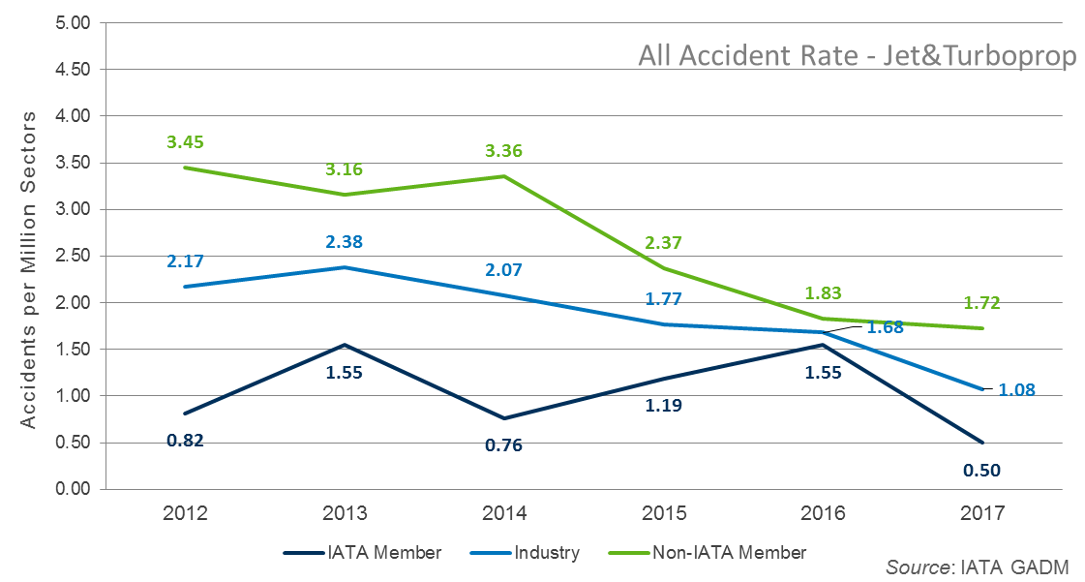
Safety Performance:
All Accidents per Million Sectors
Accidents Update: As at 31st December 2017
Copyright ©2018 International Air Transport Association. All rights reserved.
Subject to restrictions and disclaimer.

Slide 3
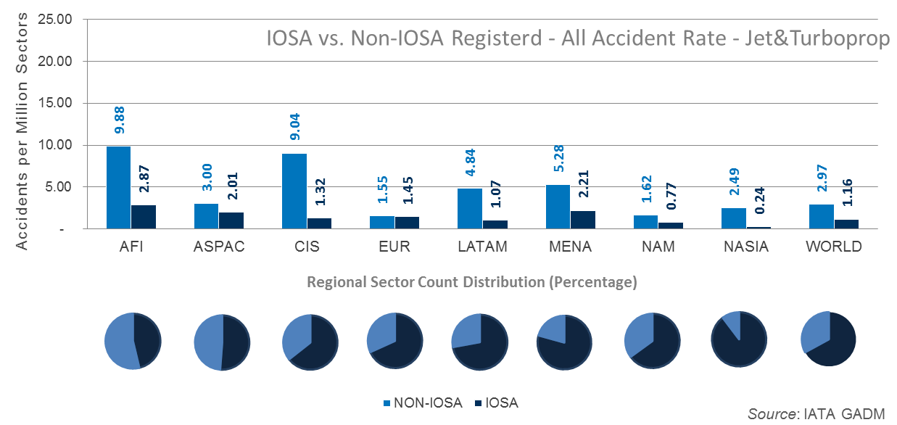
All Accident Rate for IOSA Operators vs. Non-IOSA (includes Jet & Turboprop aircraft)
Period: 2013 to 2017
Copyright ©2018 International Air Transport Association. All rights reserved.
Subject to restrictions and disclaimer.

Slide 4
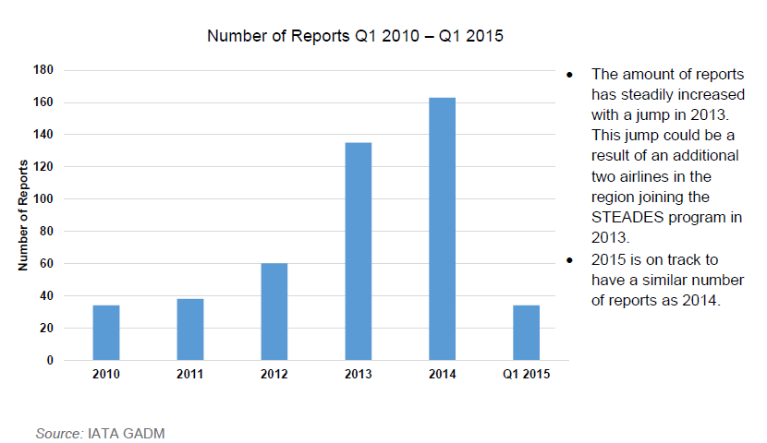
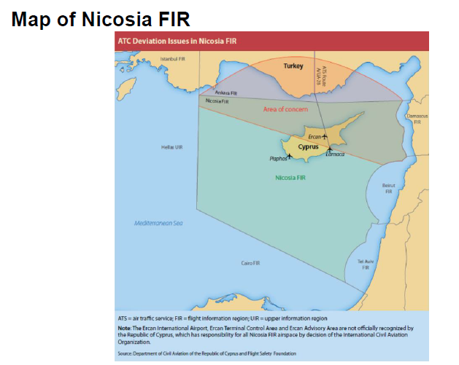
Issues around the MED

Slide 5
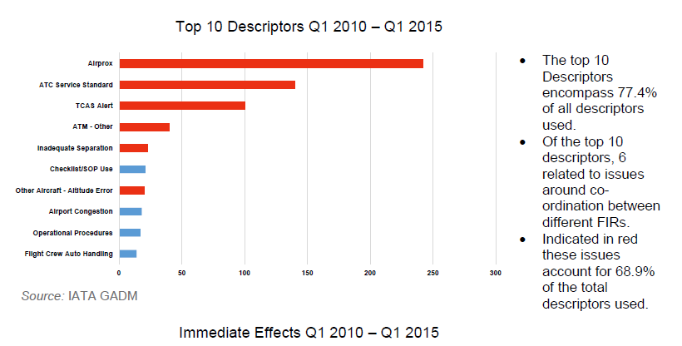

Slide 6
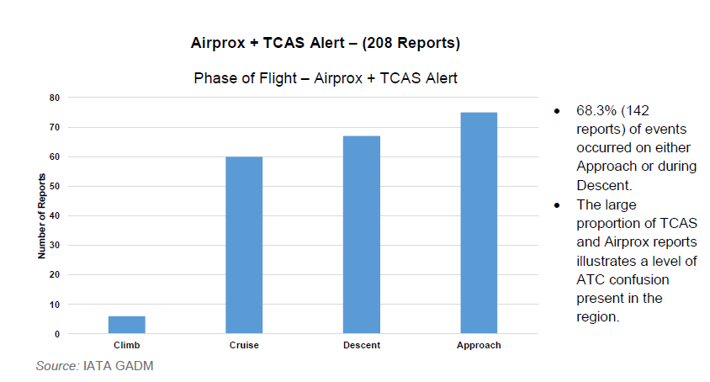

Slide 7
Conclusions
The high proportion of altitude deviations, flight path deviations, and avoidance maneuvers occurring highlights the lack of ATC co-ordination in the region.
Of the TCAS alerts present there were no TA (traffic advisory) alerts, there were only RA (resolution advisory) alerts. This indicates that in-adequate separation is being provided to aircraft flying in the region.

Slide 8
Financial Performance
2017 Actual vs Plan SU’s +8.1% (BlueMed +3%)
2012-16 Capex underspent more than €1bn (BlueMed ~50%)
2017 Actual enroute ATFM delay 0.85 min/flt vs 0.5min/flt (BlueMed significant contributor)
2016 Actual cost -2.3% vs Plan but revenues were +3.8% vs Plan (BlueMed in-line)
2016 Actual surplus (profitability) +9.4% vs +4.7% (BlueMed in-line)
Notes:
SU – Service Units - calculated as the multiplication of the distance factor and the weight factor for the aircraft

Slide 9
BlueMed ANSP Challenge- Priorities
Cyprus-separation of the service provider and Civil Aviation Authority
Sufficient staffing levels to provide adequate capacity at peak times
Greece-recruitment of required ATCO`s for both enroute and terminal, particularly the Islands to ensure safe and efficient operations

Slide 10
BlueMed ANSP Challenge
Flexibility is urgently needed – difficult to do – but essential
Profitability high – capacity & flight-efficiency below expectations
Ensure Safety performance with traffic growth - deliver the planned Capex and Staff investments
IATA supports Service Providers investing in-line with Performance Plans – how can we help?

Slide 11
Regional traffic situation
Cyprus : 2018 YTD = +12.5%, 2017 vs 2016 = +12%
Israel : 2018 YTD = +33%, 2017 vs 2016 = +20%
Notes:
Growth codes : H = High forecast, B = Baseline forecast, L = Low forecast

Slide 12
Regional traffic situation (cont’d)
Greece : 2018 YTD = +10%, 2017 vs 2016 = +9%
Notes:
Egypt remains below its 2014 traffic level despite recent increases (2018 YTD = +2%, 2017 vs 2016 = +7.5%)

Slide 13
Regional traffic growth

Slide 14
Regional delay situation

Slide 15
Regional capacity bottlenecks
Cyprus : significant capacity increase and recovery required
Needed measures : gradual staffing increase, revised rostering, NM re-sectorization in coop with Israel, independent ANSP (CyANS)
Egypt : limited route options & frequent admin changes
Greece : ATCO recruitment and ATM system upgrade required (to continue very good enroute performance)
Notes:
NM re-sectorization for Cyprus with Israel to further increase capacity in Cyprus, to accommodate future Israel overflights, and to further improve civil/military coordination in the region
Cyprus to be encouraged to move forward with needed measures
Frequent admin changes in Egypt complicate coordination of airspace (re-)design initiatives
Greek ATCO recruitment needed for both enroute and airport

Slide 16
Regional contingency capacity
Middle East traffic to/from Europe is flying via Iran/Iraq and Turkey
In case the Iran/Iraq interface would become unavailable, Middle East traffic would have to re-route via Saudi Arabia, Egypt, and Cyprus
Not enough capacity would be available to accommodate the re-routing traffic

Slide 17
Iran/Iraq interface unavailable

Slide 18
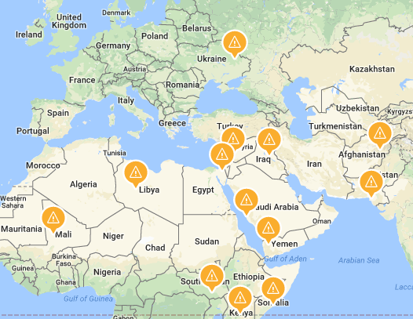
Conflict zones around the MED

Slide 19
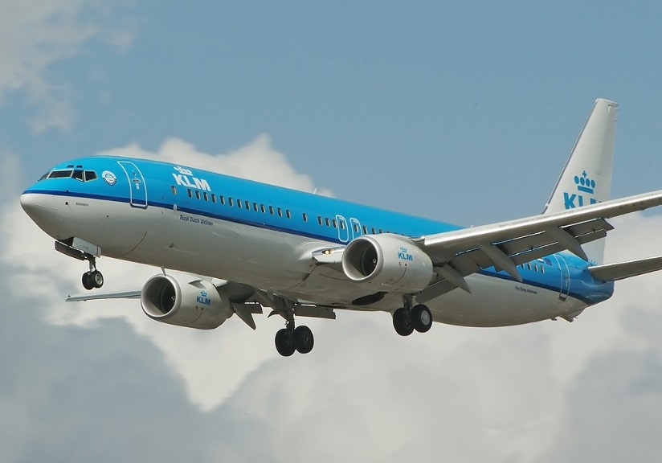
PBN
Safety improvements for approaches to Greek Island Airports (mountainous terrain)
Replace visual circling procedures
Provision of more precise lateral navigation
Provision of vertical guidance thereby reducing the risk of CFIT
Improved landing minima
Less weather diversions

Slide 20
Interested in what IATA is doing across Europe, CIS, Israel, Russia, Turkey and Ukraine?
www.iata.org/europeblog

