Slide 1
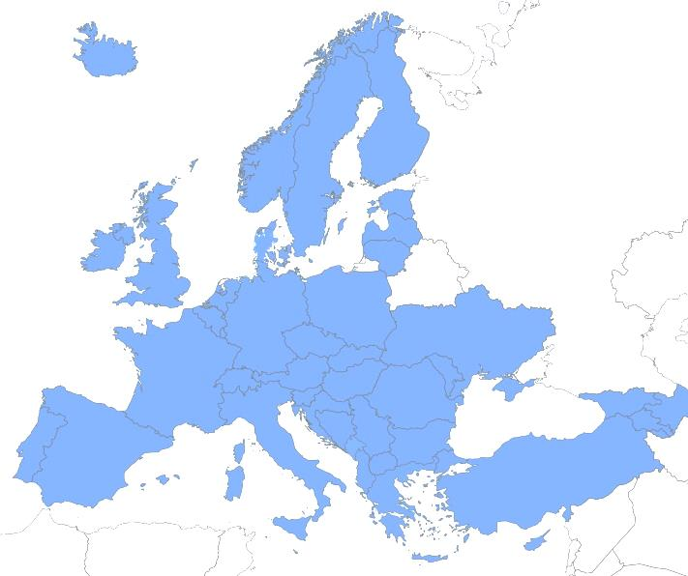
European ATM Master Plan
From Strategic View to Timed Deployment
Rob Peters
EUROCONTROL

Slide 2
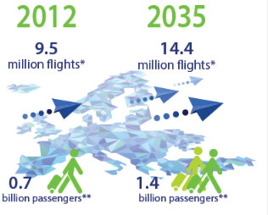
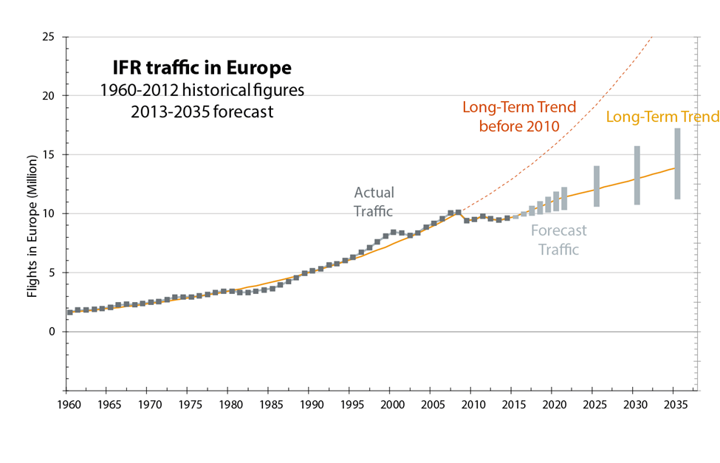
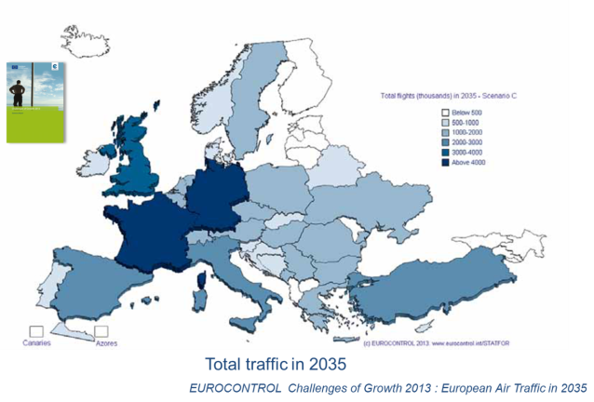
Performance requires change
More Traffic
& Safer
User Needs
Less Costs

Slide 3
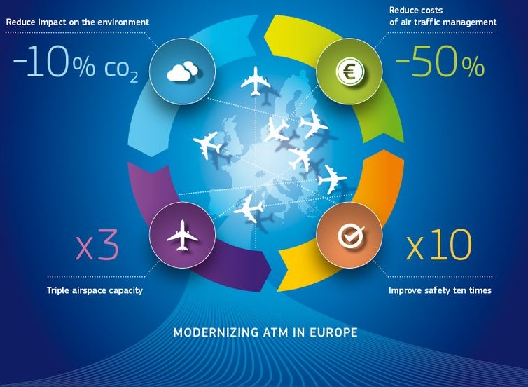
Increasing efficiency and European competitiveness through a Single European Sky

Slide 4
Four Key Areas
- Associated solutions
High Performing Airport Operations
Optimised ATM Network Services
Advanced Air Traffic Services
e.g. LVP using GBAS, integrated surface management, incl. safety nets…
e.g. UDPP, Management of dynamic airspace configuration…
e.g. AMAN / DMAN integration,
Sector team operations…
Enabling Aviation Infrastructure
e.g. CNS rationalisation, 4D, Mission trajectory…

Slide 5
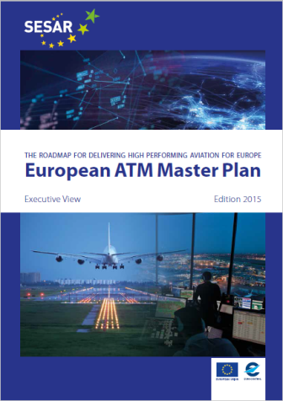
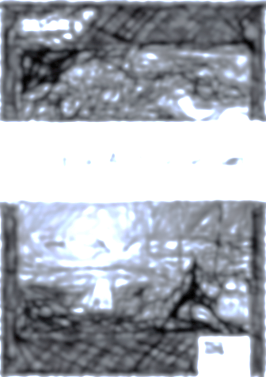
Master Plan and Common Project CP
PCP
CP2
CP3
Priority
Research Areas
Priority
Research Areas
Prerequisite
Ed.2 (2012)
Ed. 2015
Ed. 2018

Slide 6
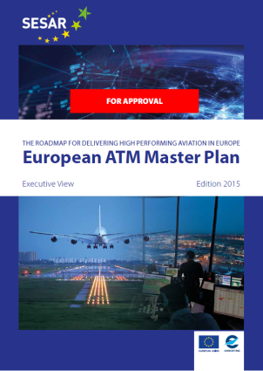
Global landscape
Global Air Navigation Plan
Other Regions

Slide 7
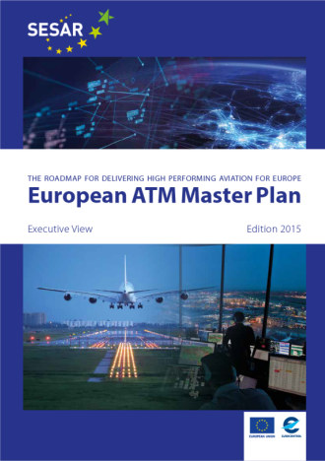
The emerged part of the iceberg
III
I

Slide 8
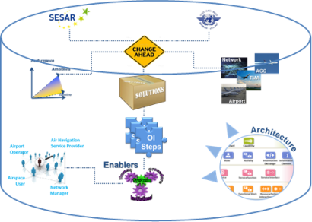
The ATM Master Plan : three levels
Executive
Architecture
& Planning
Implementation

Slide 9
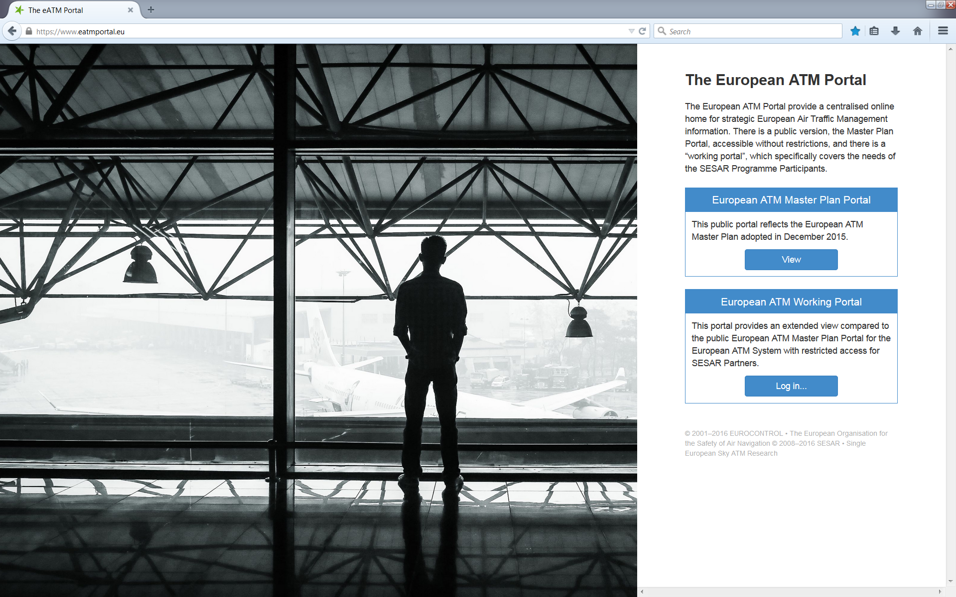
Access the Master Plan via the ATM Portal
https://www.eatmportal.eu

Slide 10
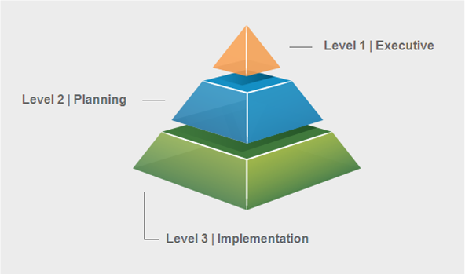
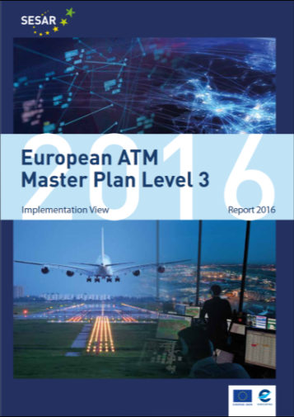
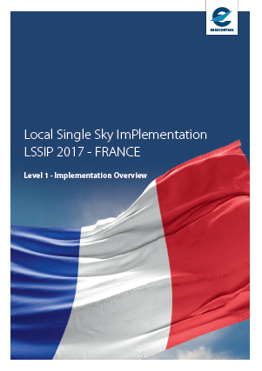
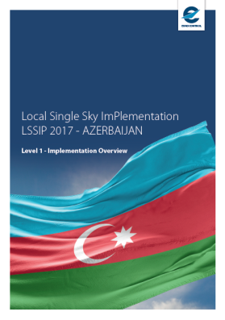
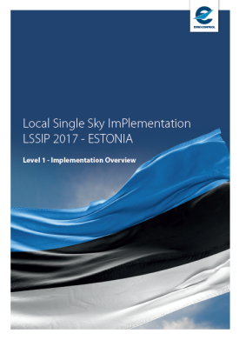
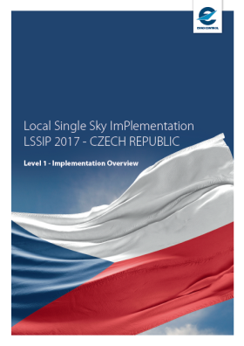
Now focusing on the ATM Master Plan Level 3 + LSSIP
Yearly Plan
Yearly Progress Report
ATM MP Level 3 aka ESSIP
LSSIP documents

Slide 11
Master Plan Level 3 Plan
Plans for next 5-7 years
MP L3 Plan includes:
Implementation Objectives
Stakeholder Lines of Action (“SLoAs”)
For the year 2017 cycle, there are 50 Implementation Objectives of which:
18 related to the PCP
39 related to ICAO GANP
The Plan for the year 2018 is under development, to be ready 30 June 2018
www.eurocontrol.int/sites/default/files/content/documents/official-documents/reports/2017-masterplan-implementationplan.pdf

Slide 12
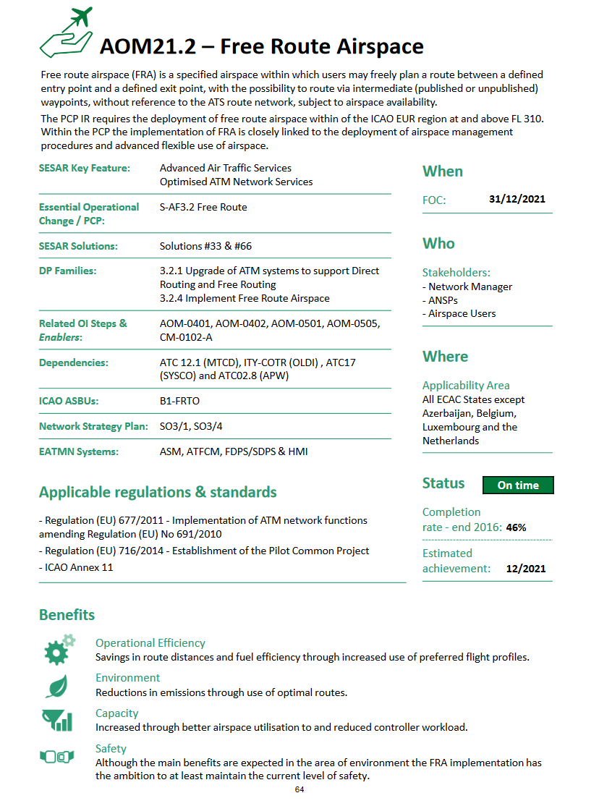
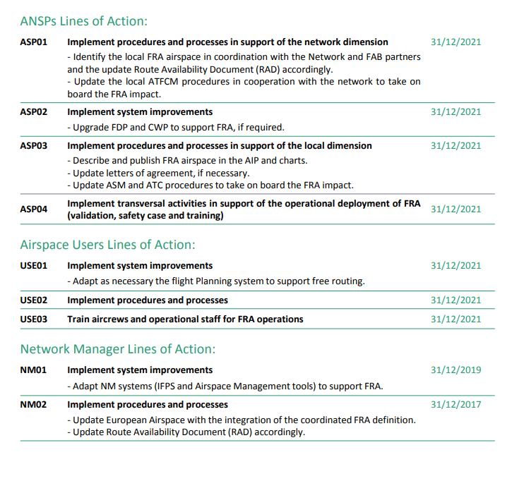
Master Plan Level 3 Plan An Objective example
Each Implementation Objective is described in a more detailed deployment view answering:
What: providing a brief description of the improvement to be implemented
Why: detailing the performance benefits brought by the Objective
Who: listing the ATM Stakeholders involved in its implementation
When: presenting agreed timelines
Where: setting the geographical scope for implementation
How: breaking down the actions to be taken by each stakeholder

Slide 13
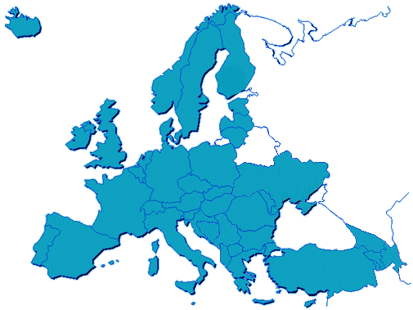
LSSIP Reporting
Planning and Reporting Tool
For all National Stakeholders
Annual documents, based on MP L3 Plan = fact finding on real progress and plans
42 Documents (one per each continental ECAC state + MUAC)
Level 1 – High Level View on the National ATM situation (Public part) Level 2 – Details on progress and plans of all Implementation Objectives
(Restricted part)
www.eurocontrol.int/articles/lssip

Slide 14
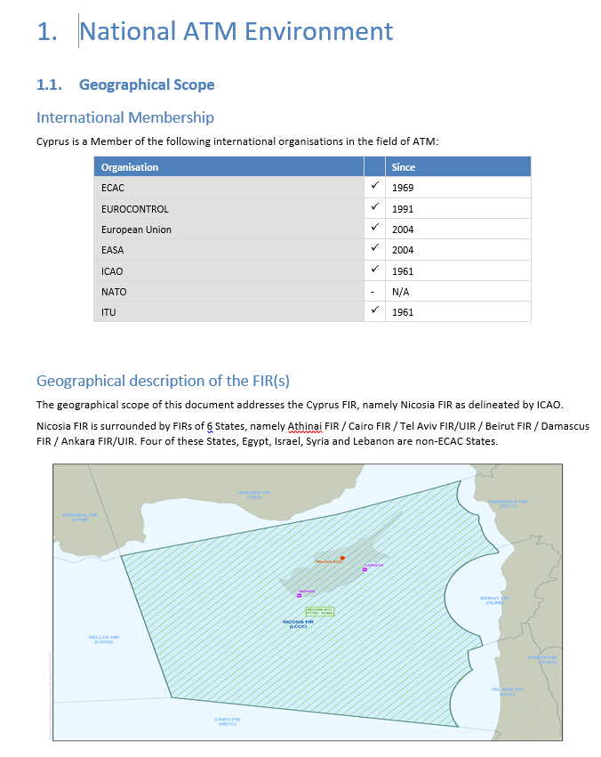
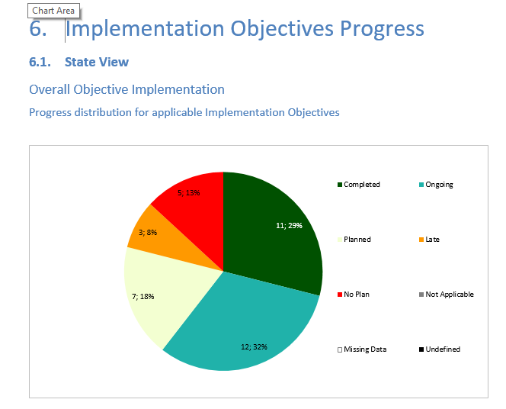
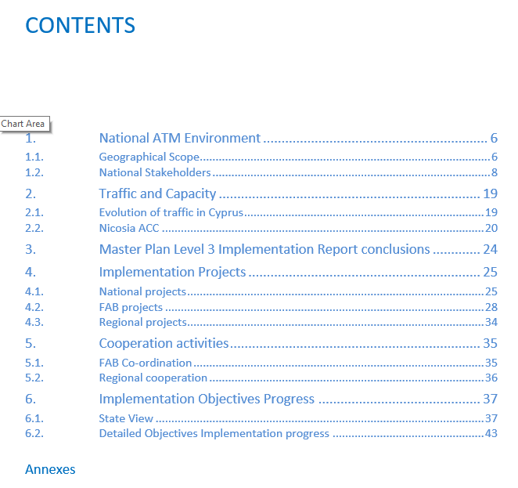
LSSIP Documents set up

Slide 15
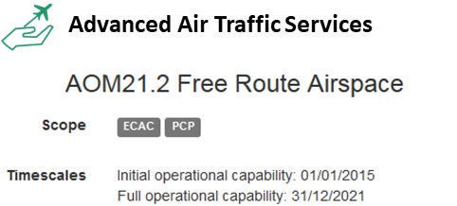
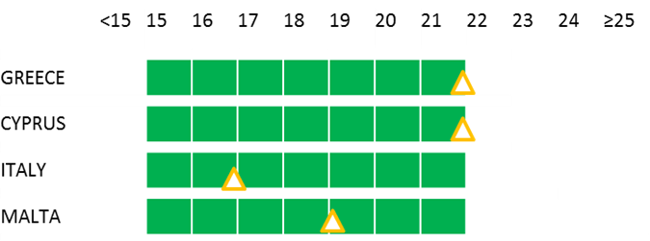
LSSIP Documents – example of Objective progress

Slide 16
Master Plan Level 3 Report
ECAC-wide implementation Progress Assessment
Master Plan L3 Report is based mainly on LSSIP data
Provides different views of implementation (Strategic, Deployment, FAB, State centric View)
Fully driven by SESAR Key Features and aligned to Master Plan Levels 1 & 2

Slide 17
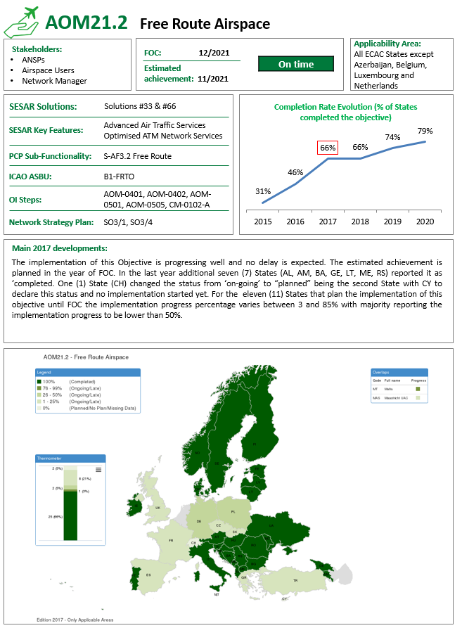
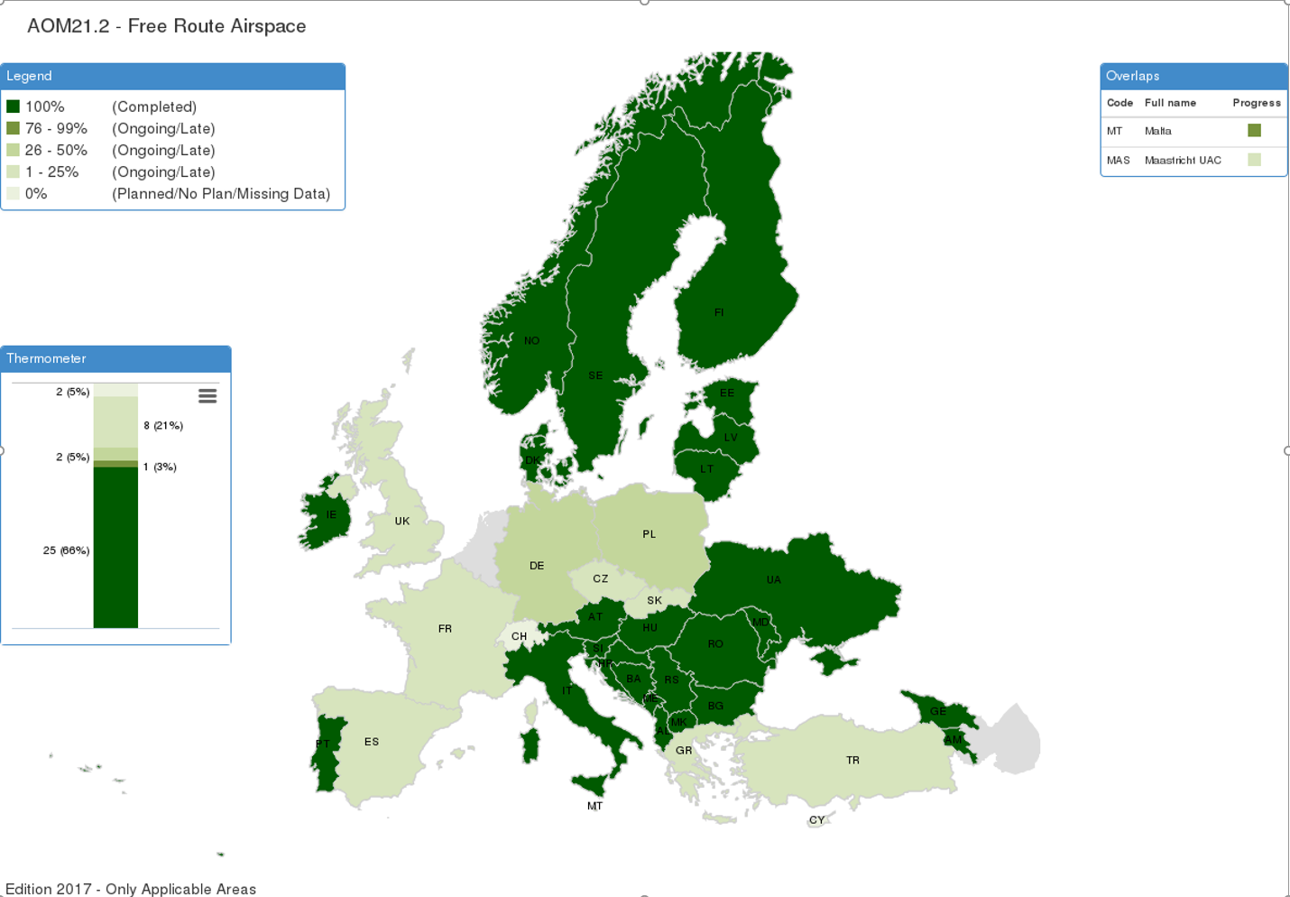
Master Plan Level 3 Report Example of a “Deployment View”
https://www.eatmportal.eu/working/downloads
www.eatmportal.eu/working/depl/essip_objectives/map

Slide 18
Input to ICAO GANP monitoring
www.eurocontrol.int/sites/default/files/content/documents/official-documents/reports/2016-icao-report-final.pdf

Slide 19
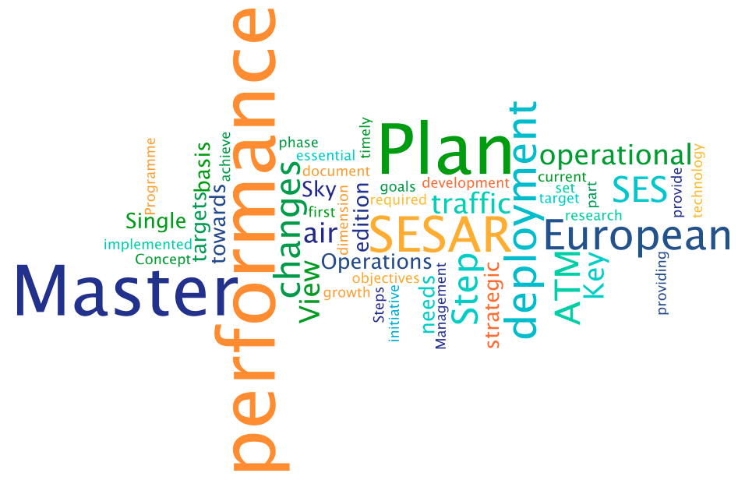
Thank You

