Slide 1

Flight Safety Foundation Regional Seminar
“SATISFYING INCREASED DEMAND FOR CAPACITY WHILE MAINTAINING SAFETY / SPECIAL CHALLENGES FOR E. MEDITERRANEAN AND M.EAST REGIONS”
Safety and Security
Osman Saafan
Director Corporate Safety and Security and Military Affairs
DFS Deutsche Flugsicherung GmbH
Vice Chair CANSO SSC
Vice Chair EASA Stakeholder Advisory Body)
13.04.2018, Larnaca

Slide 2
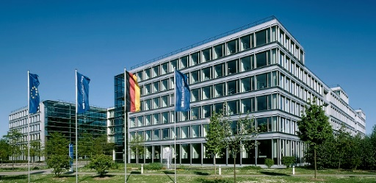
DFS Deutsche Flugsicherung GmbH

Slide 3
Legal framework
DFS Deutsche Flugsicherung GmbH is a limited liability company organised under private law.
The sole shareholder and thus owner of DFS is the German government. Shareholder rights are exercised by the Federal Ministry of Transport and Digital Infrastructure (BMVI).
Provisions concerning air navigation services are to be found in the
  Basic Law, Article 87d
  Aviation Act, Article 31b in conjunction with Article 27c
Notes:
Basic Law Article 87d - (1) Air transport administration shall be conducted under federal administration. Air navigation services may also be provided by foreign air navigation service providers which are authorised in accordance with European Community law. Details shall be regulated by federal law.
Aviation Act (LuftVG) Article 31b - (1) Subject to the aviation legislation of the European Community and Article 31f, only one air navigation service provider as a limited liability company (GmbH), solely owned by the German government shall be entrusted to perform the tasks outlined in Article 27c, paragraph 2, sentence 1, number 1. Details shall be laid down in statutory instruments by the Federal Ministry of Transport, Building and Urban Development in consultation with the Federal Ministry of Defence. The consent of the Bundesrat (the upper house of parliament) is not required.
Aviation Act (LuftVG) Article 27c
The air navigation services ensure the safe, orderly and expeditious handling of air traffic.
(2) The air navigation services shall comprise in particular:
1. Air traffic services, including:
a) Air traffic control services (aerodrome, approach and area control services), including checking, warning and rerouting aircraft in airspace
b) Alerting services,
c) Flight information services,
d) Air traffic advisory services,
2. Communication services,
3. Navigation services,
4. Surveillance services,
5. Aeronautical information services, and
6. Aeronautical meteorological services.

Slide 4
Statutory obligation of DFS
safe
orderly
expeditious
DFS is responsible for the
handling of air traffic
Air traffic services
Air traffic control services
Additional air navigation services
Communication services
Alerting services
Flight information services
Air traffic advisory services
Navigation services
Surveillance services
Aeronautical information services
Meteorological services (DWD)
Civil and Military
Civil and Military
Notes:
The statutory obligation of DFS is defined in Article 27c of the German Aviation Act. In addition to the tasks of the air navigation services (safe, orderly and expeditious handling of air traffic), it also specifies which services (air traffic services and other air navigation services) the air navigation service provider must provide to airspace users.
Examples of air traffic services provided by DFS:
Air traffic control services comprise aerodrome, approach and area control services. They are provided by the DFS units Tower and Control Centre. DFS is the only ANSP in Europe that also provides control services for military aircraft.
Within the scope of the alerting service, DFS alerts the Bundeswehr, for example in the case of an aircraft hijacking ("Renegade").
The flight information services (FIS) are co-located in the control centres and provide specific advice and information to VFR pilots via radiotelephony.
DFS does not offer air traffic advisory services.
Examples of additional air navigation services:
Communication services: air-ground communication, voice and data communication
Navigation services: provision of ILS, D-VOR, GBAS, etc.
Surveillance services: surveillance of aircraft by means of radar, MLAT or ADS-B
Aeronautical information services: They are provided by the Aeronautical Information Service Centre (AIS-C) of DFS in Frankfurt-Rödelheim.
Aeronautical meteorological services are not provided by DFS but by the German Meteorological Service (DWD).

Slide 5

DFS locations
Langen: Headquarters, Academy, Systems House and R&D Centre
Control centres:
Langen, Bremen, Munich, Karlsruhe
16 Tower locations
AIS-C in Frankfurt-Rödelheim
Hamburg
Bremen
Hannover
Berlin
Münster/
Osnabrück
Düsseldorf
Leipzig/
Halle
Cologne/Bonn
Erfurt
Dresden
Frankfurt
Tower
Langen
Headquarters
Nürnberg
Air Navigation
Services Academy
Saarbrücken
Control centre
Stuttgart
AIS-C
Karlsruhe
Munich
Notes:
Control centres
The control centres in Bremen, Langen and Munich control lower airspace in Germany. The control centres in Karlsruhe and Maastricht are responsible for upper airspace.
DFS has reduced the number of control centres from six to four. In 2003, the Düsseldorf Control Centre was closed and transferred to Langen. The Berlin Control Centre (in Tempelhof) was also closed and the associated airspace transferred to the control centres in Munich (2004), Karlsruhe (2005) and Bremen (2006).
DFS is also represented at the EUROCONTROL centre in Maastricht, where DFS staff control military air traffic in the German airspace portion (Hannover UIR).
Tower
DFS is responsible for air traffic control services at the 16 international airports in Germany.

Slide 6
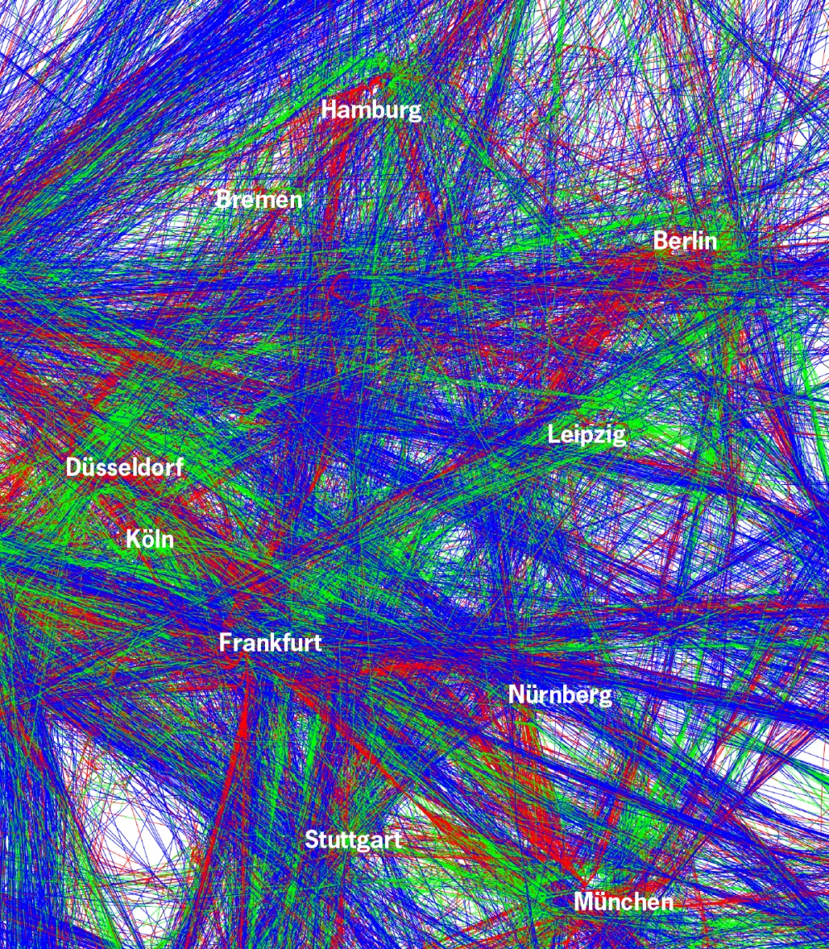
Aircraft movements in Germany
One day in January 2018
Climbs
Transit flights
Descents
Notes:
Red - climbs
Blue - transit flights
Green - descents
24-hour plot

Slide 7
EU Performance Scheme
Key Performance Areas (KPAs) How do those together?
Safety
Capacity
Cost-efficiency
Percentage of application of the risk analysis tool (RAT)
Implementation of measures
Safety maturity level that must be achieved by the ANSPs and NSAs
Environment
Minutes of en-route ATFM delay per flight
Total of ANS-related ATFM delays in terminal areas
Additional time in the taxi-out phase
Additional time for ASMA at aerodromes with more than 100,000 aircraft movements per year
Average horizontal en-route flight efficiency
Effective use of civil/military airspaces
Average European unit rate for en-route charges
Costs and air navigation charges in the terminal area
Notes:
Community-wide performance targets
The new sub-area regulatory ATM approach intends to improve the performance of air navigation services in European airspace by implementing, among other things, a common performance scheme including the introduction of an adapted charging scheme (= economic regulation). The performance scheme is based on the KPAs: safety, capacity, environment, and cost-efficiency.
Introduction of the performance scheme on 1 January 2012
In December 2010, the European Commission adopted the first Europe-wide performance targets for safety, environment, capacity and cost-efficiency. By the end of June 2011, the States had to submit national and/or FAB-wide performance plans showing their contribution towards reaching the targets for approval by the European Commission. The performance plans set the targets for the involved organisations (ANSP, MET, NSA, Military). These form the basis for the first reference period, which covers the period from 2012 to 2014. The subsequent reference periods will last five years each.
FABEC Performance Plan
The FABEC State representatives agreed on the creation of a FABEC performance plan for the first reference period. It includes safety, capacity and environmental indicators and each national contribution to the cost-efficiency indicator. The FABEC performance plan also includes FABEC indicators and the KPA Military Mission Effectiveness.

Slide 8
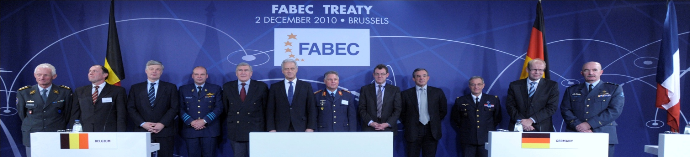
FABEC States Agreement
Functional Airspace Block Europe Central (FABEC) Treaty was signed on December 2nd, 2010.
Objective is to create a single FABEC airspace, being understood as one continuum.

Slide 9
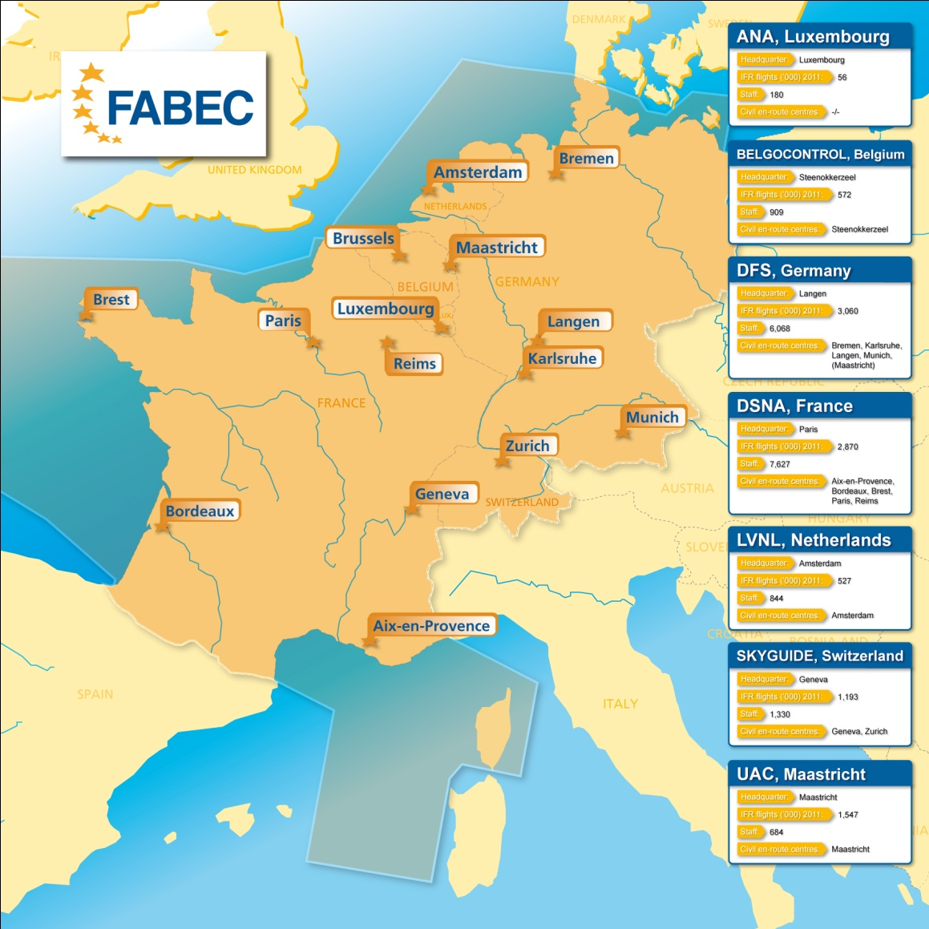
Functional Airspace Block Europe Central (FABEC)
DFS is part of FAB Europe Central (FABEC).
FABEC is a collaboration of seven civil and three military ANSPs.
FABEC is one of the busiest
and most complex airspaces in Europe: FABEC has 60% of all European air traffic.
The FABEC Treaty, which was ratified as of 1 June 2013, is the formal basis for this collaboration.
Notes:
The Functional Airspace Block Europe Central (FABEC) covers the airspace of six States (Belgium, France, Germany, Luxembourg, the Netherlands and Switzerland) and lies at the heart of Europe. This airspace is one of the busiest and most complex in the world. Most of the largest European airports are located here. The military uses this airspace for its training areas and large civil airlines are based in the FABEC area.
The key data of FABEC:
A complex and dense route network
A dimension of 1.7 million km²
Six million aircraft movements in 2007, which corresponds to 60 percent of all European aircraft movements
Expected traffic growth of 50 percent between 2006 and 2018, which corresponds to eight million aircraft movements for 2018
Approximately 410 military airspaces and areas for special use (e.g. parachute descents)
Approximately 370 control sectors
14 control centres (Brussels, Bordeaux, Brest, Marseille, Paris, Reims, Bremen, Munich, Karlsruhe, Langen, Maastricht, Amsterdam, Geneva and Zurich)
Approximately 240 airports at which flights under instrument flight rules (IFR) are conducted
Three large international hubs (Paris, Amsterdam, Frankfurt) and proximity to the London airports
Approximately 18,000 employees, including 5,500 air traffic controllers

Slide 10
How do we (ANSPs and associate members) organize ourselfes at global level in order to master the challenges?
CANSO
The Civil Air Navigation Services Organisation

Slide 11
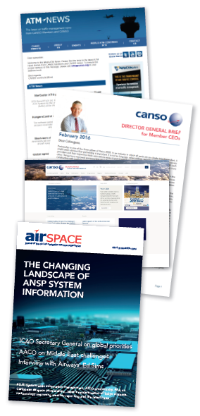
Civil Air Navigation Services Organisation
Global voice of ATM worldwide – CANSO Members support over 85% of world air traffic
Members share information and develop new policies
International forum for development and exchange of ideas
International network for ANS experts
Represent views/interests of Members

Slide 12
Safety Standing Committee (SSC)
Develops and executes the CANSO safety work programme
Governed by SSC Steering Committee
Includes the following SSC Workgroups:
  SMS Capability Workgroup
  Safety Performance Measurement Workgroup
  Future SMS Development Workgroup
  Human Performance Management Taskforce

Slide 13
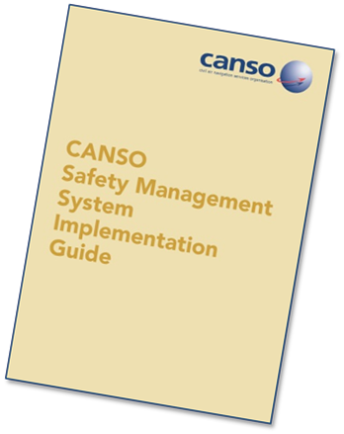
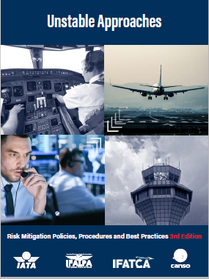
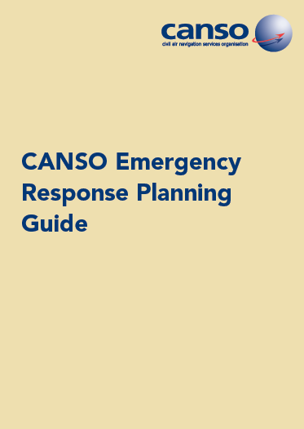
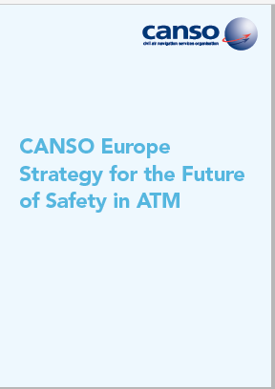
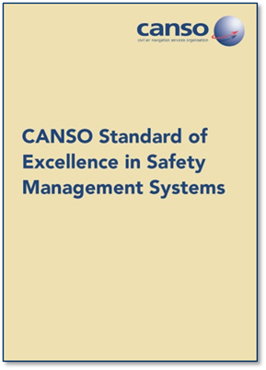
CANSO Safety Publications
CANSO Safety publications are available online at https://www.canso.org/publications

Slide 14
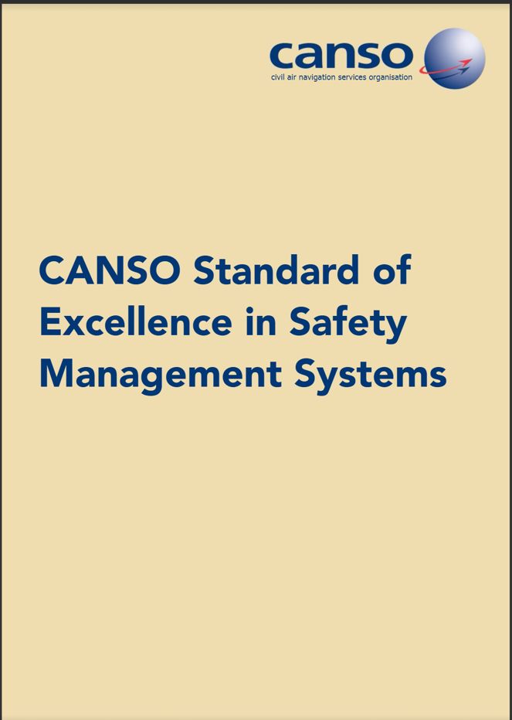
CANSO Standard of Excellence in SMS
The CANSO Standard of Excellence in Safety Management Systems provides a framework for the implementation and maturity of an appropriate SMS.
It serves as means through which ANSPs can comply with the requirements contained in ICAO Annex 19 – Safety Management
https://www.canso.org/canso-standard-excellence-safety-management-systems

Slide 15
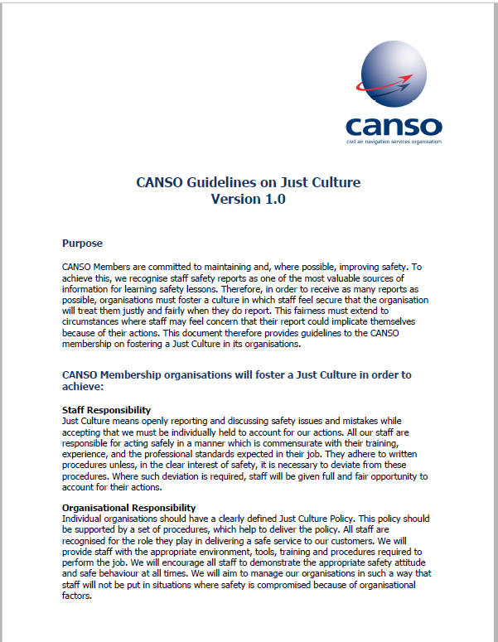
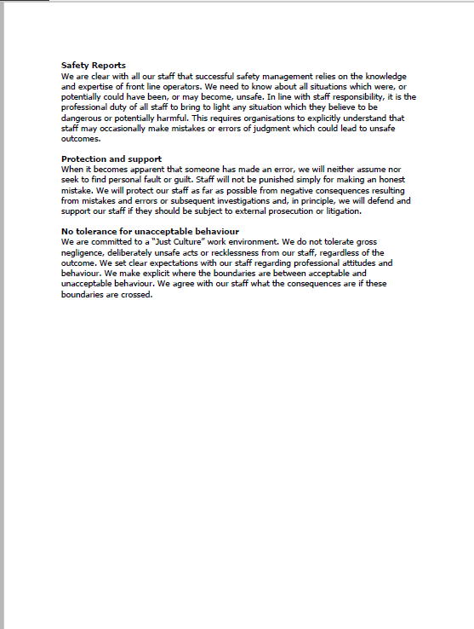
CANSO Guidelines on Just Culture

Slide 16

CANSO view on Cyber Security

Slide 17
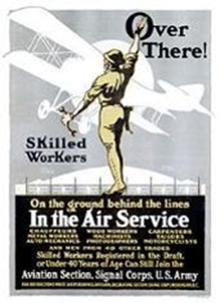

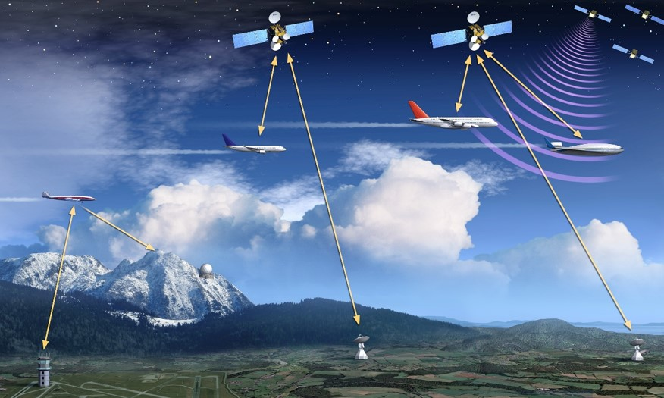
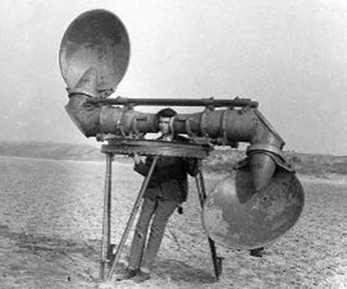

Being realistic…
To this… and much more

Slide 18
ATM Security definition ICAO Doc. 9854
(Global ATM Operational Concept)
“Security refers to the protection against threats that stem from intentional acts (e.g. terrorism) or unintentional acts (e.g. human error, natural disaster) affecting aircraft, people or installations on the ground. Adequate security is a major expectation of the ATM community and of citizens.
The ATM system should therefore contribute to security, and the ATM system, as well as ATM-related information, should be protected against security threats.
Security risk management should balance the needs of the members of the ATM community that require access to the system, with the need to protect the ATM system”

Slide 19
What’s new?
The digital (r)evolution: we are now living in a fully interconnected, digitalised, interoperable environment.
Threat scenario changes:
sophisticated enemies + state sponsored attacks;
evolving terrorists;
high tech availability and low prices;
new vulnerabilities affecting Hardware and Software;
interdependencies and domino effects;
reconsider some weaknesses: internal threats and contractors/subcontractors/consultants...

Slide 20
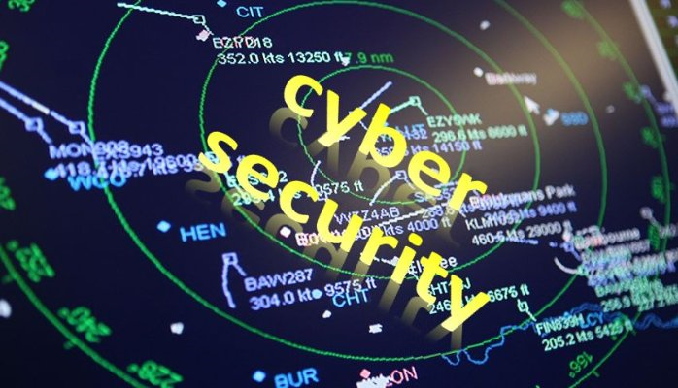
Operational Concept
  While a traditional enterprise approach tends to protect business continuity, ANSPs call of duty is to play a role in protecting human life, service continuity and fundamental rights connected to flying.
  ANSP Role → safety → primary values and not business first
  Information Security is one of the major drivers to ensure the safety and regularity of air traffic services provision.

Slide 21
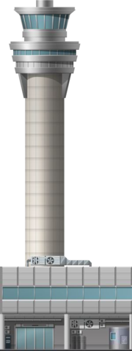
Duty of Care
Availability
Integrity
Confidentiality
To ensure prevention, detection, reaction and recovery of any event that could jeopardise the safe and secure provision of air traffic services and to preserve human life on board and on the ground, the safe, efficient, regular and confidence of transportation by air

Slide 22

COMPLIANCE + DUE DILIGENCE
  Compliant with regulatory requirements doesn’t mean to be diligent
  Having a security management system means to be aware of riks and vulnerabilities and act to fix
  Governance is critical for a Security Management System to be efficient
  Not prevent an event, when there is a legal duty exists to prevent it, is equivalent to causing it
  Liability is based on what organisations do before – not after – a security breach;
  Compliance and diligence cannot be delegated
  Due diligence must always be proven by evidence.

Slide 23
Conclusions
CANSO believes that Information Security in civil aviation should be demystified and reverted to a consistent operational concept in which:
  Synergy should be a primary value →public/private partnership;
  Rules are clearly defined and defragmented;
  Strategies are defined, made sustainable and cost-effective based on a risk-based approach;
  Funding is essential and thus provided;
  Critical factors are identified and involved (e.g. non-aeronautical entities, such as telco and energy)
  Human factor is definitely understood and addressed

Slide 24
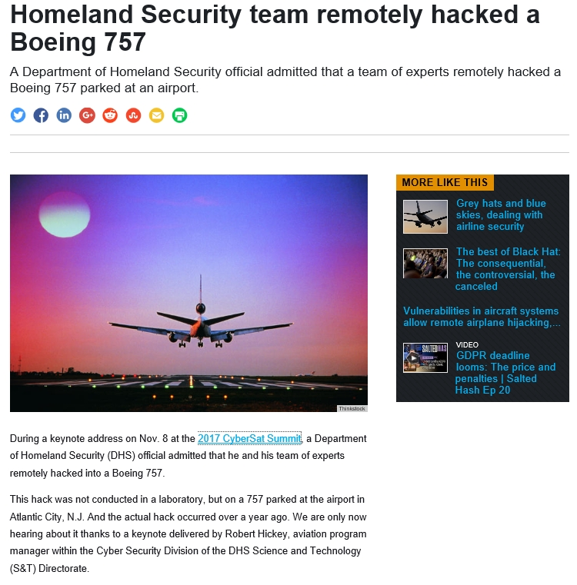
Cyber Attack

Slide 25

Attacks

Slide 26
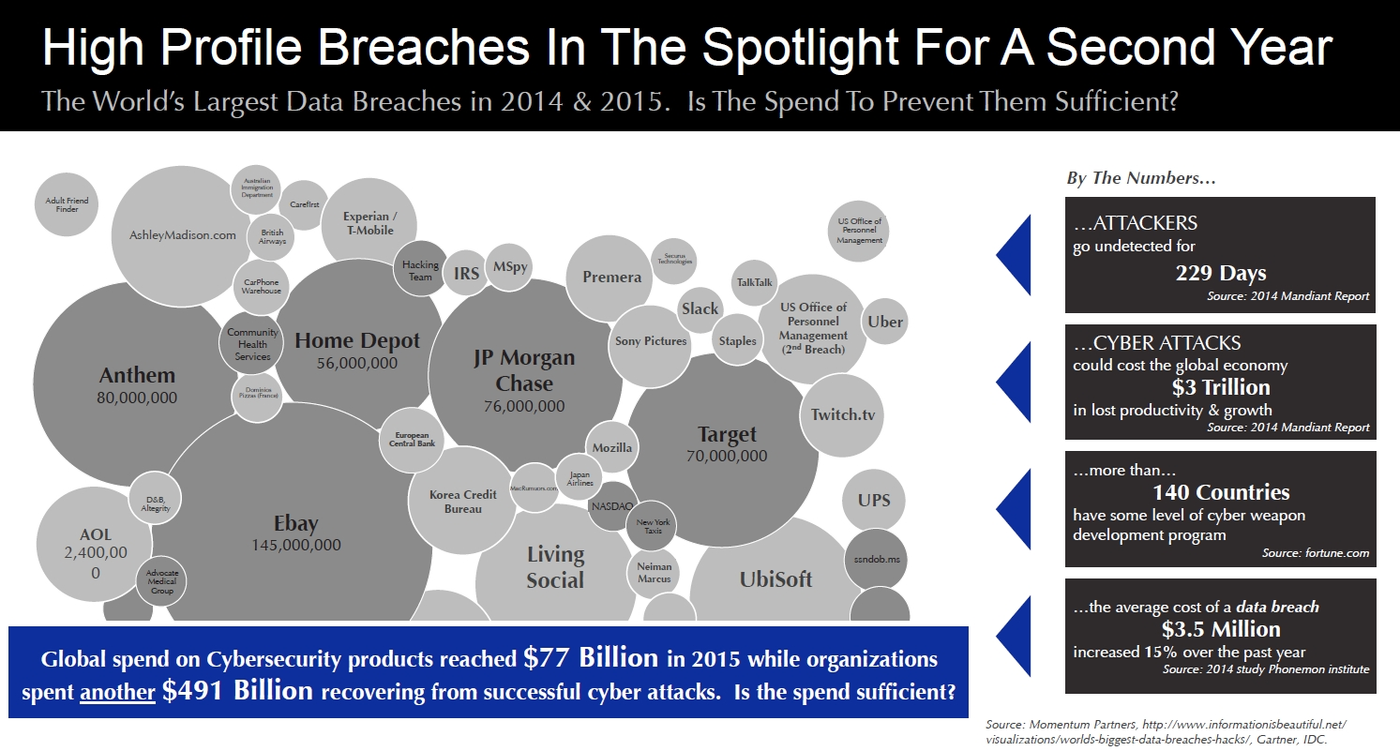
Attacker

Slide 27
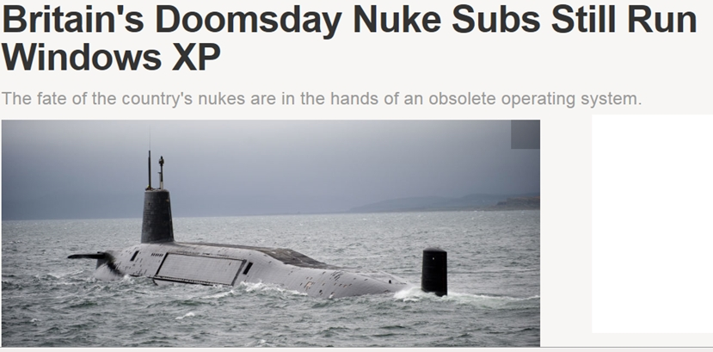
Awareness?

Slide 28
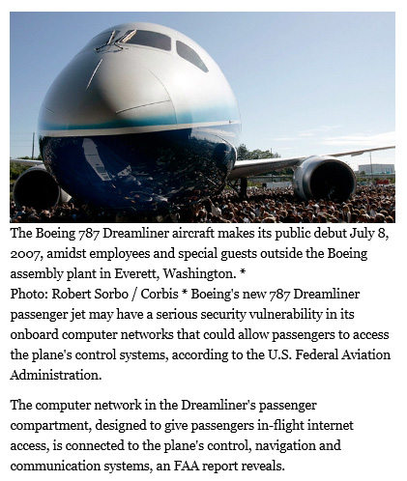
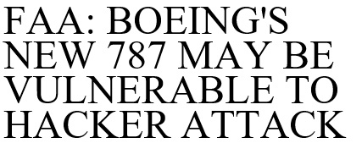
Awareness?

Slide 29
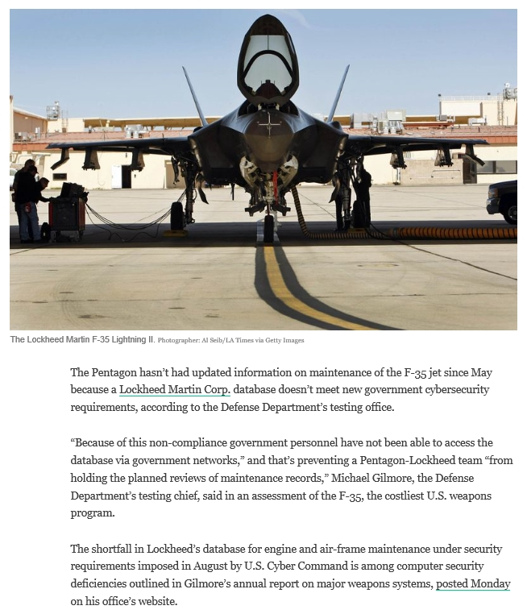
Awareness?

Slide 30
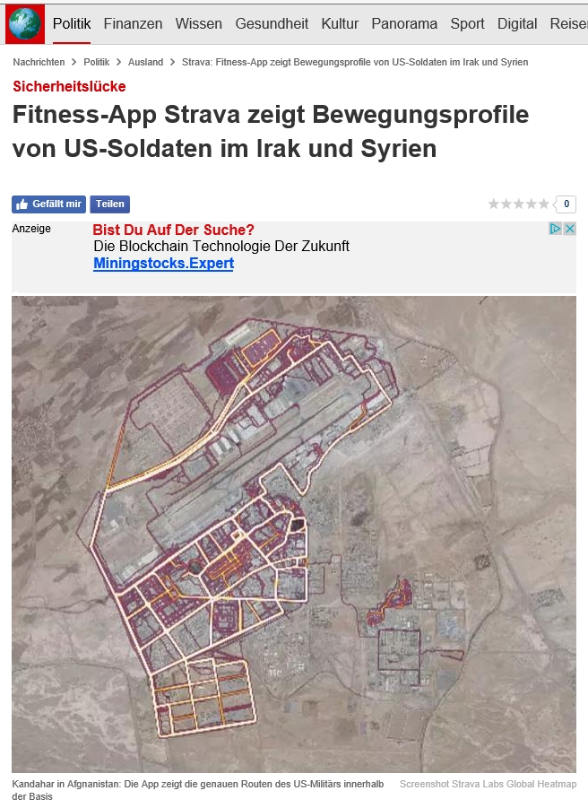
Awareness?

Slide 31
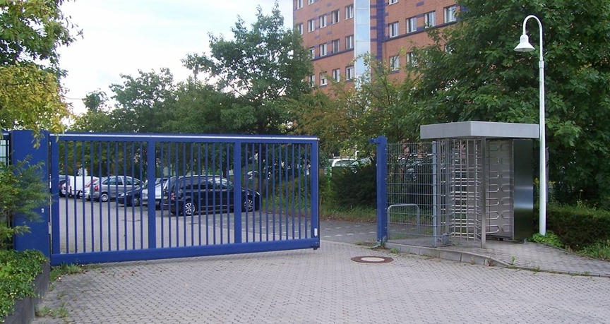
Awareness ?

Slide 32
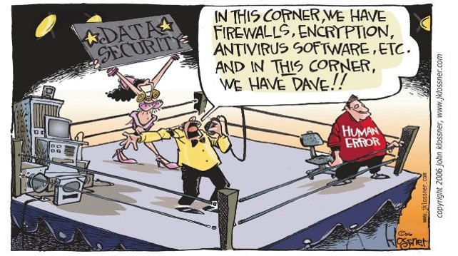

Slide 33
Some of my lessons learned ...
The importance of an effective and effiecient Air Transport System and a supporting safe and efficient Air Navigation Service Provision for the economy, groth and prosperity of a country cannot be overstated.
Establishing and maintaining a good safety and security culture (including just culture principles), sharing and learning, implementing and maintaining an appropriate SMS and ISMS, being aware of hazards and threats, will increase your systems robustness and effectiveness.
A robust system and an effective on trust based collaboration is crucial for the desirable high and safe performance of the ATM/ANS System and key to success. (Hence a national and cross national border initiative needs a good Civil-Military, Civil-Civil and Military-Military Collaboration)
Almost irrespective of general or specific conditions prevailing today, at least at national level an efficient and trustful cooperation and continuous improvements are
feasible and will pave the way also for successful cross border activities.

Slide 34
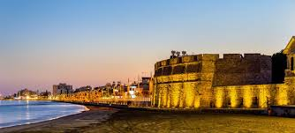
Thanks for the invitation

