Slide 1
Be Smart
Digitalization - Automation
ATSEP
ATM/ANS
2018
Presentation by Costas Christoforou, Director Region Europe slide nr 1/12

Slide 2
MAIN POINTS
IFATSEA , European region and its activities
Aviation Strategy for Europe – SESAR
Moving towards a new Era - New Technologies
Future CNS
Cyber Security
IFATSEA view on the way forward - New challenges
Presentation by Costas Christoforou, Director Region Europe slide nr 2/12

Slide 3
IFATSEA - The ATSEPs’ Federation
Founded 1972
More than 40.000 ATSEP in 64 Countries.
Non political & Non industrial
Promote Safety & Efficiency in Aviation.
Assists and advise in the development of ANS systems
Development of high standards, technology Skill, Knowledge & Professionalism
Close cooperate with international /European Aviation bodies ICAO, NGAP task force and EASA, Eurocontrol,.
Productive and cooperative relationships with other ATM Professional staff organizations IFATCA, IFAIMA, ECA, ITF –ETF, CANSO and the training academies in Europe.
Presentation by Costas Christoforou, Director Region Europe slide nr 3/12

Slide 4
OUR MEMBERS IN EUROPE
32 Affiliates
Albania, Austria, Belgium, Bulgaria, Croatia, Cyprus, Czechia, Finland, France, FYROM, Germany, Greece, Ireland, Italy, Lithuania, Luxembourg, Malta, Montenegro, Netherland, Norway, Portugal, Romania, Russia, Serbia, Slovakia, Slovenia, Spain, Sweden, Switzerland, Turkey, Ukraine, United Kingdom, (Estonia, Poland, Georgia as observers)
IFATSEA Region Europe main activities
European Commission at ICB – Industry Consultation Body
Expert Group on Human Dimension – EGHD
SESAR Joint Undertaking (SJU) - SESAR 2020
European Aviation Safety Agency (EASA) - ATM/ANS TEC
Just Culture working group – ATM partners
EC Social Dialogue ATM Working Group (with ETF)
Presentation by Costas Christoforou, Director Region Europe slide nr 4/12

Slide 5
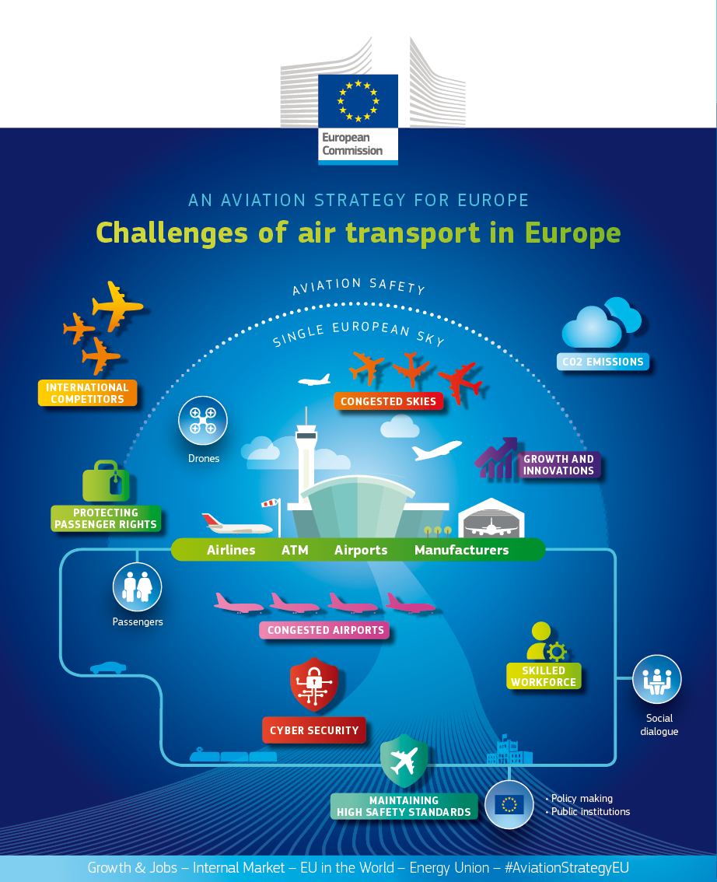
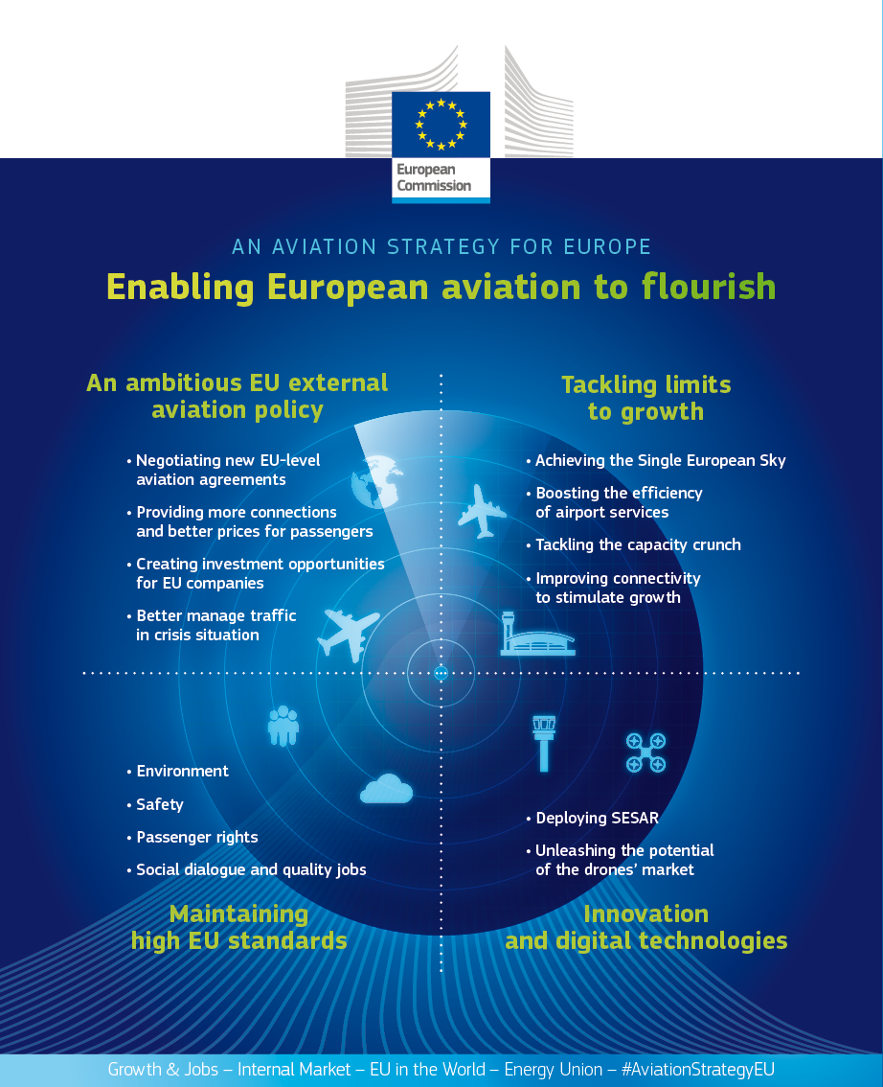
Presentation by Costas Christoforou, Director Region Europe slide nr 5/12

Slide 6
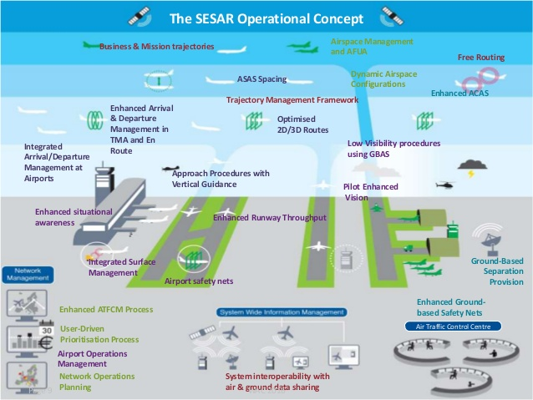
Presentation by Costas Christoforou, Director Region Europe slide nr 6/12

Slide 7
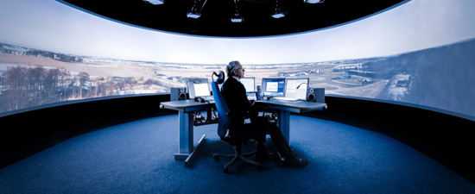
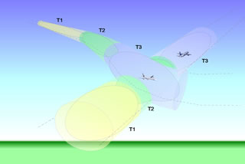
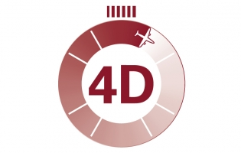
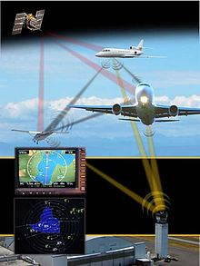
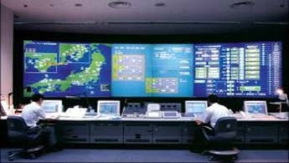
MOVING TOWARDS A NEW ERA - NEW TECHNOLOGIES
Cybersecurity – Big Data – AI
4D – Trajectory
Precision Navigation
Remote Towers
Datalink
AI in ATM – Expert Systems
Digitalization & Networking of ATM
ATSEP Technical Ops Systems Monitoring and Control.
Integration of Drones in ATM
Satellite navigation
Presentation by Costas Christoforou, Director Region Europe slide nr 712

Slide 8
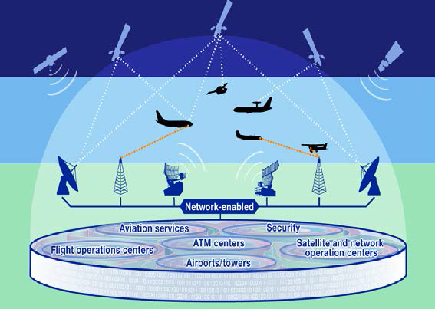
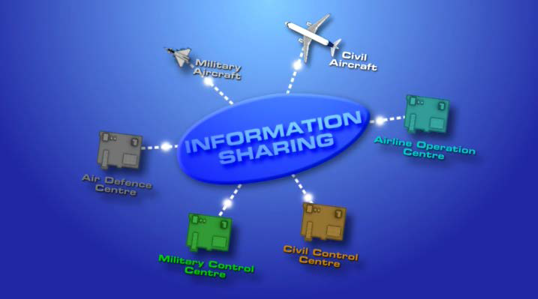
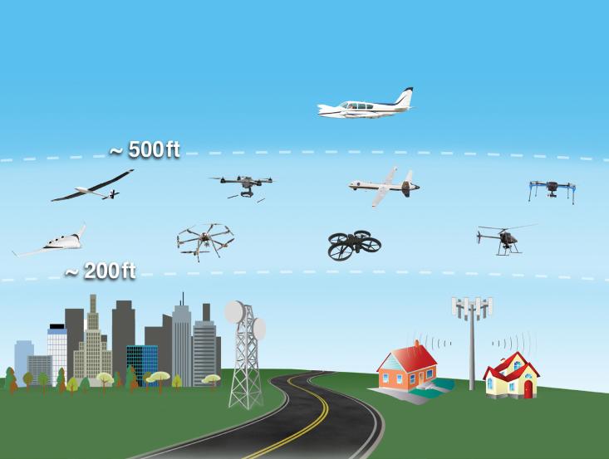
Future CNS will rely on a Network Centric Approach…
The Human intervention will be in an Advance - SMC
Health systems monitoring software.
Human decision support tools.
Challenge: Human issues: stress, lack of attention, loss of situational awareness are factors we should examine.
Risk: Increase dependence on automation will imply to consider automation failure scenarios, complex systems resilience and human de-skilling.
Presentation by Costas Christoforou, Director Region Europe slide nr 8/12

Slide 9
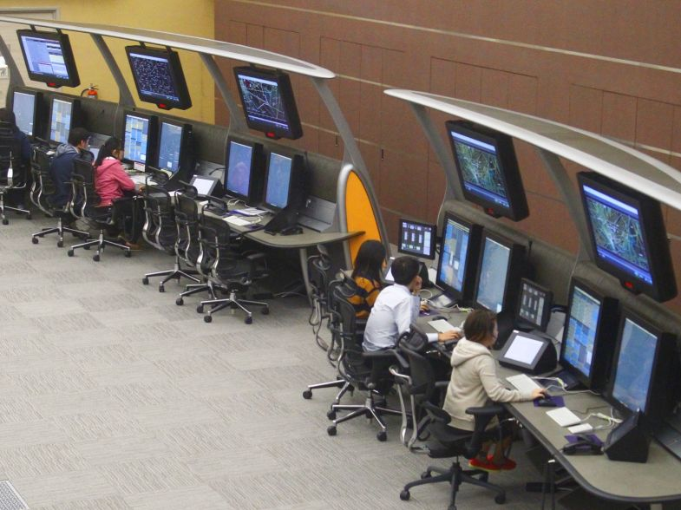
Cyber Security … a very big challenge
where?
* Remote towers & Virtual Centers
* Enhanced Automation
* Networked services, SoA
* Integration of RPAs (UAV/UAS/Drones,..) in ATM.
* DLS communication
* Availability, accuracy, integrity and security of critical info.
* We focuses on solid preventative measures
Cyber-security protection for a robust, resilience and data-sharing environment
Presentation by Costas Christoforou, Director Region Europe slide nr 9/12

Slide 10
IFATSEA view on the way forward - New challenges
Data link complementary technologies.
Integration of RPAs (UAV/UAS/Drones,..) in ATM.
CNS rationalization.
“Digitalization of ATM” really the networking of ATM and Aircraft.
Enhanced Reality, remote towers and virtual towers.
Networking services and SoA-Service oriented architecture.
Cybersecurity and Expert Systems - Artificial Intelligence - in ATM.
Legal Liability issues
New training disciplines for ATSEP to maintain their competences
IFATSEA has developed a CONOPS
for Cybersecurity in the ATM/ANS
to facilitate resilient operations.
Common goals in the CONOPS are :
- The cyber intrusion must never reach the Controller or the Pilot (ideally)
- ATSEP to certify the reliability and integrity of all data.
Presentation by Costas Christoforou, Director Region Europe slide nr 10/12
Notes:
Required navigation performance (RNP) extends the capabilities of modern airplane navigation systems by providing real-time estimates of navigation uncertainty, assurance of performance through its containment concepts, and features that ensure the repeatability and predictability of airplane navigation. This precise characterization of airplane performance is key to designing more efficient airspace routes and procedures.
Performance-Based Navigation (PBN)
Information related to the use of Area Navigation (RNAV) Standard Instrument Departures (SIDs), RNAV Standard Terminal Arrivals (STARs), and Required Navigation Performance Authorization Required (RNP AR) Approaches.
Integrates arrival, departure, and surface (IADS) concepts and technologies
A-SMGCS (Advanced Surface Movement Guidance & Control System) is a system providing routing, guidance and surveillance for the control of aircraft and vehicles in order to maintain the declared surface movement rate under all weather conditions within the aerodrome visibility operational level (AVOL) while maintaining the required level of safety. (ICAO Doc 9830: Advanced Surface Movement Guidance and Control Systems (A-SMGCS) Manual).

Slide 11
Conclusions
The new system is still a Safety critical Socio-technical environment…
New approaches on technologies and concepts are used…
Systems are increasingly interconnected…
The issue of monitoring and control has not been solved yet.
Digitalization is surely the way forward. BUT…
We should keep a sharp outlook and take a wise and
stepped approach.
Ave all, we should not treat aviation as any other industry.
Aviation domain is NOT just another business activity.
Presentation by Costas Christoforou, Director Region Europe slide nr 11/12

Slide 12
Presentation by Costas Christoforou, Director Region Europe slide nr 12/12

