Slide 1

CYPRUS AIR TRAFFIC CONTROLLERS’ ASSOCIATION
CHRISTOS KOMODROMOS
SUPERVISOR – NICOSIA ACC
APRIL 2018
COMMUNICATION & coordination DEFICIENCIES between Nicosia and ankara ACC
–
”ercan” interventions

Slide 2
Safety is the FIRST priority.
Lost of flight efficiency!
Lost of capacity!
Increased of delays within Nicosia FIR!
FOR US THE ATCOS

Slide 3
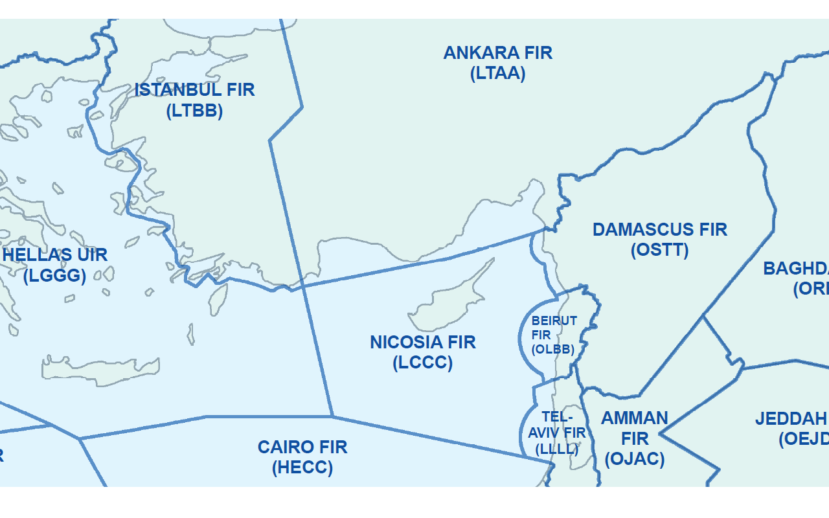
NICOSIA FIR

Slide 4
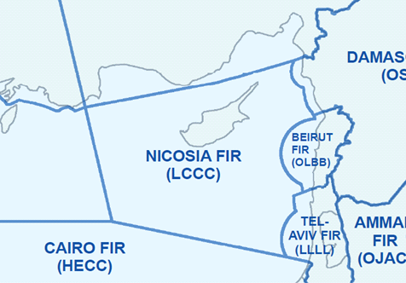
NICOSIA FIR

Slide 5
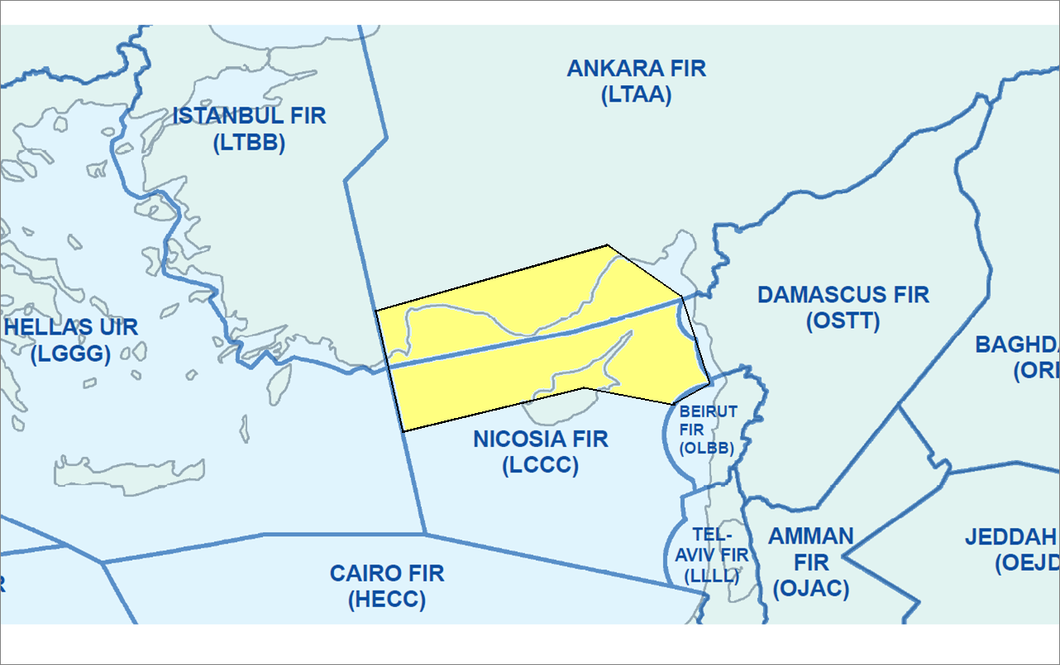
NICOSIA FIR – INTERVENTIONS
1974 Turkish Invasion – Disruption of ATC coordination
1977 “Ercan Control”
AREA OF DEFICIENCY

Slide 6
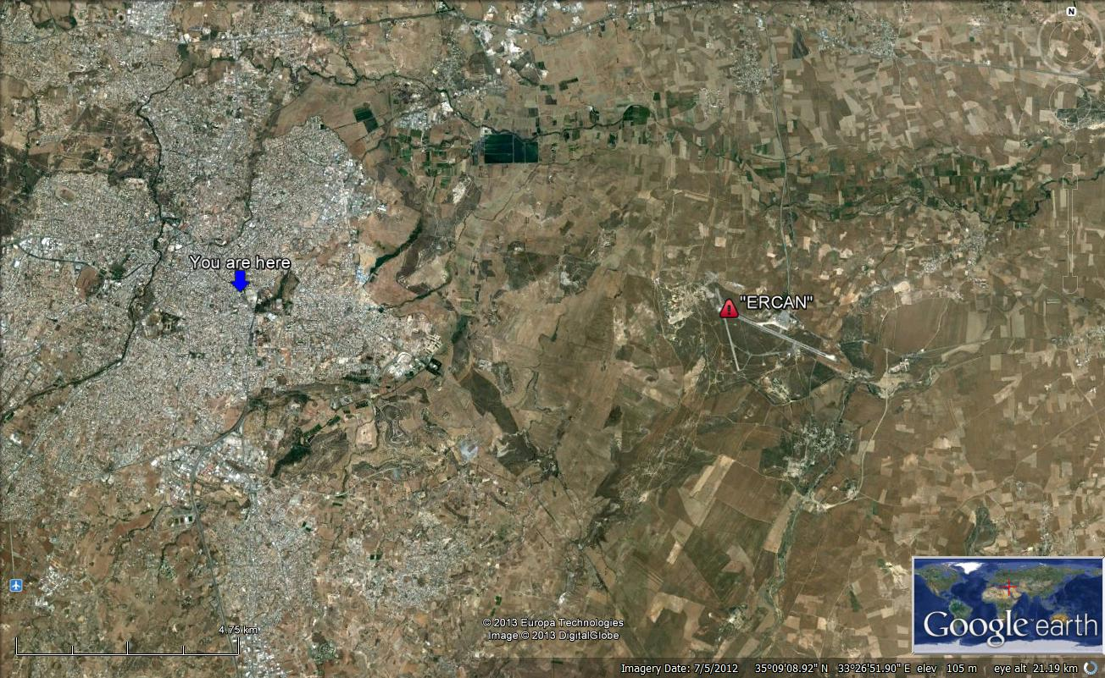
5 NM

Slide 7
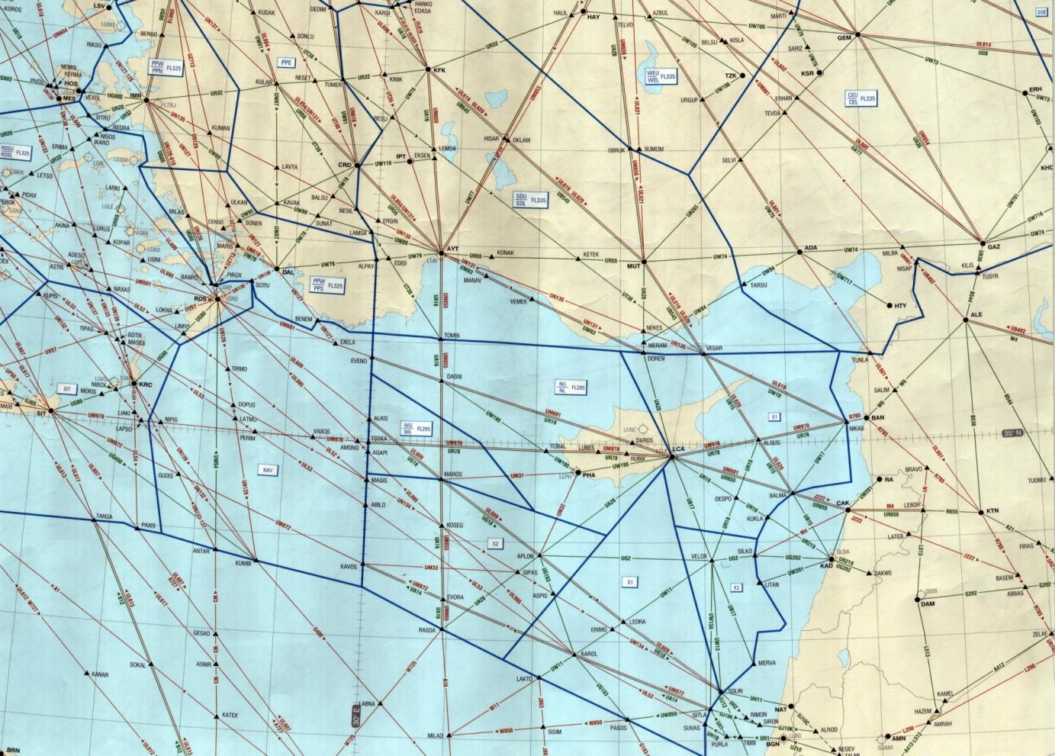
NICOSIA FIR – INTERVENTIONS
No transfer of flight info to Nicosia ACC
Transfer of flights on wrong frequency
Instructions that change Flight profile across FIR boundary
Low capacities
Consider a/c as RCF entering adjacent FIR as unknown traffic

Slide 8
Un-coordinated traffic from Turkey
A3465 F350
Nicosia identification and control
Need to pass estimate to Nicosia 10 min before entry. Nic ACC activates specific FP
MEA 212
F350
a/c instructed to change or to keep same
SSR code in order to be correlated
Transfer of control to next ACC/FIR
Notes:
Here is an example of the actions expected from the pilot of a flight that will transit the FIR boundary coming from Ankara to Nicosia and continuing to Middle East.

Slide 9
Side effects from “ERCAN” interventions
Additional workload in the cockpit
Additional stress on ATCO – “double control”
Change of ATCO planning
“Unknown Traffic” – RCF procedures
Reduced capacity – increased delays

Slide 10
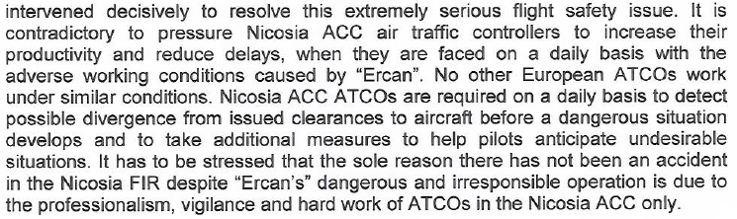

Slide 11
NEW trends...
Additionally to the ATC interventions, issues of double control and the non communication issues...
...and despite that according to the EU airspace regulation , Nicosia FIR/UIR is classified as Class C above FL195......
..and despite efforts for enhancing flight efficiency with direct routes....
...tactical action is the trend employed by the pirate station to enhance its existence.... in the area.
Please watch the following video:

Slide 12
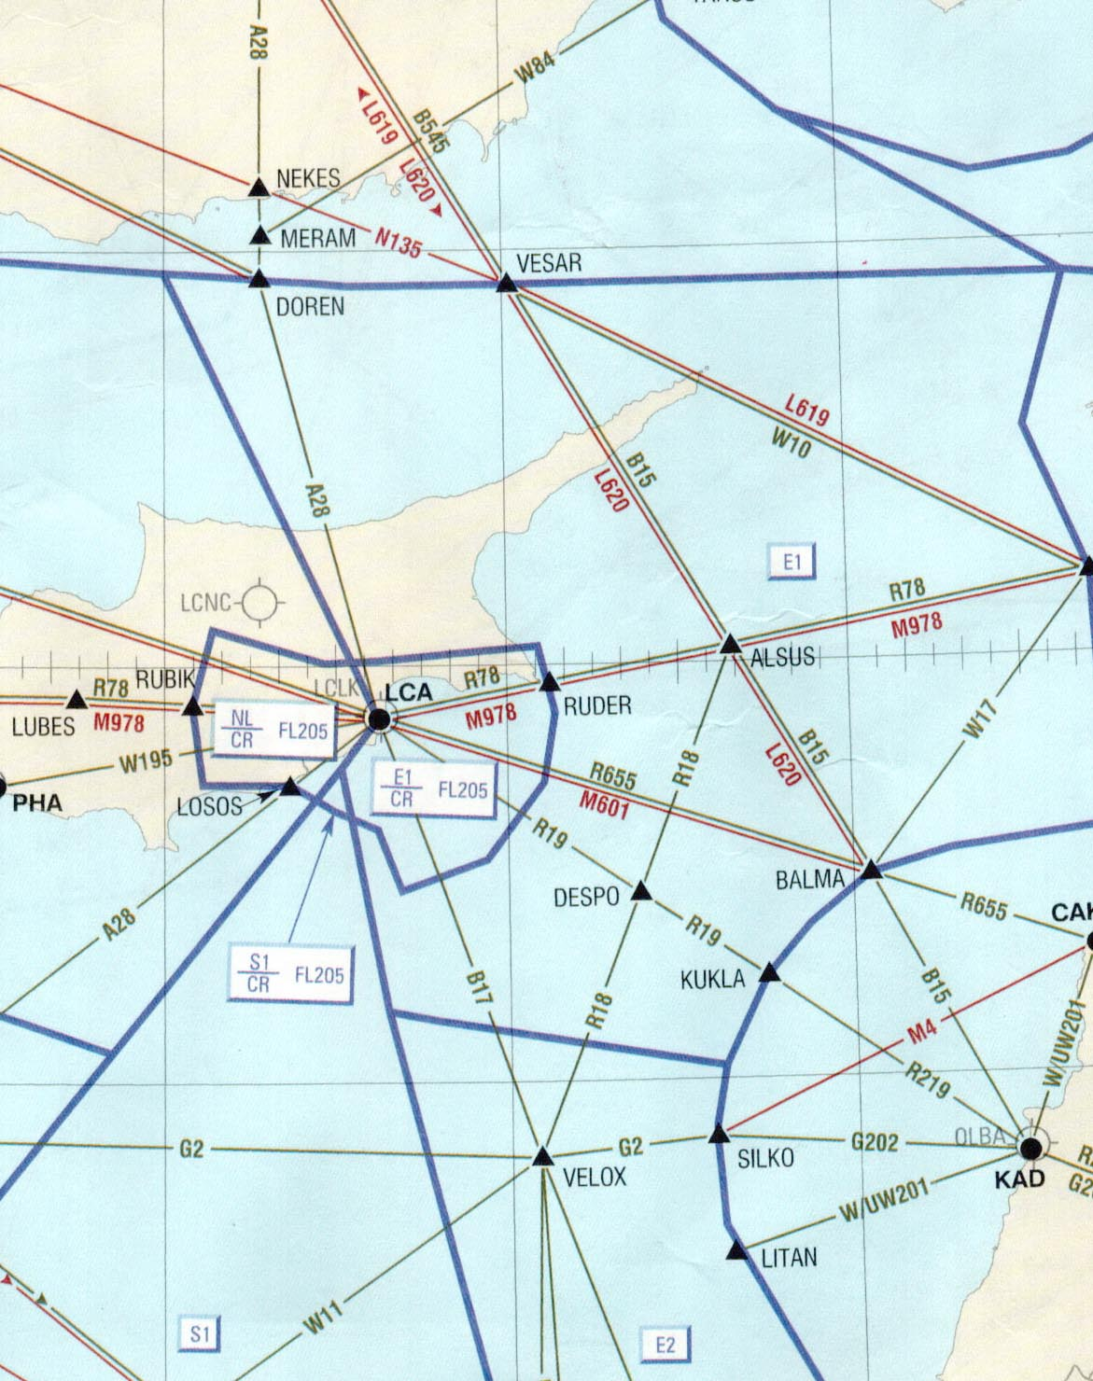
In this case the pilot was on a direct track from Point NIKAS to TOSKA (entry-exit)

Slide 13
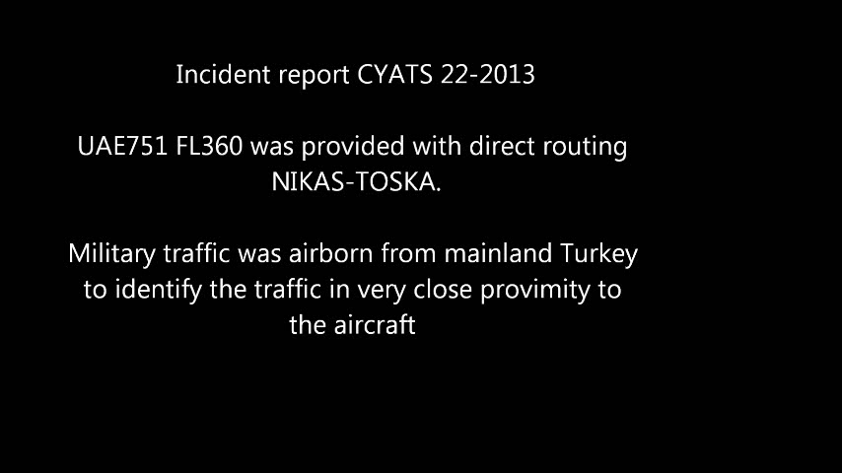

Slide 14
Pirate action...
On another occasion an ELY pilot on a direct route from VELOX to VESAR was threatened by the “ercan controller” with interception unless he complied with his routing instructions.

Slide 15

Another audio sample of a similar incident....

Slide 16
RESULTS
Reported flight failures in 2012 -2017 to coordinate flight plans and observe ATC instructions
 | 2012 | 2015 | 2016 | 2017
Aircraft deviations from published ATM procedures | 458 | 369 | 276 | 260
Aircraft deviations from ATC clearance | 100 | 39 | 21 | 22
Unauthorized penetration of airspace (RCF?) | 390 | 319 | 249 | 233

Slide 17
EFFORTS - DCA ACTIONS
Implementation of SMS
Monitoring and reporting
Contact with airlines – educating
Publications – raising awareness
Upgrade of infrastructure and safety tools
BLUE MED activity

Slide 18
WAY AHEAD
Rule of Law
International Standards and Practices
Improved cooperation
Support by Stakeholders; IATA, ICAO
Users actions ; Aos,ADO
FSF, ATCEUC, IFATCA, IFATSEA

Slide 19

Notes:
Ladies and gentlemen. I thing the claim on the first slight is very well justified. Its about time to act on the situation.

