Slide 1
FSF-MED REGIONAL SEMINAR 13-APRIL-2018, CYPRUS SESSION TWO Civil-Military Co-ordination Landau Tal Head of Tel Aviv ACC

Slide 2
Who Are Our Customers?
Civil traffic to & from ISR\AMN FIR
ISR air force flights in & around our air space
Foreigner air forces – NED, FRA, ITA, CAN, POL, GER, USA…
RAF
UAV
Carriers
Missals launches by different forces

Slide 3
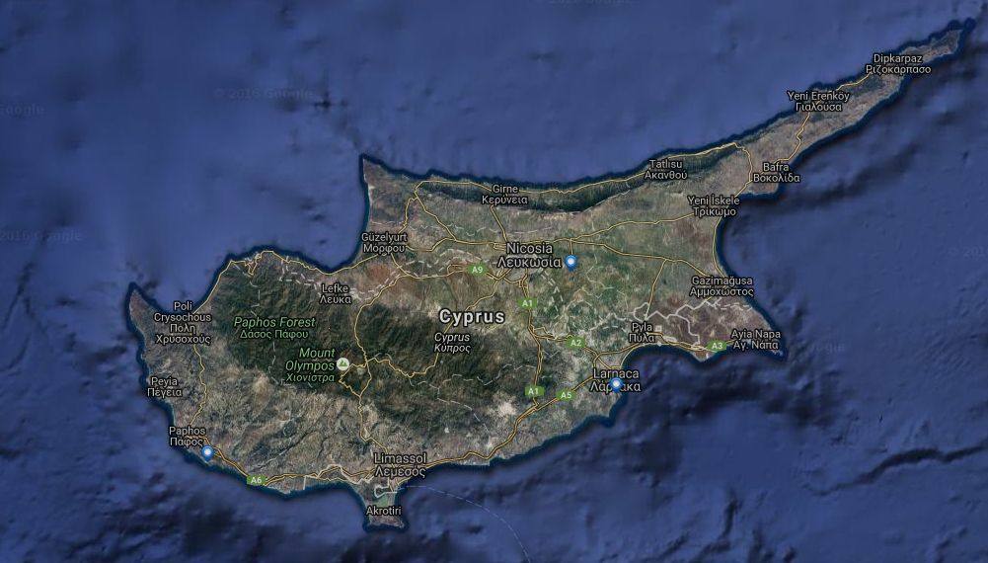

Slide 4
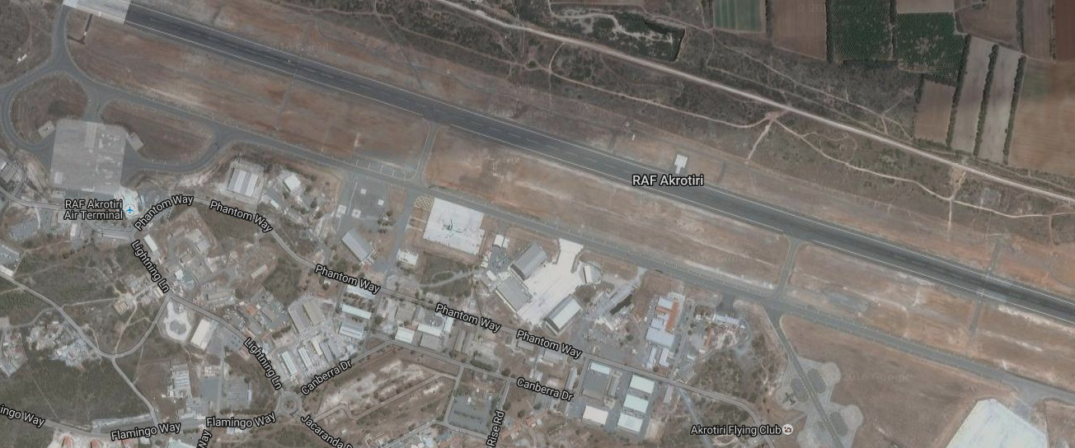
LCRA

Slide 5
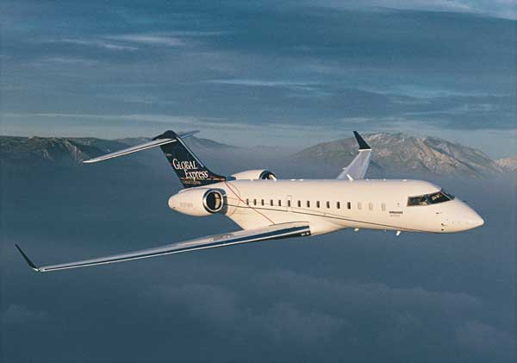
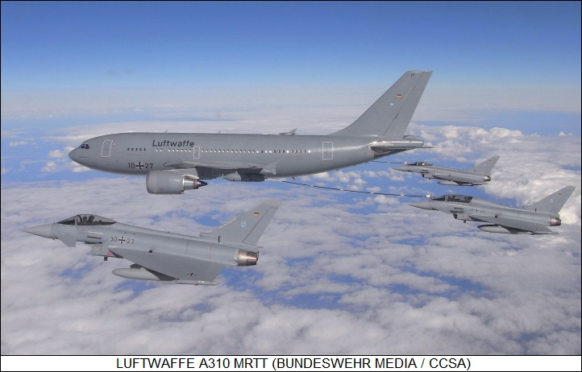
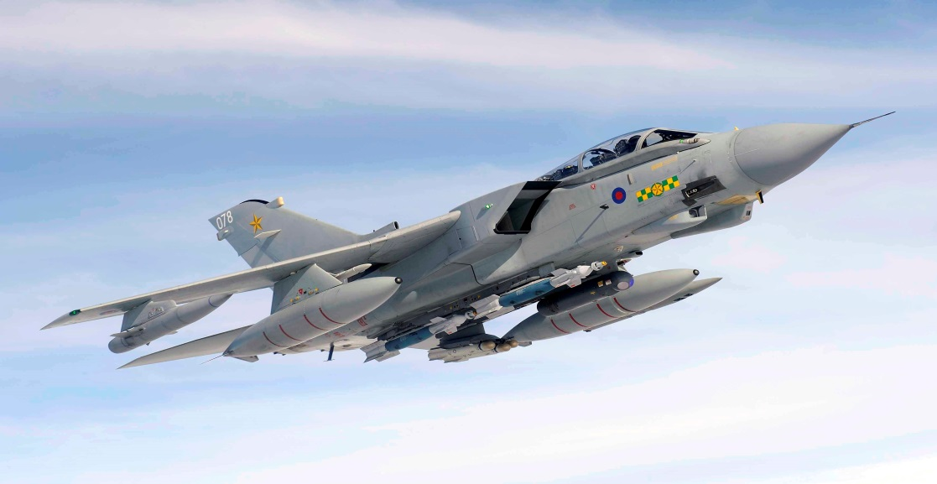
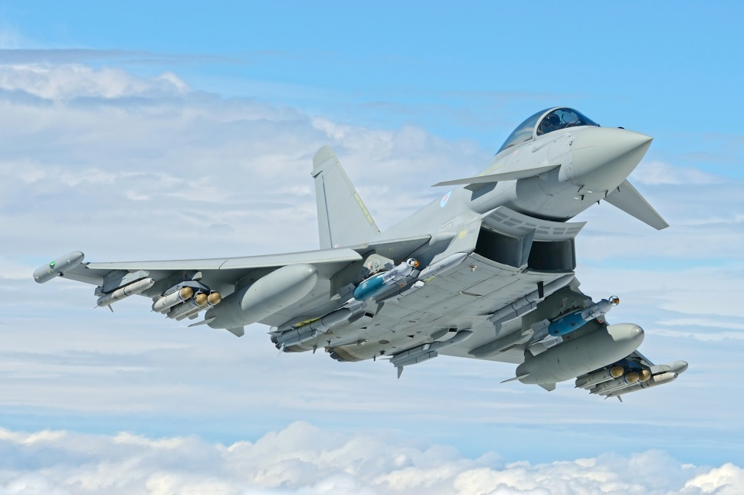
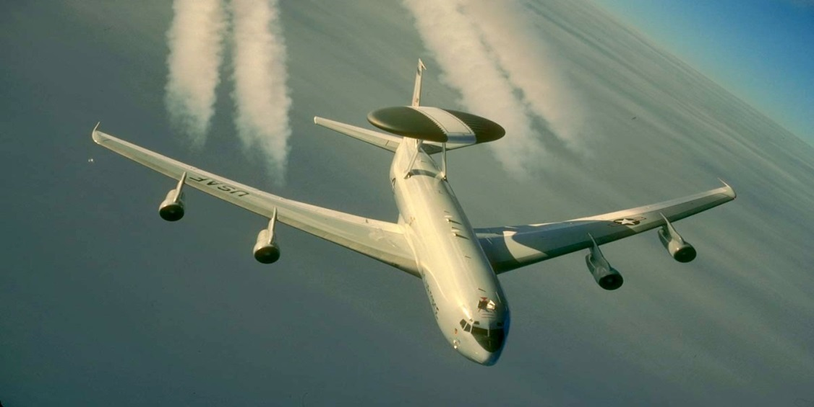
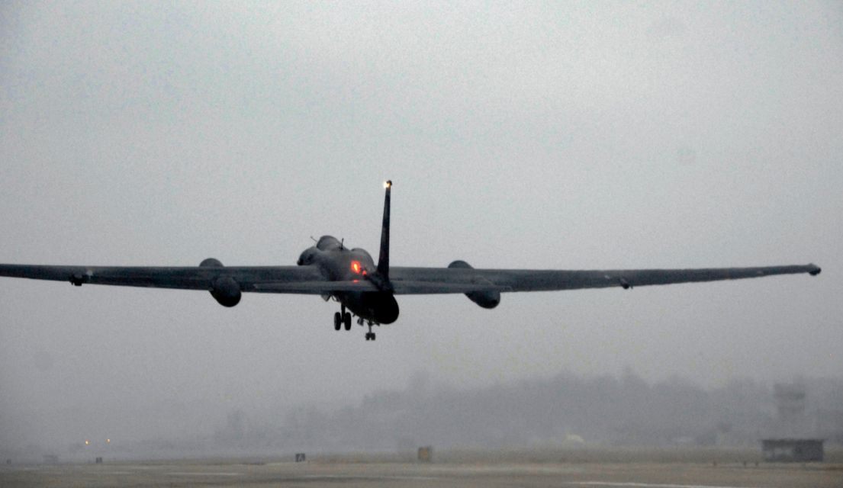
Back

Slide 6
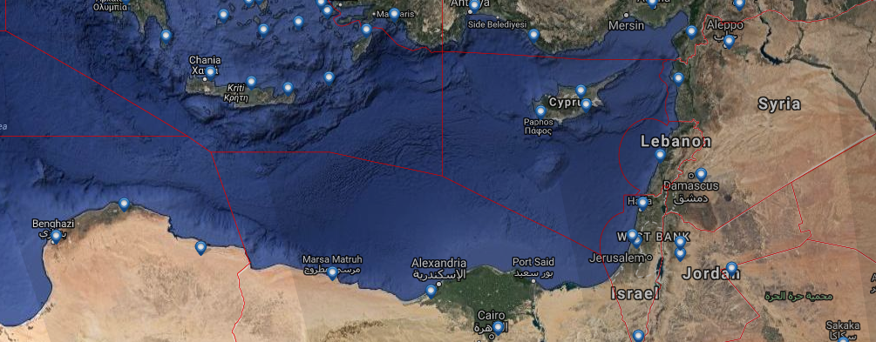

Slide 7
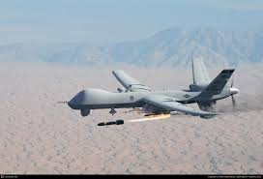
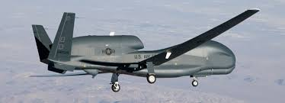
Back

Slide 8
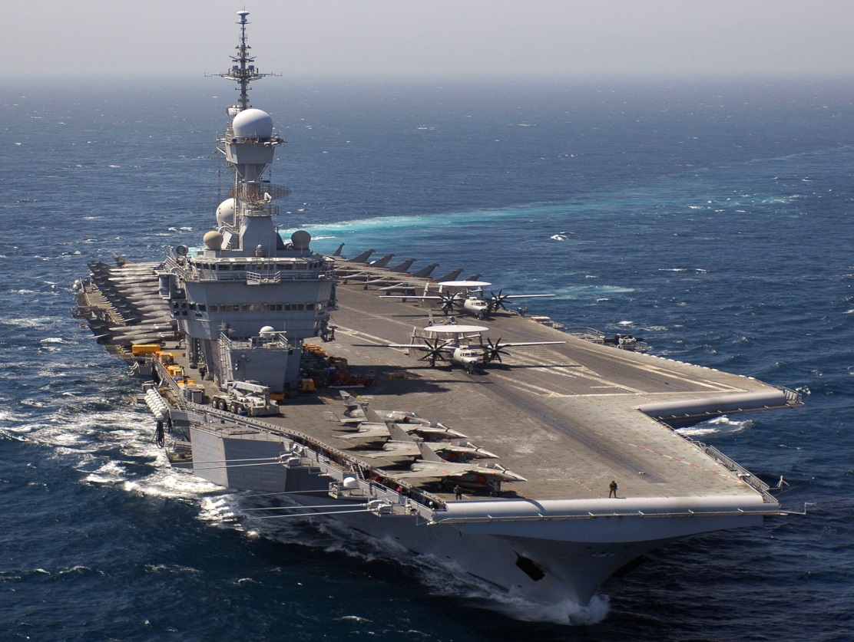
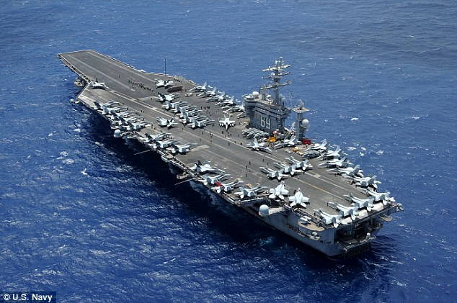
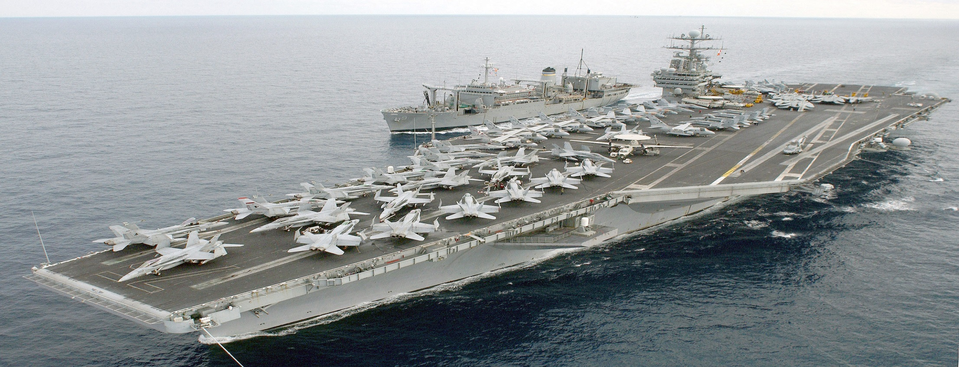

Slide 9
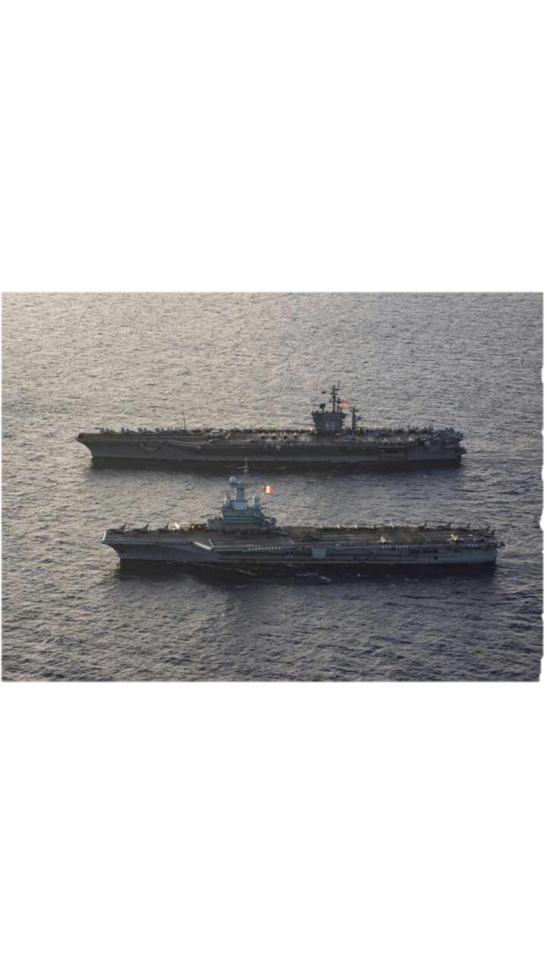

Slide 10
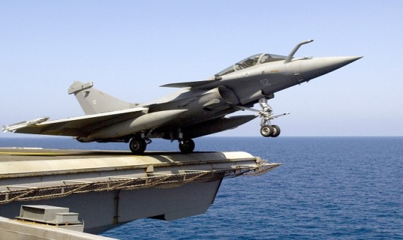
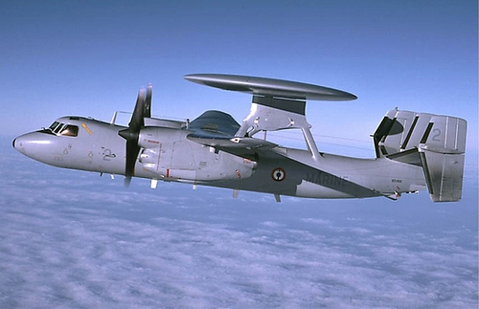
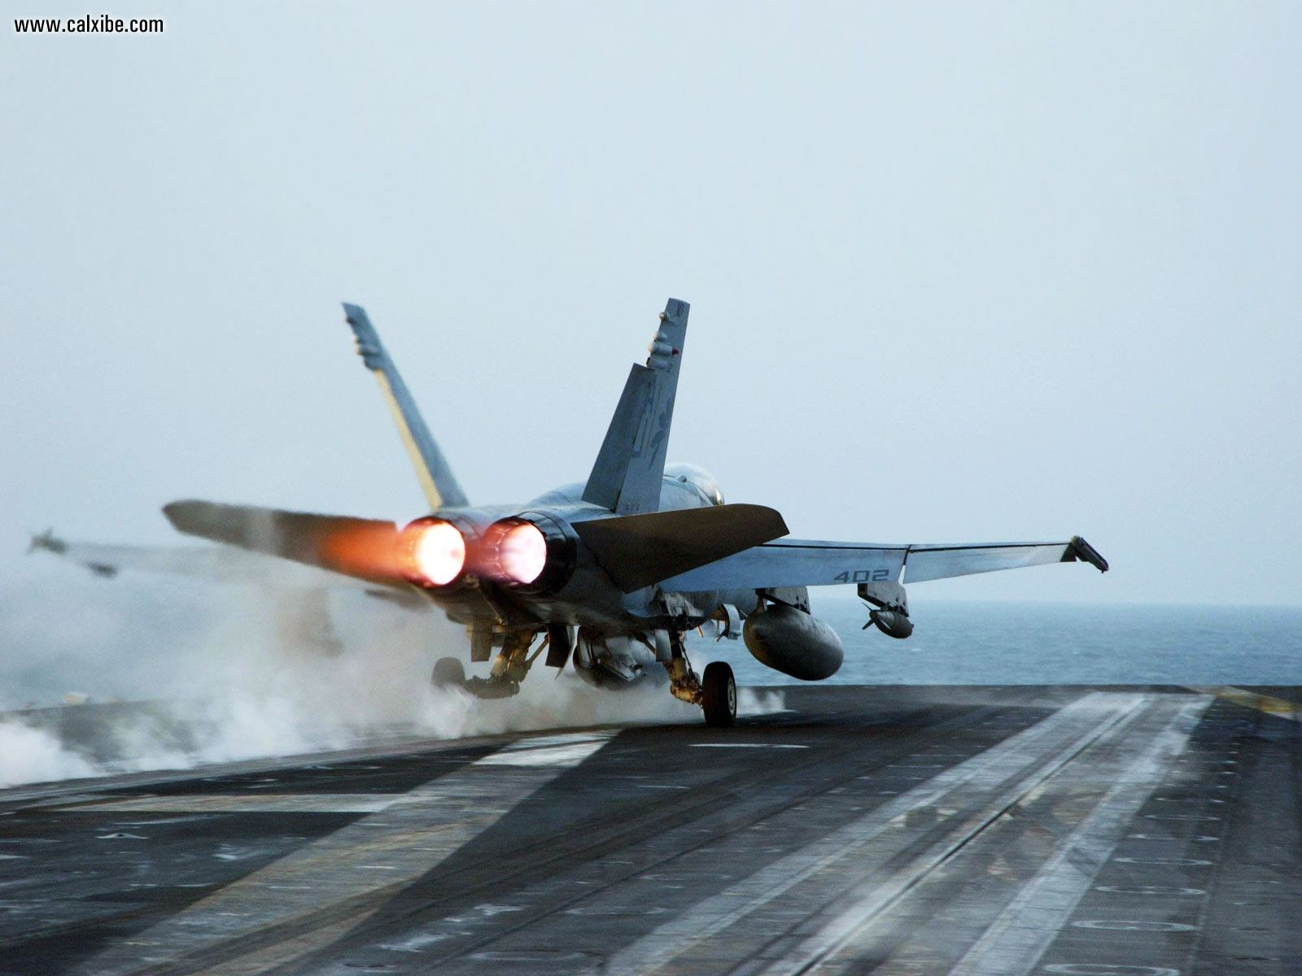
Back

Slide 11
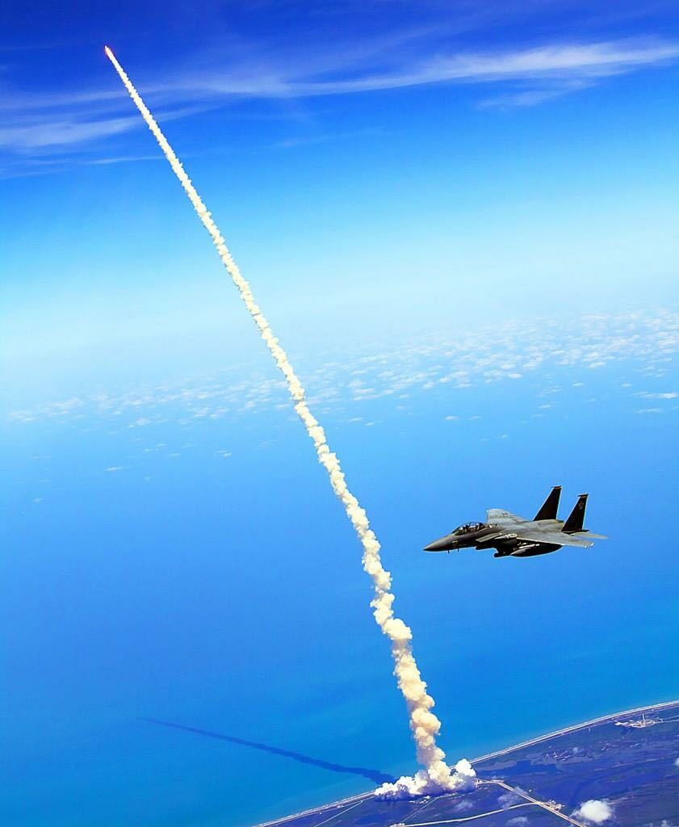
Back

Slide 12
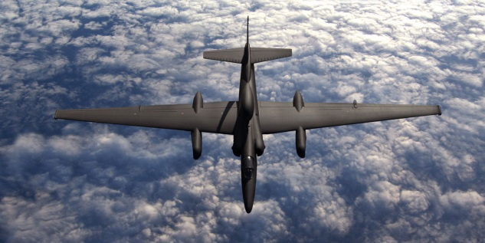
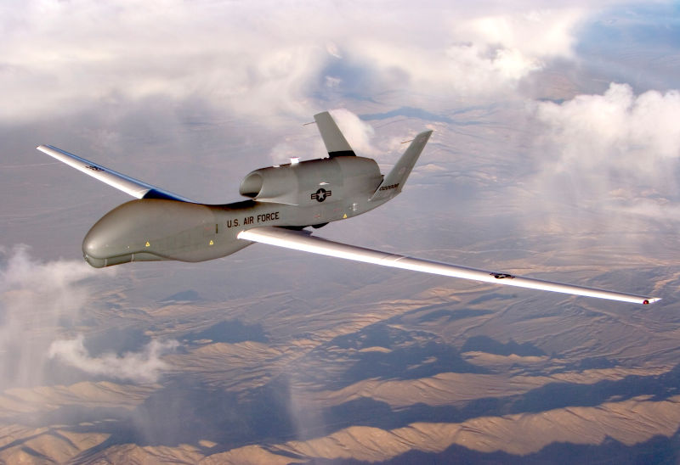
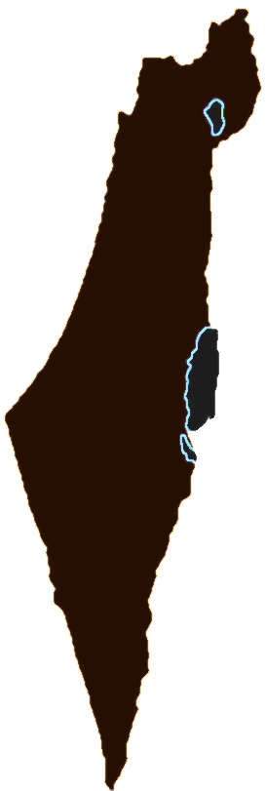
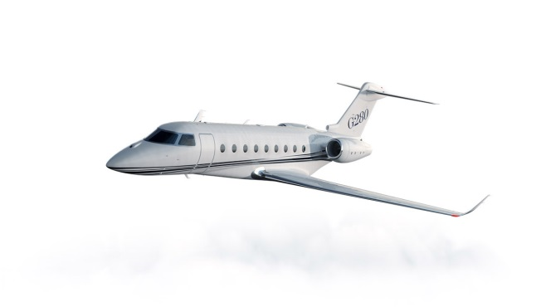
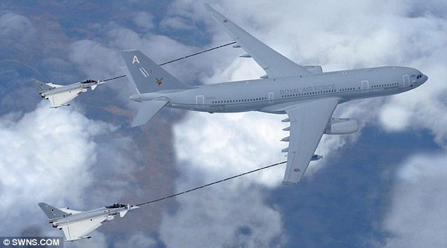
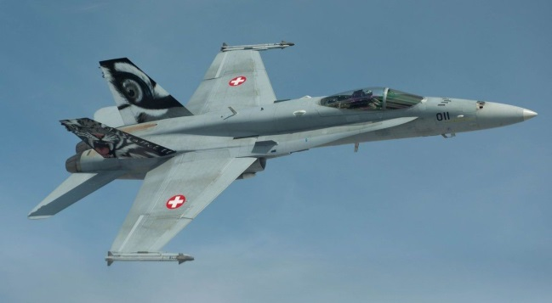
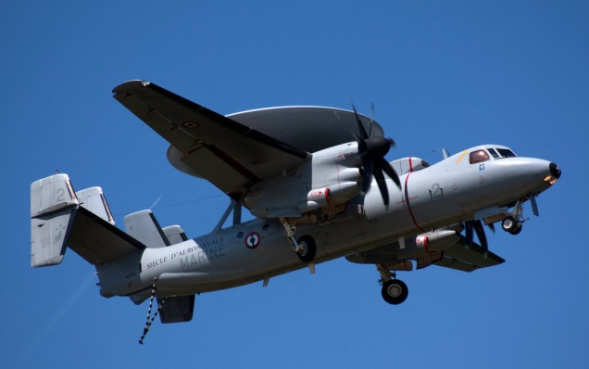
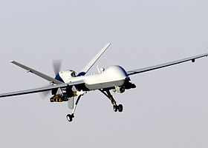
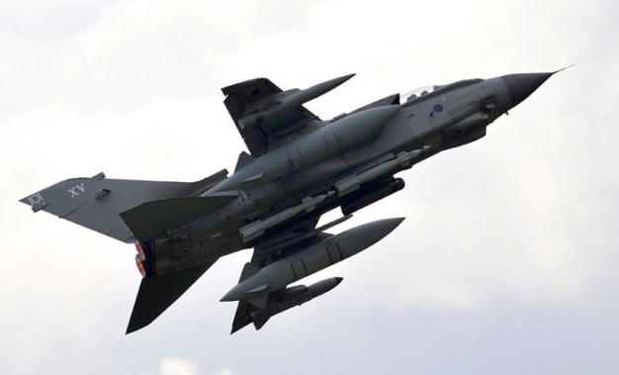
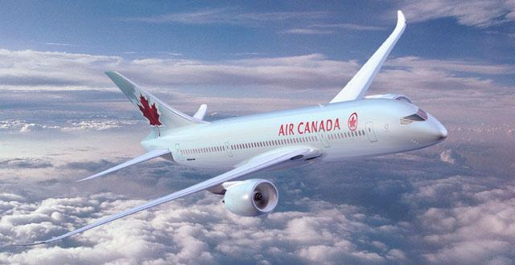
U2
60,000
Side View
Global hawk
55,000
50,000
Glex
45,000
Awacs
40,000
35,000
Voyager
Rafale EF
30,000
E2C
Civil Traffic
Reaper
25,000
Tornado
20,000
15,000
10,000

Slide 13
Quick Look on The Radar Display

Slide 14
Coping
Space sharing with IAF
Networking NIC\TLV\AMN
Pre briefing of foreigners before arrival
Larger separation from civil traffic
Referring and demanding as a regular flight (FPL, Transponder, TCAS, NON RVSM)
Creating involvement and partnership feeling of the staff with the mission

Slide 15
Thank You
talla@iaa.gov.il
050-9755025

