Slide 1
Fatigue management
Salvatore Luca Greco
ANACNA
Italy

Slide 2
Fatigue: what are we talking about?
A physiological state of reduced mental or physical performance capability resulting from sleep loss or extended wakefulness, circadian phase or workload (mental or physical activity, or both) that can impair an individual's alertness and ability to safely perform his/her tasks;
Eu. Reg 373/2017

Slide 3
Fatigue: why are we talking about it?
“Satisfying increased demand for capacity while maintaining safety”
Strong link between fatigue, stress and performance.

Slide 4
Fatigue is affected by all waking activities.
Fatigue management is a shared responsibility between
Individuals
ANSPs

Slide 5
The need for sleep
Sleep types
Non-REM (NREM)
REM

Slide 6
Non-REM sleep
Quiet brain and quiet body.
Brainwave activity slows down.
Phase 1
Three stages of NREM sleep
Light sleep
Phase 2
Phase 3
Deep sleep
SWS – Slow wave sleep
Muscles grow, damaged tissues get repaired.
SWS is necessary for learning

Slide 7
REM sleep
Busy brain and paralized body.
Brainwave activity looks similar to waking activity.
The body can’t move.
Electric signals from brain do not get through spinal cord.
People awaken from REM recall vivid dreaming.
Brief paralysis sometimes experienced after waking up.
Brain repairs itself during REM sleep.

Slide 8
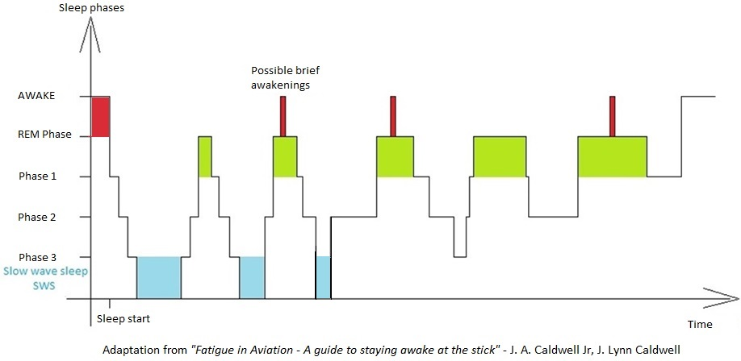
Restorative sleep = unbroken REM - NREM cycles

Slide 9
Factors affecting sleep quality
Caffeine
Nicotine
Alcohol
Environmental factors (light, temperature)
Unfamiliar environment
Time on-call

Slide 10
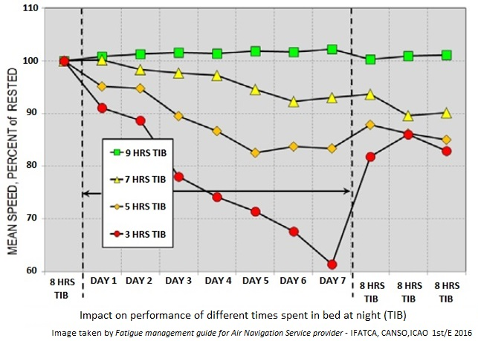
Sleep restrictions and performance

Slide 11
Shift and fatigue
How is sleep-wake cycle defined?
Circadian body clock (or circadian rhythm) sleep homeostatic process
Light-stimulated electric signals from eyes to brain, to keep body sincronized with day/night cycle.
Need for sleep increases as time spent awake passes.
Endogenous substance (Adenosine) is created during the day, leading to sleepines.
WOCL

Slide 12
Workload and fatigue
ICAO defines workload as “mental or physical activity” and recognizes it is a potential cause of fatigue.
Three main aspects of workload:
Nature and amount of work to be done (including time on task, task difficulty and complexity, and work intensity).
Time constraints.
Factors relating to the performance capacity of an individual (for example experience, skill level, effort, sleep history, and circadian phase).
High and low workload can contribute to fatigue.
Also, think about continuous changes in tasks, technology & rules
Source: Fatigue management guide for Air traffic services providers
IFATCA, CANSO, ICAO (2016, first edition)

Slide 13
Fatigue management methods
The prescriptive approach The proactive approach
FRMS
Fatigue risk management system

Slide 14
The prescriptive approach
ICAO requires States to develop regulatory limits for work and non-work periods.
Last minute duty extensions flexibility to manage operational disruptions.
Fatigue risks can be managed using existing SMS processes.

Slide 15
The prescriptive approach HOW TO?
Comply with prescribed limits (social regulations can unintentionally help the fatigue management process)
Use scientific principles in rostering (Be aware of Circadian rhytms, WOCL)
Use caution while assigning unscheduled shifts
ATCOs should be careful when swapping shifts

Slide 16
The prescriptive approach
Staying within prescribed limits may not be enough to manage fatigue.

Slide 17
The proactive approach - FRMS
A data-driven means of continuously monitoring and managing fatigue-related safety risks, based upon scientific principles and knowledge as well as operational experience that aims to ensure relevant personnel are performing at adequate levels of alertness.
ICAO DOC 9966
Manual for the oversight of fatigue management approaches
2° edition, 2016

Slide 18
Why a FRMS?
With a prescriptive approach, fatigue is one of the possible hazards that the SMS should consider
but
data-driven evidence related to fatigue is not specifically and actively collected unless a fatigue issue has been identified by the SMS.
The ANSP reacts when a fatigue hazard is identified.

Slide 19
FRM process
Using a FRMS, the Service Provider must additionally identify and assess potential fatigue risks prior to conducting operations, as well as identifying and assessing actual fatigue risks proactively during operations.
Monitor operations using proactive, predictive and reactive approach
Identify fatigue hazards
Mitigate risks
Assess risks

Slide 20
FRMS - Monitoring phase
Three ways of hazard identification:
- Proactive: Measuring fatigue levels in normal day-to-day operations
- Predictive: Examining scheduled rosters - the fatigue management way
- Reactive: Assessing the contributions of fatigue to safety reports/events
Proactive
Predictive
Reactive
Self reported fatigue risks
Fatigue surveys
Safety databases
Scientific studies
Sleep monitoring
Previous experience
Evidence based rostering
Bio-mathematical models
Safety reports
Event investigations

Slide 21
FRMS – Risk assessment
Assessing fatigue risks is a complex process:
Complex interaction between fatigue and performance. Fatigue is rarely the only cause of an event, but it is often a contributing factors.
Methods need to be used with full knowledge of potential and limitations.
Fatigue management is under continuous development: fatigue risk assesment processes might change as more experience in fatigue management is achieved all over the world.

Slide 22
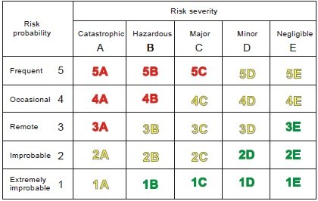
FRMS – Risk assessment METHODS
A risk assessment matrix can be used to calculate fatigue safety risk.
Source:
ICAO DOC 9859
Safety Management
Manual

Slide 23
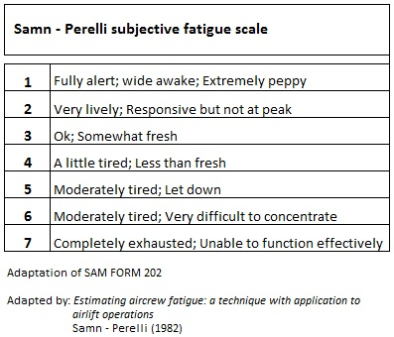
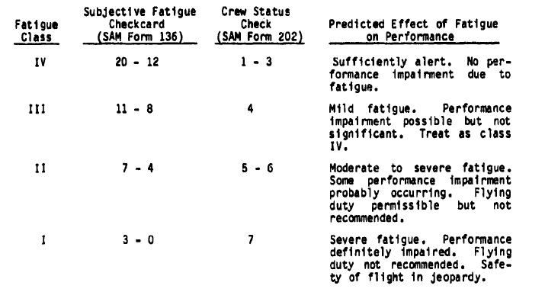
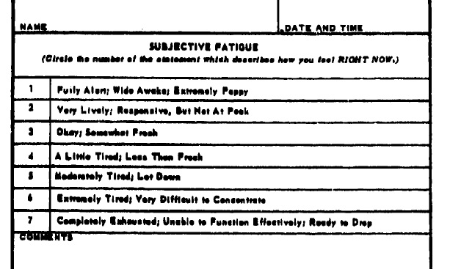
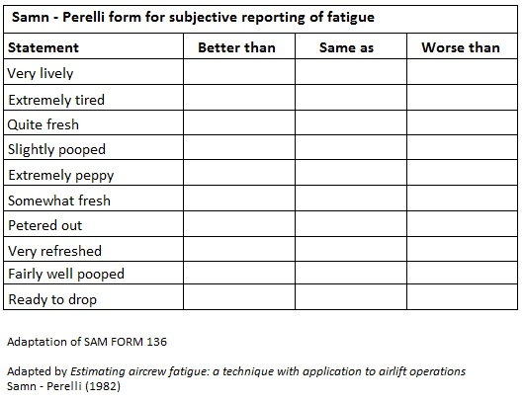
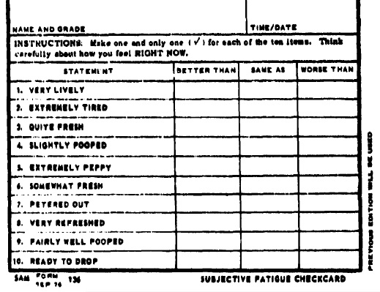
FRMS – Risk assessment METHODS
A risk assessment matrix can be used to calculate fatigue safety risk.
Safety risk is defined as the projected likelihood and severity of the outcome from an existing hazard
When managing fatigue risks, different severity classification are needed. Examples are:
Subjective sleepiness scale (Samn-Perelli, KSS)

Slide 24
FRMS – Risk assessment METHODS
A risk assessment matrix can be used to calculate fatigue safety risk.
Safety risk is defined as the projected likelihood and severity of the outcome from an existing hazard
When managing fatigue risks, different severity classification are needed. Examples are:
Subjective sleepiness scale (Samn-Perelli, KSS)
Bio-mathematical models (Not to be used as a stand alone method!)
Assessing the number of relevant fatigue factors associated with a specific duty or work pattern

Slide 25
FRMS – Risk mitigation
Risk assessment determines whether or not risk mitigation is required
Mitigations are costly in terms of HR, time, money
Need for a careful selections of fatigue risks to be mitigated,
going beyond duty and rest times!

Slide 26
point of view
Prescriptive approach may not be enough for an effective fatigue management. Let’s go (together!) beyond sleep and duty times
FRMS implementation is fundamental
A proper caution in shift swap and rest times is required. ATCOs, FISO, and anyone involved in the provision of ANS shall be aware of fatigue risks
In high workload environment no operational duty shall exceed a period of two hours without there being taken during, or at the end of that period, a break totalling not less than 30 minutes, as a strong decrease in performance is generally observed after two hours on duty.

Slide 27
QUESTION TIME
Further readings:
IFATCA, CANSO, ICAO (2016) – Fatigue management guide for Air Traffic Services Providers, first edition.
ICAO (2016) DOC9966 - Manual for the Oversight of Fatigue Management Approaches, Second Edition.
Gander, P. (2001), Fatigue management in air traffic control: the New Zealand Approach, Transportation Research Part F: Traffic Psychology and Behavior, 4(1), 49-62.
EUROCONTROL (2018) – Fatigue and sleep management
CONTACT:
Luca Greco
salucagreco@gmail.com
info@anacna.it

