Slide 1
Optimising Institutional structure of ATS/ New business models
Τom Laursen - IFATCA EVP Europe
NICOSIA- Cyprus, 13 APRIL 2018

Slide 2
Program:
Organisation of ANS:
Three different models
IFATCA Observations:
Aspects of what has happened during implementation of new organisational structures
Conclusions

Slide 3
Three models of National organisation of ANS
ANS governed by:
Governmental depart.
Autonomous public
sector organisations
Private sector
organisations
NSA
NSA
NSA
ANSP
ANSP
ANSP

Slide 4
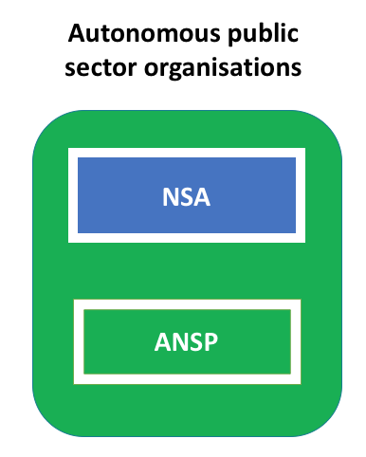
IFATCA observations
There is a movement from solely government owned Air Navigation Service organisation towards autonomous public or private/public organised ANSPs
There is no one-size fits all. The model you chose is dependent on the local context
Here I will cover the the following issues:
Institutional
Regulatory
Financial
Human
Legal

Slide 5
Institutional issues
Separation of the regulator and the ANSP
Separation of powers (NSA and ANSP)
ILO and IFATCA says that ATC is a government task
The EU Commission has defined ATC as a monopolistic government task
Some countries have defined the ANSP task by law
Privatised entities have had problems with financing there ANSP
It is a government task no matter what

Slide 6
Regulatory issues
Two kinds of regulation is needed:
Safety and,
Financial
Safety oversight is key to making sure that the autonomous ANSP model works
Überlingen and Milano Linate accidents are bad examples. But also other bad examples out there
Financial regulation is important to prevent ANSP bankruptcy
Single European Sky financial regulation is an example – Poland, Rumania, Malta etc.
Risks:
Understaffed NSAs
Lack of know-how
Governmental re-thinking is necessary
Lack of investments (mainly training and new equipment)
Remember all four ANS tasks – next slide:

Slide 7
Who is going to pay for the 4 pillars of Air Navigation Service (ANS)??
Air Traffic Management (ATM)
Metrology (MET)
Search and Rescue (SAR)
Communication, Navigation and Surveillance (CNS)

Slide 8
Financial issues
ANSP income comprise of:
En-route charges, approach charges, and landing taxes
Government contribution to MET, SAR, FIS, etc.
Other income from investments and services
This business model is fragile because of possible rapid changes in traffic patterns
Ukraine, Rumania, Poland
Financial crises
Only little margins are allowed (CAPEX)
Risks:
Understaffed ANSPs
Lack of investments (mainly training and new equipment)
Pension funds problems
Remember to capitalise your ANSP

Slide 9
Human issues
When separating the powers of NSA and ANSP and the introduction of SES, IFATCA has observed the following:
Longer working hours
Longer careers
Single man operations
Rosters with minimum sleep and rest
A move from focus on safety towards focus on finances
Bonus systems for achieving safety goals
Individual financial issues:
Initial pay increase!!!
Change of pension systems
Increased use of overtime (is cheaper than hiring new staff)
Outsourcing of services to make it cheaper

Slide 10
Legal issues
ANSP liability changes:
Clear arrangements of liability
Insurance needed to avoid bankruptcy?
Individual liability:
Make sure that you are covered
ATCO insurances

Slide 11
Conclusion
Staff representatives needs to involved
Get it right the first time – it is difficult to re-open governmental arrangements and laws
Build in safety and financial margins
Beware of SWEET-POISON

