Slide 1
Stress in ATC
Nicosia Area Control Center
E. Symeonides
Air Traffic Control Officer
Safety Assessment Specialist
Apr 2017

Slide 2
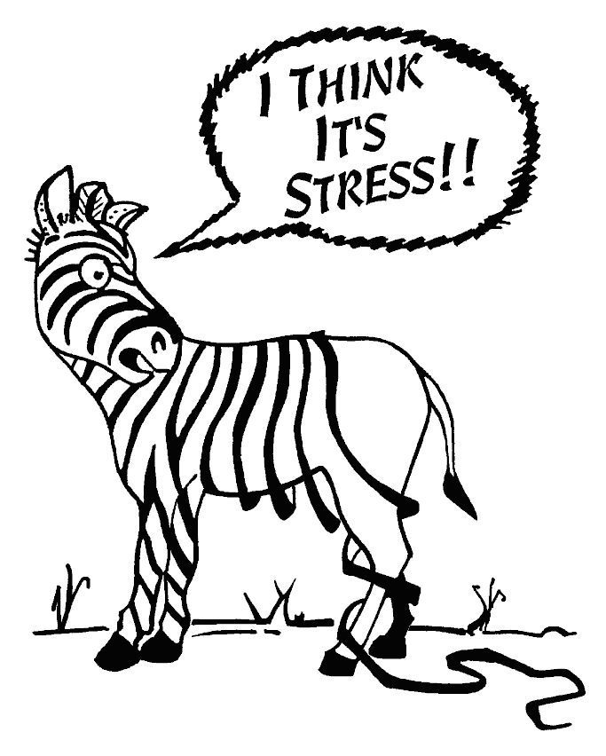
Feel like you are Losing It?

Slide 3
Stress / Stressor Definition
Stress
A state of physical, mental or emotional strain (tension) due to some external or internal stimulus.
Stressor
Any activity, event or other stimulus that causes stress.

Slide 4
Stress Mechanism
HUMAN
SITUATION
THREAT ?
Adrenalin: FIGHT OR FLIGHT
Cortisol, Serotonin

Slide 5
Types of Stress based on duration
Acute Stress
The individual is able to resolve the stressful situation and return to normal mental and psychological state.
Chronic Stress
Increased risk of cardiovascular diseases.
Gastrointestinal problems.
Sleep disorders.
Stressors occur for a short period of time.
Caused by constant stream of demands, risks, pressures, for a long period of time.
Drains mental and physical resources.
Sense of hopelessness
Inability to cope.
Stroke.
Suicide.
Symptoms
Sweaty Palms
Increased heart rate.
Trembling
Shortness of breath.
Gastrointestinal distress.
Muscle Tension.

Slide 6
Acute Vs Chronic Stress
Chronic Stress
Hard to manage. Very dangerous.
Acute Stress
Manageable at the time or soon after the stressor.

Slide 7
Performance and arousal stress curve.

Slide 8
Types of stress based on performance
Eustress (positive stress) motivates a person to cope with stressors and allows a person to perform effectively and may even increase performance. Eustress generally occurs when an individual perceives that he or she has the ability to effectively cope with a stressor.
Distress (negative stress) occurs when stimulation is excessive and causes fear of the situation, panic, anxiety or agitation. Distress usually results in poorer performance.
Anxiety stress related to an unforeseen or imagined threat. It is caused by the anticipation or perception that something dangerous, unpleasant or harmful may be about to occur, and the individual is fearful that he or she will not be able to cope with the event.
Remembered Stress is triggered by an event that reminds an individual of a past experience that caused extreme stress or harm. The actual stress-causing agent may not be present, but the memory still causes the body to arouse the nervous system, and the stress related to the effects of the unpleasant episode are experienced again.

Slide 9
Stress Symptoms
Physical symptoms | Emotional symptoms | Behavioral symptoms | Cognitive symptoms
Tense muscles, especially in the neck and shoulders | Frustration, irritability or anger | Abuse of alcohol, drugs or other substances | Forgetfulness, preoccupation and difficulty concentrating
Headache or backache | Depression or anxiety | Marital problems | Indecisiveness
Stomachache, nausea, vomiting, diarrhea or constipation | Nervousness | Binge eating | Work mistakes and loss of productivity
Tiredness or difficulty sleeping | Boredom | Self-destructive behavior | Excessive worry
Unusually rapid heartbeat | Apathy |  | Decrease in creativity
Shakiness or excessive sweating |  |  | Loss of sense of humor
Weight loss or weight gain
Clenched jaw or clenched teeth
Fingernail-biting
Sighing or changes in breathing patterns
Decreased interest in sex

Slide 10
Stressors
Physical (external)
Noise
Pollution
Overcrowding
Excess weather conditions
Time pressure
Performance standards
Physical (internal)
Pain
Hunger
Lack of sleep
Exhaustion
Threats to security and self-esteem.

Slide 11
Stressors
Work related
Pressure from the management to ensure on time performance (meet the deadlines).
Pressure from the clients
Productivity Vs. Safety
Work underload
Work overload
Colleague dealing with a stressful situation creates stress to those around him.

Slide 12
Karasek Job Strain Model – Stress prediction
LOW HIGH
Low Strain
Active
Passive
High Strain
Positive Stress (motivation)
Decision Latitude
Negative Stress (Health problems)
Job demands

Slide 13
Stressors
Personal
Financial problems
Illness
Injury
Loss of a relative
Preoccupation with personal problems consumes mental resources and distracts a person from the task at hand.
Small stressors can add up over time and greatly affect people’s performance.

Slide 14
The social readjustment scale -Holmes and Rahe (1967)

Slide 15
Stress in ATC
Work Nature – Complex set of tasks
High levels of knowledge
Expertise
Practical application of skills
Limited decision time
High sense of responsibility

Slide 16
En Route ATCOs
Six main activities can be identified
Situation monitoring
Resolving aircraft conflicts
Sequencing
Routing or planning flights
Assessing wx impact.
Managing sector position resources
Include 46 sub-activities
348 distinct tasks

Slide 17
Main sources of stress in ATC
DEMAND
Peak traffic hours
OPERATING PROCEDURES
WORKING TIMES
Shift and night work
H.L. Ammennan, L.J. Bergen, D.K. Davies, CM. Hostetler, E.E. Inman and G.W. Jones: FAA air traffic control operations concepts, Vol. VI. AKTCC/HOST En route controllers, report number DOT/FAA/AP/86-01 (Washington, Federal Aviation Administration, 1987).
H.L. Ammennan, L.J. Bergen, D.K. Davies, CM. Hostetler, E.E. Inman and G.W. Jones: FAA air traffic control operations concepts, Vol. VI. AKTCC/HOST En route controllers, report number DOT/FAA/AP/86-01 (Washington, Federal Aviation Administration, 1987).
Number of aircraft under control
Extraneous Traffic
Unforeseeable events
Time pressure
Having to bend the rules
Feeling loss of control
Fear of consequences of error
Unbroken duty periods
Limitations and reliability of equipment
Layout / ergonomics
WORK ENVIRONMENT
Lighting
Noise
Rest facilities
Microclimate
WORK ORGANIZATION
Role ambiguity
Relation with sups and colleagues
Lack of control over work process
Salary
Public opinion
WORKING TOOLS
H.L. Ammennan, L.J. Bergen, D.K. Davies, CM. Hostetler, E.E. Inman and G.W. Jones: FAA airtraffic control operations concepts, Vol. VI. AKTCC/HOST En route controllers, report number DOT/FAA/AP/86-01 (Washington, Federal Aviation Administration, 1987).

Slide 18
Main consequences of stress for ATCOs
Sources of stress
Work demands
Operating procedures
Working times
Working Tools
Work environment
Work Organization
Short term effects
Brain and cardiac activity
Hormonal excretion
Performance efficiency
Mental Process
Operative behavior
Long term effects
Hypertension
Ischemic heart disease
Diabetes
Peptic ulcer
Psychoneurotic disorders
Depending on
Personality traits
Skills
Aptitude
Motivation
Experience
Operating behavior
Copying strategies
Social support

Slide 19
Stress management in ATC
Recognize the potential signs and symptoms of stress
Be proactive in removing the cause of stress (e.g. assign more priority to the short term conflict first before controlling other aircraft etc.)
Removing yourself from the stressful situation by knowing one's own capabilities (e.g. calling out for help from colleagues if in a very complex ATC scenario)
Prioritise actions
Do not be over focused in finishing the mission at any cost and regardless of the situation
Be current with all existing procedures at the workplace

Slide 20
Stress Management in ATC
Physical Factors
Maintain good physical fitness
Use relaxation techniques
Have regular meals
Have sufficient sleep
Time management
Control the physical environment

Slide 21
Stress Management in ATC
Psychological Factors
Sound preparation with regard to knowledge, skills and procedures
Building confidence in own training and ability
Leading balanced social and family life
Share and discuss problems so as not to bottle them up
Solve problems as soon as possible to prevent “the domino” effect

Slide 22
Is the modern way of life stressful?

Slide 23
Further Reading
“Stress Management in ATC”, Skybrary
Prof. Giovanni Costa, “Occupational stress and stress prevention in Air Traffic Control”
EUROCONTROL, “Human Factors Module Stress”, 15.03.1996

Slide 24
Stress Management
Questions

