Slide 1
EMERGENCY /CONTIGENCY PLANS-ICAO POLICIES
Sarantis Poulimenakos
Program Manager Technical Assistance
ANS/Implementation
12/10/2018
Notes:
Introduction by Secretary General

Slide 2
Contingency Arrangements –Air Traffic Services
Aerodrome Emergency Plan
ICAO EUR/NAT Crisis Management Framework Document(EUR Doc 031)
Notes:
First part of briefing will provide the background and foundation for the briefing on the contingency arrangements related to the Qatar circumstances.

Slide 3
Contingency Arrangements - AIR TRAFFIC SERVICES
ICAO Standard contained in Annex 11 – Air Traffic Services, 2.31
Guidance Material contained in Attachment C to Annex 11
Notes:
While contingency planning can be complex, as we will see later in the presnetation, the ICAO provisions are not. There is one main provision that applies to contingency arrangements contained in Annex 11.
There is also about 4 pages of guidance contained in the green pages of the Annex: Attachment C.
It can be surmised that the almost limitless reasons why contingency arrangements need to be implemented; combined with the varying circumstances of airspace, traffic, and needs means that prescriptive provisions in the Annex would always be unlikely and the guidance in the Attachment bears this out.

Slide 4
Contingency Arrangements – AIR TRAFFIC SERVICES
-Guidelines for contingency measures for application in the event of disruptions of air traffic services and related supporting services were first approved by the Council on 27 June 1984 in response to Assembly Resolution A23-12,following a study by the Air Navigation Commission and consultation with States and international organizations concerned.
-The guidelines were subsequently amended and amplified in the light of experience gained with the application of contingency measures in various parts of the world and in differing circumstances.

Slide 5
Contingency Arrangements – Air Traffic Services
Annex 11 – Air Traffic Services, 2.31
ATS authorities shall develop contingency plans
in the event of disruption or potential disruption of ATS & related services
in airspace they are responsible for providing such services
with the assistance of ICAO when necessary and in coordination with adjacent authorities and airspace users
Notes:
You may wish to note that this is not an exact reproduction of the provision but a simplified bullet list of the main points.
You will note that it refers to disruptions and potential disruptions.. This effectively means that all States are responsible for develop contingency plans for those disruptions and could normally be expected to occur. The focus or basis for this work will differ for all States given the natural disasters that can occur in a region. In some States and regions, active volcanoes can be a significant concern, while in others, it may be potential conflict between adjacent States
Sometimes contingency action will be necessary in real time as a result of disruption, the circumstances of which , could not have been predicted.
The plans would be developed to cover all the airspace one is responsible for, including sovereign airspace, airspace of undetermined sovereignty and high seas airspace.
Many States require significant assistance from ICAO, for almost all disruptions, other States might need assistance for certain types of disruptions and some States need very little assistance at all.. Core western Europe, for instance, utilize the services of the Network Manager in EUROCONTROL for adapting the traffic flow in the event traffic is disrupted for some reason, and very quickly aircraft can be moved to avoid a particular sector of airspace. This comes from many years of experience and having a playbook for want of a better term, that can be referred to, for disruptions and can be anticipated.
ICAO can sometimes play a lead role in the development of a contingency plan; and at other times, a limited role of coordination across regions.
IATA often plays a significant role in most aspects of contingency planning, especially in voicing the needs of its members and suggesting different safety and efficiency options that need to be considered in the development of the plan.

Slide 6
Responsibility for developing, promulgating and implementing contingency plans (Guidance in Attachment C to Annex 11)
3.1The State(s) responsible for providing air traffic services and related supporting services in particular portions of airspace is (are) also responsible, in the event of disruption or potential disruption of these services, for instituting measures to ensure the safety of international civil aviation operations and, where possible, for making provisions for alternative facilities and services. To that end the State(s) should develop, promulgate and implement appropriate contingency plans. Such plans should be developed in consultation with other States and airspace users concerned and with ICAO, as appropriate, whenever the effects of the service disruption(s) are likely to affect the services in adjacent airspace.
3.2 The responsibility for appropriate contingency action in respect of airspace over the high seas continues to rest with the State(s) normally responsible for providing the services until, and unless, that responsibility is temporarily reassigned by ICAO to (an)other State(s)

Slide 7
Contingency Arrangements – General
(Guidance in Attachment C to Annex 11)
The purpose of such arrangements are to:
assist in the safe and orderly flow of international air traffic
preserve the availability of major traffic air routes via alternative facilities/services that are temporary in nature
Notes:
While every disruption is different , uppermost in our minds is that the contingency arrangements assist in the safe and orderly flow of international traffic. While progressively, a contingency plan might provide for domestic operations, there is the need to preserve major air routes. The brief closure of the airspace of India a number of years ago is an example where the primary focus was how would the Asia-Europe flow be maintained India and what impact would this have on airports where fuels stops would become necessary .
When looking at potential disruptions States, in developing contingency plans should look especially to issues outside their airspace, given that when this external disruption occurs, its own airspace could become the solution for the alternative flow.

Slide 8
Contingency Arrangements – General
(Guidance in Attachment C to Annex 11)
It is complex:
circumstances of disruptions vary widely (no two disruptions are alike)
measures, including access for humanitarian reasons, must be adapted for these circumstances
likely significant impact on adjacent airspace so international coordination, with ICAO as necessary, is essential
A common solution is the establishment of
Contingency Coordination Teams (CCTs)
Notes:
For Information in case needed:
MIDANPIRG endorsed the MID Region ATM Contingency Plan in 2013 to address contingency planning at regional level through the establishment of Contingency Coordination Team to share information btw stakeholders and agree on measures to overcome the challenges associated with contingency situations such as, conflict zones, weather, users decision to circumnavigate airspace(s); etc.
The MID Region Contingency Plan includes notification process with IATA, States and ICAO as main providers for information. CCTs are established based on ICAO internal coordination.;
Currently, we have active CCTs for Baghdad, Damascus, Sana’a, Tripoli, FIRs as well as Qatar.
CCTs that have been found to be no longer necessary includes Cyprus-Lebanon (concerning a high seas issue); The Turkey Coup; and restricted airspace related to the Ankara-Baghdad-Tehran flow.

Slide 9
Contingency Arrangements – General
(Related to Note 2 to Annex 11, 2.31)
Relationship with Approved Regional Air Navigation Plan:
the changes are temporary in nature, they do not constitute an amendment to the ANP.
these temporary deviations are approved, as necessary, by the President of the Council, on behalf of the Council
In the case of airspace over high seas or undetermined sovereignty:
this can include temporary reassignment by ICAO of the ATS provision
Notes:
Occasionally, a part of a contingency plan will differ from the approved regional air navigation plan. Because the contingency arrangements are temporary in nature, they do not constitute an amendment to the air navigation plan. These temporary deviations are approved by the by the President of the Council, on behalf of the Council.
And this can include temporary reassignment by ICAO of ATS provision and relates services.
The most recent example of this was the assignment of the provision of AIS –so, effectively the promulgation of Notams, for the high seas airspace within the Tripoli FIR, to Malta, during the Libyan conflict. This allowed for the promulgation of procedures for humanitarian flights en route to Tripoli and some other airports in Libya.

Slide 10
Airport Emergency Planning

Slide 11
Objectives
The Airport emergency planning is the process of preparing an airport to cope with an emergency occurring at the airport or in its vicinity
The objective of an airport emergency plan is to minimize the effects of an emergency, particularly in respect of saving lives and
The airport emergency planning sets forth the procedures for coordinating the response of different airport agencies (or services) and those agencies surrounding community that could be of assistance in responding to the emergency.

Slide 12
Regulatory Framework
• Annex 14 - Chapter9
• Airport services Manual, Part 7
• Doc 9137-PART 7 – Airport Emergency Planning
• Manual on certification of Aerodromes
• Doc 9774, Appendix 1, Part 4.3
• Safety Management Manual
Doc9859, Appendix 3 to Chapter 5 - Emergency Response Planning

Slide 13
Annex 14 – Aerodromes
Vol. 1 – Aerodromes design and operation
Chapter 9 – Services, equipment and installations
9.1 Aerodrome Emergency Planning (contain 16 SARPs)

Slide 14
Aerodrome Emergency Plan
– Annex 14 - 9.1.1
An aerodrome emergency plan shall be established at an aerodrome, commensurate with the aircraft operations and other activities conducted at the aerodrome.
– Annexe 14 - 9.1.2
The aerodrome emergency plan shall provide for
the coordination of the actions to be taken in an emergency occurring at an aerodrome or in its vicinity.
Note 1.— Examples of emergencies are : aircraft emergencies, sabotage including bomb threats, unlawful seized aircraft, dangerous goods occurrences, , building fires, natural disaster and public health emergencies .
Note 2.— Examples of public health emergencies are increased risk of travellers or cargo spreading a serious communicable disease internationally through air transport and severe outbreak of communicable disease potentially affecting a large proportion of aerodrome staff

Slide 15
Contents of AEP
 Types of emergency situation for which it is intended to deal
 Agencies involved in the plan
 Responsibilities and the role of each agency, the director of the emergency operations Centre and emergency command post, for each type of emergency
 Names and phone numbers of services or people to alert in the case of an emergency
 Grid map of the aerodrome and its immediate surroundings.
7

Slide 16
Agencies involved
– Annex 14 - 9.1.3
The plan shall coordinate the response or participation of all existing agencies which, in the opinion of the appropriate authority, could be of assistance in responding to an emergency.
Note 1.— Examples of emergencies are:
On the aerodrome : air traffic control unit, rescue and fire fighting services, aerodrome administration, medical and ambulance services, aircraft operators, security services, and police ;
Off the aerodrome: fire departments, police, health authorities(including medical, ambulance, hospital and public health services), military, and harbour patrol or cost guard.
Note 2.— Public health services include planning to minimize adverse effects to the community from health-related events and deal with public health issues rather than provision of health services to individuals

Slide 17
Emergencies in difficult environments
At those aerodromes located close to water and/or swampy areas, or difficult terrain, the aerodrome emergency plan should include the establishment, testing and assessment at regular intervals of a predetermined response for the specialist rescue service.

Slide 18
Infrastructures
Emergency Operations Centre
Mobile command post
Communication
Other

Slide 19
Implementation of Emergency Plan
– Annex 14 - 9.1.12
The plan shall contain procedures for periodic
testing of the adequacy of the plan and for reviewing the results in order to improve its effectiveness.
– Annex 14 - 9.1.13
The plan shall be tested by conducting:
a full-scale aerodrome emergency exercise at intervals not exceeding two years and partial emergency exercises in the intervening year to ensure that any deficiencies found during the full-scale aerodrome emergency exercise have been corrected; or
a series of modular tests commencing in the first year and concluding in a full-scale aerodrome emergency exercise at intervals not exceeding three years;
and reviewed thereafter, or after an actual emergency, so as to correct any deficiency found during such exercises or actual emergency.

Slide 20
Key success factors
 MANAGEMENT (COMMANDMENT)
 COMMUNICATION
 COORDINATION
Aerodrome Agencies
Airport Authority
Government Authorities
The plan will take into account the
principles of human factors to promote the optimal response of all existing agencies involved in an emergency operations.
Other Agencies (Off Aerodrome)
12

Slide 21
Aerodrome Emergency Planning 9137 – Part 7
Agencies involved
Responsibilities and role of the various stakeholders depending on the type of emergency
Emergency operations Centre and position of mobile command
Commander and Coordinator (s) for the plan
Grid map

Slide 22
Aerodrome Emergency Planning 9137 – Part 7
Information on agencies to call
Triage of victims and medical services of survivors
Removal of dead bodies
Telecommunications
Exercises for the testing of the aerodrome emergency plan
Update of the aerodrome emergency plan

Slide 23
Aerodrome Emergency Planning 9137 – Part 7
Appendix 2 . Outline of an Airport Emergency Plan
Appendix 3 . Airport Medical Services
Appendix 4 . Preservation of Evidence for Accident Investigations
Appendix 5 . Mutual Aid Emergency Agreements
Appendix 6 . Aircraft Accidents in the Water
Appendix 7 . Aircraft Operators (Emergency kits)
Appendix 8 . Casualty Identification Tag
Appendix 9 . Emergency Exercise Critique Form

Slide 24
Annex 9 - Facilitation
Communicable disease outbreak national aviation plan
8.16 A Contracting State shall establish a national aviation plan in preparation for an outbreak of a communicable disease posing a public health risk or public health emergency of international concern.
Note 1.— Guidance in developing a national aviation plan may be found on the ICAO website on the Aviation Medicine page.
Note 2.— Annex 11 — Air Traffic Services and Annex 14 — Aerodromes, Volume I — Aerodrome Design and Operations require air traffic services and aerodromes to establish contingency planning or aerodrome emergency plans, respectively, for public health emergencies of international concern.

Slide 25
Public Health Provisions in AEP

Slide 26
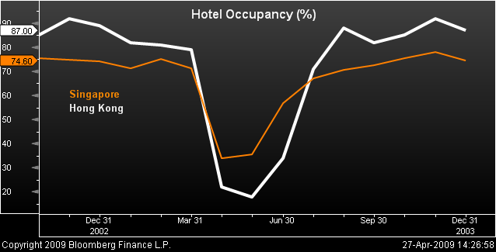
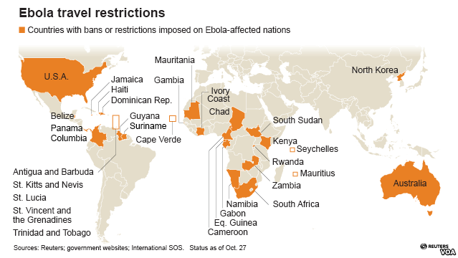
Impact of SARS and Ebola

Slide 27
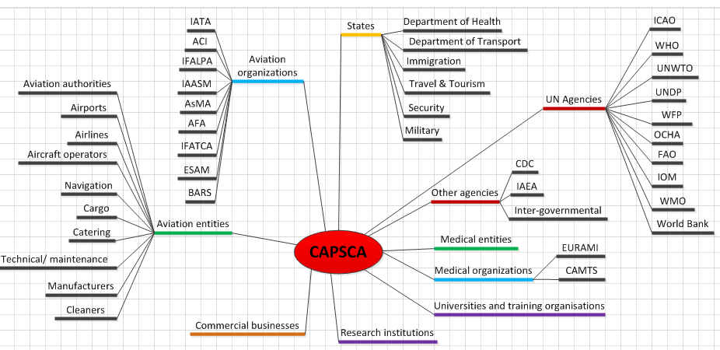

Slide 28
ICAO Crisis Management Framework Document (EUR Doc 031)

Slide 29
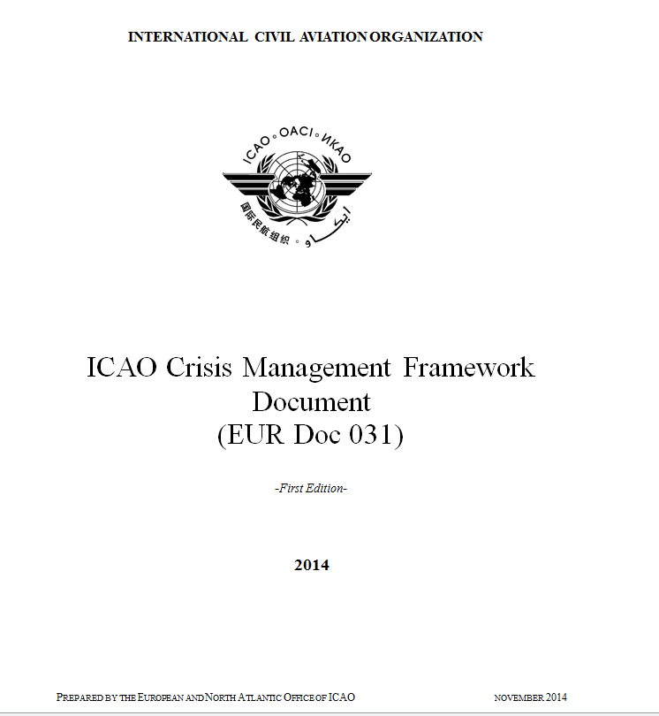

Slide 30
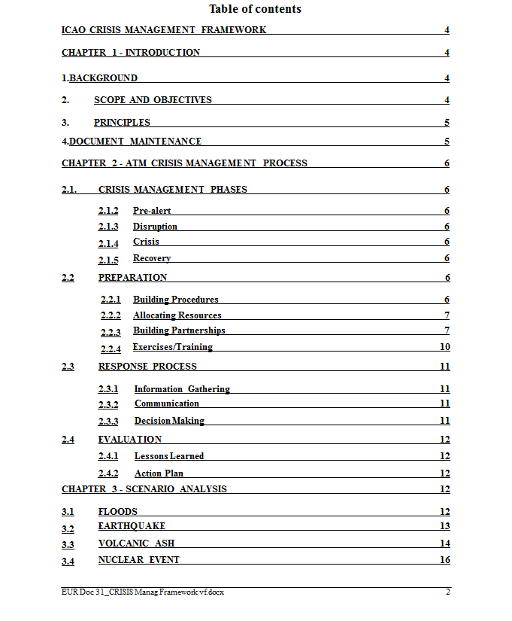

Slide 31
Notes:
Thank you Excellencies , ladies and gentlemen , and now I hand it over again to the Secretary general.

