Slide 1
EACCC and NM Activities
European Aviation Network crisis management preparedness
Hans de Haan
EUROCONTROL NM Crisis Management Team
FSF-MED Nicosia, 12 October 2018

Slide 2
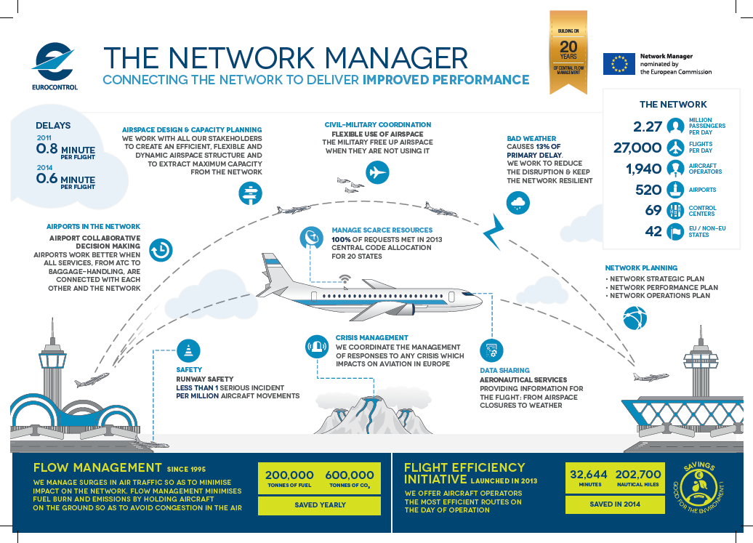
Network Manager adds value to network performance: 1 + 1 = 3
Classification - TLP: green

Slide 3
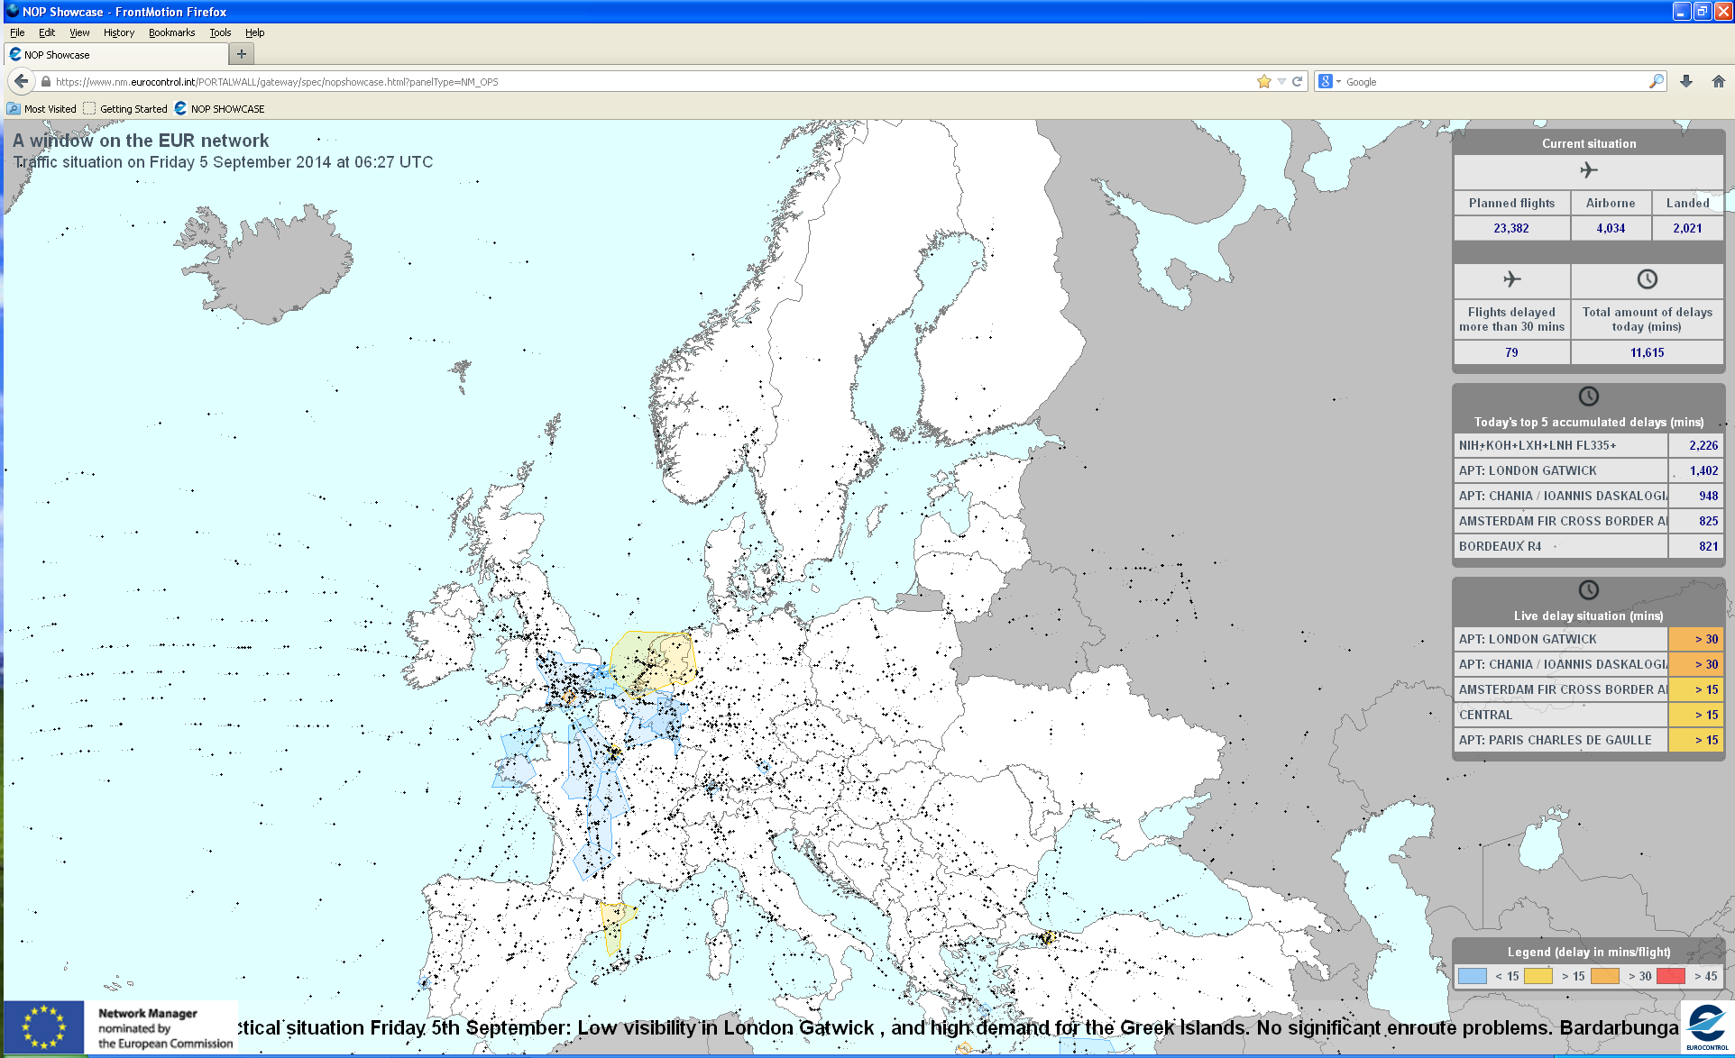

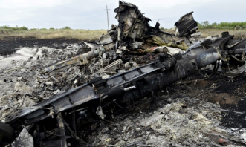
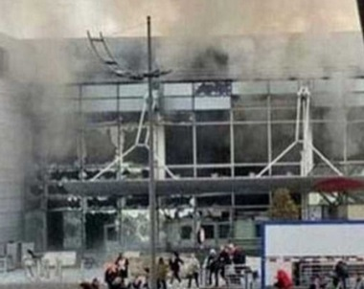

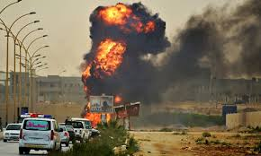
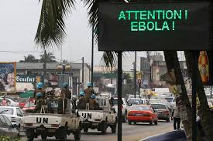
The Network Manager: 24/7 actor in coordinating & managing response to crises affecting aviation in Europe
Bárðarbunga
MH17
Brussels attacks
ICAO
Alert status
NM mechanisms
Readiness
Airspace status: NM ultimate source of info & support to AOs
Security measures
Info exchange
NM to push for sharing risk assessments
Conflict zones
Ebola
Teleconferences
Alternate routes
Mitigated impact
Supporting role to coordinated response

Slide 4




Roles of Network Manager (NM) and European Aviation Crisis Coordination Cell (EACCC)
Coordinate management of response to the
network crisis affecting aviation in Europe
NM
&
EACCC
EACCC activated to support the NM in
political aspects of network crises
Airlines
Members
…
Airports
ANSP
Military
State focal points
Classification - TLP: green

Slide 5




Role of State Focal Points
Network Manager / EACCC
National Crisis Structures
National Crisis Structures
Network Manager / EACCC
Local
Local Expertise
Classification - TLP: green
Notes:
In broad terms, the State Focal Point is the individual(s) who will act as the conduit between the NM/EACCC and his/her State. Patently that individual needs to be suitably senior to command authority, and suitably experienced (in aviation preferably, but in Crisis Management if not) to engage at short notice – and likely without time to have received comprehensive briefing on the issue – with the EACCC.
The State Focal Points will be the link between their respective local (aviation and national) Crisis Structures and the NM/EACCC (both ways)
The conditions for the SFPs to be this link highly depends on the national structure and the SFPs position in these structures.
EACCC survey confirms
SFPs need to build links to local knowledge centres and expertise
Important role for EACCC to prepare the SFPs for their task

Slide 6
Network Manager & EACCC preparedness
ICAO Crisis Management Framework - EUR Doc 031
EACCC risk register
Training
    Pan European Crisis Management Exercises
    EACCC Workshops
    State Focal Point Training sessions
    Contingency and Crisis Management training at IANS (Luxembourg)
    https://trainingzone.eurocontrol.int (GEN-CTG)
Classification - TLP: green

Slide 7
Contingency & Crisis Management Course (GEN-CTG)
Target audience contingency and crisis responsibles from:
  ANSPs
  NSAs
  Airports
  Airline Operations
Covering:
  Regulatory requirements
  Contingency planning (including risk assessments)
  Crisis management and contingency operations

Slide 8
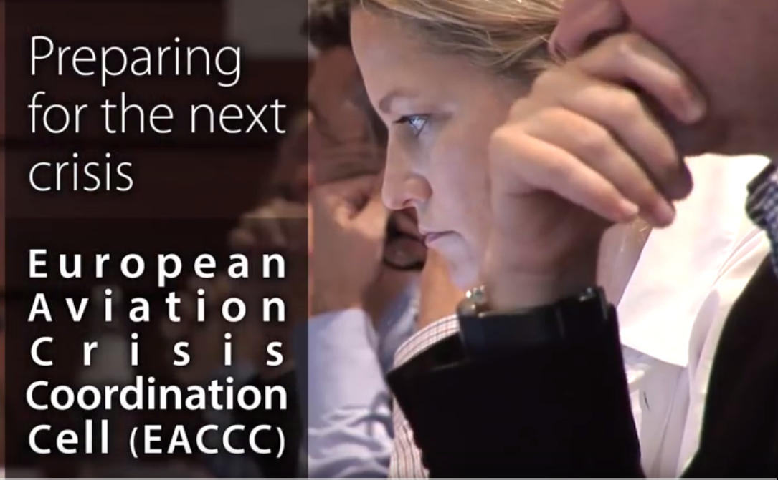
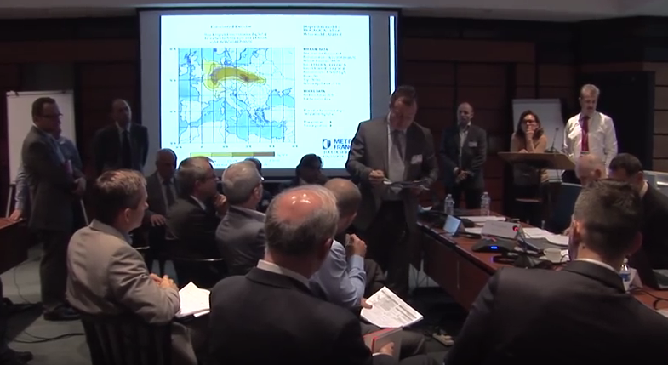
Exercise, exercise, exercise, …

Slide 9

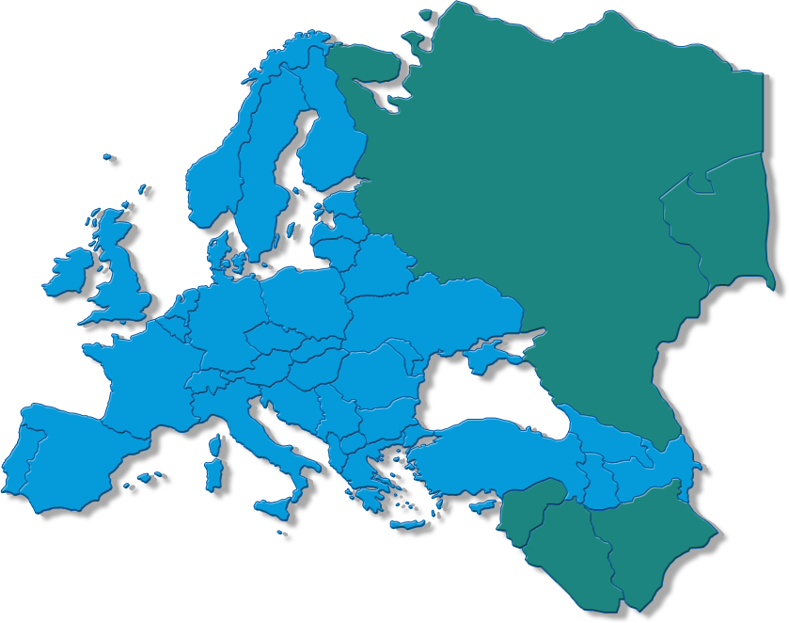







CYBER 13 – scenario & participants
Day 1
crisis
Day 2
recovery
The Community of European Railway and Infrastructure Companies
Observers
Classification - TLP: green

Slide 10
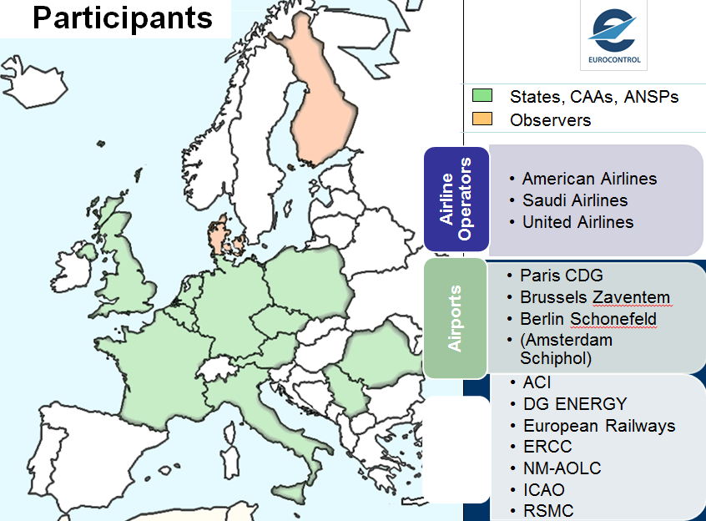
NUCLEAR 14 – scenario & participants

Slide 11

SECURITY 15
Held on 2-3 February 2016 - security related scenario
18 States + EACCC
Security and aviation experts from airports, airlines, EC & NM
Classification - TLP: green

Slide 12
POWER 17
Held on 1-2 February 2017 – blackout scenario
Full loss of power in 4 States
Test the response of aviation in major power failure events, including decision making and interfaces between crisis management, and operational organisations in aviation and power supply.
12 States + EACCC
Expert Organisations: European Network of Transmission System Operators for Electricity (ENTSO-E)
ANSPs, airports, airlines, EC & NM
Classification - TLP: green

Slide 13
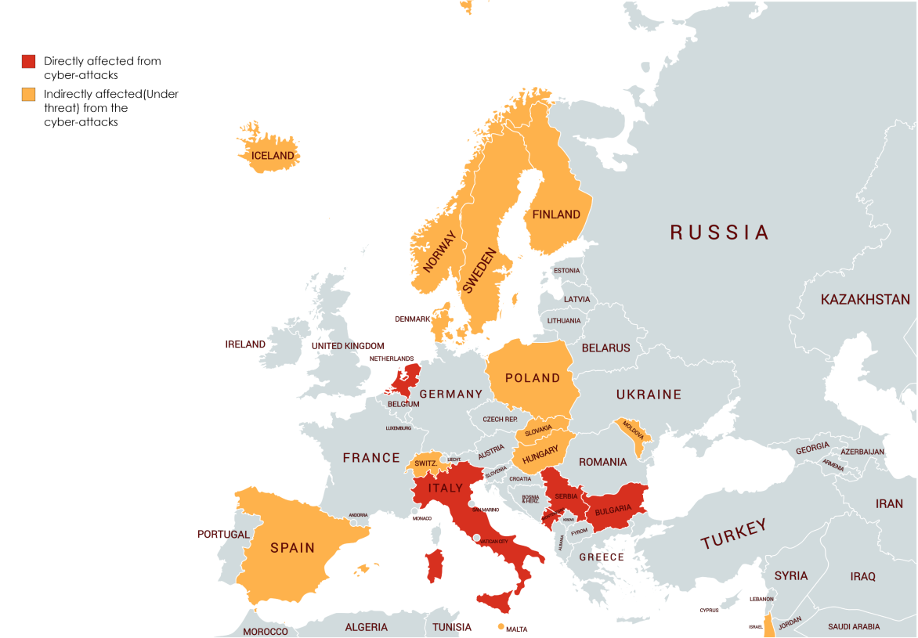
EACCC18 – ATM coordination/cyber
13-14 March 2018 in Brussels
Simulating a network crisis resulting from a pan-European cyber-attack affecting radar processing systems
            Focus on the EACCC coordination and communication of the European response in case of a pan-European cyber-attack targeting Air Traffic Management (ATM).

Slide 14
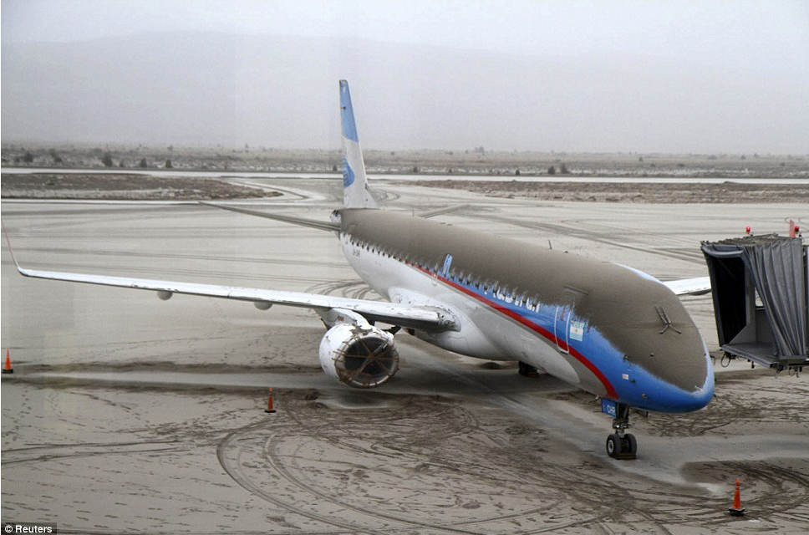
ICAO volcanic ash exercise:
VOLCEX 18, 28 November 2018
Getting ready for the next eruption
Classification - TLP: green

Slide 15

PANDEMIC19
19-20 March 2019 EUROCONTROL HQ Brussels

Slide 16
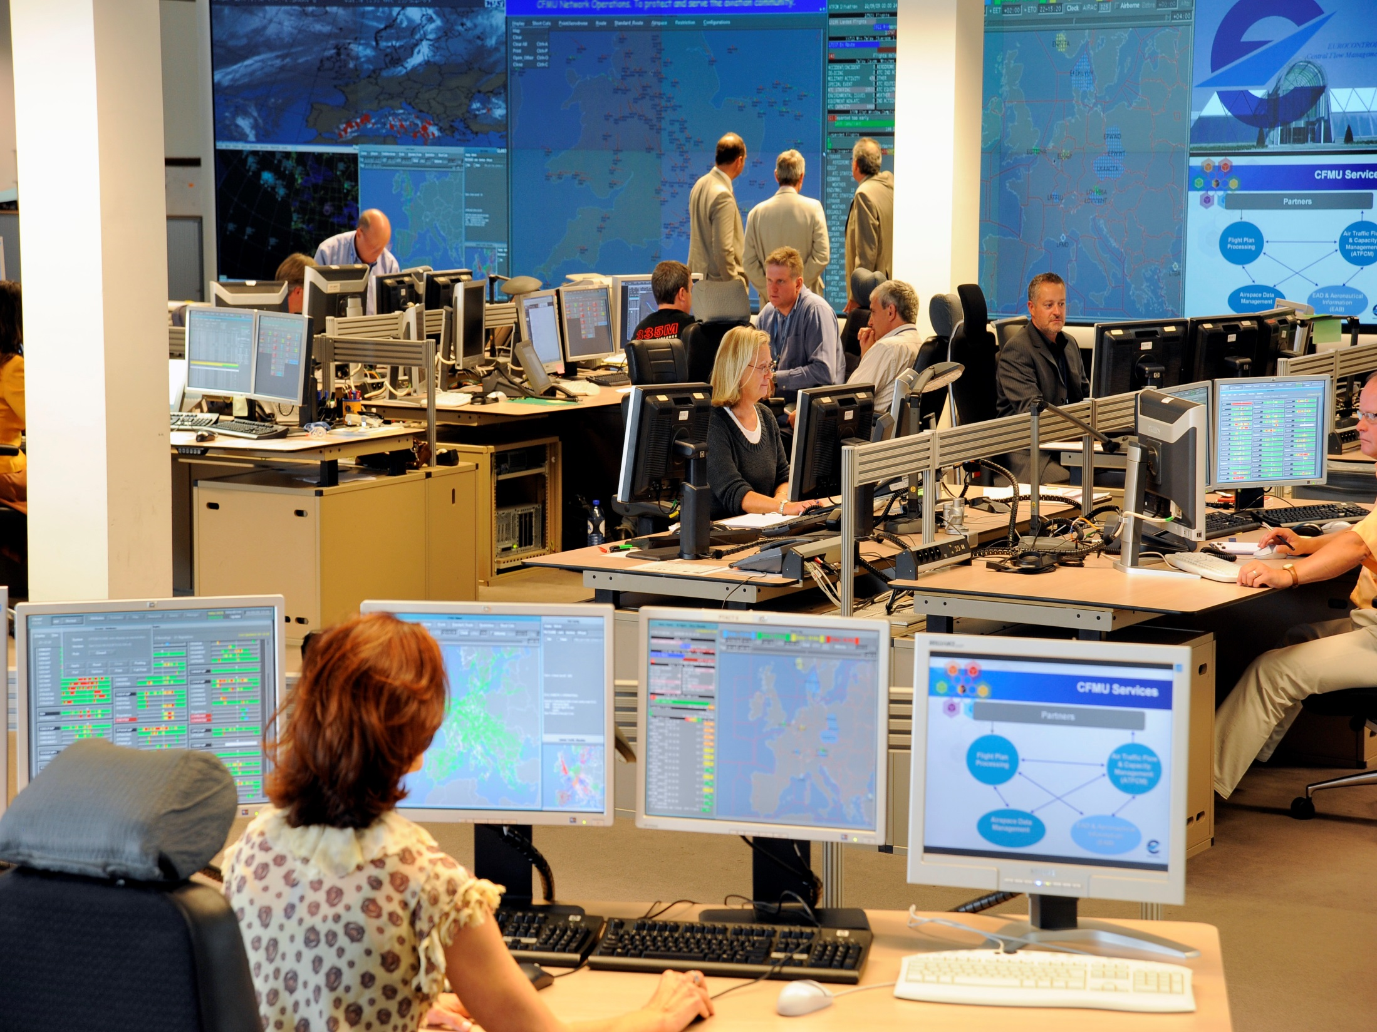
Thank you!
johannes.de-haan@eurocontrol.int
European aviation sector reactions on the Ebola threatle
16
Notes:
12-10-18
Enter here your Presentation Title
16

