Slide 1
Contingency and Emergency Planning An Airport’s Perspective
12 OCTOBER 2018

Slide 2
Why do we need Emergency & Contingency Plans?
Fulfil regulatory, legal or contractual compliance
Look ahead and prepare than look back and regret
Plan well and be prepared. Saves lives & reputation
Things that can go wrong, will go wrong at some point
Notes:
First of all why do we need Emergency & Contingency Plans?
First of all to Fulfil regulatory, legal or contractual compliance
Secondly, its better to Look ahead and prepare than look back and regret
Planning and more specifically planning well tends gets everybody prepared. This cannot be discounted when it comes to saving lives but also saves reputation
Do you remember this guy Murphy? How about the phrase “ Things that can go wrong will go wrong at some point” . Well in a few instances we discovered that this correct. Things tend to go wrong in bundles…..

Slide 3
Emergency Vs Contingency Planning
Emergency Planning:
ICAO and EASA requirement
Regulated from local CAAs
Contingency Planning:
Operator developed & driven
Aims to maintain efficiency
Notes:
So what is the key difference between Emergency planning and contingency planning?
Well…
Emergency Planning: is an
ICAO and EASA Requirement and is very frequently also regulated from local CAAs
Contingency Planning: on the other hand is developed & driven by an airport Operator and aims to maintain the functioning efficiency when things go wrong

Slide 4
Emergency Planning
An ICAO and EASA requirement
Annex 14
Airport Services Manual, Part 7 - guidelines
EU Regulation No 139/2014 and AMC
Provisions are developed into a Manual → Airport’s Emergency Response & Preparedness Plan (ERPP)
States can and should develop their regulatory framework based on ICAO and EASA
Notes:
Taking a closer look at the emergency planning
It’s an ICAO requirement:
Annex 14 and
ASM part 7 - guidelines
Based on the above requirements a manual needs to be developed
The names of the manual can vary…. Some call it
Airport’s Emergency Response & Preparedness Plan (ERPP)
Emergency Plan
Emergency Manual
But the essence is the same
In addition to this States can and should develop own regulatory / legal
framework over and above ICAO and EASA

Slide 5
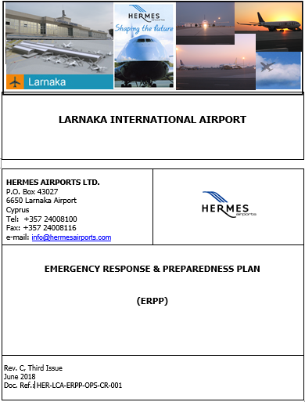
Emergency Planning
Airport’s Emergency Response & Preparedness Plan (ERPP)
The plan to prepare the airport community to face an emergency (life threatening) situation
Derives the procedures and guidelines on how individual agencies/organizations, of the airport community, are expected to respond in a crisis situation
Notes:
Airport’s Emergency Response & Preparedness Plan (ERPP)
The plan to prepare the airport community to face an emergency (life threatening) situation.
Derives the procedures and guidelines on how individual agencies/organizations, of the airport community, are expected to respond in a crisis situation

Slide 6
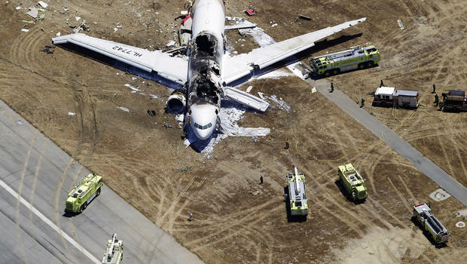
Emergency Planning
Follows Specific Structure covering ICAO Emergency Scenarios
Alert for Aircraft Emergency (Local Standby or Full Emergency)
Crash on and off Airport
Crash on Water
Structural Fire
Hazardous Material Handling
Medical Emergency (General)
Notes:
The plan needs to Follow a Specific Structure covering ICAO Emergency Scenarios as laid down in the slide
Alert for Aircraft Emergency (Standby Crash on Airport
Crash off Airport
Crash on Water
Structural Fire
Hazardous Material Handling
Medical Emergency (General)

Slide 7
Emergency Planning
Follows Specific Structure covering ICAO Emergency Scenarios
Medical Emergency (Pandemic)
Natural Disaster (earthquake)
Ground Accidents/Incidents
Security related scenarios (under DCA)
Notes:
Follows Specific Structure covering ICAO Emergency Scenarios
Medical Emergency (Pandemic)
Natural Disaster (earthquake)
Ground Accidents/Incidents
Security related scenarios (under DCA)

Slide 8
Emergency Planning
Formalizes processes between all services during each scenario:
Rescue & Fire Fighting
Police
Paramedics / Ambulance / Hospitals
Airline / Passenger-Ground Handler
Civil Aviation Authority / Accident Investigation Board
Airport Operator
Notes:
The overall content needs to be structured and pre agreed with all involved entities in such a way that it will Formalize the conduct between all emergency and other services during each scenario:
SO the
Rescue & Fire Fighting
Police
Paramedics / Ambulance / Hospitals
Airline / Passenger Handler / Ramp Handler
Civil Aviation Authority / Accident Investigation Board
Airport Operator
All need to know exactly what to do

Slide 9
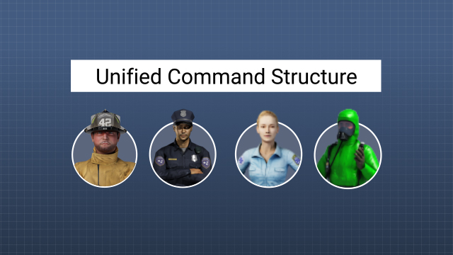
Emergency Planning
Describes the flow of command during each scenario
Who assumes role as On-Scene coordinator
How command cascades progressively
Who assumes role as Emergency Coordination Centre (ECC) Director
Notes:
The plan needs to Describe how the flow of command during each scenario:
Who assumes role as On-Scene coordinator.
How this command cascades as time goes by.
Who assumes role as Emergency Coordination Centre (ECC) Director

Slide 10
Emergency Planning
Leaves no margin for guess-work & assumptions
Everybody involved needs to know
What to do
When to do it
Where to do it
What means to use
Notes:
The plan needs to be thoroughly structured and written in such a way that it would leaves no margin for guess-work & assumptions
Everybody involved needs to clearly know:
What to do.
Where to do it.
When to do it.
What means to use.

Slide 11
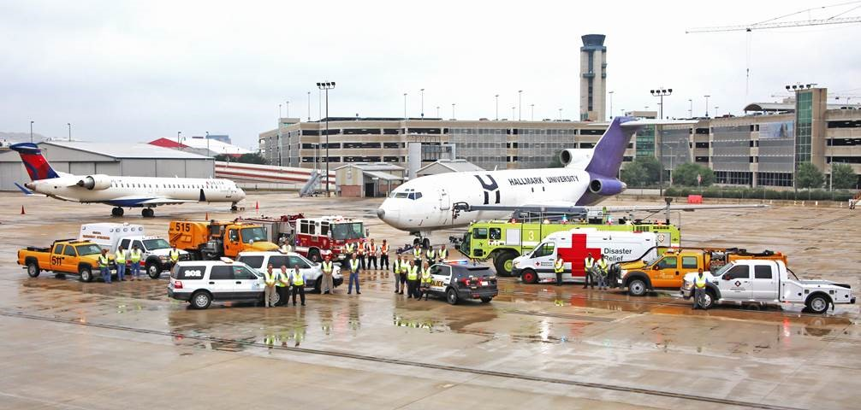
Emergency Planning
Practice makes Perfect
Full Scale Exercise:
At least every two years
Partial Exercise:
At least one every year
Table top Exercise:
At least one every 6 months except during the 6 months period of a full scale exercise
Notes:
Practise makes Perfect. The plan is useless without testing it . That is where the Exercise part of the plan comes into play…
ICAO “regulates” the exercises as:
Full Scale Exercise:
At least every two years.
Partial Exercise:
At least one every year.
Table top Exercise:
At least one every 6 months except during the 6 months period of a full scale exercise.

Slide 12
Emergency Planning
Criticism Helps!
Examine what went wrong during each exercise
Build on exercise findings to clear up roles
Notes:
Criticism is not the enemy . On the contrary it Helps
Each exercise needs to be put under the microscope to Examine what went wrong
The overall findings need to serve as the foundations amend the plan to clear up roles further.

Slide 13
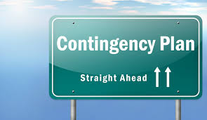
Contingency Planning
Typically is in the form of
Alternate systems that can be used
Procedures that need to be followed – Standard Operating Procedures (SOPs)
Notes:
Typically is in the form of:
Alternate systems that can be used.
Procedures that need to be followed – Standard Operating Procedures (SOPs)

Slide 14
Contingency Planning
PLAN B
Minimizes impact on Operations Reduces passengers inconvenience
Maintains safety margins
Keeps the airport running even at a reduced efficiency
Helps avoid Chaos
Helps avoid Criticism
Notes:
PLAN B
Minimizes impact on Operations Reduces passengers inconvenience
Maintains safety margins
Keeps the airport running even at a reduced efficiency
Helps avoid Chaos
Helps avoid Criticism

Slide 15
Contingency Planning
Caters for the interim period until the full recovery of a primary system (actions required until the return to normal functioning)
Covers all major abnormalities which are likely to occur at the airport and might cause an infraction
Prioritizes scenarios depending on the criticality and impact on operations
Relies on input and assistance of all stakeholders / service providers
Notes:
Caters for the interim period until the full recovery of a primary system (actions required until the return to normal functioning)
Covers all major abnormalities which are likely to occur at the airport and might cause an infraction
Prioritizes scenarios depending on the criticality and impact on operations
Relies on input and assistance of all stakeholders / service providers

Slide 16
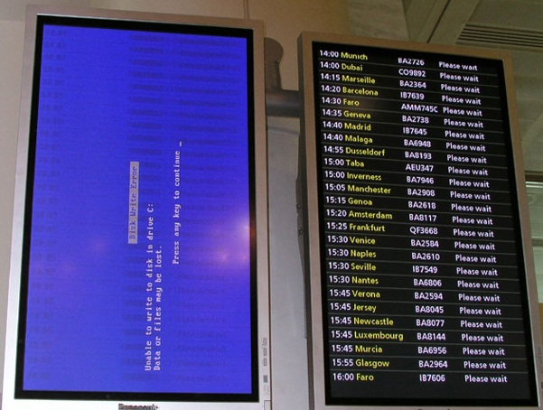
Contingency Planning
Typical Scenarios
Baggage Handling System
Partial Failure
Total Failure
Info Systems
Flight Info Display (FIDS) Failure
Babbage Info Display (BIDS) Failure
Notes:
Typical Scenarios of contingency plans:
What if the Baggage Handling System is lost?
Partial Failure
Total Failure
How about if we loose the Info Systems :
Flight Info Display (FIDS) Failure
Babbage Info Display (BIDS) Failure

Slide 17
Contingency Planning
Critical Systems such as Runway Lighting Systems
Notes:
It call also cover Critical Systems such as Runway Lights
Do you remember Murhpy?? Runway lights are typically hooked up to two independent electrical loops and in a way that every other light is connected to a different loop. This means that if you loose one of the two loops or circuits you will loose only half of the lights of the runway. This will impose restrictions on operating procedure in reduced visibility conditions etc. On the 24th of December 2009 in LCA we lost one circuit. Electricians were looking into the issue when the second circuit was also gone. So now we have a contingency for runway light failure….

Slide 18
Contingency Planning
Cookbook Approach - Everybody knows what to do
Clear allocation of duties between agencies & departments
List of cases can be quite tedious & non-exhaustive
Cluster cases based on common trunk approach
Aircraft disabled on the runway
Low visibility
ATC Industrial action
Runway Closed
Notes:
Contingency plans need to follow a Cookbook Approach - Everybody knows what to do.
There has to a pre agreed Clear allocation of duties between agencies & departments.
The list of cases for contingency plans can be quite tedious & non exhaustive but typically they can be Clustered based on common trunk approach:
Lets take for a example a single runway strip airport
In the case that an Aircraft disabled on the runway, or if the visibility is lower that the required minima or if there is an Industrial action affecting the Control Tower
It all means that the Runway Closed so typically one plan for this can cover various cases.

Slide 19
Emergency & Contingency Planning
Emergency Planning
Safety aspect first
Contingency Planning
Efficiency aspect first
Common Goal
Safeguard Airport Operations
Notes:
Concluding
The Emergency Planning – evolves around safety
The Contingency Planning – evolves around efficiency
But both also have a Common Goal which is to Safeguard the functioning of the airport

Slide 20
Emergency & Contingency Planning
Emergency Planning
Safety aspect first
Contingency Planning
Efficiency aspect first
Common Goal
Safeguard Airport Operations
None of them will work out without
PRACTISE | EXERCISE | TESTING | COOPERATION
Notes:
And once again None of them will work out without
PRACTISE
EXERCISE
TESTING
COOPERATION

