Slide 1
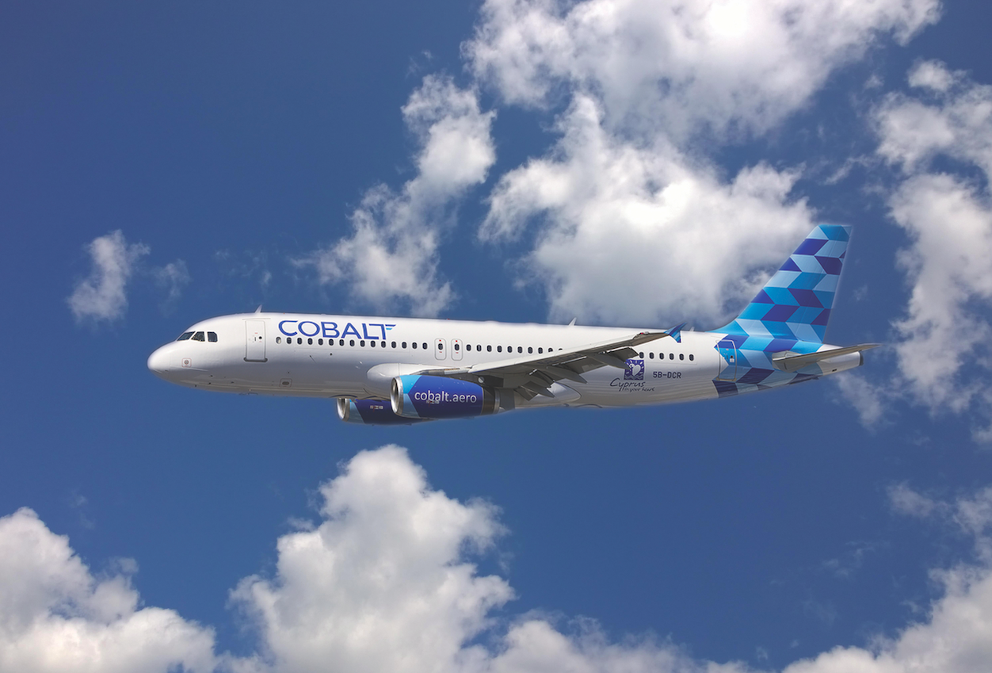
AIRLINES ER & CRISIS MANAGEMENT PLAN
THE LEGITIMACY TEST

Slide 2
The Operators Challenges
Aviation accidents are rare occurrences
Operators preparation key to successful crisis management
First few hours: Critical
Operators Emergency Response and Crisis Management Plan
Complex Challenges:
i) Impact to business and Legitimacy of the operator
ii) Political, social and media environment
iii) Family assistance regulations
iv) Legal Implications
v) Pressures and Expectations.
Above ALL - The “BREAKING NEWS” effect

Slide 3
The Operators Goals and Objectives
Smooth and orderly transition from Normal to Emergency Crisis Operations
Effective Activation and Implementation of ALL elements of the ERP
Safe continuation / return to normal operations as soon as possible
Most Critical: Social and Media Response
National /International Coverage
Operators statements and media strategy response

Slide 4
The Operator: Consequences
Weak / Ineffective implementation of ERP:
Commercial suicide
Loss of airline and management reputation
Negative media coverage
Loss of coordination and cooperation with stakeholders
Legal liabilities
The airline must act quickly to regain control and try to reduce the damaging effects of the events to its stakeholders and its reputation
--- The Legitimacy Fight

Slide 5
Operators Legitimacy Test – CPR - MCRS
Crisis Management Top Priority - Initiate CPR
Credibility - Protection - Reputation (CPR)
CPR Success Influenced by: MRCS
Management Response Communication Strategy
If successful: Organizations Legitimacy
If unsuccessful: Tremendous impact to the airline - Possible loss of the company

Slide 6
Airlines Legitimacy test
“An Airline can be seen as legitimate if it is perceived by its stakeholders as acting appropriately, keeping to societies norms and living up to the expectations of their stakeholders .”
Airline’s legitimacy - stakeholders’ perception that the actions of the airline are:
Appropriate
Acceptable
Keeping up to society’s norms and the expectations of the stakeholders
The most significant threat to the airlines legitimacy test is the response to Media

Slide 7
Operators Legitimacy Test
The Span Air Legitimacy Fight
20 August 2008 Spanair flight 5022 crashed during takeoff
154 of 172 people on board died.
A/C attempted a first takeoff but returned to the gate due to technical problems which were resolved
During the second take off aircraft stalled during rotation
A/c crashed soon after take off
Emergency Response and Crisis Management was slow and weak by the airline
Media presented the accident as an immediate fault by the airline
SAS – parent company took over the media response
Company lost the legitimacy fight

Slide 8
AirAsia Indonesia Flight QZ8501
28 December 2014 - AirAsia Indonesia Airbus A320 went missing over the Java Sea
Operating flight from Surabaya to Singapore
155 passengers and 7 crew members on board
a/c lost contact with ATC at 07.24am Singapore time while deviating weather
A/c discovered two days later
Great media attention – resemblance of MH370
The AirAsia Group CEO Tony Fernandes IMPACT

Slide 9
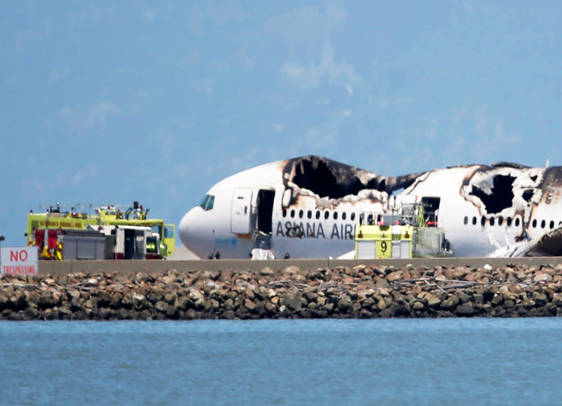
Asiana Airlines Flight 214, San Francisco International Airport July 6, 2013

Slide 10
Asiana Emergency Response
Asiana Emergency Response
Weak – Delayed
San Francisco’s Fire Services - Aftermath
While praising firefighters for rescuing several passengers from the burning wreckage and having more than the required number of personnel on hand, the report said "the arriving incident commander placed an officer in charge of the fire attack" who hadn't been properly trained.
The responders also had communication problems, including being unable "to speak directly with units from the airport on a common radio frequency" and didn't rush medical buses to the scene, which "delayed the arrival of backboards to treat seriously injured passengers.“
The Air Asiana Saver – The Legitimacy Test - Passed by Lee Yoon-Hye.

Slide 11
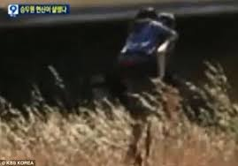
Lee Yoon-Hye – The Asiana Legitimacy Test ?

Slide 12
THANK YOU

