Slide 1
Flight Safety Foundation Mediterranean October 2018
Being ready to face increased Threats from Drones
( )
Notes:
Drones as opposed to sUAS (Small Unmanned Aircraft System)
Threats as opposed to Risks other definitions? Reality? Challenges?
The main objective of this event, is to highlight the importance of being ready to face emergency situations relating to dangers to aviation safety as well as security and to propose actions how to respond to these dangers
A crisis situation is the result of a major internal or external event which impacts upon an Organization in the context of public safety, staff safety, service continuity.
In addition however, a crisis may be defined as an event that is not directly related to an Organization , but that happens elsewhere and is linked to its activities. For example the tourist sector may be affected by crisis in airports or air travel or a natural disaster.

Slide 2
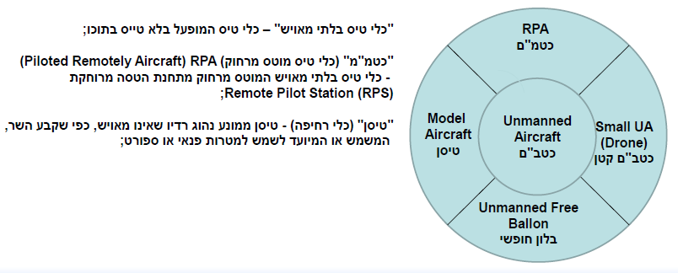
Definitions

Slide 3
London Gatwick Drone Incident -

Slide 4
Drone Incidents/Accidents = Crisis ?
Major event with dramatic operational consequences
Potential serious safety implication (direct, due to disruption)
Lack of certainty increases impact - difficulty in rolling back to standard operations
Effect of heavy snow fall with 2 kg of plastic and electronics

Slide 5
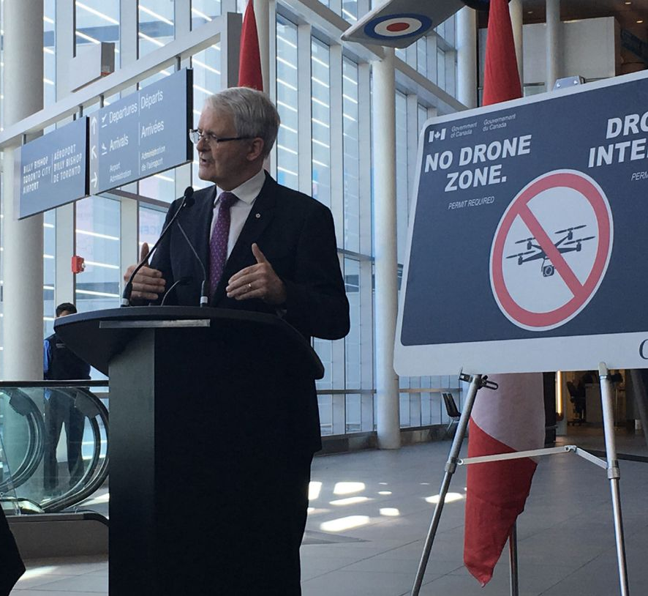
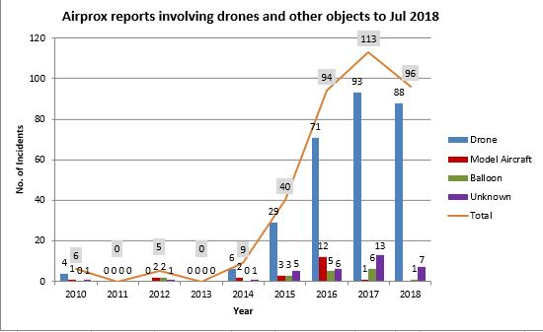
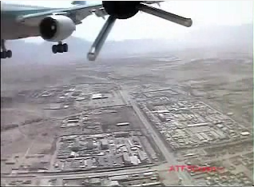
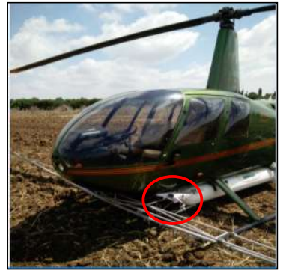
Evolution of Drone-related Safety Occurrences
Civil-Civil
MID-2000s:
Military-Civil
Rare
Low Profile
Near-Miss
High Profile
TODAY
Versatility
No longer rare
Intentional
Near-Miss & Accidents
Source: CAAI Annual Safety Report, 2018
YouTube, UK Airprox Board
Israel AIAI report 81-18
Notes:
Picture – minister of transport (Canada) following Quebec Intl. Airport near-miss incident
CAAI yearly report – all 4 near-miss incidents reported by Ben Gurion Tower in 2017 were drone-related (Approach is 6 out of 7)

Slide 6
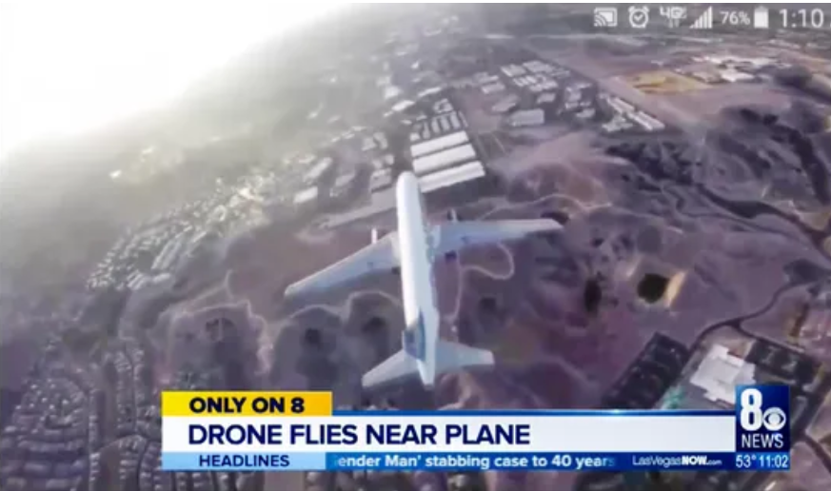
Media

Slide 7
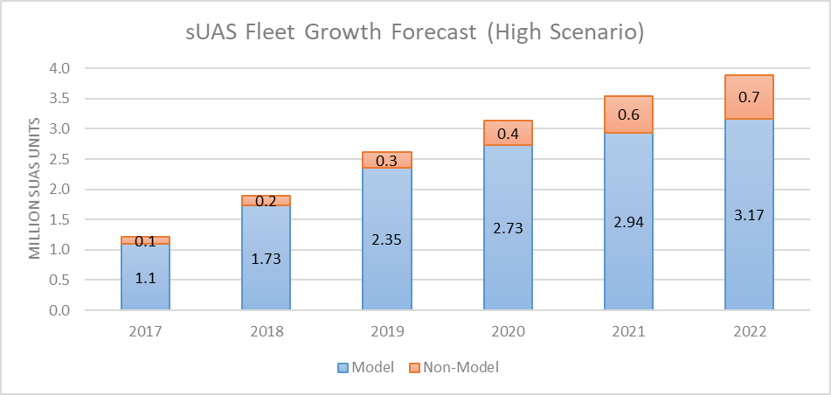
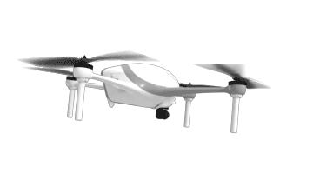
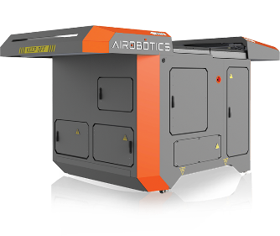
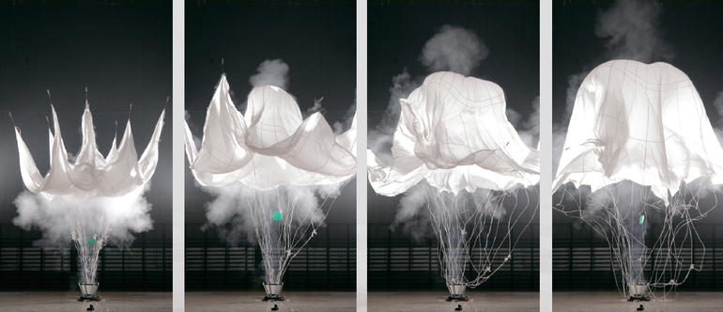
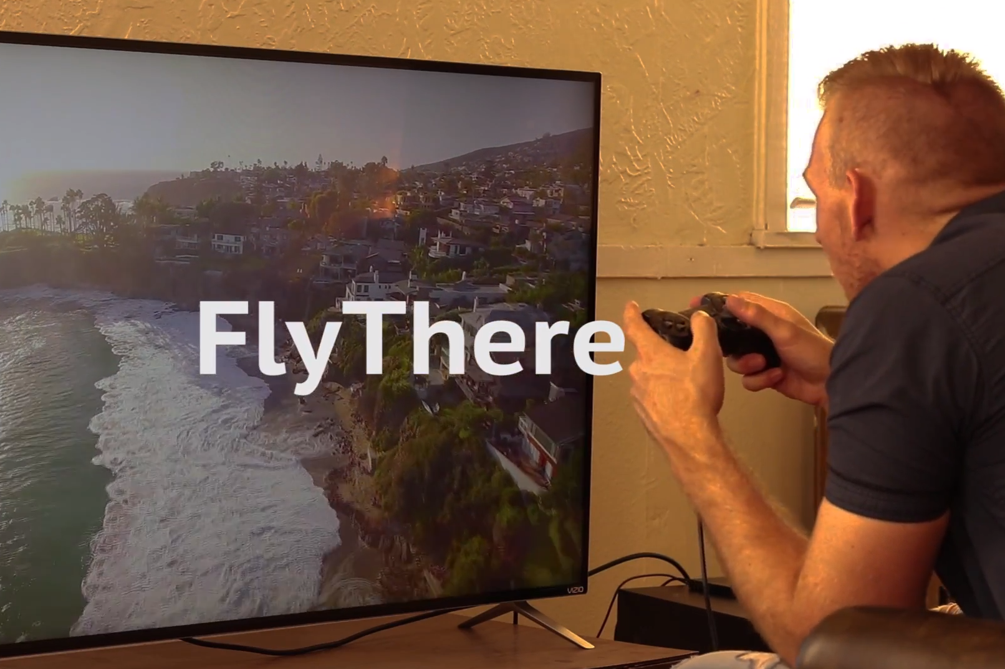
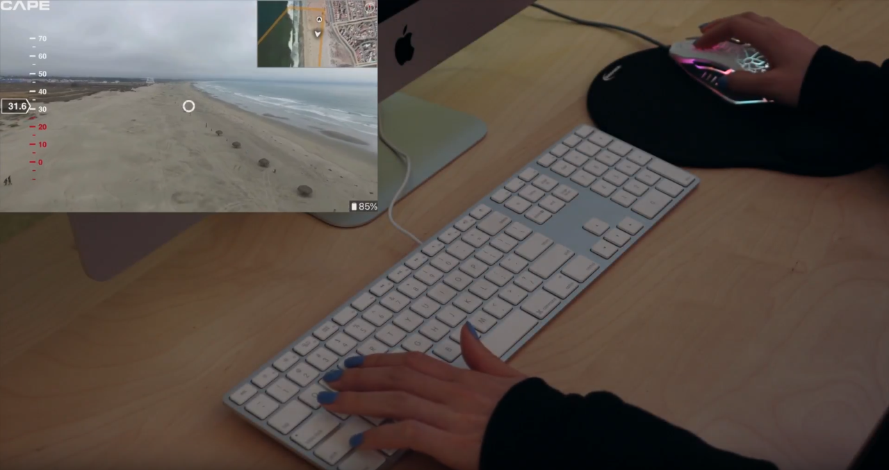
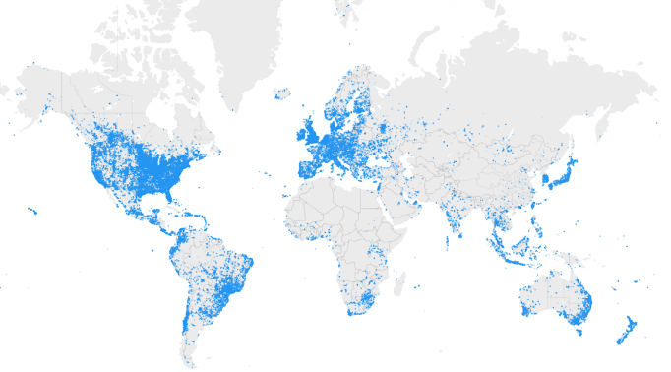
Drones Industry Trends
Growth (Fleet, Flight hours, Sorties)
Automation
Demand → Technology
Innovative CONOPS: Connectivity, cloud and digital ecosystems
DroneDeploy
Source: FlyThere, Cape, Percepto, Aerobotics, Parazero
FAA Aerospace Forecast 2018-2038
CAPE
Notes:
Israel – CAAI annual safety report indicates 60% growth in number of UAVs in 2017, 443 UAVs – commercial only, number of Remote Pilots increased by 40% (460)
DroneDeploy – cloud platform for commercial drones, 180 countries, 30 million acres (120,000 sq.km) data repository

Slide 8
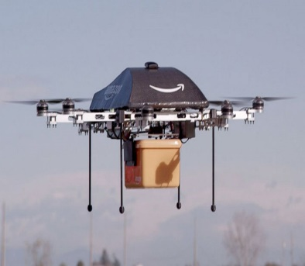
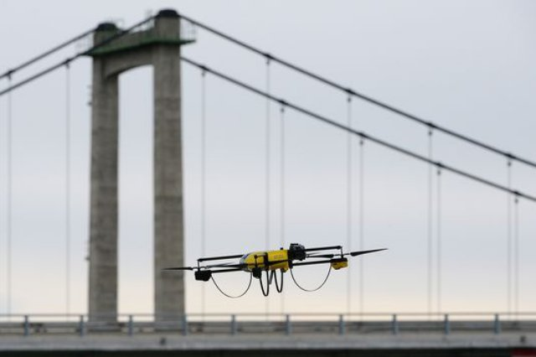
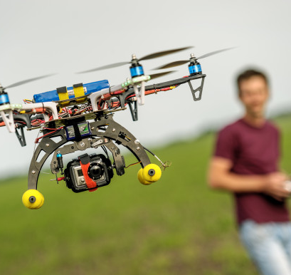
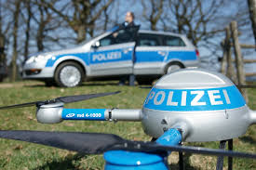
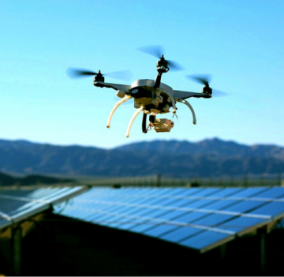
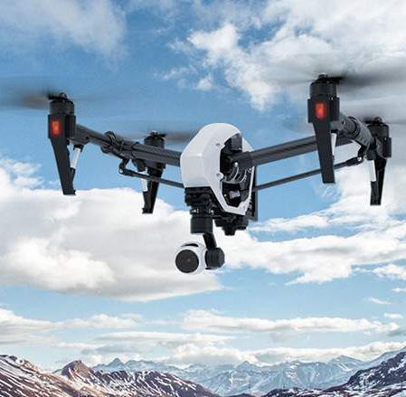
Use Cases
Desaster Prevention and Managment
Infrastructure & Maintenance
Delivery and Supply Chain
Hobby/
Recreation
Agriculture
Security
Research
Environment Monitoring
Photography
Research

Slide 9
Categorization
Desaster Prevention and Managment
Infrastructure & Maintenance
Delivery and Supply Chain
Recreation
Agriculture
?
Security
Research
Environment Monitoring
Photography
Research

Slide 10
Categorization
Commercial/Gov.
Cooperative
Non-
Cooperative
Private/Hobby
Research
Notes:
Dimension – Level of cooperation / Characterization of User

Slide 11
Categorization
Commercial/Gov.
Non-
Cooperative
Cooperative
Private/Hobby
Research

Slide 12
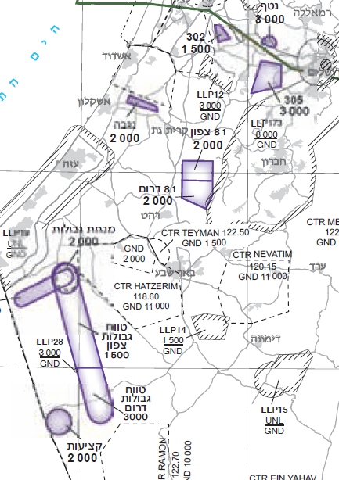
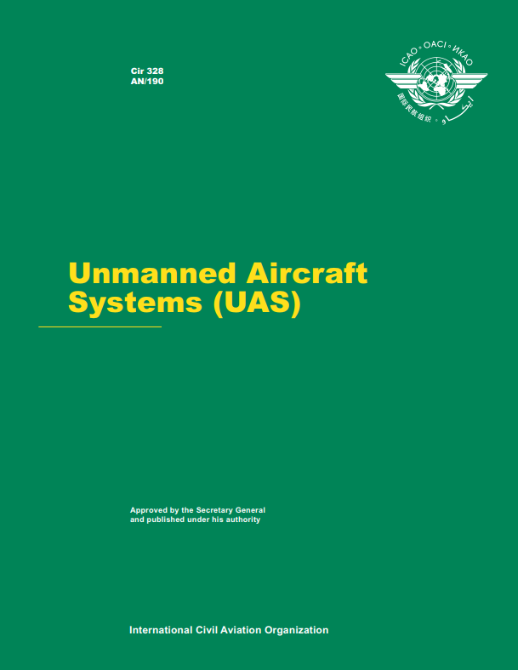
Coping Methods Commercial & Cooperative
Developing and implementing regulation (national, ~ICAO SARPs), specifically Safety and Harmonization
Registration
Supervising & enforcing regulation (fines, charges) - Airspace requirements, Airworthiness, Licensing
Guidance for stakeholders
Implementation of UTM
MINI RPAS Aerial Infrastructure
Source: Israel AIP, ICAO
Notes:
Standards and Recommended Practices (SARPs) – ICAO Gantt includes Annex 6 @ 2022, Annex 10 @ 2021-2022, Annex 19 @ 2023 – Probably not primarily “drones” due to risk-based-approach
UAS Traffic Management

Slide 13
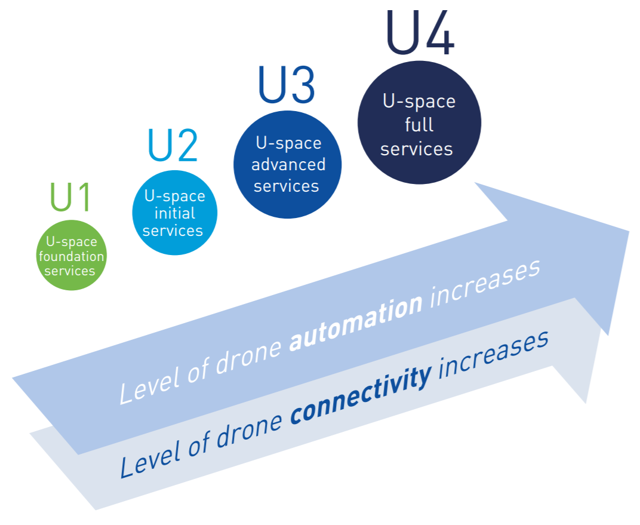
UAS Traffic Management (UTM) U-space example
SESAR program (started mid 2017)
Autonomous and digitized sUAS airspace and traffic management
Source: CAAI, SESAR
Notes:
Demonstrations during 2018
Foundation of service roll out during 2019

Slide 14
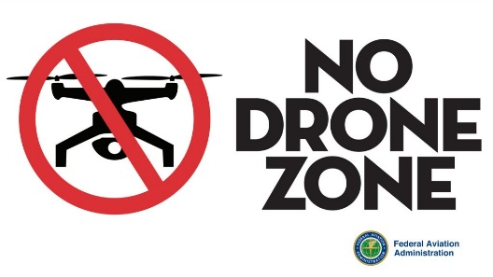
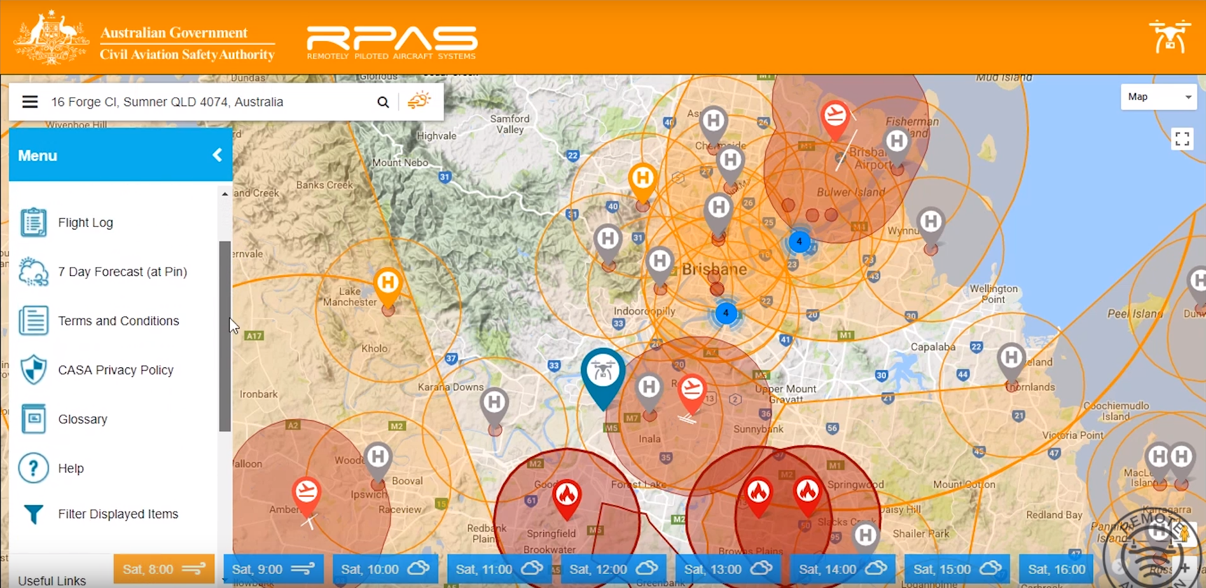
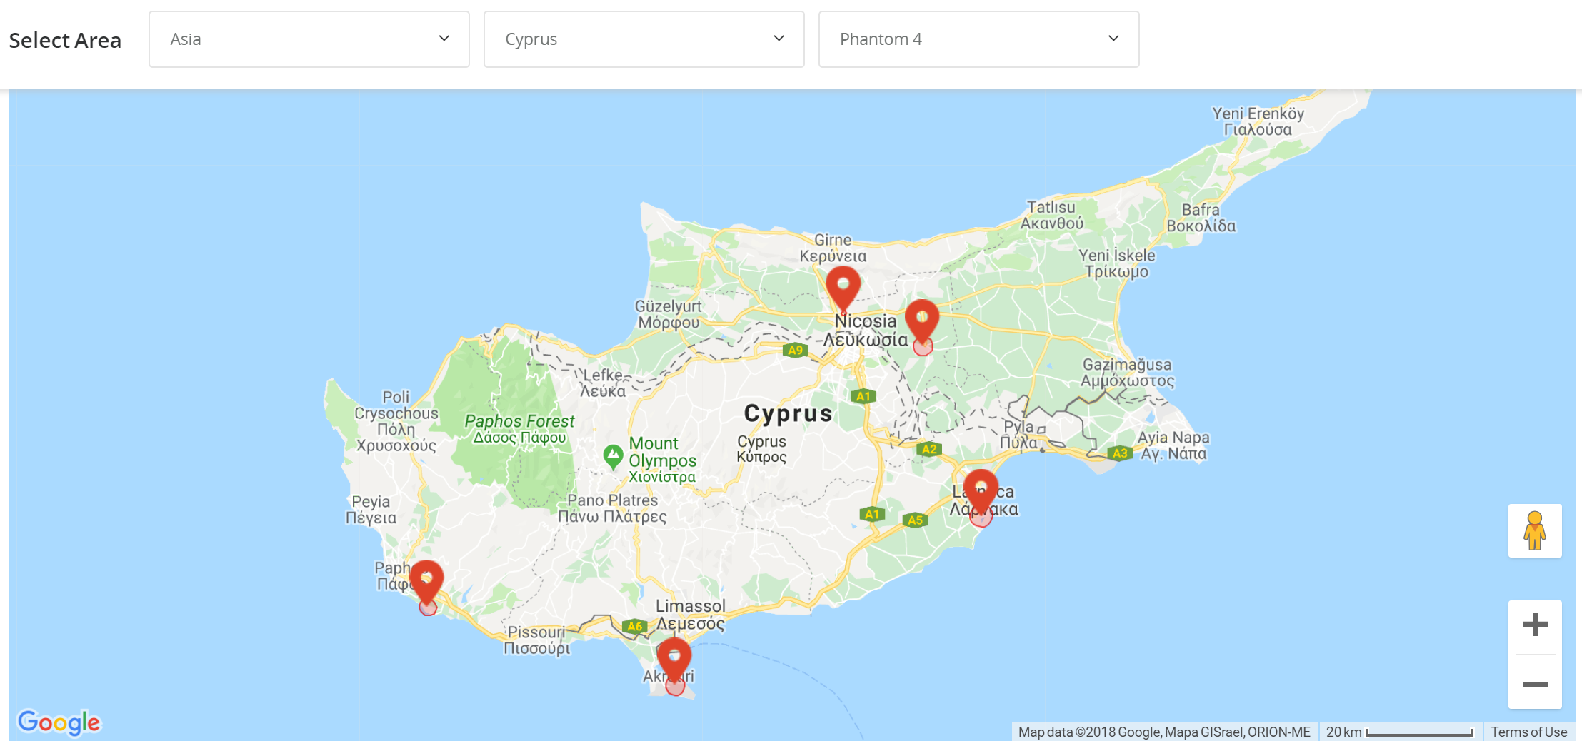
Coping Methods Hobby & Cooperative
Self regulation (out of interest, only goes so far…)
Guidance material
Registration, FAA difficulties
No-Fly Zones, regulator/manufacturer
Source: DJI, FAA, CASA
Notes:
FAA - May 2017 voided by appeal court and reinstated on Dec. 2017
Airports, Government, Military and DOD facilities, sensitive infrastructure, sport stadiums etc.

Slide 15
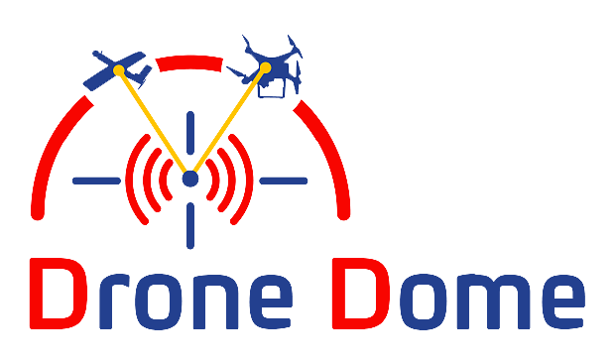
Coping Methods Commercial/Hobby & Un-Cooperative
Regulation & Enforcement
Counter-drone systems
Some operational solutions, emerging market
Rises difficult questions
Who is the operator?
How to coordinate with ATC?
What are the associated risks?
Will the value justify the cost?
Detection Area
Alert Area
Interference Area
Source: RAFAEL

Slide 16
Range of Solutions
Commercial
Guidance Material & Education
Develop & Implement Regulation
Enforcement
Counter Drone Systems
UAS
Traffic Management
Guidance Material & Education
Cooperative
Non-
Cooperative
Registr-ation
Counter Drone Systems
No-Fly Zones
Private/Hobby
Research

Slide 17
Conclusion
Drones revolution
Already a part of the aviation industry and its ecosystem,
Growing and evolving
Has the potential of leading to a crisis
Threat → Challenge
Threat implies “elimination”, a forceful and less accurate solution
Challenge implies “understanding”, managing the situation, communication and adapted solution
Versatile challenges = versatile solutions
Data is critical for effective solutions - are we collecting information properly?
Safety Occurrence reporting, registration of drones/users

Slide 18
Always Stay AGL

