Slide 1
Ministry of Interior Cyprus Civil Defence Force
Aviation related Emergency plans in Civil Defense activities
Chrysilios Chrysiliou
Director
Larnaca District Civil Defence

Slide 2
Civil Defence, Law 117(I)/96
According to Law 117(I)/96, “the civil defence law”,
civil defence includes any measure which constitutes a way of confronting disasters or minimizing its effects and includes the systematic actions for
prevention,
planning,
training,
preparing,
responding and
dealing with the consequences,
regardless if the measures are taken prior (preventive measures), during or after a disaster

Slide 3
Civil Defence, Law 117(I)/96
Law 117(I)/96, “the civil defence law”,
Gives to the word “disaster” the following meaning,
Any disastrous event within the territory of the Republic which occurs due to an earthquake, land slide, flood, cyclone, storm, rough sea, technological accident, fire, explosion, epidemic, accident, shipwreck or other major incident, the extent of which causes or may cause dangers for the lives or welfare of a large number of persons or extensive damage to the environment or natural resources of the Republic.

Slide 4
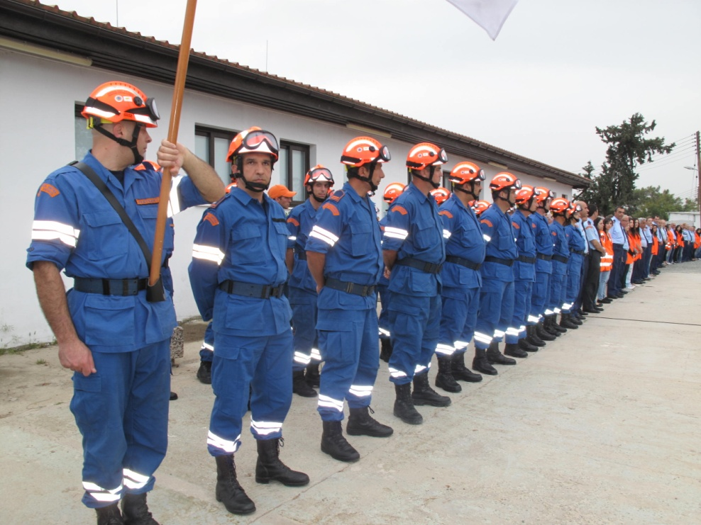
Civil Defence, Law 117(I)/96 and Civil Defence general Bylaws 221/97
“With the aim of preparing, organizing and taking whatever civil defence measures are deemed needed anywhere within the Republic of Cyprus, a Civil Defence Force is created.”

Slide 5
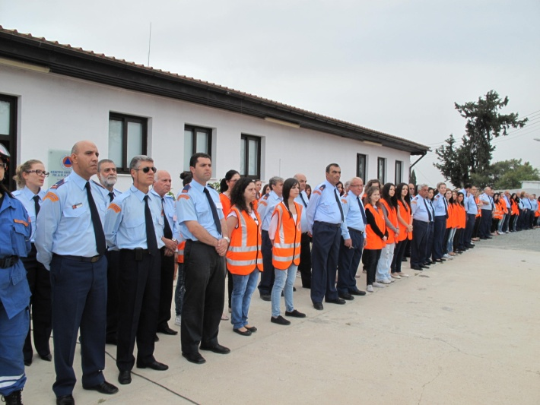
Cyprus Civil Defence
Human resource
Cyprus Civil Defence is manned with,
Permanent paid staff, who constitute the senior management team
7 (senior officers) + 25 (mid level officers) + 40 (auxiliary personnel)
Reserve Sub Officers, who positioned in the Civil Defence Stations and Units and also manning the Rescue Teams
539
Citizen conscripts who serve a two year mandatory period and man
7,308

Slide 6
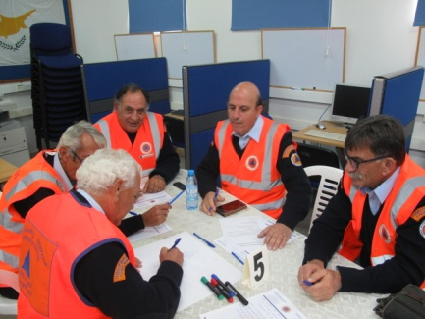
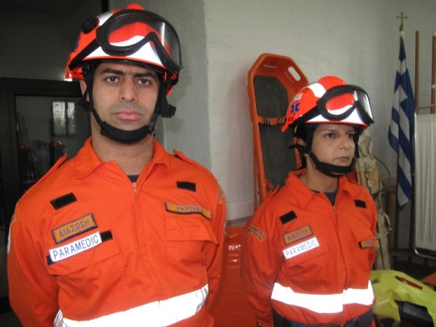
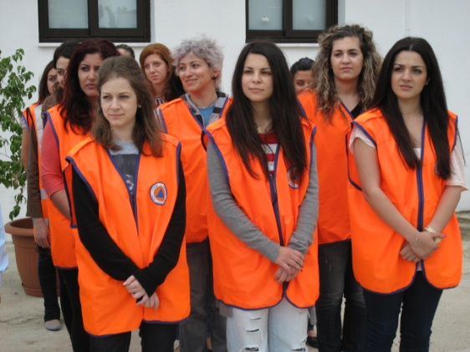
Civil Defence Personnel

Slide 7
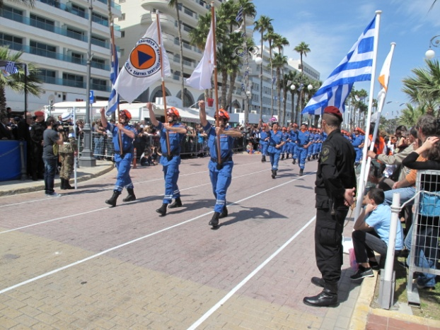
Civil Defence Personel

Slide 8
Civil Defence Force Capabilities (response)
The small number of paid professional officers, the dependency on a large number of reserve officers and the subsequent dependency on a much bigger number of conscript citizens, create obvious problems to the capabilities of the Civil Defence Force, especially in the parameters of,
response (time) and
The level of autonomous dealing with the consequences of a disaster (time, personnel, means)
The Force does not have “first response” capabilities.
Depending on the season, day, time, level of response needed (in means and personel) and other parameters, the response time of Civil Defence Forces, might range from a few minutes to a few hours.

Slide 9
Civil Defence Force Capabilities (training)
Having in mind the Civil Defence law, by laws and Civil Defence Force capabilities are those of an auxiliary force,
Cyprus Civil Defence could be engaged in all possible events which might cause a disastrous effect or have caused,
As such, CCD, offers a balanced training program to its members aiming at offering auxiliary assistance to the first responding agencies in case of having to face a disastrous event,
Training includes,
Advance A’ aid
Setting up and running camps for homeless people
Telecommunications in a crisis situation
Manning and operating a Crisis Management Multi Agency Coordination Center
Mass evacuation
Urban Search and Rescue
Mountain Rescue
Fire fighting
Assisting in case of an aerial accident
At exceptional cases our personnel receive additional specialized training as was the case with our cooperation with the Joint Rescue Coordination Center in the fields of,
Medical Evacuation and
Marine Rescue

Slide 10
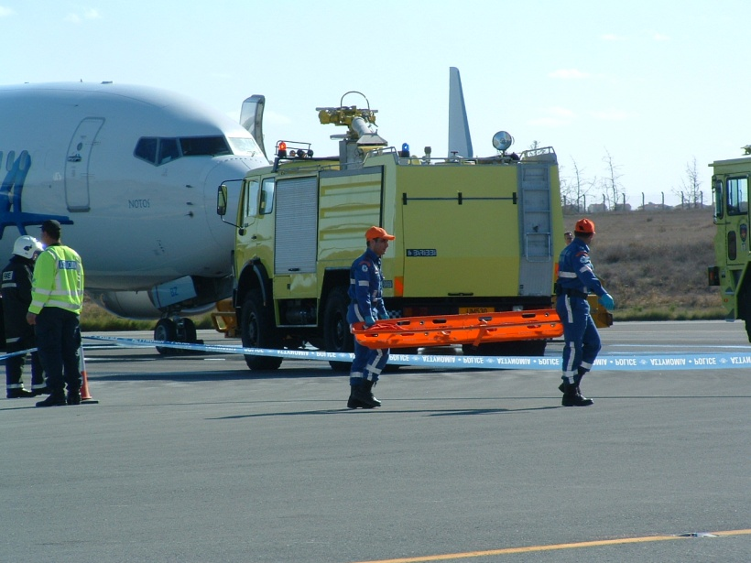
Cyprus Civil Defence and Flight Safety
Flight Safety is of great importance to Cyprus Civil Defence Force as a flight accident might lead to a “disastrous event”
(since, such an incident might cause danger for the lives or welfare of a large number of persons or extensive damage to the environment or natural resources of the Republic. Civil Defence, Law 117(I)/96)

Slide 11
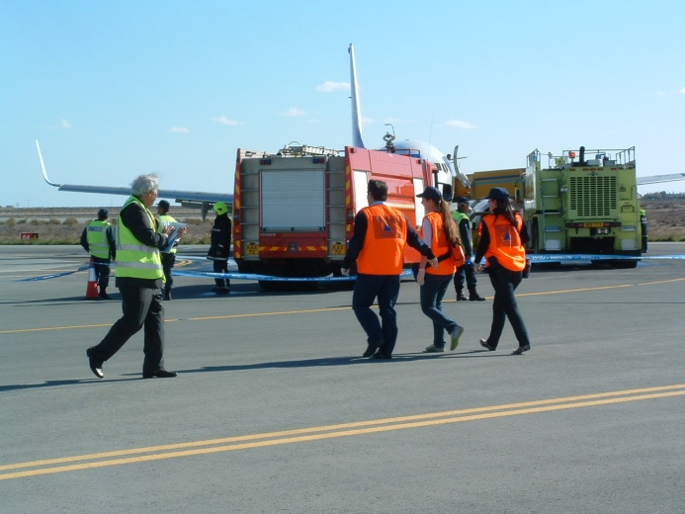
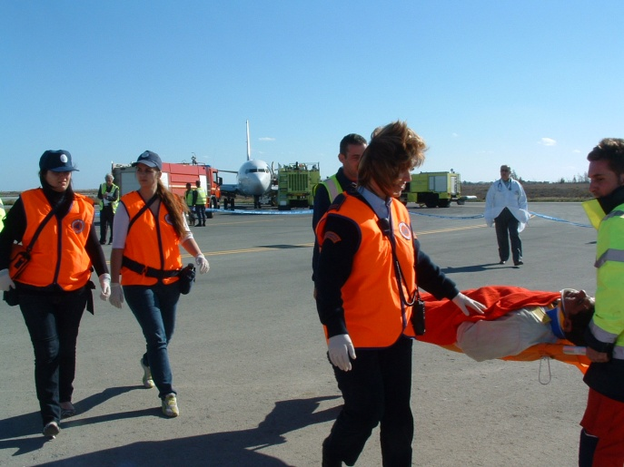
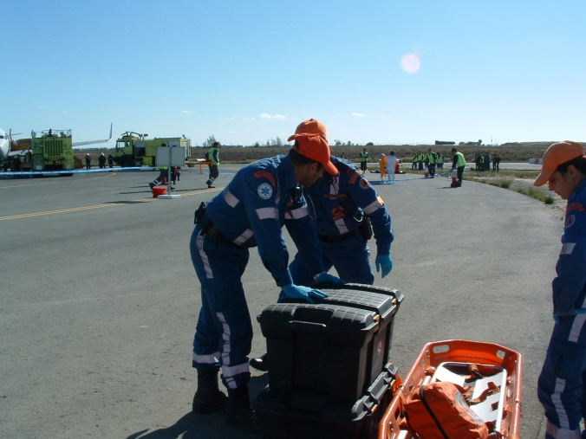
Cyprus Civil Defence Cooperation with the Airports
Cyprus Civil Defence and the Airports (Airport EMERGENCY Plan)
CCD is actively engaged in the airport’s emergency plans as a partner (auxiliary force) to be called and involved in case of an accident. Even though CCD does not have first response capabilities, it is expected that in case of a major incident/accident, Civil Defence Personnel will respond offering auxiliary assistance to the first responding agencies and directly to the affected persons, depending where the incident may occur and the extend of the damages caused.

Slide 12
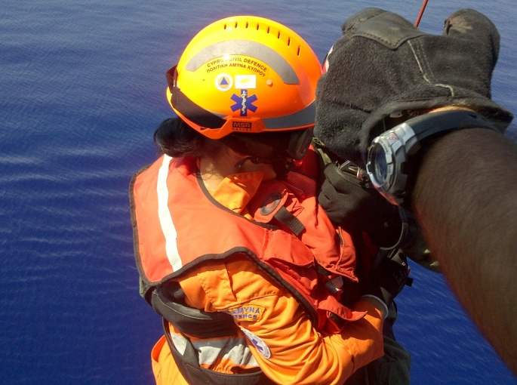
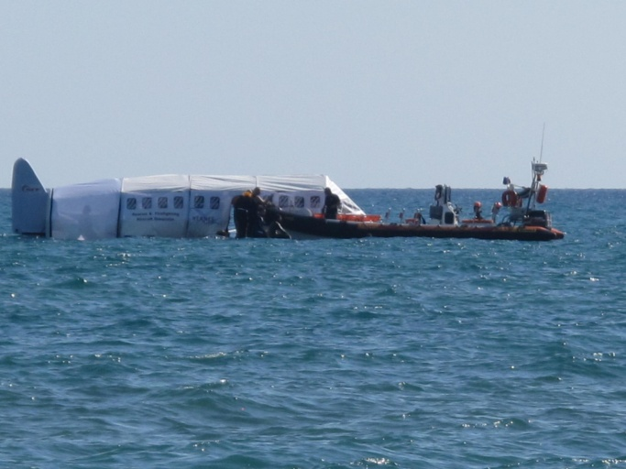
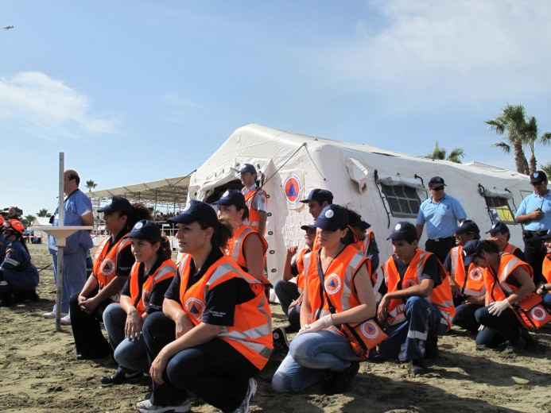
Cyprus Civil Defence Cooperation with JRCC
Cyprus Civil Defence and JRCC (Plan NEARCHOS)
CCD actively cooperates with JRCC by creating a specialized team of volunteer members who have been trained (funds provided by JRCC) and have been participating in MEDEVAC operations as well as marine search and rescue operations after a aeronautical incident.

Slide 13
Cyprus Civil Defence and aerial means
CCD has long seen the value of utilizing aerial means in almost all of its civil defence activities/measures.
Utilizing Drones was identified as the way forward and so efforts begun as early as 2010 by participating in various European programs to start gaining know how.
By 2015, we participated in the submission of a specific proposal which would offer us not only know how but also hard ware.

Slide 14
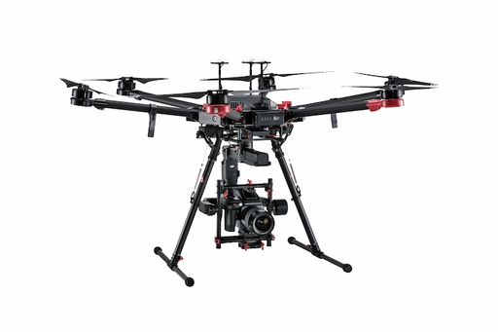
European program 2016-1017 “PREDICATE: Preventing disasters by capitalizing on unmanned aerial systems technology”
CCD, KIOS university of Cyprus, KEMEA Greece
Two year period
Aim, to develop a software for Drone use in search and rescue and other civil defence actions
Two drones equipped with cameras (including thermal camera)
DRONE
2 Matrice 600
Cameras Zenmuse Z3 by Flir
Thermal camera Zenmuse XT By Flir
Drones distance up to 5km
Drone up to 500metres height
Drone can carry up to 6 extra kilos
Drone weight 9kg
We have day cameras and thermal camera

Slide 15
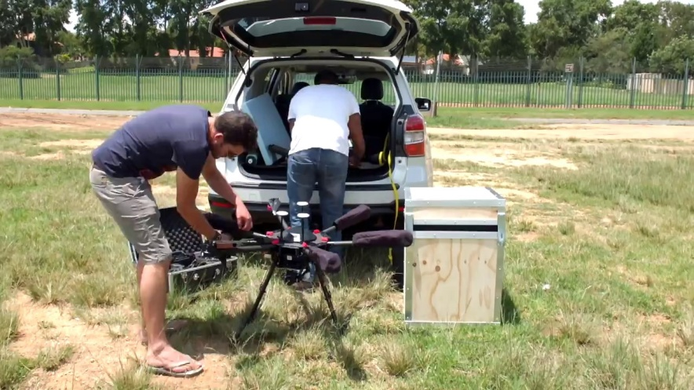
New European Programs, Swifters and Leapfrog
New program, following and based on the Predicate program Swifters (Safe and rapid evacuation facilitated by UAV swarms) 2018 – 2019 (University of Cyprus & other EU Countries)
Leapfrog (Leading Activities for Enrollment of RPAS Units in the Voluntary Pool) aim to register our Drone team as an EU response team. (University of Cyprus & other EU Countries)

Slide 16
Engagement of Cyprus Civil Defence Drone Team
Took part in a number of exercises within Civil Defence Force as well as with other government agencies.
The Drone team also responded to a number of major incidents with the aim of assisting in the surveillance and data collection as a tool to the local crisis coordination team.

Slide 17
Flight Safety. Using Drones Safely
The core members of our team who use our Drones have been officially trained and certified as drone pilots. Our pilots attended a full training program to receive an approved Drone Pilot certificate from a registered training school
At the moment we are in the process of offering training to 12 more of our members, thus ensuring that at any given time, we will have the possibility of having adequate number of trained pilots to safely and efficiently fly our Drones in case of an emergency.

