Slide 1



Slide 2
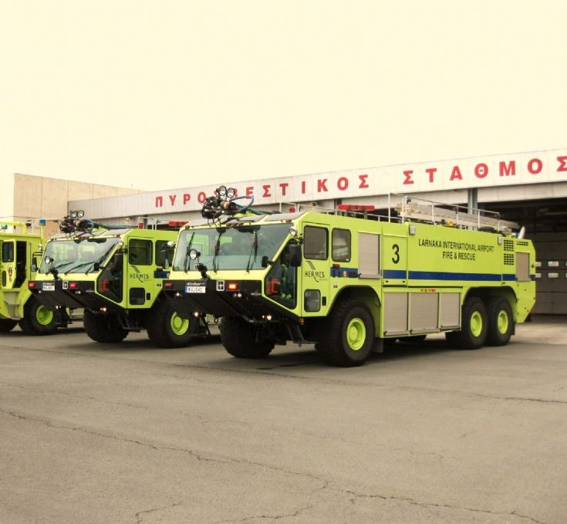
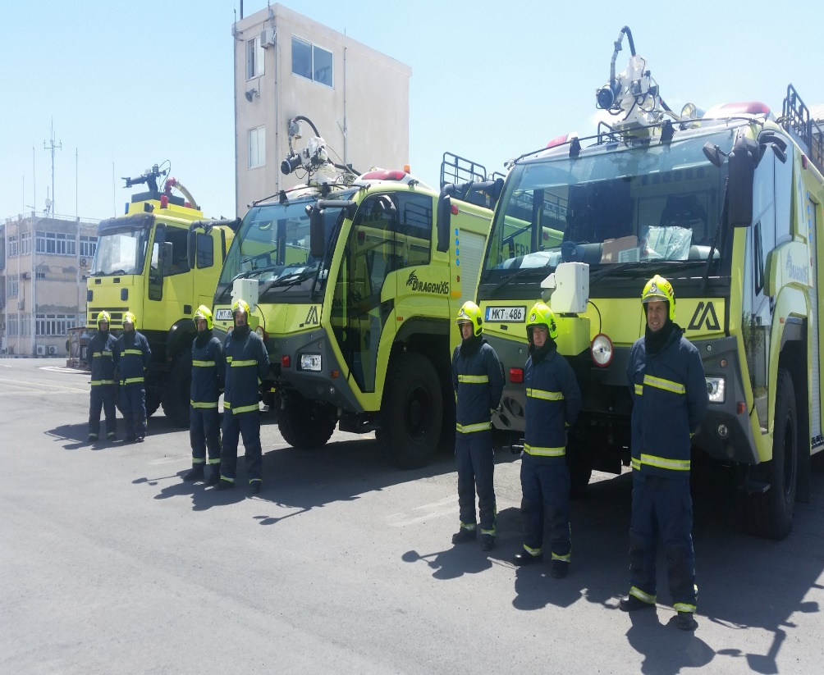
RESCUE AND FIREFIGHTING SERVICES
Infrastructure of rescue and firefighting services at LARNACA and PAFOS INTERNATIONAL AIRPORTS

Slide 3
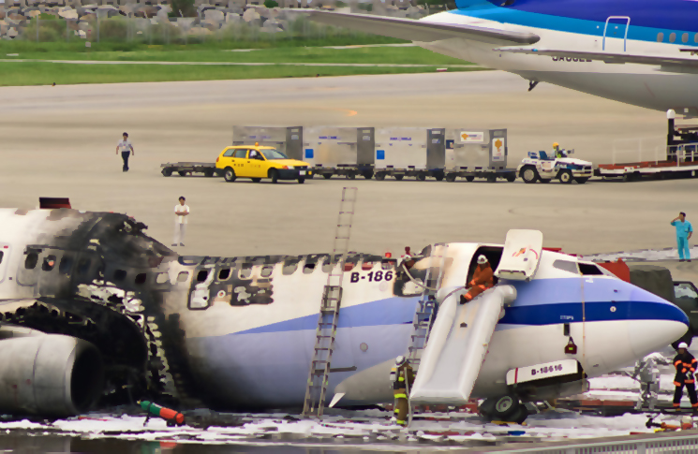
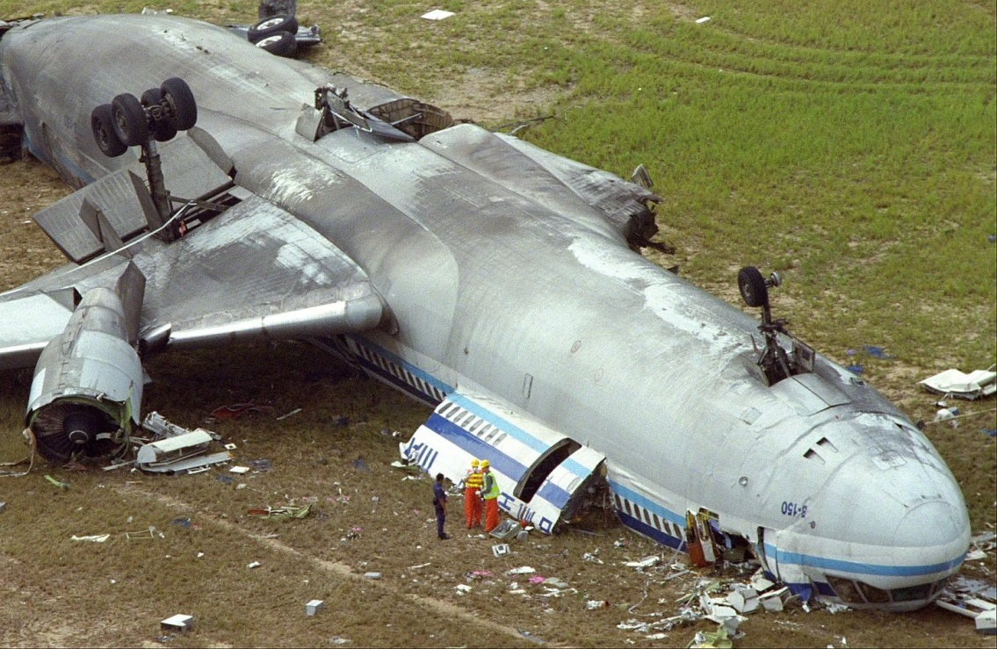
RESCUE AND FIREFIGHTING SERVICES
The scope of the rescue and firefighting services is to save lives in the event of an aircraft accident or incident occurring at or in the immediate surroundings of the aerodrome.

Slide 4
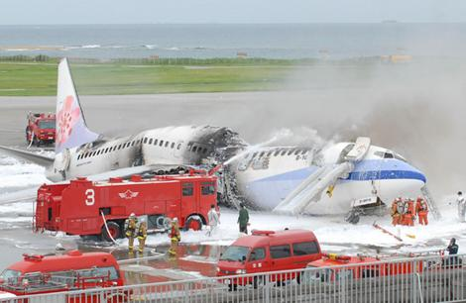
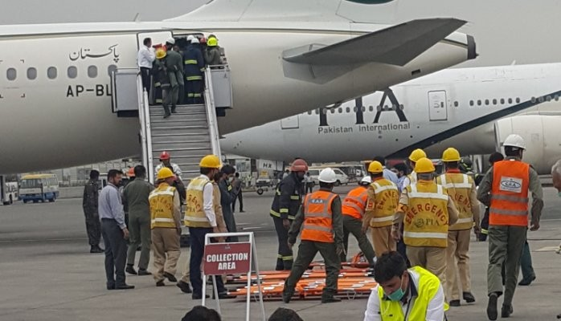
RESCUE AND FIREFIGHTING SERVICES
The operational objective is to create and maintain survivable conditions, to provide egress routes for occupants and to initiate the rescue of those occupants unable to make their escape without direct aid.

Slide 5
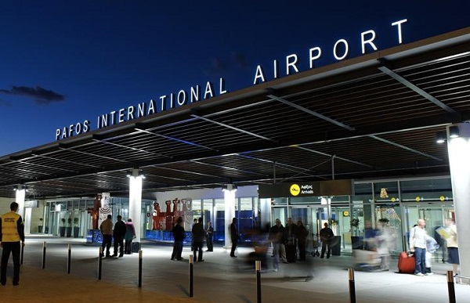
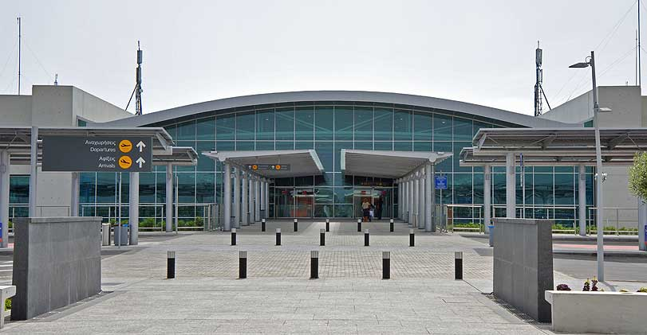
RESCUE AND FIREFIGHTING SERVICES
The Fire Service covers fire and rescue category
LARNACA CAT 8 PAFOS CAT 7

Slide 6
MINIMUM USABLE AMOUNTS OF EXTINGUISHING AGENTS
AERODROME CATEGORY | WATER ( L ) | DISCHARGE RATE FOAM SOLUTION / MINUTE ( L ) | COMPLEMENTARY AGENTS DRY CHEMICAL POWDERS ( KG ) | COMPLEMENTARY AGENTS DISCHARGE RATE ( KG / SECOND )
1 | 230 | 230 | 45 | 2.25
2 | 670 | 550 | 90 | 2.25
3 | 1200 | 900 | 135 | 2.25
4 | 2400 | 1800 | 135 | 2.25
5 | 5400 | 3000 | 180 | 2.25
6 | 7900 | 4000 | 225 | 2.25
7 | 12100 | 5300 | 225 | 2.25
8 | 18200 | 7200 | 450 | 4.5
9 | 24300 | 9000 | 450 | 4.5
10 | 32300 | 11200 | 450 | 4.5

Slide 7
LARNACA AIRPORT FIRE STATION FOAM TENDERS
FOAM TENDERS | WATER (L) | FOAM (L)-AFFF | DISCHARGE RATE FOAM SOLUTION/MINUTE | COMPLEMENTARY AGENTS - DRY CHEMICAL POWDER
CRASH 1 | 12000 L | 1680 L | 4730 L | 225 Kg
CRASH 2 | 12000 L | 1680 L | 4730 L | 225 Kg
CRASH 3 | 10750 L | 1500 L | 4500 L | 225 Kg
CRASH 4 | 12000 L | 1500 L | 4750 L | 225 Kg
TOTAL | 46750 L | 6360 L | 18710 L/Min | 900 Kg

Slide 8
PAFOS AIRPORT FIRE STATION FOAM TENDERS
FOAM TENDERS | WATER (L) | FOAM (L) AFFF | DISCHARGE RATE FOAM SOLUTION/ MINUTE | COMPLEMENTARY AGENTS - DRY CHEMICAL POWDER
CRASH 1 | 12000 L | 1500 L | 6000 L | 250 Kg
CRASH 2 | 12000 L | 1500 L | 6000 L | 250 Kg
CRASH 3 | 4000 L | 480 L | 3000 L | 250 Kg
TOTAL | 28000 L | 3480 L | 15000 L/Min | 750 Kg

Slide 9
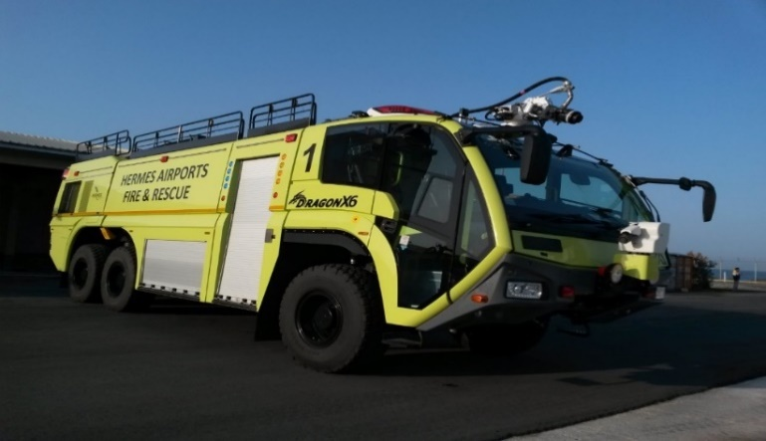
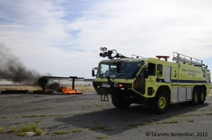
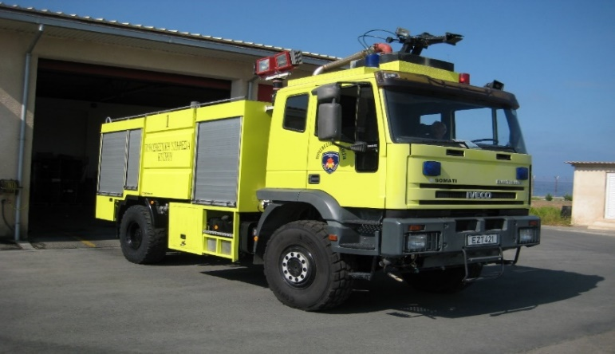
LARNACA AND PAFOS FOAM TENDERS

Slide 10
EXTINGUISHING AGENTS
Both principal and complementary extinguishing agents are provided at the aerodromes
Principal extinguishing agent ( FOAM - AFFF )
Complementary extinguishing agent ( DRY CHEMICAL POWDER )
A reserve supply of foam and dry chemical powder are maintained on the aerodromes for vehicle replenishment purposes.

Slide 11
RESPONSE TIME
The respond times of the RFFS are compliant with the requirements of EU regulation 139/2014 and requirements of ICAO.
According to data available at Pafos airport Fire Station, the respond time of the RFFS to the furthermost point of runway 29 is measured between 2 minutes, 15 seconds and 2 minutes, 50 seconds.
According to data available at Larnaca airport Fire Station, the respond time of the RFFS to the furthermost point of runway 22 is measured between 2 minutes, 25 seconds and 2 minutes, 50 seconds.

Slide 12
LARNACA AND PAFOS AIRPORTS NUMBER OF RFFS PERSONNEL
FIRE STATION | OFFICER | SUB OFFICERS | LEADING FIREMEN | FIREMEN/FIREWOMEN | TOTAL
LARNACA | 1 | 5 | 6 | 41 | 53
PAFOS | 1 | 6 | 8 | 24 | 39
PERSONNEL IS DIVIDED IN FOUR SHIFTS ( RED – BLUE – GREEN – WHITE )
11 PERSONS MINIMUM ON DUTY IN LARNACA AIRPORT
8 PERSONS MINIMUM ON DUTY IN PAFOS AIRPORT

Slide 13
TRAINING OF RESCUE AND FIREFIGHTING PERSONNEL
OFFICERS and SUB OFFICERS are trained in the UK in various trainings such as Overseas Command and Control, Officer Course and Supervisor Initial Course and some of them in the military aircraft in Greece.
RFFS personnel is trained daily in both theoretical and practical terms in various thematic units according to the bimonthly program.
RFFS personnel is participated in live fire drills commensurate with the types of aircraft and type of rescue and firefighting equipment in use at the aerodrome.
RFFS personnel is also trained in retraining programs
RFFS training records are kept.

Slide 14
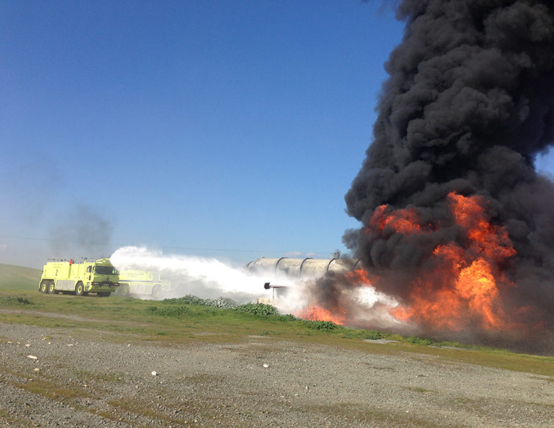
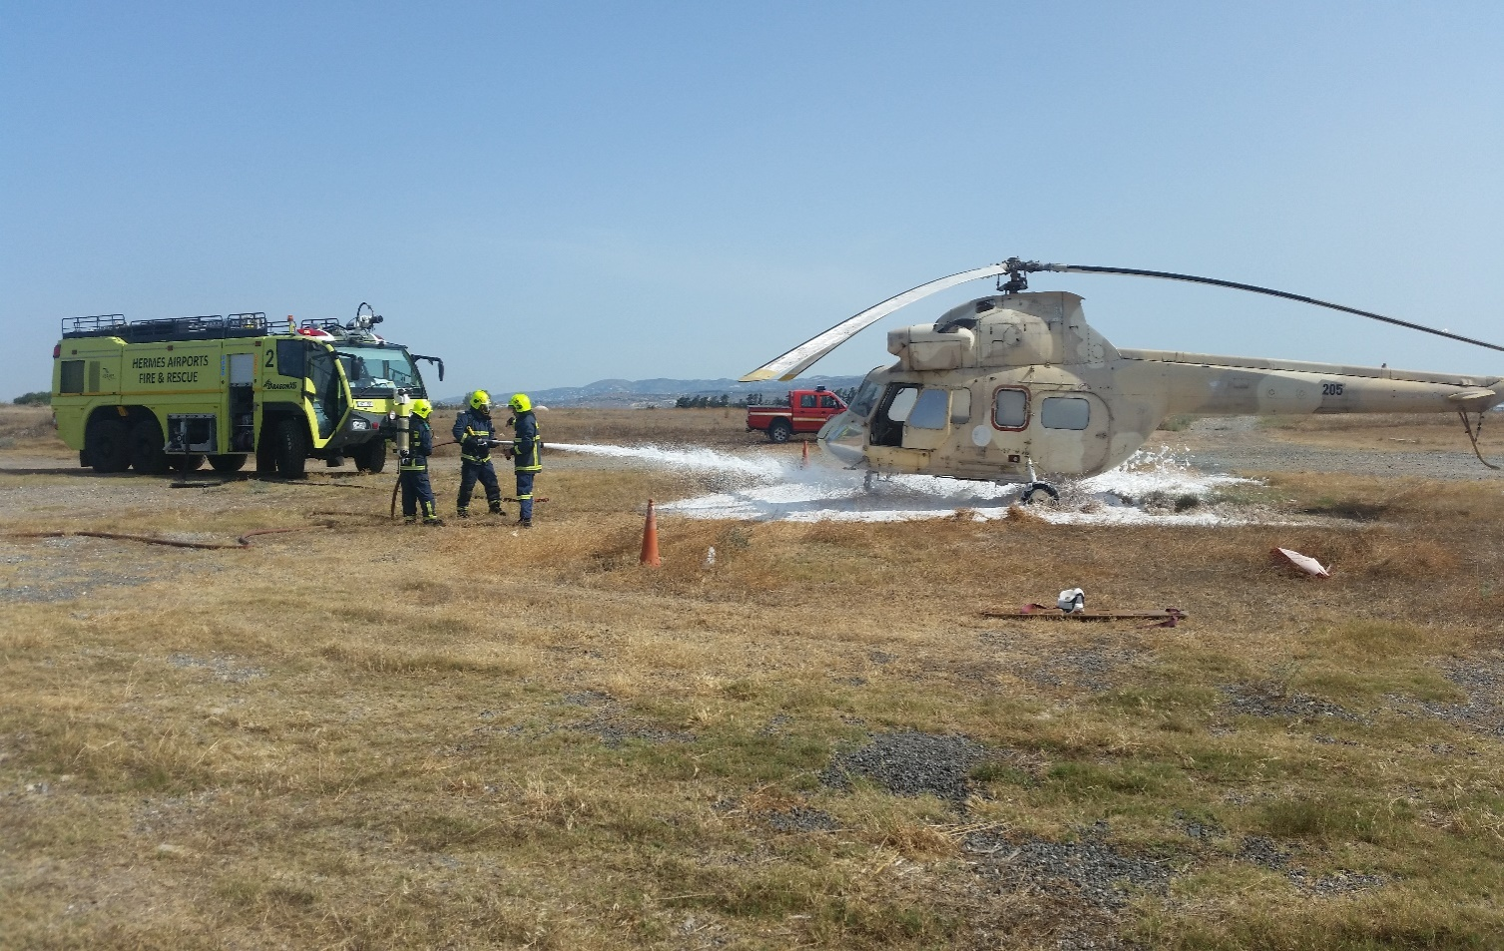
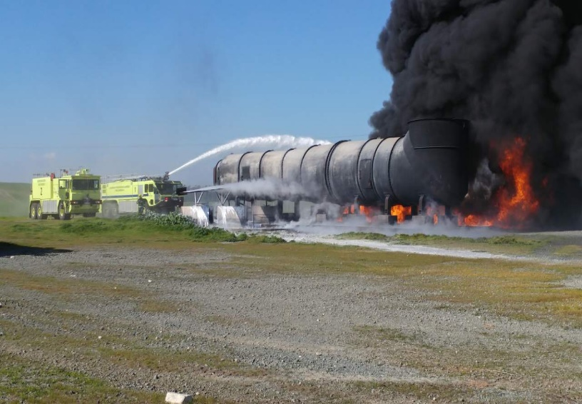
TRAINING OF RESCUE AND FIREFIGHTING PERSONNEL
Larnaca and Pafos Fire Training Areas

Slide 15
RESCUE AND FIREFIGHTING SERVICES EMERGENCY PLAN
The emergency plan of RFFS is based on the following international regulations and national action plans.
ICAO ANNEX 14 AERODROMES VOLUME I AERODROMES DESIGN AND OPERATIONS, ICAO DOC.9137-AN/898 PART 1 AIRPORT SERVICES MANUAL PART1 RESCUE AND FIREFIGHTING, ICAO AIRPORT EMERGENCY PLANNING PART 7
ERPP – HERMES AIRPORTS LTD
EU 139/2014 / ADR.OPS.B.010 RESCUE AND FIREFIGHTING SERVICES
NATIONAL SAR PLAN < NEARCHOS >
NATIONAL SAR PLAN < TEYKROS >
AIRPORT SECURITY PROGRAM ( CONTINGENCY PLAN AND SOP )

Slide 16
TYPES OF EMERGENCIES
ON AIRPORT EMERGENCIES ( NON – SECURITY )
Alert for Aircraft Emergency ( Local stand by – Full Emergency )
Crash on Airport ( includes inside salt lakes )
Structural Fire
Medical Emergency ( General )
Medical Emergency ( Pandemic )
Natural Disaster ( Earthquake )
Hazmat Emergency

Slide 17
TYPES OF EMERGENCIES
ON AIRPORT EMERGENCIES ( SECURITY )
Hijack
Bomb threat ( Aircraft )
Bomb threat ( Structural )
Sabotage ( Armed attack against the airport )

Slide 18
TYPES OF EMERGENCIES
OFF AIRPORT EMERGENCIES
Crash off Airport ( Within 5 NM )
Crash off Airport ( Beyond 5 NM )
Crash on Water Areas ( Sea, Salt Lakes )

Slide 19
TYPES OF EMERGENCIES
COMPOUND GROUND AIRPORT EMERGENCIES
Ground Aircraft Emergency
Ground Emergency

Slide 20
RFFS ACTION PLAN
An incident / accident can be divided up into a sequence of events
The initial call to the RFFS
Responding to the incident
Dealing with the external situation
Making entry to carry out rescues
Maintaining site safety and security
Preservation of evidence
Making up

Slide 21
RFFS ACTION PLAN
The Fire Incident Commander has the overall command, control and coordination in the red zone ( hot zone ) of the aircraft accident or incident.
The Fire Incident Commander has close cooperation with the OSC.
When the Mobile Command Post is activated, RFFS representative ( Officer ) must be in attendance
When the Emergency Coordination Centre (ECC) is activated, RFFS representative ( Officer ) must be in attendance
Call for assistance and back up the neighboring local fire stations as necessary.

Slide 22
ACCIDENT AREA CONTROL ZONES
BLACK ZONE
YELLOW ZONE
RED ZONE

Slide 23
TYPICAL CRASH SCENE LAYOUT
BUS
1
III
100Μ
MCP
COLLECTION AREA
II
TRIAGE AREA
AMB
I

Slide 24
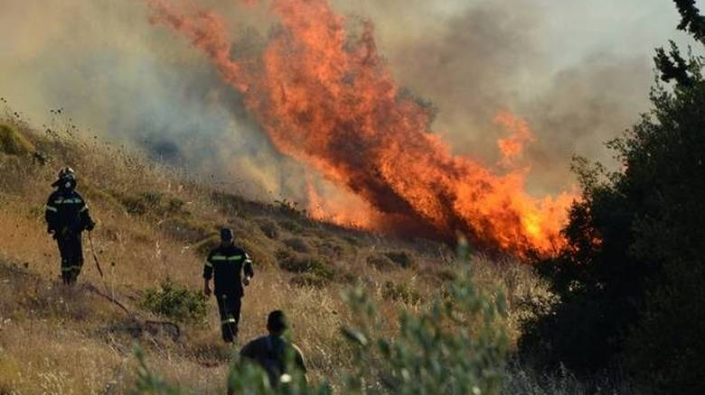
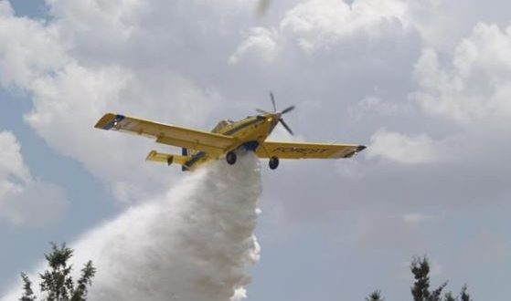
MANAGEMENT SYSTEM FOR FOREST FIREFIGHTING AERIAL MEANS IN CYPRUS
In Cyprus, the responsibility for extinguishing fires in the countryside is under the fire service department while for fires in the national forests the responsibility is under the forest department. Nevertheless there is a very close and excellent cooperation and both departments are involved in the confrontation of fires wherever these may appear.

Slide 25
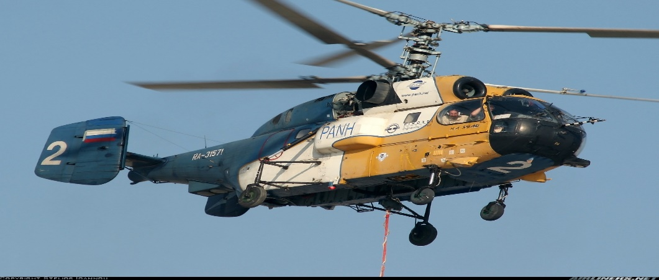
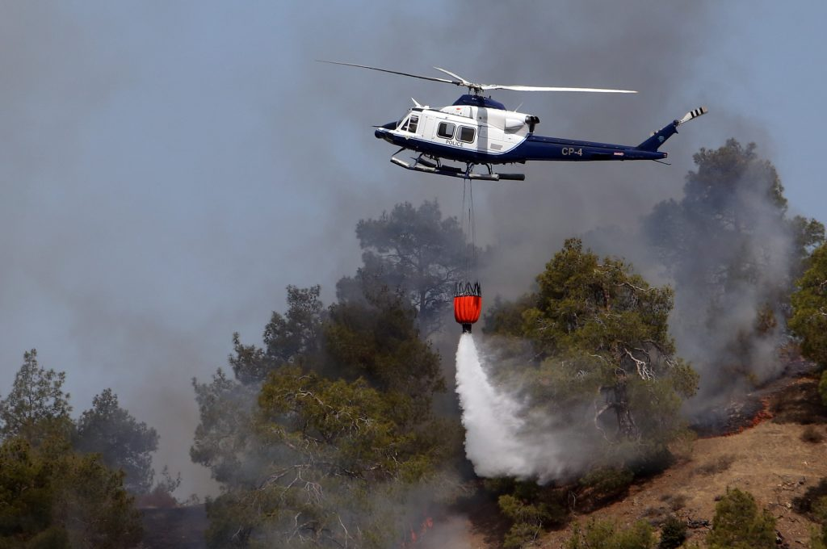
MANAGEMENT SYSTEM FOR FOREST FIREFIGHTING AERIAL MEANS IN CYPRUS
The Republic of Cyprus has a total number of 12 aerial means (helicopters and small planes) that are strengthened/supported by 2 helicopters of United Kingdom sovereign base areas (SBA). Four of them are responsible for search and rescue operations. The two planes are “air tractor” type while the helicopters are Bell, Augusta and Kamov.

Slide 26
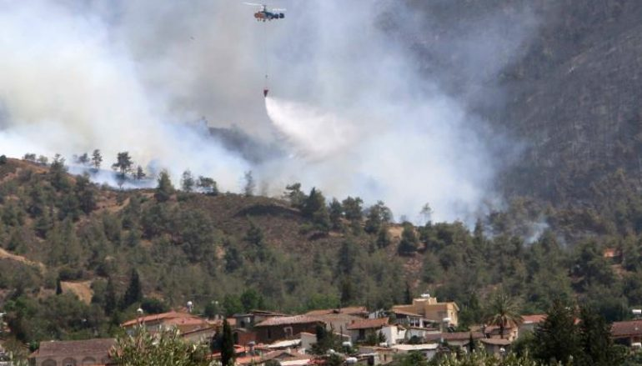
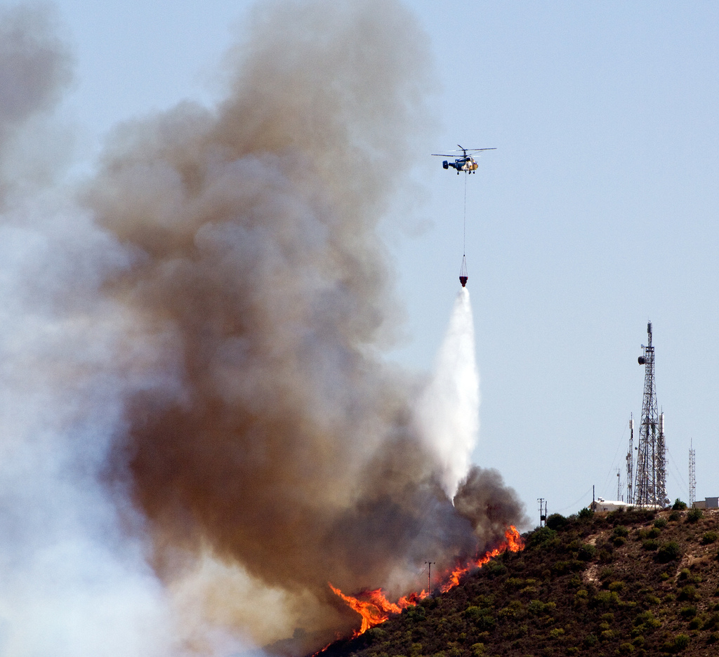
MANAGEMENT SYSTEM FOR FOREST FIREFIGHTING AERIAL MEANS IN CYPRUS
In approximately 40, of the fires that burst in Cyprus the involvement of aerial means is needed.
Instructions for the response of aerial means are given only by the fire or forest department chief of operations

Slide 27
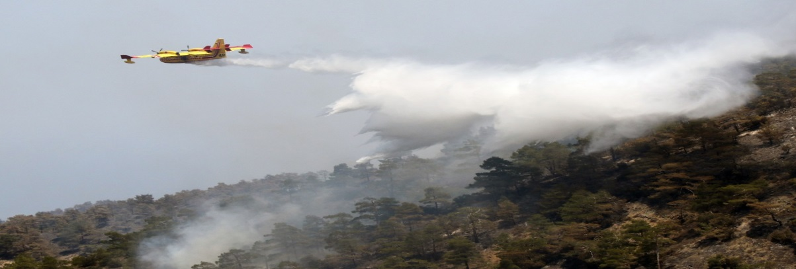
MANAGEMENT SYSTEM FOR FOREST FIREFIGHTING AERIAL MEANS IN CYPRUS
In many cases per year base on fire behavior the involvement of all the aerial means that the Republic of Cyprus has under its possession is required.
For cases where the involvement of more than six aerial means is considered necessary, then the national action plan under the name “IKAROS” comes into force.

Slide 28
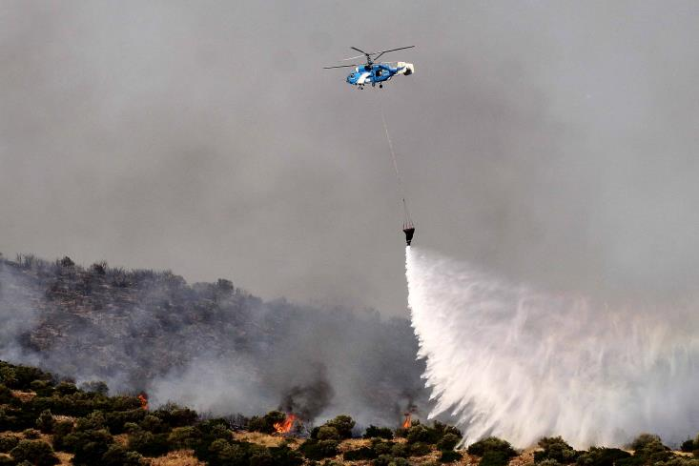
MANAGEMENT SYSTEM FOR FOREST FIREFIGHTING AERIAL MEANS IN CYPRUS
In such cases, the ground coordination in regards to the water or foam drop areas, the usage of retarder fluid, is done by a military personnel, usually a pilot, while the helicopter flies over the fire-fighting aerial means for security purposes. It goes without saying that the helicopter coordinating has a constant contact with the ground coordinator of the aerial means in order to determine the import and export points, the water intake locations and the altitudes.

Slide 29
MANAGEMENT SYSTEM FOR FOREST FIREFIGHTING AERIAL MEANS IN CYPRUS
The coordinator of the aerial means receives his instructions in regards to the drop areas from the general coordinator of the fire in accordance with the needs and requests of the sector leaders of the fire areas.

Slide 30
MANAGEMENT SYSTEM FOR FOREST FIREFIGHTING AERIAL MEANS IN CYPRUS
Aerial means ground search and rescue operations:
Flood operations
Collapse buildings after earthquakes
Observing and giving feedback to the rescue teams
Live streaming to Fire Service to the advanced control center

Slide 31
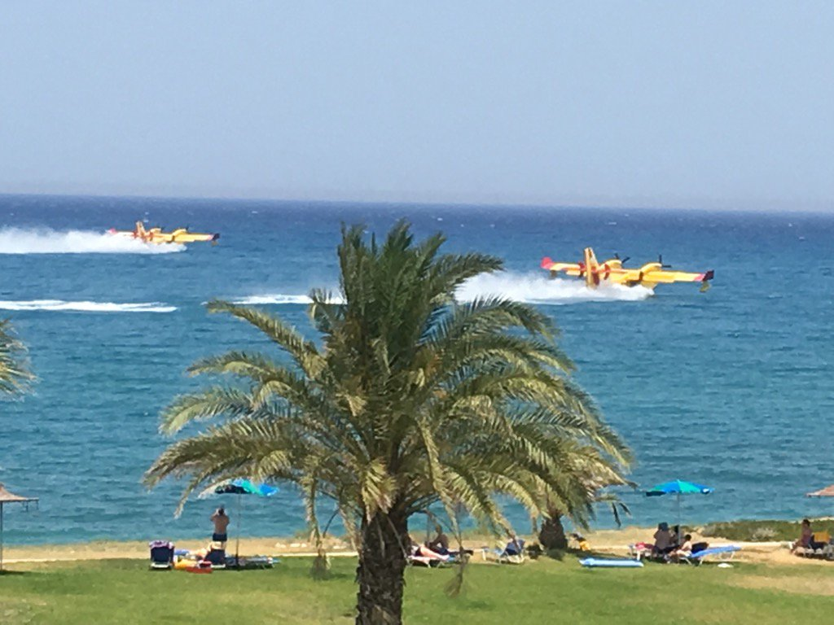
MANAGEMENT SYSTEM FOR FOREST FIREFIGHTING AERIAL MEANS IN CYPRUS
The Republic of Cyprus, and more specifically the Cyprus Fire Service, has a memorandum of cooperation with the Fire Service departments of Greece and Israel in regards to the management of general disasters. For the last two years we are organizing and executing common drills with aerial and terrestrial means.

Slide 32


