Slide 1
Crisis Management Plans in Aviation
David Herriman

Slide 2
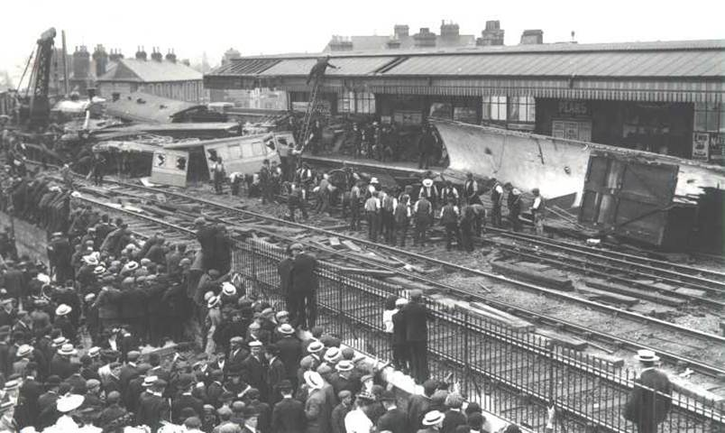
Kenyon International - starting in 1906

Slide 3
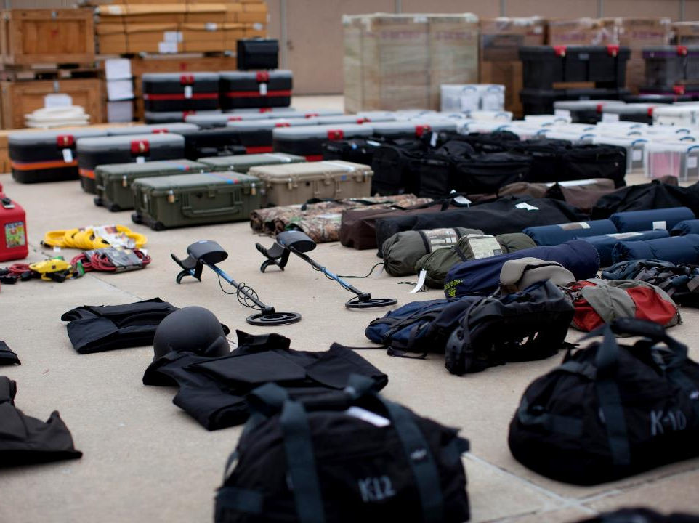
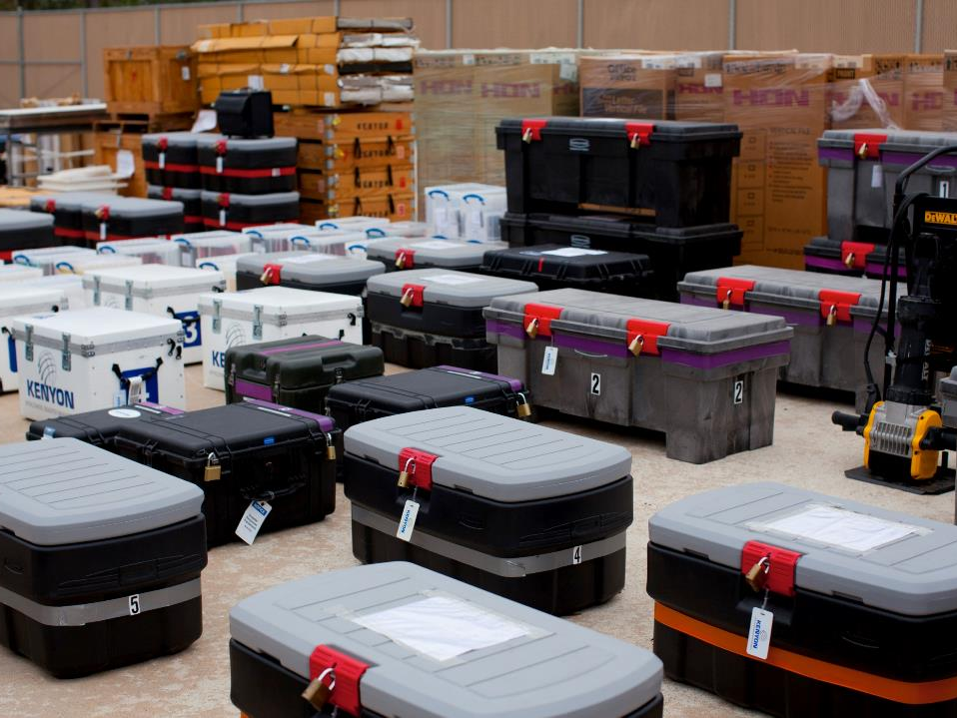
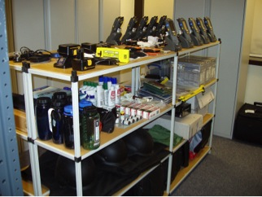
Briefly
World’s leading full-service disaster management company
Privately owned
Responded to hundreds of mass-fatality events since 1906
500+ retained members
Global reach, rapid response
Significant operational resources
Notes:
Let me tell you a little about Kenyon. It will help you understand our overall capabilities and why we do what we do.
Kenyon is the world’s only full service disaster management specialist. We do have competitors but none of them have Kenyon’s resources and experience. None of them offer the full suite of services Kenyon has which I will present a little later.
Kenyon is a privately-held, but widely-known, international business with over a century of history. We trace our history back to 1906, when the London and South Western Railway boat train jumped its tracks and crashed in Salisbury, England. Brothers Herbert and Harold Kenyon of JH Kenyon Limited deployed from London to work with the Coroner and Chief Constable to prepare and repatriate the deceased, nearly all of whom were American. After embalming the deceased, Herbert escorted five aboard the Cunard Steamer RMS Carmania from Liverpool to New York.
Kenyon’s first air disaster was an Imperial Airways crash at Croydon Airport in the UK. There were 7 casualties. Since then Kenyon has responded to hundreds of incidents from single fatality incidents to international disasters and acts terrorism.
Kenyon has nearly 500+ members which includes governments and public and private organizations and companies. Most are airlines but many are not.
Let me talk a little about our resources and capabilities.

Slide 4
Worldwide Facilities
Houston
Dominican Republic
London
Beirut
Sydney

Slide 5
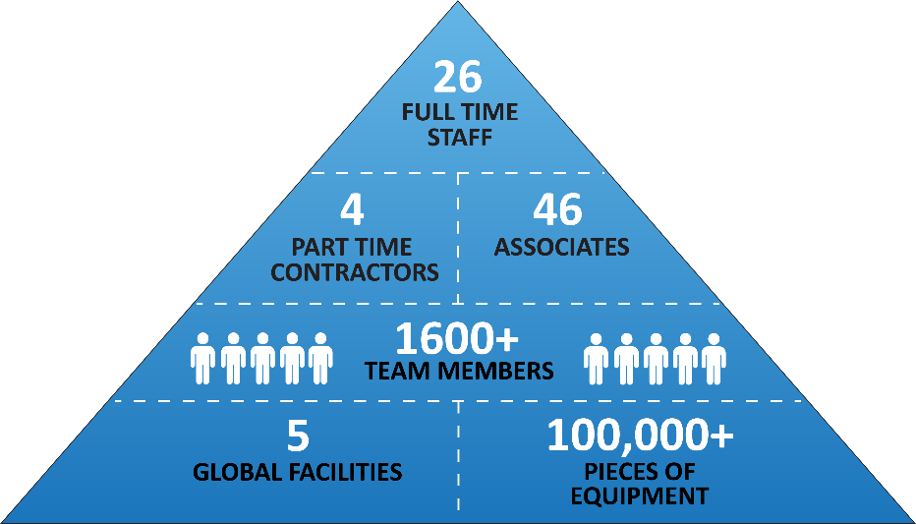
Kenyon Team

Slide 6
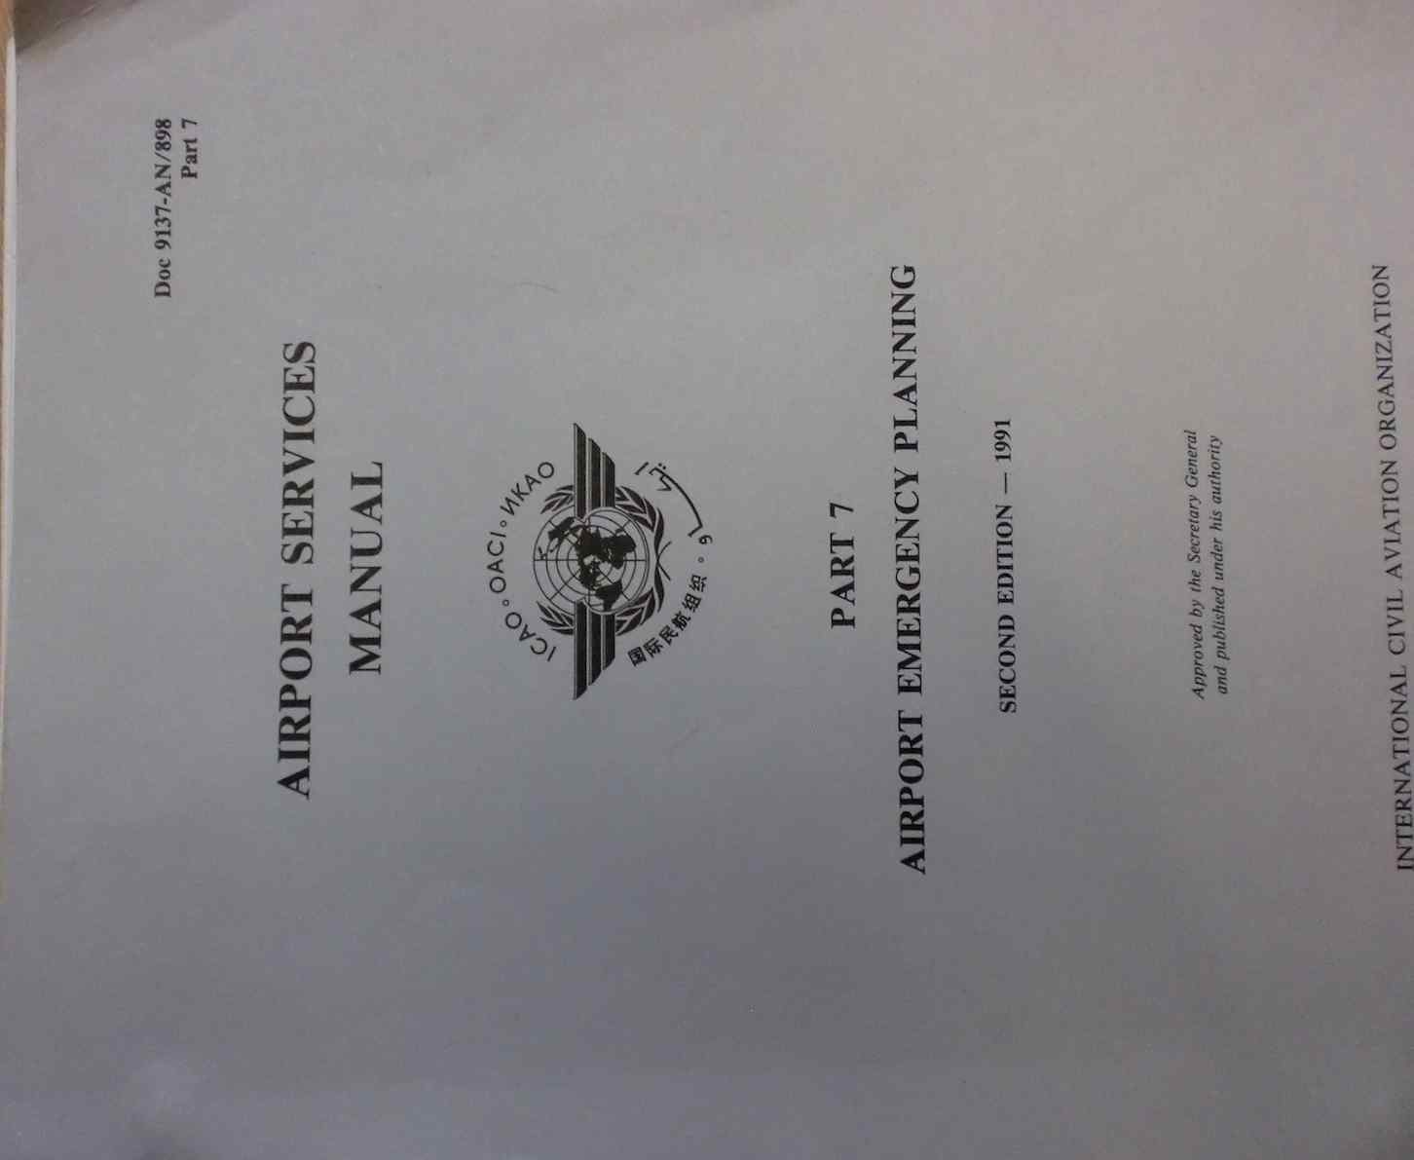
Emergency Plans
No Plan = Bad Response
No Training = Bad Response
Those who will be involved must be trained and know their Plan
Keep it simple
Checklists should be used
Plan belongs in the cupboard
Good Compliance is not necessarily Best Practice

Slide 7
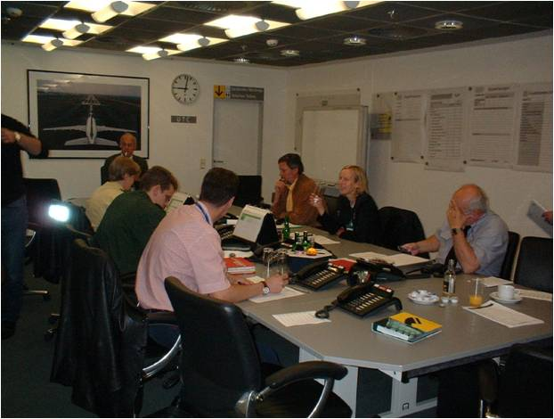
Emergency Plans – Training Training Training
Exercise & Train
Table Top Exercises
Input Exercises
Train deputies
Train senior management
Ensure all players understand the “bigger picture” and the significance of “Best Practice”
Exercise Day 2 or Day 3, not just the first hours
Exercise regularly ( annually is ideal )
A good Plan is a “living” thing – it changes, like the world

Slide 8
Plans & Players
Business
Continuity
ERP
Laws & Regs
Laws & Regs
Partnerss

Slide 9
Plans & Players
Business
Continuity
ERP
Laws &
Regs
Partnerss
Laws & Regs

Slide 10
Kenyon’s 12 Principles
All clients are given initial training
Airline Crisis Response
Humanitarian Assistance
Crisis Communications
Telephone Enquiry Centre
Investigation
Insurance, Risk Management
Data Management
Government/ Community Affairs
Fatality Operations
Personal effects
Business Continuity
Crisis Leadership

Slide 11
Assisting clients – Best Practice
Use practical examples based on experience
Stress “Best Practice”
Stress “Deal with the consequences'!”
Audit Plans
Train senior management in Crisis Comms
Train CMTs & ensure they understand the “bigger picture”

Slide 12
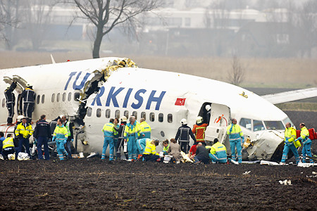
Public Perception/Expectations
The public (Families, Customers, Media etc.) have their own ideas of what should be done.
These differ from ours (CAA, EASA,ICAO etc.)
Where do the public get their (aviation) education?
TV & Newspapers (Media)
TV programs and films
Social media

Slide 13
Nowhere to hide

Slide 14
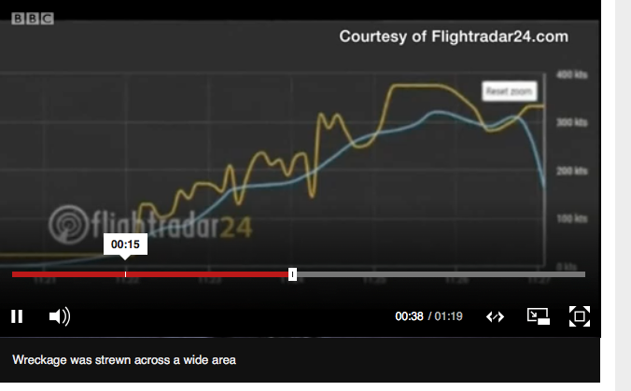
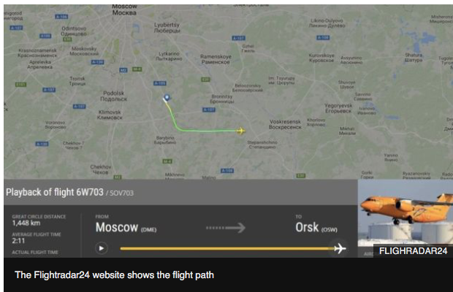

Slide 15
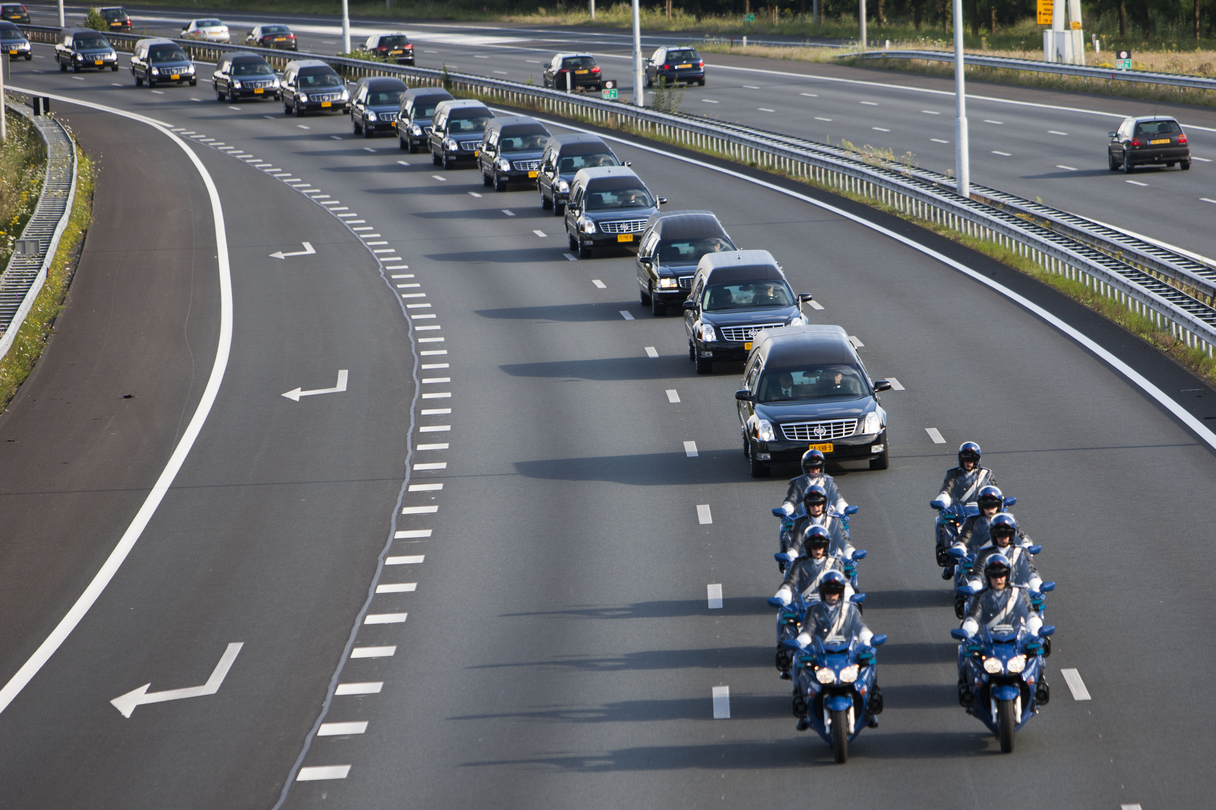
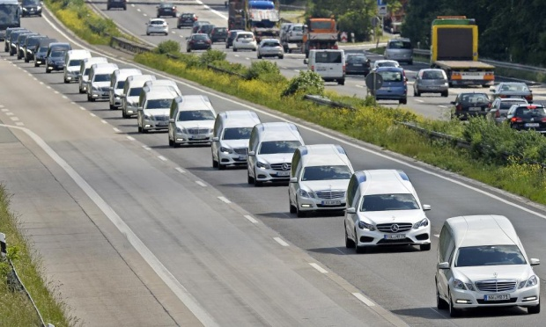
Example – Public Expectations
2014 – The Netherlands
2015 – Germany

Slide 16
Social Media

Slide 17
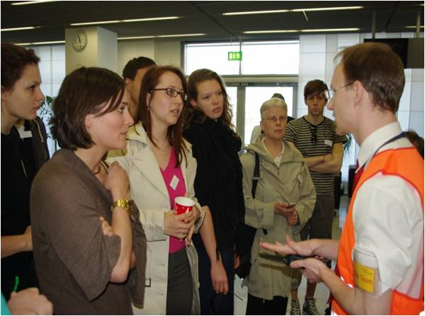
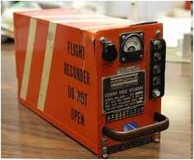
Public Perception & Expectation
Understand:
The difference between Compliance and Best Practice
The reality of what the public expect
The importance of Intelligence gathering
The “Bigger Picture”

Slide 18
Summary
Do not:
Re-invent the wheel
Do it alone
Do:
Learn from (mistakes & experience) others
Know your players
Plan ahead
Be practical
Educate & train your people
Be prepared

Slide 19
Thank You
www.kenyoninternational.com

