Slide 1
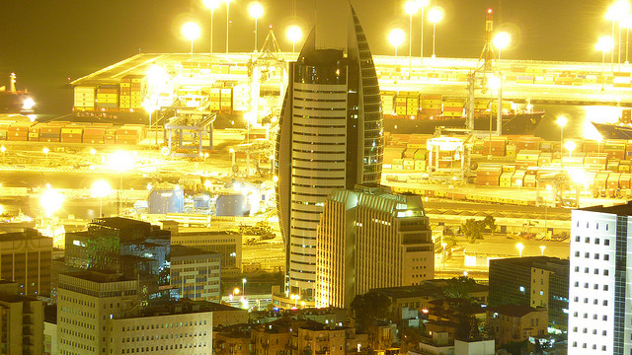
RCC HAIFA

Slide 2
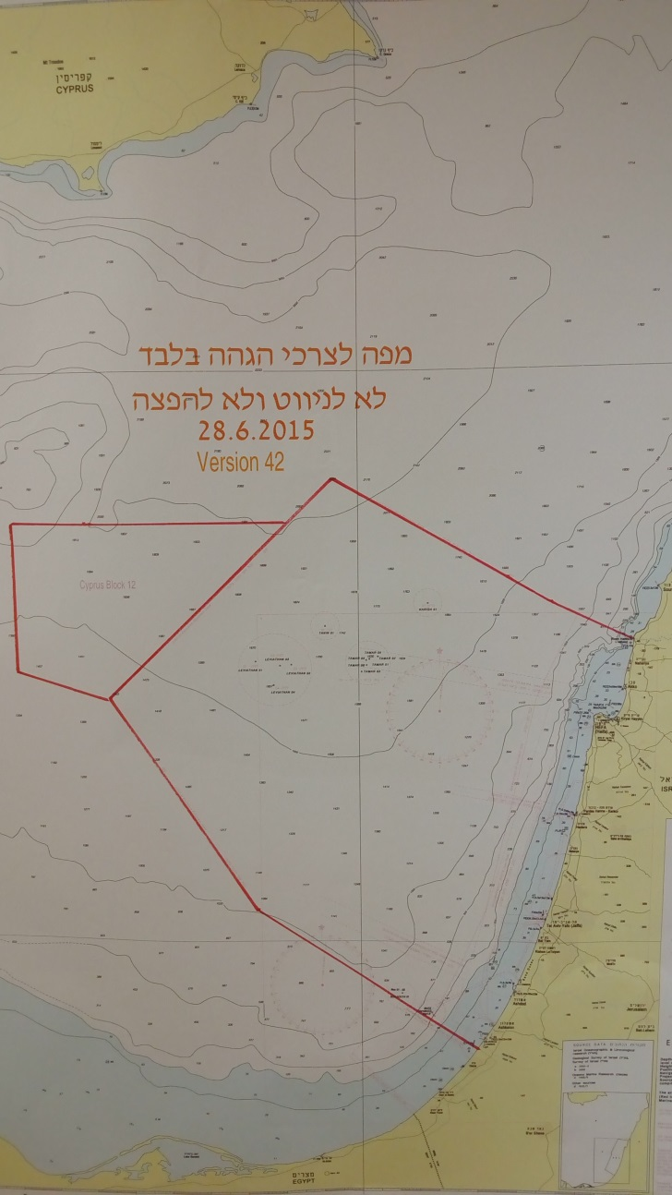
RCC Haifa Area of Responsibility
EEZ
SAR Area
Territorial Sea

Slide 3
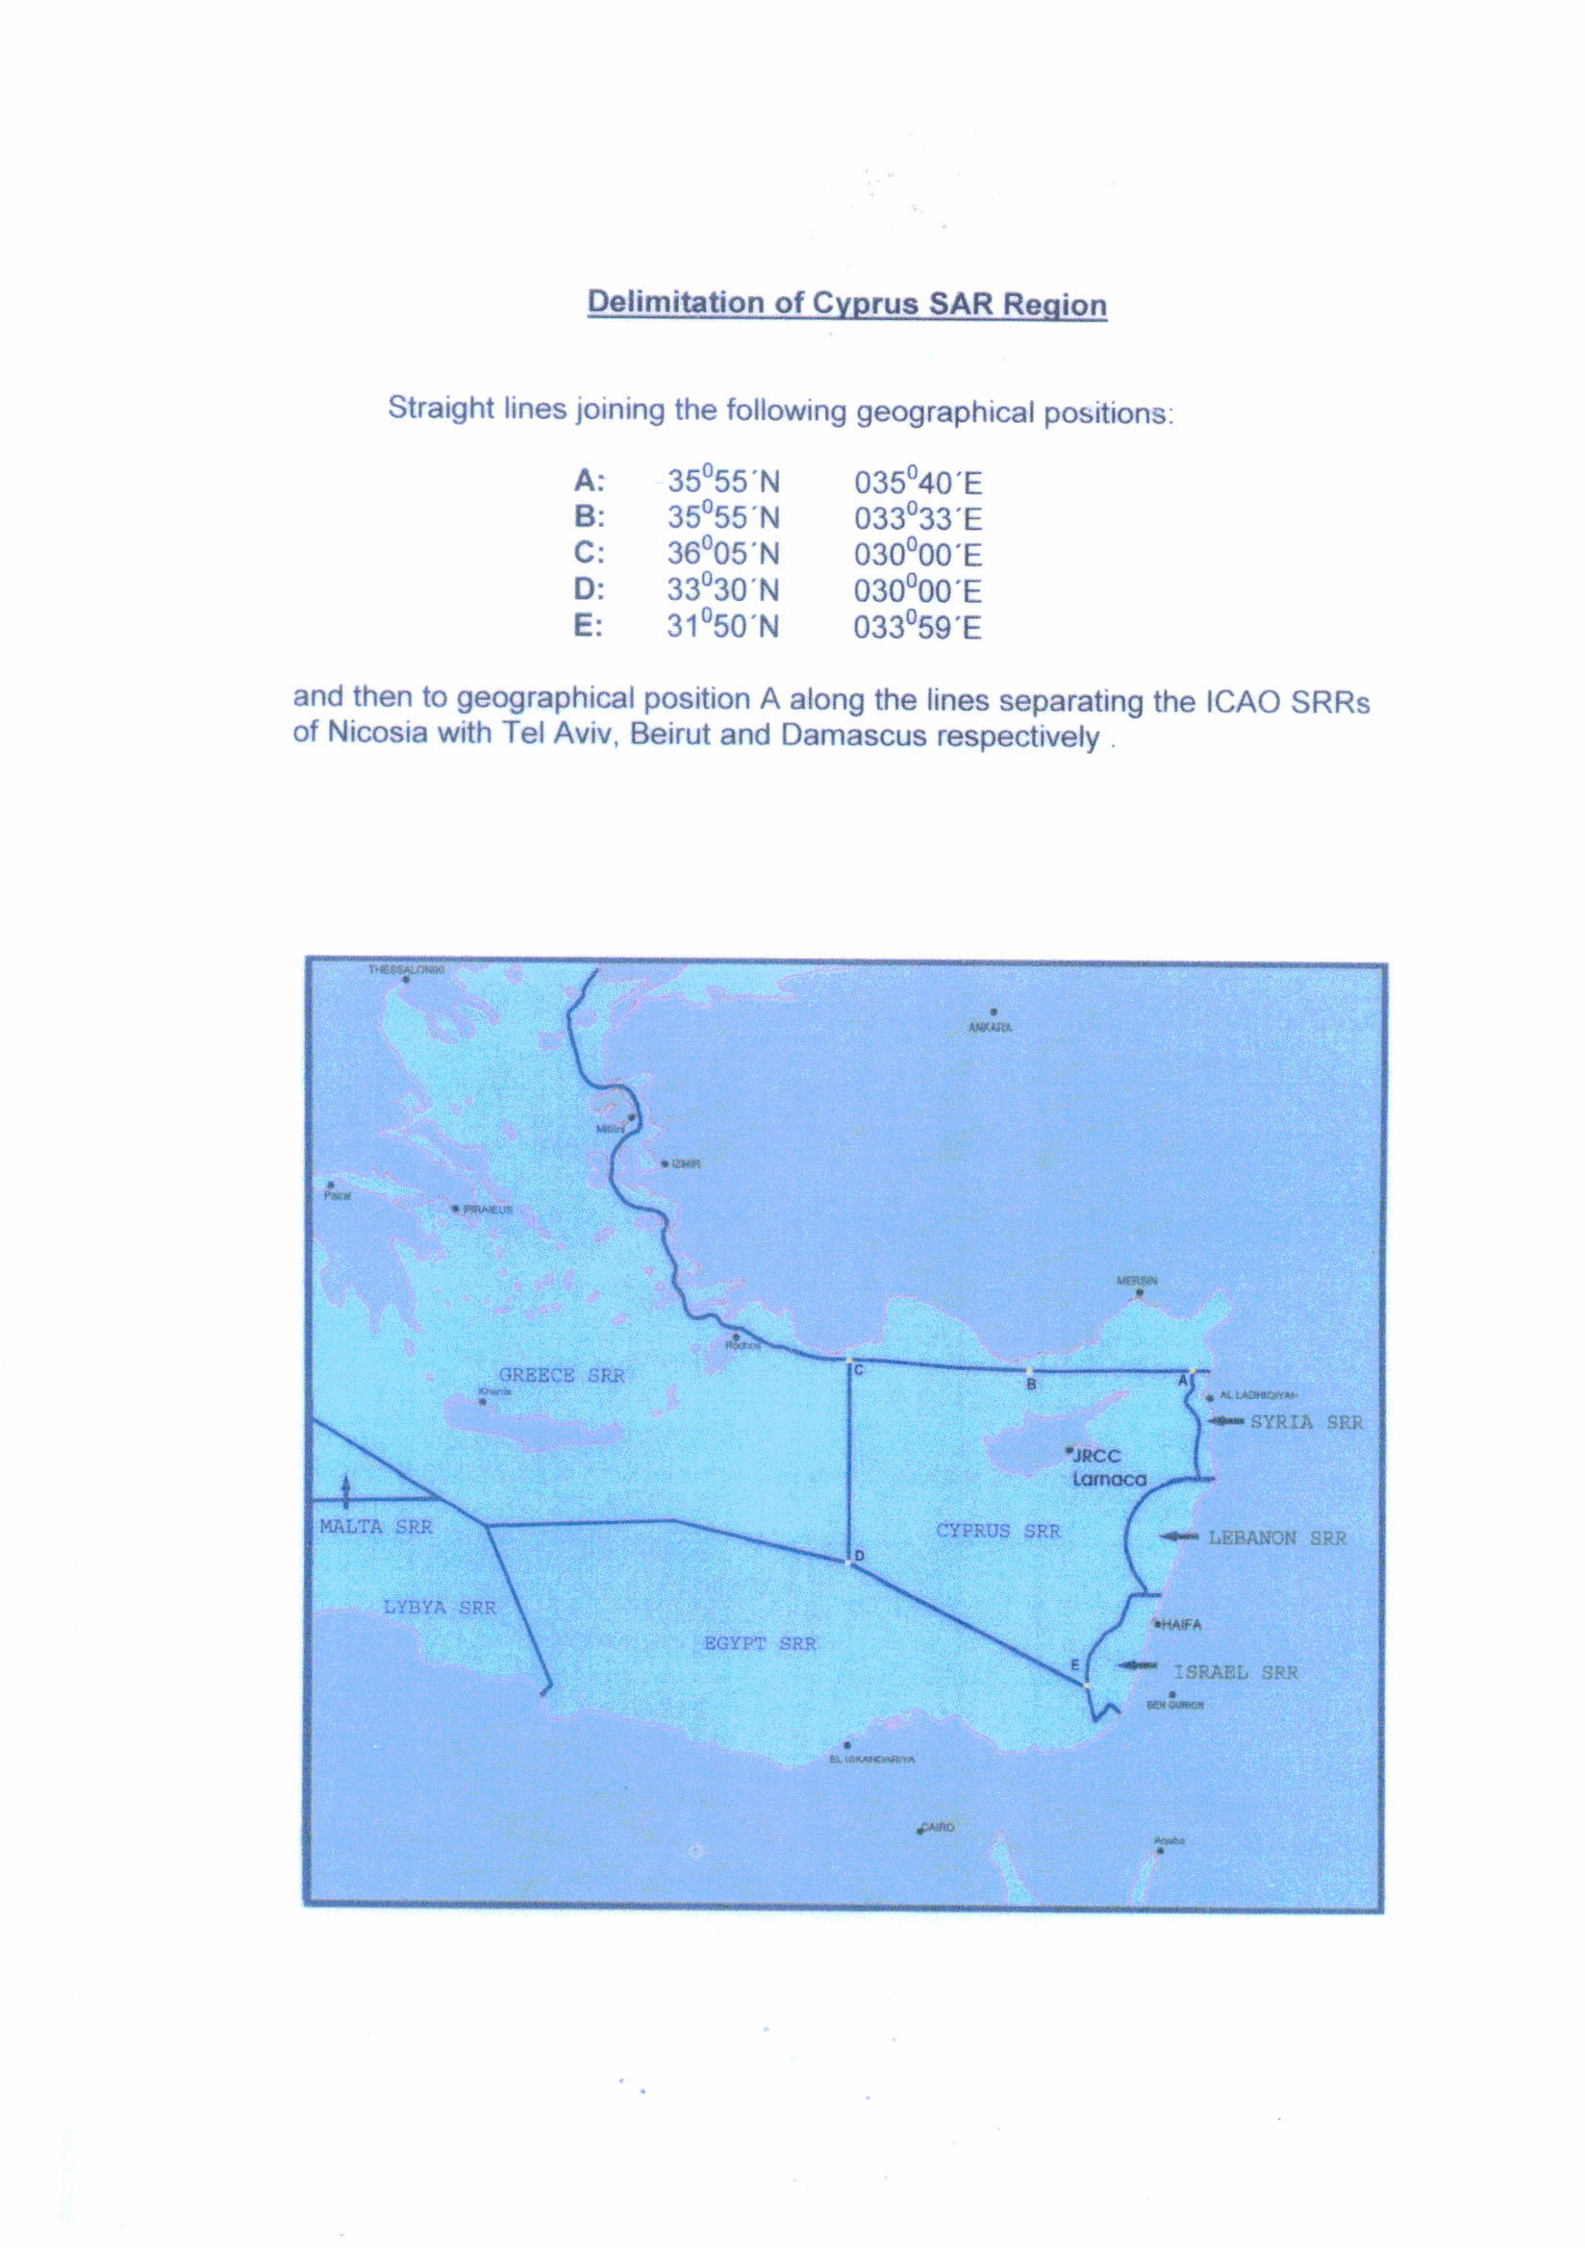
SAR Regions

Slide 4
Communications Console
AIS Display
COSPAS-SARSAT
INMARSAT
VHF, MF and HF - DSC Remote Control Station
Marine Communications
console
INMARSAT
Voice
Computer Terminal
Aircraft
Comm
Console

Slide 5
Second Operating Station
NAVTEX
Khz 518
Communications console
AIS

Slide 6
Emergency Response
Environment Ministry

Slide 7
CONFERENCE ROOM
Briefing Room
VIDEO
CONFERENCE

Slide 8
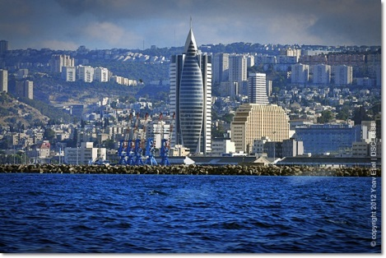
Watchkeeping in RCC HAIFA- 2 Operators, 24x7 (Formerly Haifa Radio) SMC’s and additional personnel on call, 24x7

Slide 9
Fields of Responsibility
Maritime Search and Rescue
Medical Assistance
Civilian Vessel communications with Israeli Civil and Defence Authorities
Emergency Response for pollution
Assist Israeli civilians and marine assets worldwide
Marine Safety and Meteorological broadcasts via Navtex
Cooperation with neighbouring RCC’s
Haifa Radio and Ports + Lighthouses

Slide 10
Agreements
Bilateral Agreement between The State of Israel and The Republic of Cyprus
Operational Procedures with the Israeli Navy
Cooperation between the Israeli Ministry of Transport and the Environment Ministry
MoU with the Israeli Ports and private companies with marine interests
Free medical advice 24x7 (IMOT Contract with private facility)

Slide 11
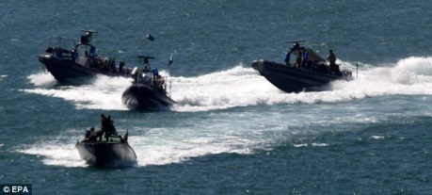
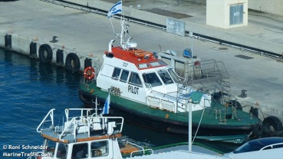
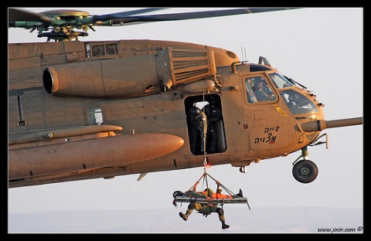
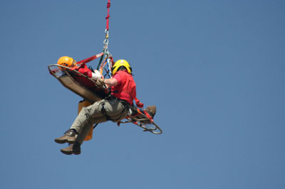
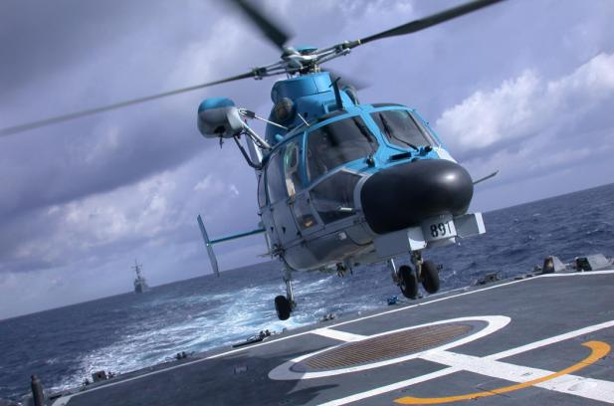
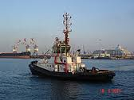
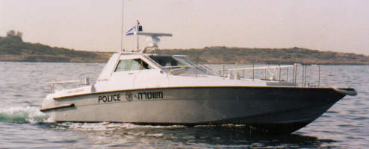
Available SAR Assets
Civilian Vessels and Aircraft (with CAAI assistance)
Israeli Navy and Air Force
Israeli Police
Environment Ministry vessels
Port tugs and support vessels

Slide 12
Events handled
Average of 15 serious incidents per year
Average of 20-25 incidents per month
Several daily requests for information
Average of 40 IMOT arrival reports per day (Merchant vessels, Pleasure craft and Fishing vessels)
Numerous commercial communication
Enquiries from the public
Requests for assistance out of area
Lighthouse malfunction monitoring

Slide 13
RCC Haifa
Captain MICHAEL SOLOMON
Senior Marine Surveyor│Marine Accident Investgator│RCC Manager
Israeli Ministry of Transport│Shipping and Ports Administration
15A, Pal-Yam street, Building "B", P.O.B. 806, Haifa, 31007, Israel.
Tel: +972-4-8632110│Fax: +972-4-8632155│Mob: +972-50-6212923│
E-mail: captmikesolo@gmail.com
Thank You Very Much

