Slide 1
ICAO SAR Regional Framework
Mr. Celso FIGUEIREDO
Regional Officer ANS – ICAO EUR/NAT Office
“AVIATION SAFETY FOR OFF-SHORE OPERATIONS/ SEARCH AND RESCUE”

Slide 2
Outlines
SAR Capabilities in the ICAO EUR Region;
The lack of effective implementation (LEI);
Establishment & the main objectives of the EURSAR/TF;
ICAO EUR Regional SAR Plan (cooperation with MID and APAC Regions); and
EURSAR/TF/2 – Next meeting

Slide 3
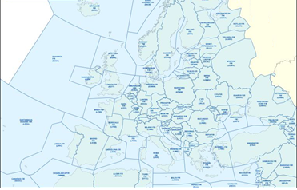
Search and Rescue capability in ICAO EUR Region
T Office
3
The EUR Region has a very complex airspace (55 States), and some States have multiple Flight Information Regions (FIRs), Rescue Coordination Centres (RCCs) and Search and Rescue Regions (SRRs).
The protocol questions (PQ) are the main tool used during the conduct of a USOAP CSA audit (Universal Safety Oversight Audit Programme – Comprehensive System Approach) to assess the State's capability of safety.

Slide 4
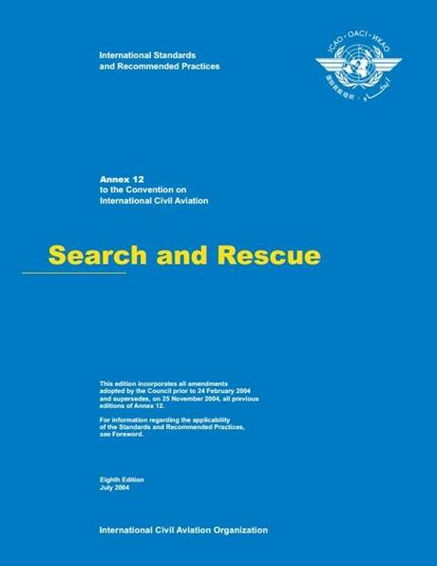
Search and Rescue – ICAO Annex 12 & IAMSAR Manual, ICAO Doc 9731
Annex 12 is applicable to the establishment, maintenance and operation of search and rescue services in the territories of Contracting States and over the high seas, and to the coordination of such services between States.
IAMSAR Manual assists States in meeting their own search and rescue (SAR) needs, and the obligations they accepted under the Convention on International Civil Aviation, the International Convention on Maritime Search and Rescue and the International Convention for the Safety of Life at Sea (SOLAS).

Slide 5
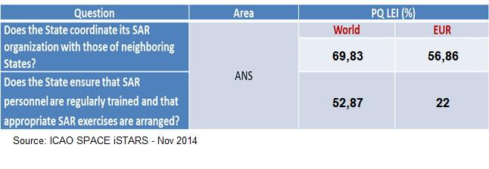
Search and Rescue capability in ICAO EUR Region
The lack of effective implementation (LEI) score reflects the ratio (%) between the number of States where this PQ was not satisfactory and the total number of States where the PQ was applicable. The data is drawn from all the available CSA audits including ICVMS.

Slide 6
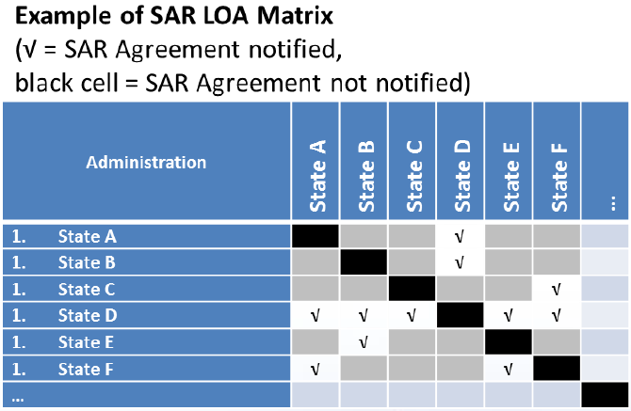
Search and Rescue capability in ICAO EUR Region
Although EUR Region theoretically has for some States SAR Agreements in place, most of these needed updating, particularly to include all SAR elements such as reference to assistance to other State SAR assets, and SAR Exercises (SAREX).

Slide 7
Search and Rescue – ICAO Annex 12 & IAMSAR Manual, ICAO Doc 9731
2.1 Search and rescue services
2.1.1 Contracting States shall, individually or in cooperation with other States, arrange for the establishment and prompt provision of search and rescue services within their territories…
2.1.1.1 …the high seas or areas of undetermined sovereignty… search and rescue services shall be determined on the basis of regional air navigation agreements.
Note.— The phrase “regional air navigation agreements” refers to the agreements approved by the Council of ICAO normally on the advice of Regional Air Navigation Meetings. (EANPG).
2.1.1.2 Basic elements of search and rescue services shall include a legal framework, a responsible authority, organized available resources, communication facilities and a workforce skilled in coordination and operational functions.

Slide 8
… and these were the fundamental reasons for a course of action to have a big picture of the SAR activities in the EUR Region. 09

Slide 9
Search and Rescue capability in ICAO EUR Region – EANPG Decision
The EANPG⁽¹⁾ established the EURSAR/TF to discuss, submit concepts and fill gaps in SAR capabilities in order to improve the overall capability of the SAR system throughout the EUR Region;
The EANPG invited the States to consider ways to enhance and improve SAR capability in the Region; and
Encouraged States to discuss and submit concepts to future EANPG sessions on how gaps in the SAR Capability Matrix might be addressed.
EANPG Decision 56/08 – Enhance and improve Search and Rescue capability in European and North Atlantic Regions
⁽¹⁾ The European Air Navigation Planning Group

Slide 10
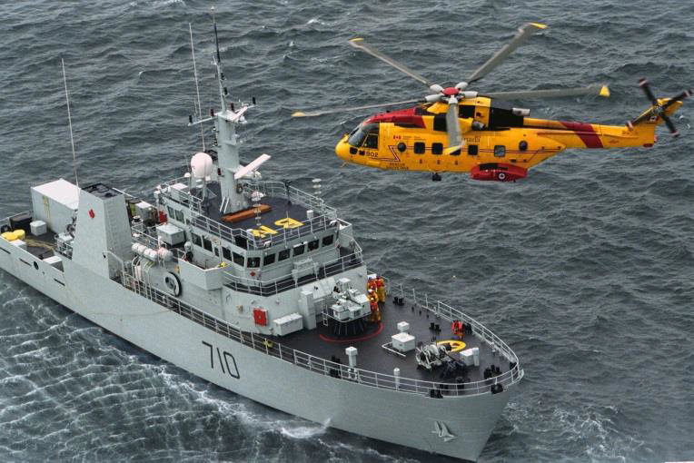
Search and Rescue capability in ICAO EUR Region – EANPG Decision
(Budapest, Hungary, from 14 to 18 September 2015)
SAR arrangements & Capabilities
Table SAR – Agreements was updated;
Table SAR Capability Matrix.
EUR Aeronautical SAR Contact List
Reliable communication and collaboration with affected stakeholders; and
This contact list should not be confused with any listings of SAR Point of Contacts (SPOCs) which are used for 24 hour SAR emergency contact purposes.
EURSAR/TF Task List.

Slide 11
EURSAR/TF and ICAO/IMO JWG – SPOC⁽¹⁾ Communications Matters
SPOC Communications Matters
COSPAS-SARSAT (ICAO/IMO JWG-SAR/22-WP/28), summarized International SPOC communication matters as at 14 August 2015;
Regarding the Regional SPOC communication, non-responsive SPOCs were those SPOCs which did not provide any response.
⁽¹⁾ COSPAS-SARSAT Programme Search and Rescue Point of Contact (SPOC)

Slide 12
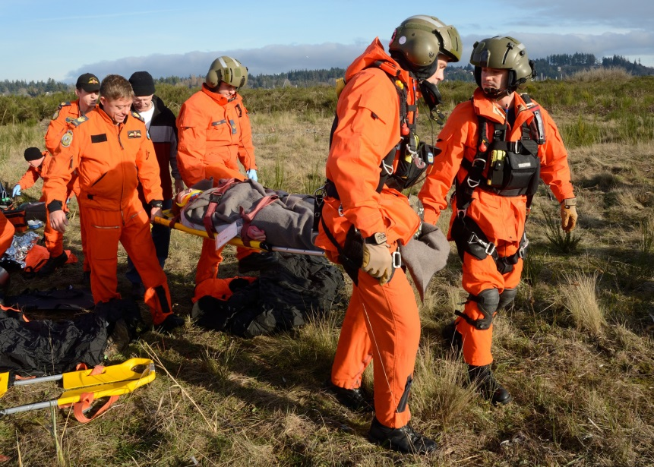
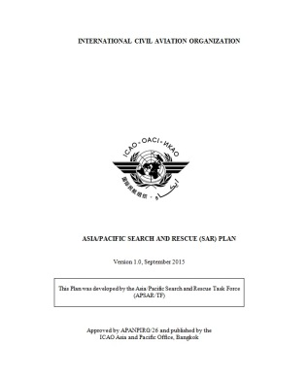
SAR Inter-Regional Cooperation
AO EUR/NAT Office 10
Future ICAO EUR Region SAR Plan
ICAO Asia/Pacific Office is cooperating with SAR Task Forces in the EUR/NAT and MID Regions to support the EUR/NAT and MID Offices with clarification of relevant SAR issues with regard to the development of their regional SAR Plans.

Slide 13
Search and Rescue – ICAO Annex 12 & IAMSAR Manual, ICAO Doc 9731
IAMSAR Manual, ICAO Doc 9731
5.2 Planning processes
5.2.1 There are specific planning processes appropriate for each level of the SAR system. Operational levels must develop plans of operation, search plans, rescue plans, etc. The SAR manager should develop what might be called “programme plans”. Plans developed by international or interagency SAR coordinating committees (SCCs) tend to be strategic, focused on areas of interest their members share in common, and used for implementation of higher-level conventions, legislation and plans which apply to multiple members.

Slide 14
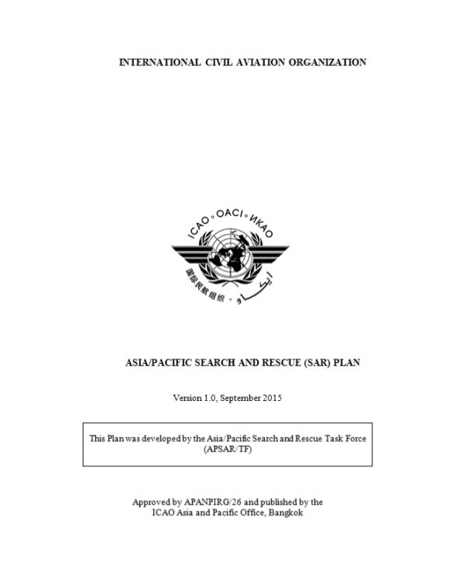
SAR Inter-Regional Cooperation 09 February 2
11
Future ICAO EUR Region SAR Plan
At the higher level are global requirements established by the ICAO Annex 12 to the ICAO Convention on International Civil Aviation (ICAO Doc 7300).
The Plan will be a regional planning guidance associated with other regional guidance material, in order to enable States to define the goals and means of meeting objectives for State planning towards improving State SAR System capability.

Slide 15
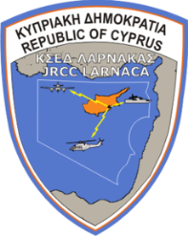
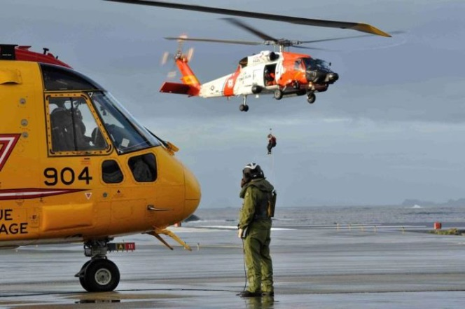
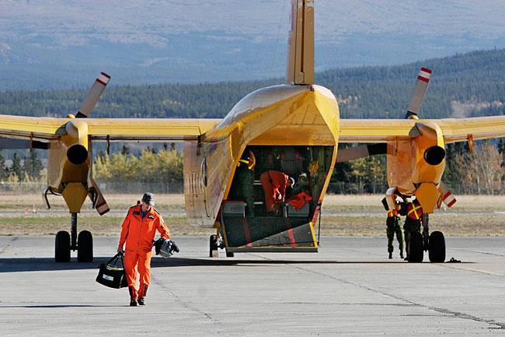
EURSAR/TF/2 09 February 2016 ICAO EUR/NAT Office
12
Next meeting
The Joint Rescue Coordination Center (JRCC) Larnaca, Cyprus, will host the EURSAR/TF/2 between 11 – 14 October 2016 for 2 days meeting, 1 day SAREX and 1 day debriefing of the SAREX.

