Slide 1
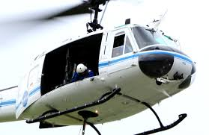
Organisational Culture Selection
for Safer Helicopter Operations
By Dimitrios Soukeras MBA(ER)

Slide 2
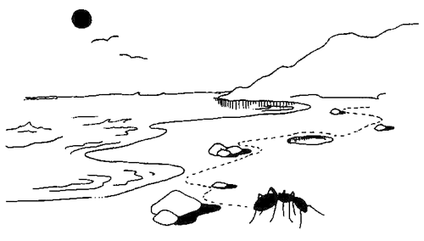
The Simon’s Ant Story

Slide 3
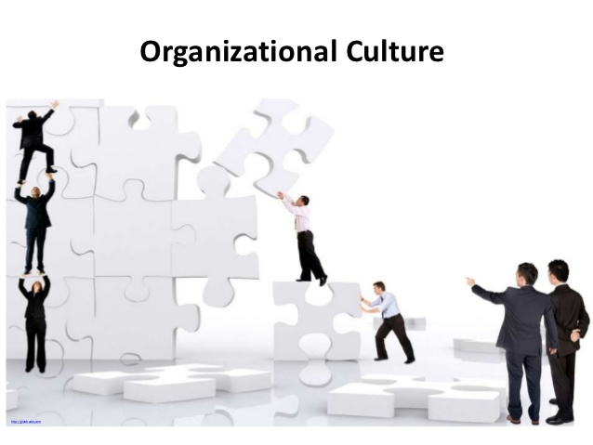
WITHIN High Risk Entities
Organisational Culture=Safety Culture
“Safety culture” according to Cooper (2000) is either the corporate culture itself ;in cases safety is their dominant characteristic, especially in high reliability organisations, or a sub-component of corporate culture which “alludes to individual , job, and organisational features that affect and influence health and safety”

Slide 4
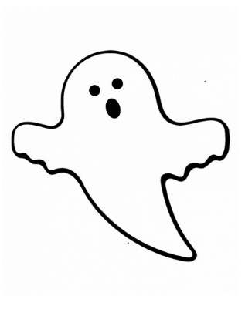
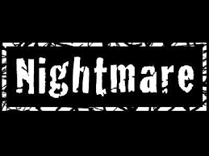
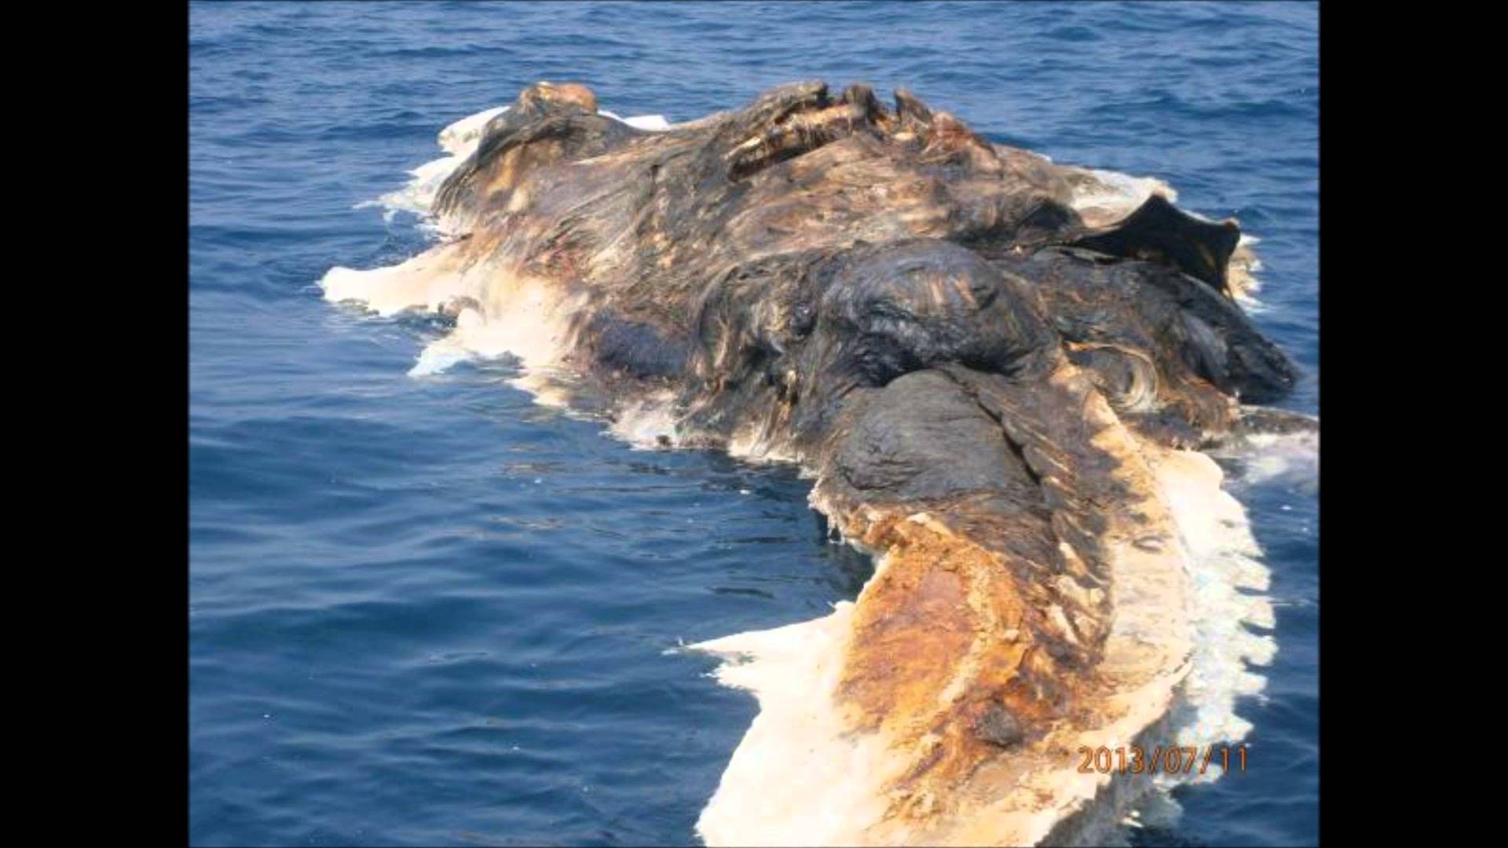

Slide 5
“Culture is treated as an attribute of the organization that can be measured separately from other organizational phenomena and, as we will show, can be very useful for predicting which organizations succeed and which do not.’’
Cameron& Quinn. 2006
Culture as suggested by Kilman et al (1986) acts as a corporate asset that inscribes on the direction, the pervasiveness and the strength of the organisation. In cases where strategy is aligned with culture, performance is expected to augment.

Slide 6
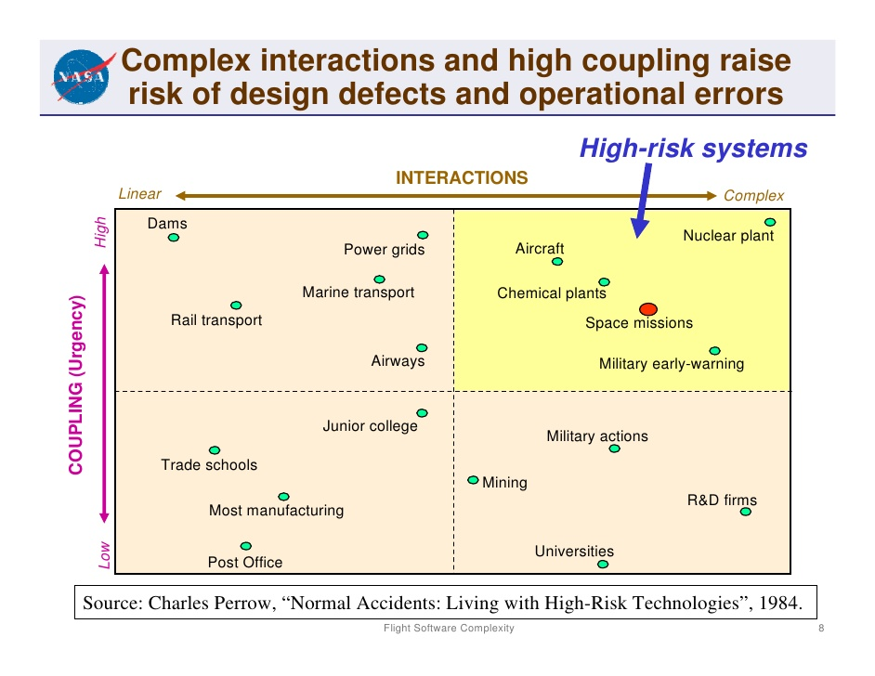

Slide 7
TIGHT COUPLING | LOOSE COUPLING
Delays in Processing Not Possible | Processing Delays Possible
Invariant Sequences | Order of Sequence can be changed
Only One Method to achieve Goal | Alternative Methods Available
Little Slack Possible on Supplies, equipment, personnel | Slack in Resources Possible
Buffers and Redundancies are Designed in Deliberately | Buffers and Redundancies Fortuitously Available
Substitutions of Supplies ,equipment, personnel limited and Designed in. | Substitutions Fortuitously Available
Charles Perrow, 1984

Slide 8
COMPLEX SYSTEMS | LINEAR SYSTEMS
Proximity | Spatial Integration
Common-mode connections | Dedicated Connections
Interconnected Subsystems | Segregated Subsystems
Limited Substitutions | Easy Substitutions
Feedback Loops | Few Feedback Loops
Multiple and Interacting Controls | Single Purpose, segregated Controls
Indirect Information | Direct Information
Limited Understanding | Extensive Understanding
Charles Perrow, 1984

Slide 9
“SAFETY CULTURE’’ MAPPING
APPROACHES TO ORGANISATIONAL SAFETY
1,5
FIXED
5,5
COLLABORATIVE
3,3
Middle of the Road
Perception of The Management Team
1,1
PROVISIONAL/
AVOIDING
5,1
DRIFTING
Von Thaden& Gibbons, 2008
The Safety Culture Indicator
Scale Measurement System
Perception of the Employees
Notes:
9

Slide 10
“SAFETY CULTURE’’ MAPPING
1. COLLABORATIVE
High assertiveness and high cooperation,
Employee/management established goals,
Recognizes and encourages personal responsibility for safety,
Esprit de corps,
Employees responsible to evaluate their own performance,
Seeks to improve, learn,
Recognises change and seeks input to ensure safety outcomes,
Looks for ways to develop win-win situation
Flexible, generative

Slide 11
“SAFETY CULTURE’’MAPPING
2. FIXED
Master plan for safety/high managerial assertiveness,
Means of ensuring safety performance =by-the-numbers,
Conservative decision making, slow to recognize change
Operates by detailed procedures/instructions/measures,
Predetermined, work carried out according to traditional
procedure policy,
Safety-by-the-Rules, rigid, calculative,
Immutable, inflexible “We‘ve always done it this way’’

Slide 12
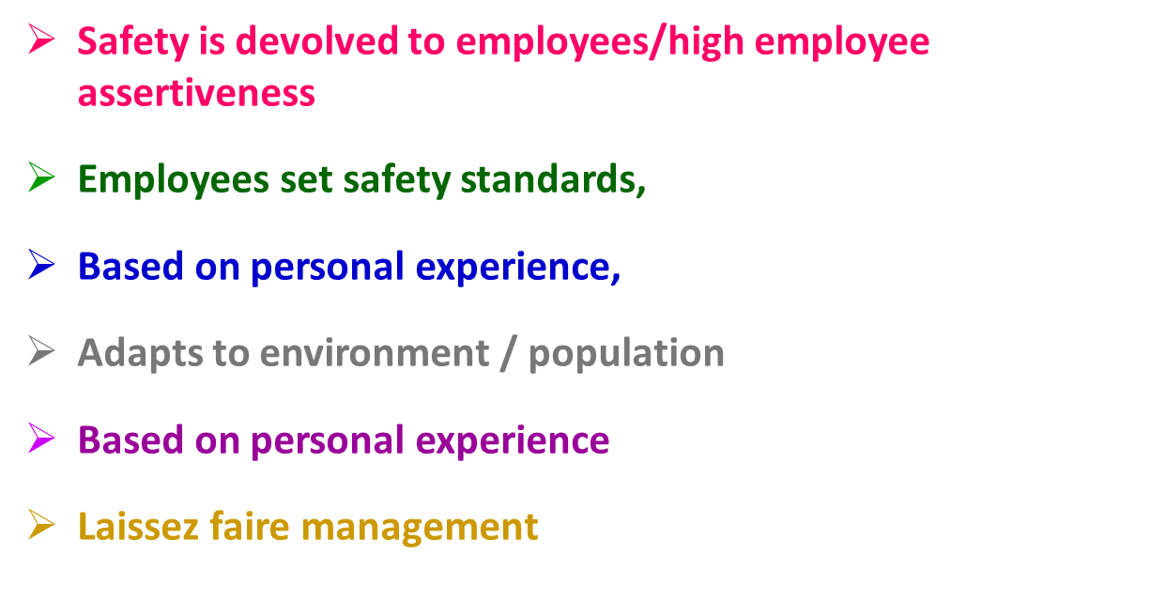
“SAFETY CULTURE’’ MAPPING
3. DRIFTING

Slide 13
Joe Mary Hatch-A Dynamic Safety Culture Model(1993)
WHAT IS BELIEVED
Management: Anonymous Hazardous Situation Report goes against him
Employees : Anonymous Hazardous Situation Report if signed brings in trouble
WHAT IS SAID
Management : EVERYBODY CAN SIGN AN ANONYMOUS HAZARDOUS SITUATION REPORT WITHOUT PUNISHMENT
THE OUTCOME
MISTRUST IN MANAGEMENT
UNDER REPORTING OF INCIDENTS
NO SEARCH FOR SYSTEMIC PROBLEMS OR INCIDENT TRENDS
NO ORGANISATIONAL LEARNING
NO DETECTION OF TRENDS
WHAT IS DONE
Management:
NO ONE GETS TRAINING TO SIGN ONE
PILOTS-Employees : DO NOT BOTHER TO SIGN ONE

Slide 14
Let’s have a Test
Complex Systems would be Fine, were it not for the erratic behaviour of some Unreliable People.
Human Error cause Accidents: Humans are the dominant contributor to more than two thirds of them.
Failures come as unpleasant surprises. They are unexpected and do not belong in the system. Failures are introduced to the system only through the inherent unreliability of people.
Sydney Dekker,2006

Slide 15
More Thoughts to be Tested
Human Frailties lie behind the majority of remaining accidents.
Safety Rules, Prescriptive Procedures and management treatises are supposed to control this element of erratic human behaviour.
But this control is undercut by unreliable, unpredictable people who still do not do what they are supposed to do.
Some Bad Apples keep having negative attitudes toward safety ,which adversely affects their behaviour. So not attending to safety is a personal problem, a motivational one, an issue of mere individual choice.
The basically safe system, of multiple defences carefully constructed by the organization is undermined by erratic people. All we need to do is protect it better from their vicissitudes.
Sydney Dekker,2006

Slide 16
Causes of Accidents
Somebody did not pay enough attention;
If only somebody had recognised the significance of this indication, of that piece of data, then nothing would have happened.
Somebody should have put in a little more effort;
Somebody thought that making a shortcut on a safety rule was not such a big deal.
Sydney Dekker,2006

Slide 17
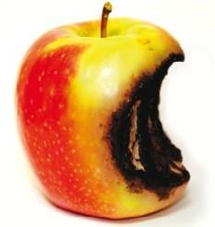
What is the Problem?
Majority of People still believe in the Bad Apple Theory

Slide 18
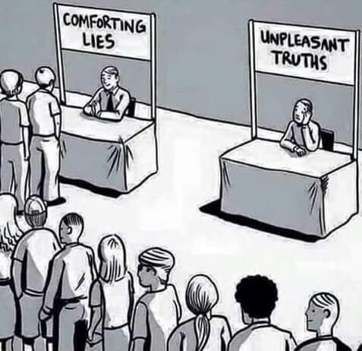

Slide 19
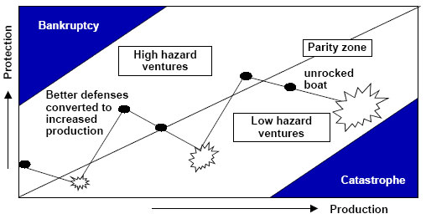
The Reason Protection-Production Dilemma

Slide 20
FURTHER INFORMATION
Dimitrios Soukeras
Chairman of the Board
HELLENIC AVIATION SOCIETY
E: admin@o-diagnosis.com
www.aviationsociety.gr

