Slide 1
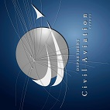
Cyprus – Israel cooperation in support of Aviation Safety for off-shore helicopter operations
FSF seminar 19th May 2016
Nicos Nicolaou
Acting Director DCAC
Notes:
The development of oil and gas exploration activities in the southeastern Mediterranean Sea has created promises for wealth and prosperity for the countries of the region. However to be able to exploit these newly found resources it is necessary to support the need for safe and secure air operations to the exploration and exploitation platforms.

Slide 2
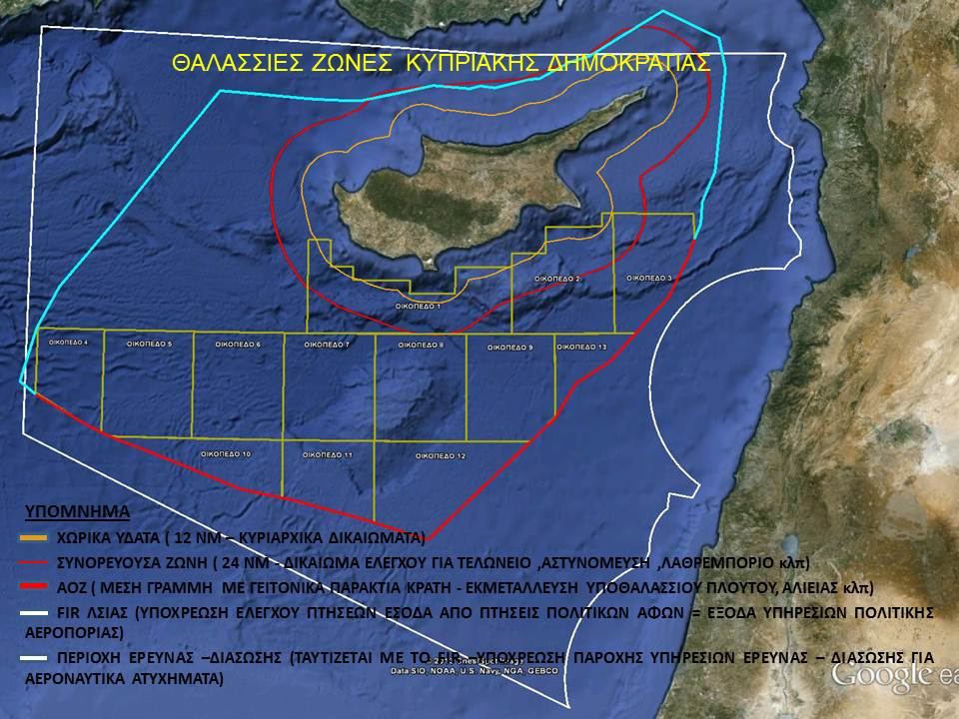
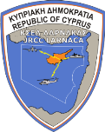
ΑΟΖ ΛΙΒΑΝΟΥ
2007
ΑΟΖ ΑΙΓΥΠΤΟΥ
2003
ΑΟΖ ΙΣΡΑΗΛ 2010
Notes:
The challenges to aviation safety posed by the demanding and unknown environment of off-shore operations can be daunting to even the most well-staffed civil aviation authority and it is frequently that we receive sad news of air accidents in such operations.
Off-shore operations of helicopters to oil and gas platforms encompass the whole breadth of aviation safety regulations and expertise. Such expertise is scarce and costly and it is becoming even more important to create and be able to access a common pool of knowledge and experts.
Regional cooperation can be an effective way to not only develop relations between states but to also lower costs and enable the development of industries to the benefit of all citizens.

Slide 3
AVIATION SAFETY FOR OFF-SHORE HELICOPTER OPERATIONS
Helicopter/air operations within the Exclusive Economic Zone (EEZ)
are regulated by the Civil Aviation Law
Air Traffic Control
Airspace Management
Licensing of Pilot, engineer, maintenance training and MRO
Flight operations
Airworthiness
Aircraft Registry
Airport Licensing
Aviation Security
Notes:
Helicopter and other aircraft operations are regulated by the Civil Aviation Law in the Exclusive Economic Zone (EEZ). The Law includes requirements for:
Air Traffic Control
Airspace Management
Licensing of Pilots, engineers, maintenance training organisations and maintenance repair organisations
Flight operations
Airworthiness
Aircraft Registry
Airport Licensing
Aviation Security

Slide 4
Cyprus – Israel current areas of cooperation
Air Traffic Control
LOA
Blue Med FAB
Airspace Management
Flow of traffic
Military activity
Crisis management
Notes:
Cyprus and Israel have a long history of cooperation in aviation
In the domain of Air Traffic Control as well as in support of search and rescue operations, the coordination mechanism is defined within a LOA which was recently updated
The Air Traffic Services of the two countries are in constant communication in an effort to provide an efficient and safe service to the rapidly increasing traffic in the region, while at the same time they strive to address the added complexity of regional events such as airspace closures and war.
One such event has recently emphasized the necessity of ATM cooperation between the neighboring countries, when most of LLBG traffic had to be rerouted around Tel-Aviv in order to avoid conflict areas.
Traffic used alternative routes with the management of traffic flows within Nicosia ACC. This event proved that effective cooperation can “move mountains”.

Slide 5
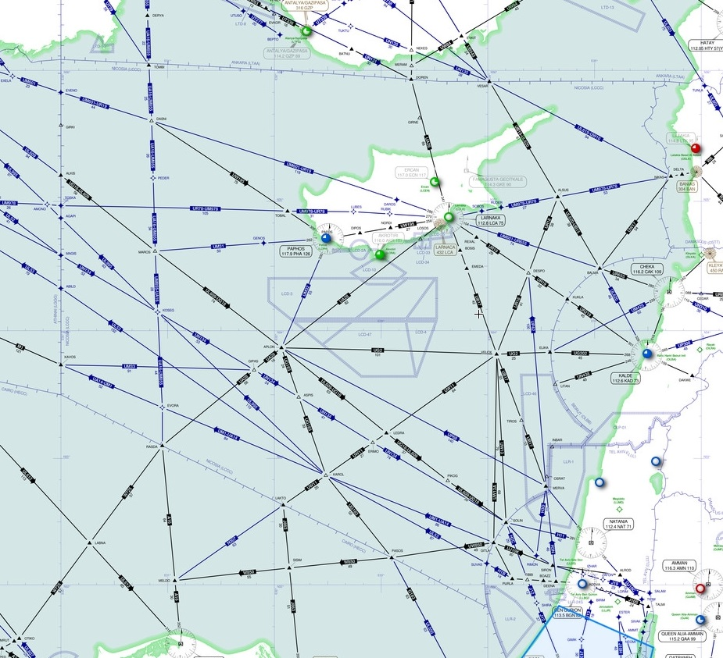
Blue Med Future Plans 2016 - 2018
DCAC | Cyprus ANSP NICOSIA FIR
 | Free Route Project • Phase 1: JAN – DEC 2016 DCTs (Entry/Exit) Implementation from FL285-FL660 , AVLB NIGHT (2100 – 0400) • Phase 2: JAN2017 DCTs with multiple Entry Exit implemented from FL195+ - AVLB: 24H
Notes:
Cyprus and Israel are partnering to commonly develop the enablers foreseen within the Blue Med FAB Implementation Programme and in order to extend the benefits of the FAB beyond the BLUE MED area.
Civil Military cooperation between the two countries is very important in an area mostly covered by high-seas. The Israel Air Force activity within Nicosia FIR is coordinated with the Cyprus Airspace Management Cell in order to minimise its effects and maintain uninterrupted and safe flow of civil traffic

Slide 6
Cyprus – Israel current areas of cooperation
Bilateral air-services agreements
Euro-Mediterranean Air Transport Agreement (2013)
in 2015 ~ 2.300 flights carried 240.000 passengers
Notes:
In 2013, the European Union and the State of Israel signed a comprehensive agreement (Euro-Mediterranean Air Transport Agreement) that will gradually liberalize the market between the EU and Israel.
The Agreement also aims to integrate Israel into a wider Common Aviation Area with the EU, based on Common rules.
In 2015 ~ 2.300 flights carried 240.000 passengers between Cyprus and Israel.

Slide 7
Opportunities and need for further cooperation in
Exchange of expertise in ATM, Airspace management and Design
Shared use of Inspectors in Flight Operations, Airworthiness and Licensing
Development of standards in specialised areas such as aircraft operations at offshore rigs and drones
Exchange of expertise and shared use of experts in aviation security and licensing of heliports
Common training programmes in aviation areas both at theoretical and practical level
Notes:
Cyprus and Israel should seize the opportunities offered and work to further their cooperation in all aviation areas. Such cooperation can be in the form of
Exchange of expertise in ATM, Airspace management and Airspace Design
Shared use of Inspectors in Flight Operations, Airworthiness and Licensing
Development of standards in such specialised areas as aircraft operations at offshore rigs and drones,
Exchange of expertise and shared use of experts in aviation security and in licensing of heliports
Common training programmes in aviation areas both at theoretical and practical level

Slide 8
Cooperation
Notes:
Further developing cooperation between Cyprus and Israel in aviation can only bring benefits to Safety for the aviation industry and reduce risks to the aviation authorities.
Regional cooperation can be an effective way to not only develop relations between countries but to also lower costs and enable the development of industries to the benefit of all citizens.

